Slide 1
2024-2025 Annual MD Education: Infection Prevention and Antimicrobial Stewardship

Slide 2
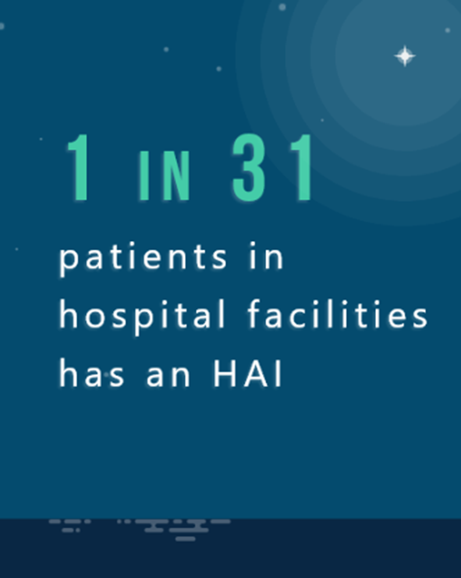
Hospital Acquired Infections (HAI)
According to the CDC, any given day, 1 in 31 patients in hospital facilities develop an HAI.
Approximately 72,000, die from their infection.
Direct medical costs of at least $28.4 billion and upwards of $45 billion each year.
An additional $12.4 billion in costs to society from early deaths and lost productivity.

Slide 3
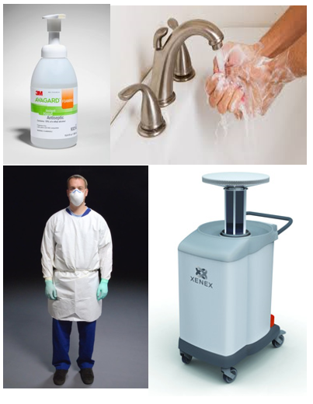
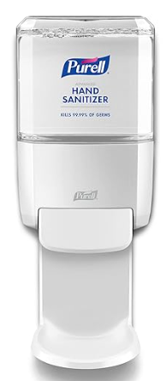
How do WE stop the spread?
Hand Hygiene
Standard Precautions
Transmission-Based Precautions
Proper cleaning and disinfection of patient care items and environmental surfaces (remember contact/wet time!!)

Slide 4
Hand Hygiene Product Conversion
Purell was chosen, among other reasons, because it is an industry leader, is hypoallergenic, has a high-tech dispenser that allows easy visualization of fill level, and was favored when trialed by Tufts Medicine clinicians.
All soap and waterless hand sanitizer product and dispensers throughout the Tufts Medicine organization transitioned to Purell soap and waterless hand sanitizer. This change does not affect procedural area scrub products.
A change was needed due to discontinued dispenser models and frequent product backorders.
Employees expressed dissatisfaction with previous product. Purell was the 1st choice amongst hand hygiene products that were trialed.

Slide 5
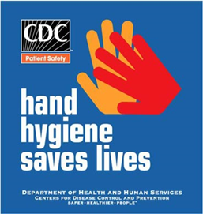
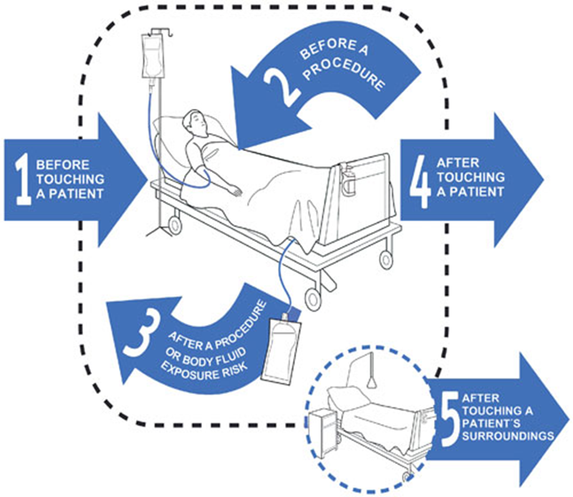
Hand Hygiene
The single most important method to prevent the spread of infection!
Before entering & upon exiting patient’s room/bedspace
After contact with a patient’s equipment or environment
Before and after procedures or body fluid exposure risk
Before and after glove use
Before eating and after using the restroom
After blowing your nose, coughing or sneezing
The 5 Moments for Hand Hygiene (World Health Organization)

Slide 6
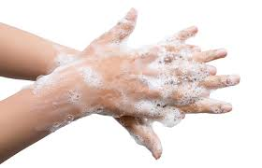

Standard Precautions
Standard Precautions apply to all patients, in all settings
Always minimize contact with blood and body fluids by utilizing safe work practices and protective barriers
All blood, body fluids, excretions, secretions and non-intact skin are treated as infectious
Use appropriate Personal Protective Equipment (PPE) such as gloves, masks, eye protection, and gowns as needed
Safe handling of sharps – never put down; dispose immediately into sharps container
Clean/disinfect equipment between patients following proper contact/ wet time
Cough etiquette
And most of all…….perform hand hygiene!

Slide 7
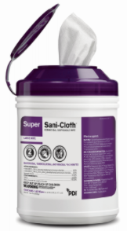
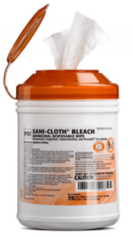
What is Contact Time?
Surface needs to be wet that entire length of time to properly disinfect
What are the contact times for the wipes?
2 minutes = PURPLE top
4 minutes = ORANGE top
What is the difference between the two?
PURPLE TOP – used for multi-patient equipment such as stretchers, blood pressure cuffs/machines, glucometers, etc.
ORANGE TOP – contains bleach. Used on equipment that has come in contact with patients who have C. difficile and Norovirus.
Notes:
Added this slide on Contact time.

Slide 8
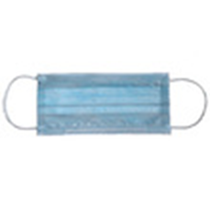
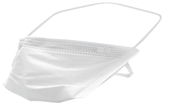
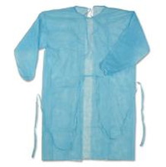
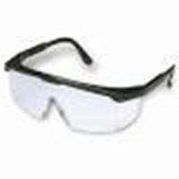
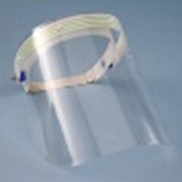
Personal Protective Equipment (PPE)
Gloves. Disposable gloves should be worn when soiling of the hands with blood or body fluids is likely.
Masks. Mucous membrane protection against coughing, sneezing, airborne illness or invasive procedures.
Gowns. Outerwear that is fluid-resistant. Should be worn when soiling of exposed skin or clothing is likely.
Face shield/goggles. Invasive techniques or any time there is an opportunity for blood or body fluids to be splashed, sprayed, or splattered.

Slide 9
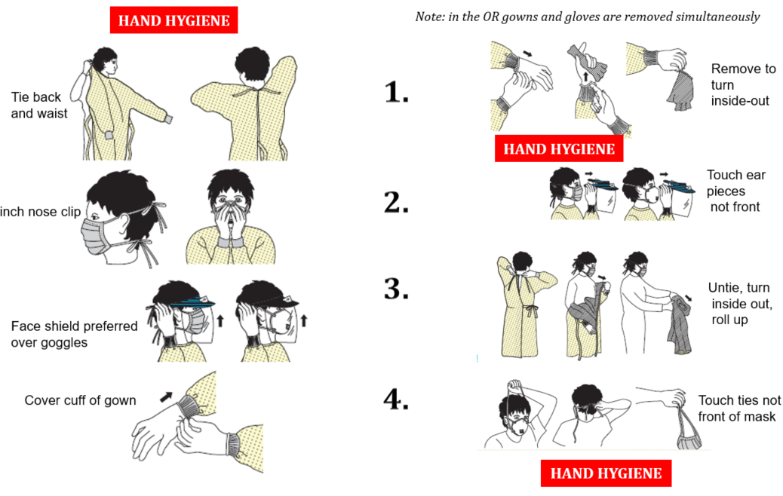
ON Gown-Mask-Faceshield-Gloves
OFF Gloves-Faceshield-Gown-Mask

Slide 10
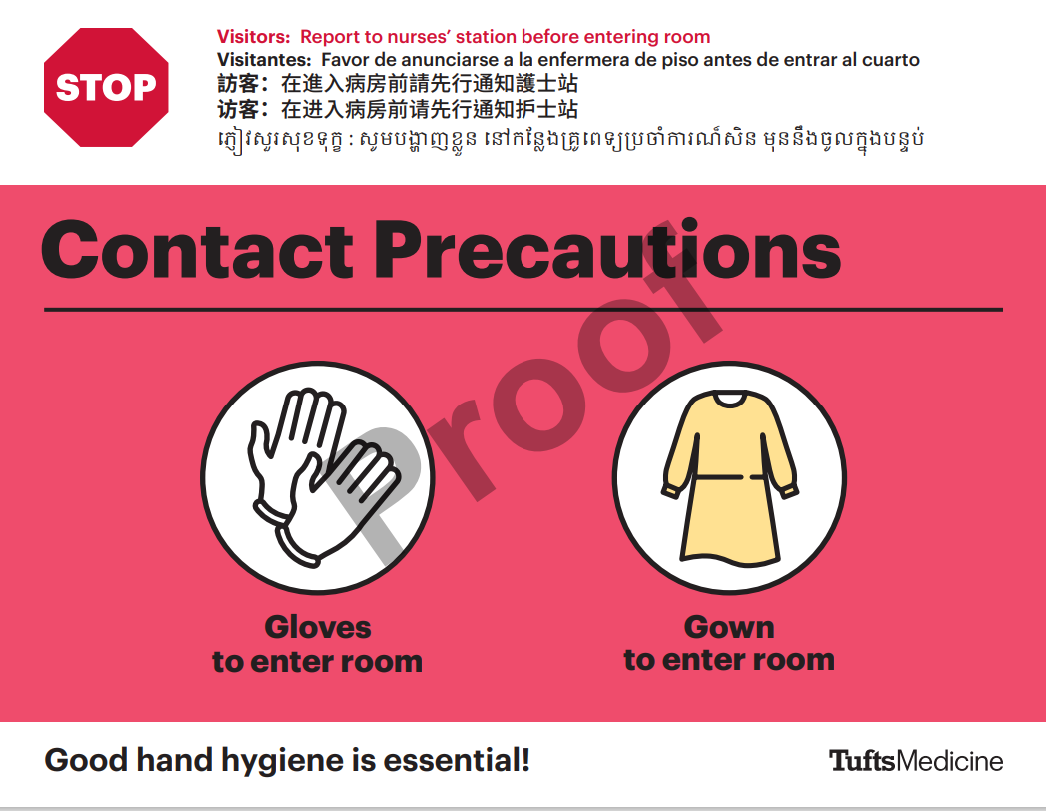
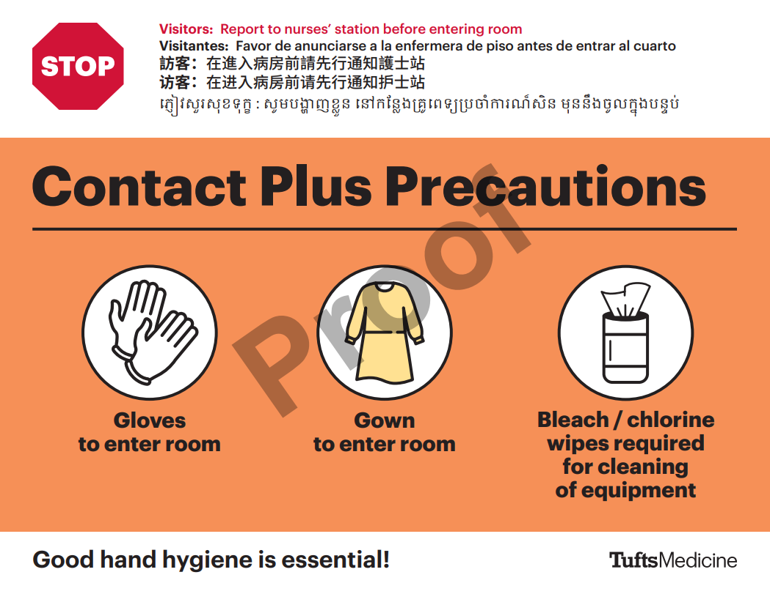
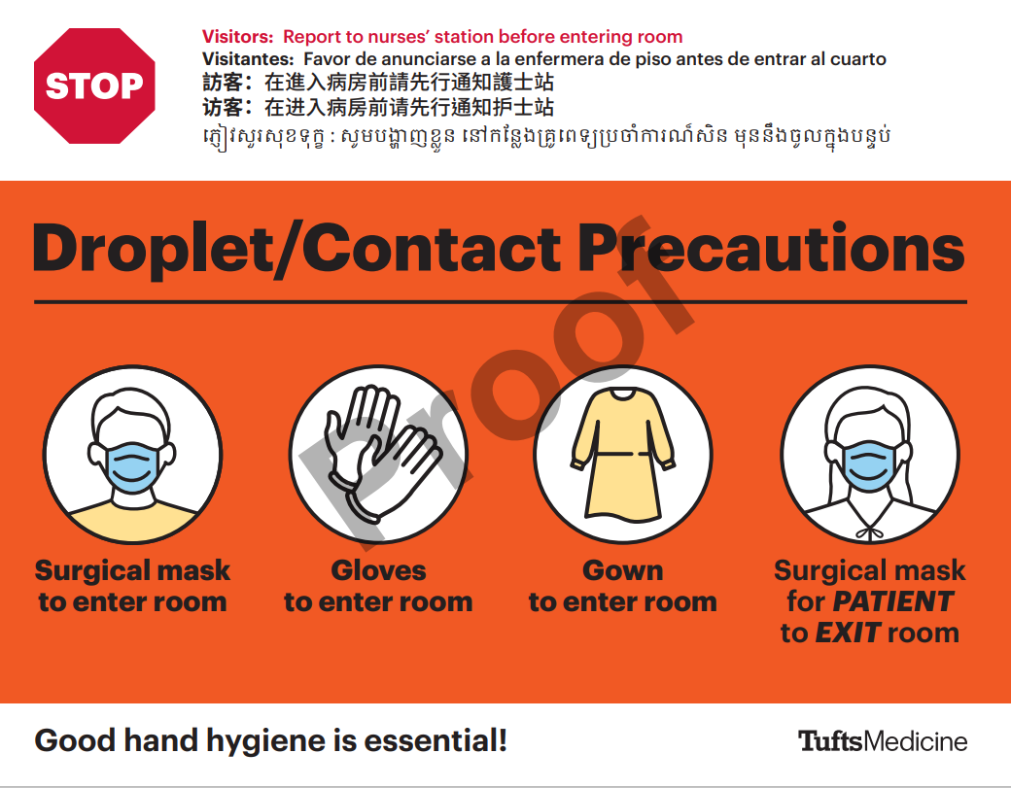
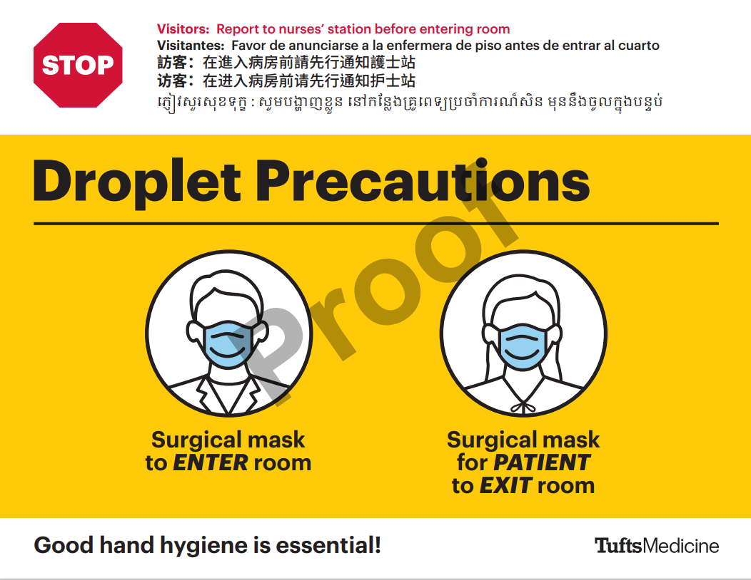
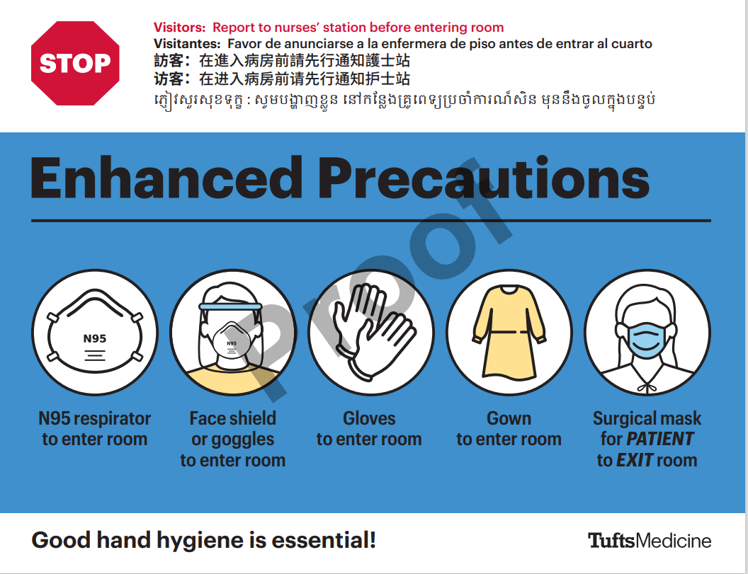
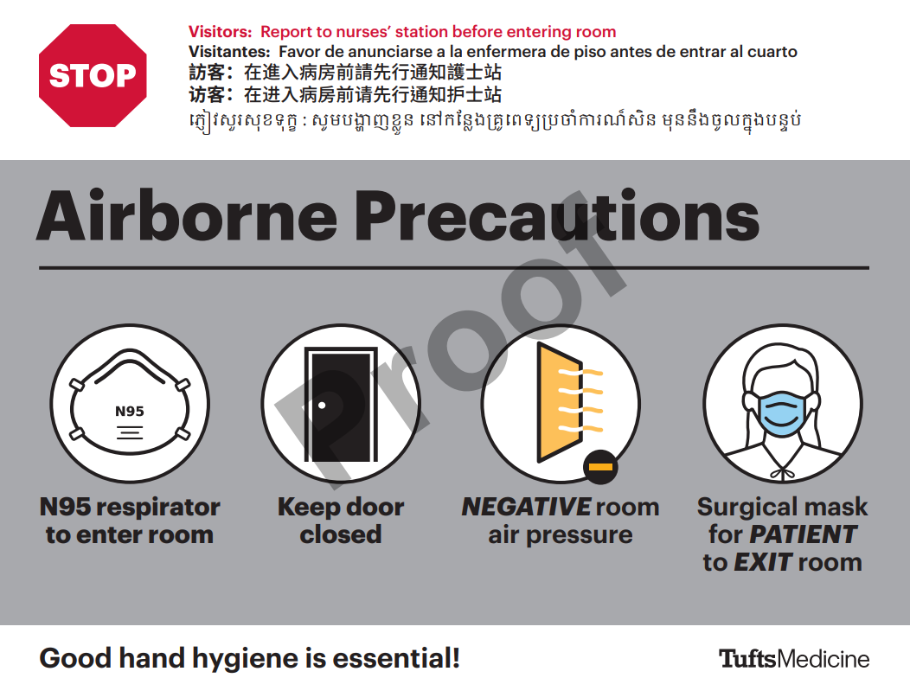
Tufts Medicine Transmission Based Precaution Signs
Notes:
Added Slide

Slide 11
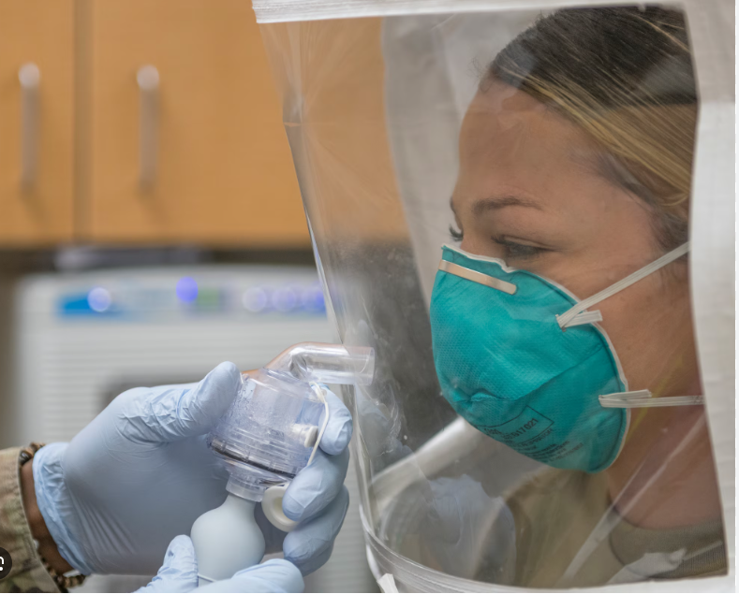
Respiratory Protection Program
To prevent occupational illness from exposure to airborne contaminants and to maintain OSHA compliance per the Respiratory Protection Standard
Required annually for all employees in a patient facing role
OSHA medical questionnaire and clearance required
Notes:
Added Slide

Slide 12
Preventing Transmission
Do
Perform Hand Hygiene
Use Standard Precautions: Handle all patients’ blood and tissue, body fluids, non-intact skin, etc. as potentially infectious
Use Personal Protective Equipment (gloves, gowns, face shields) to prevent blood, tissue, body fluid contact
Use Respiratory Hygiene/ Cough Etiquette
Use Safety Devices. Products designed to reduce risk of exposure should be used wherever possible
Put sharps in sharps container. Call for replacement when container ¾ full.
Receive Hepatitis B vaccination which prevents Hepatitis B infection (probable life long immunity). Provided by Occupational Health Services at no cost to employees
Do NOT
DO NOT Recap sharps or leave them on trays, mattresses, etc.
DO NOT Eat or drink in procedural areas or areas where specimens are handled, including patient care areas
DO NOT Handle equipment or computers with contaminated gloves
DO NOT Work with hands that cannot be cleaned due to skin issues, casts, splints, or bandages (Call Occupational Health Services)
All sharps within Tufts Medicine must be equipped with a safety device to minimize chance of sharps injury

Slide 13
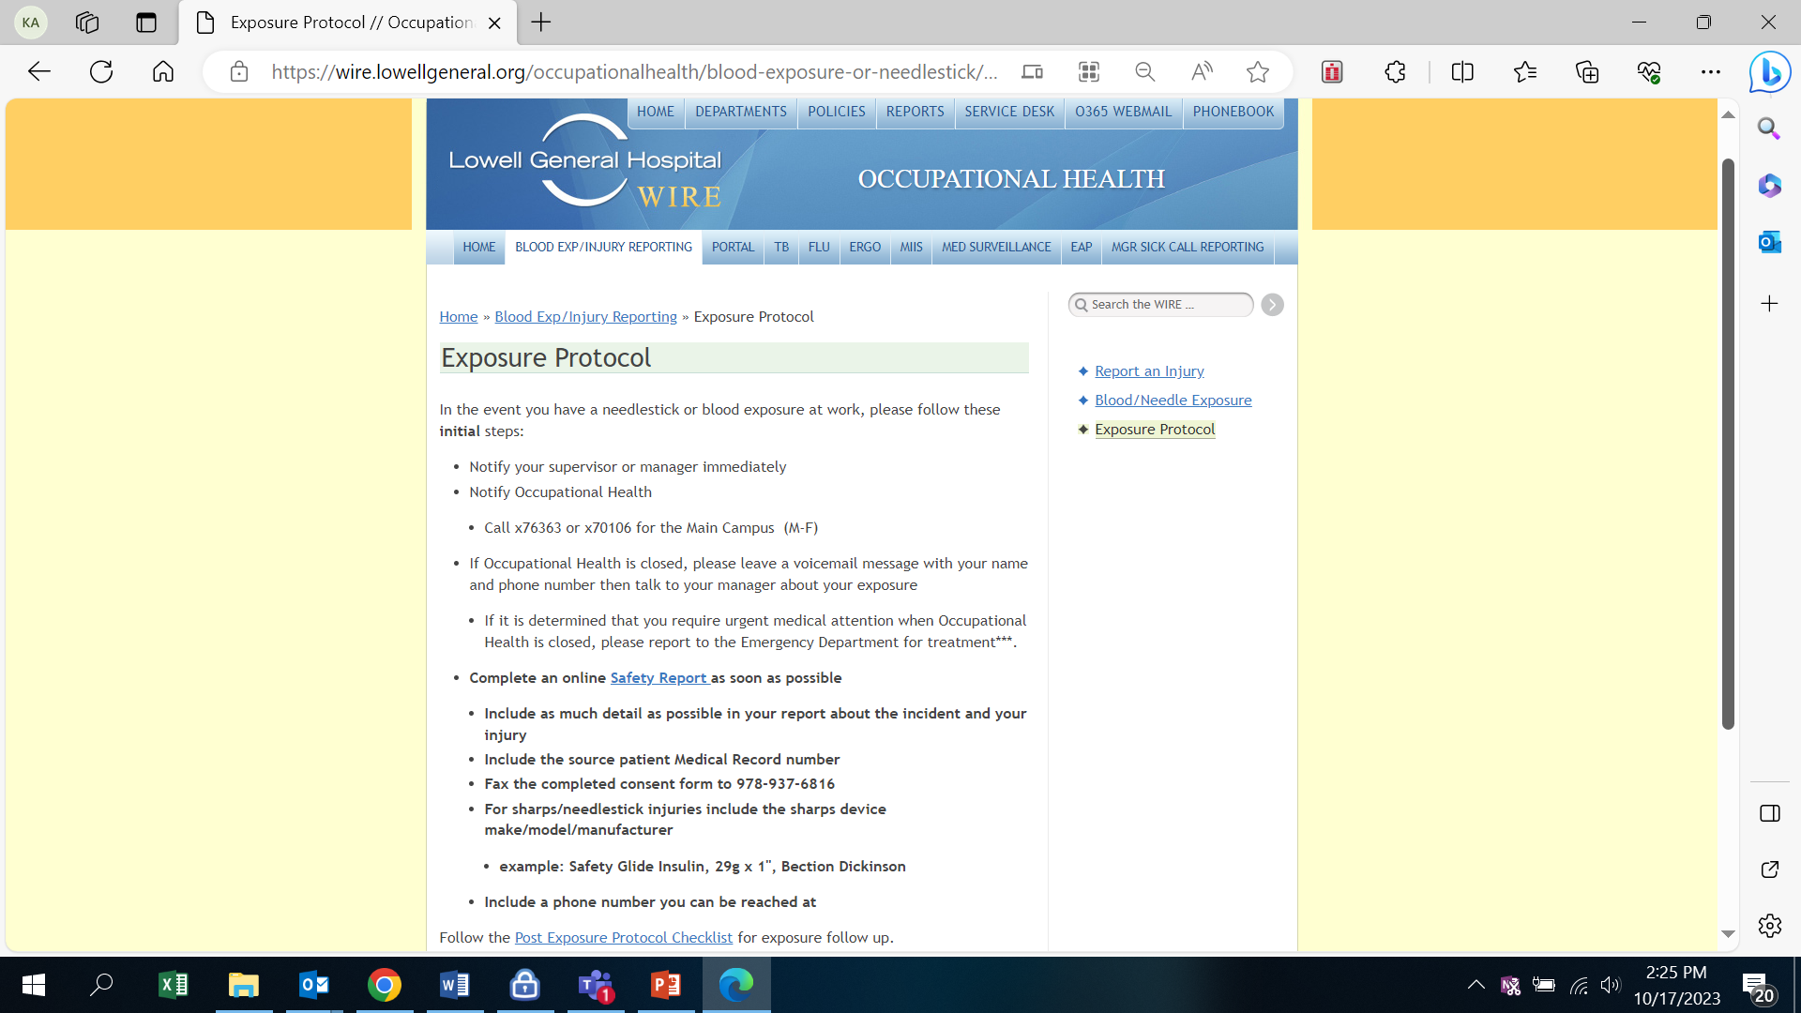
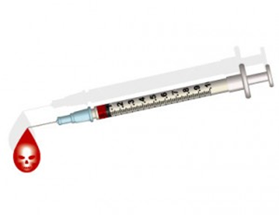
Sharps Injuries and Safety Devices
Injuries can occur because of the following:
Passing or transferring equipment
Recapping contaminated needles
Colliding with coworkers
Decontaminating/processing used equipment
Sharps left in unusual places: laundry, mattresses, tables, trays, countertops
All sharps within Tufts Medicine must be equipped with a safety device to minimize chance of sharps injury

Slide 14
Bloodborne Pathogen Exposures FY 2024 Sharps, Mucosal and “Other”
57 Sharps injuries
Most common reasons reported:
Suturing
Activating safety device
SQ injections
Handling of contaminated instruments
0 Mucosal injuries
Most common reasons reported:
1 Other injuries
Examples: scratches, splashes & bites
Most common reasons reported:
Splashed on face with blood
Notes:
Hello- my name is Jen and I am the manager of Occ Health
This presentation is a brief overview of our department and what we do.

Slide 15
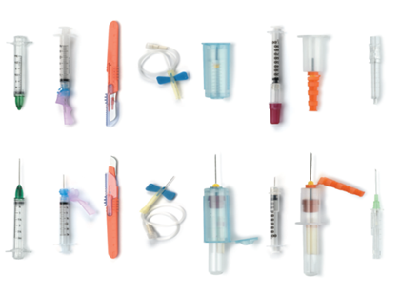
Exposures
Injuries due to sharps/ bloodborne pathogen exposure, must be promptly reported to Occupational Health Services or Emergency Department both for employee care as well as to identify potential issues with either devices or practice.
What To Do If Exposure Occurs:
SKIN: Immediately clean the exposed site with soap and water.
MUCOUS MEMBRANE: Flush liberally with tap water ASAP.
REPORT the exposure to Occupational Health Services or to the Emergency Room (off hours or weekends) within 2 hours. The value of prophylaxis diminishes as the interval between exposure and prophylaxis increases.
Complete an incident report. Notify supervisor.
An ID expert is on call 24/7 to advise on blood and body fluid exposures.

Slide 16
Infections/ Communicable Disease
Employees should be free of communicable disease while working.
Employees who suspect or have been diagnosed with a communicable disease are required to notify Occupational Health Services.
COVID-19
Conjunctivitis
All employees, volunteers, contracted services who report a communicable disease medical diagnosis to OHS, are required to comply with Return to Work guidelines.
Employees EXPOSED to a communicable disease will be notified by OHS in collaboration with Infectious Disease/ Infection Prevention.
Notes:
Added slide

Slide 17

Reducing Exposure From Environmental Sources
NO eating, drinking, applying cosmetics/lip balm and handling contact lenses in clinical areas
Policy: Bloodborne pathogen and exposure control plan
All surfaces in clinical areas shall be disinfected daily and as needed after soiling with body fluids
Don’t pick up broken glassware or other sharps with your hands. Use mechanical means, such as a brush and dust pan, tongs, or forceps.
NO Food and drink should be kept in refrigerators, freezers, shelves, cabinets or on countertops or bench tops where blood or other potentially infectious materials (OPIM) are present.
Patient food and drink shall be stored separate from employee food and drink (DPH regulation)

Slide 18

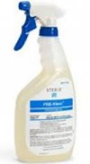
Biohazardous Materials and Waste
Red biohazard warning labels are affixed to containers of regulated waste, refrigerators and freezers containing blood or other potentially infectious material.
All specimens must be transported in a sealed, leak-proof biohazard-labeled bag/container from the time of collection until final destination
For specimen leaks including in pneumatic tube call Environmental Health and Safety
Contaminated Medical Equipment need to be transported in a leak-proof, puncture resistant container/device labeled as biohazardous from the POINT OF USE. Items need to be moistened ASAP using PreKlenz. Items are taken from the point of use to Soiled Utility Room and then the SPD.

Slide 19
CAUTI PREVENTION

Slide 20
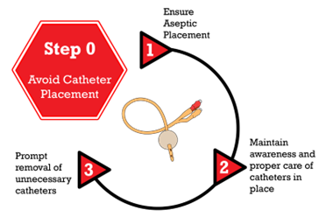
CAUTI Prevention Measures through the years…
HAI Committee
External Catheter trials
Education on insertion, care and maintenance
Return skill demonstration/competency days
Nurse driven protocol
Bladder scanners
BARD Lifecycle Assessments
Newsletters
Case Reviews
ICU CHG bathing for foleys
Bath in a bag

Slide 21
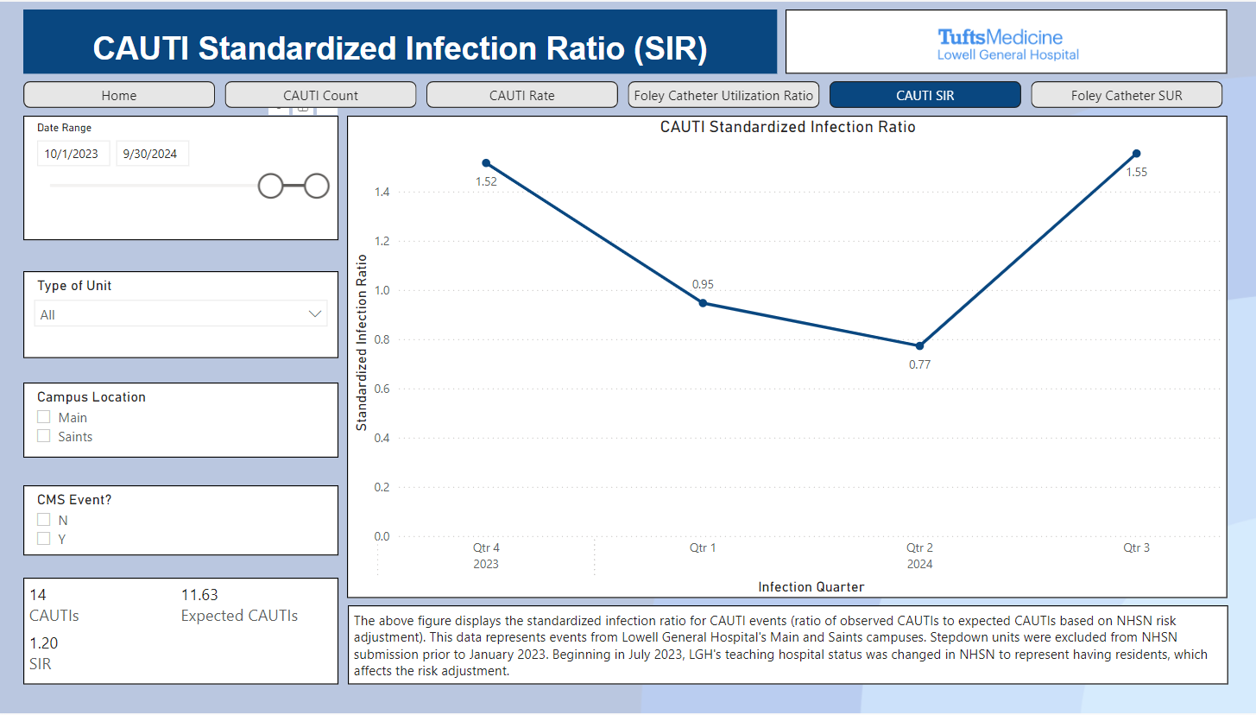

Slide 22

How Can You Prevent CAUTI?
Always seek out an alternative to a foley catheter – Can’t have a CAUTI if no foley!
Multiple external/non-invasive options available - Bladder Scanner, Bed Pan, Commode, Urinals, Intermittent Catheterization, Texas Catheters, Purewick (external female catheter), Primofit, Commode Liners, Weight Scales
If a foley catheter is needed, insert for hospital approved indications only.
Maintain and provide proper care for foley catheter.
Reassess need for foley catheter daily.
Discuss in daily huddles, utilize nurse driven foley removal protocol to remove foley promptly.

Slide 23
CLABSI PREVENTION

Slide 24
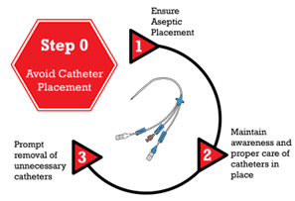
CLABSI Prevention Measures through the years…
BARD assessment and education
Unit Champion Training
CHG protective disks (GuardIVa, biopatch)
Dressing kits changes
Alcohol impregnated caps
CVC checklists
Policy updates
Case Reviews
CHG bathing for all central lines
Blood cultures bottle changes
Competency days

Slide 25
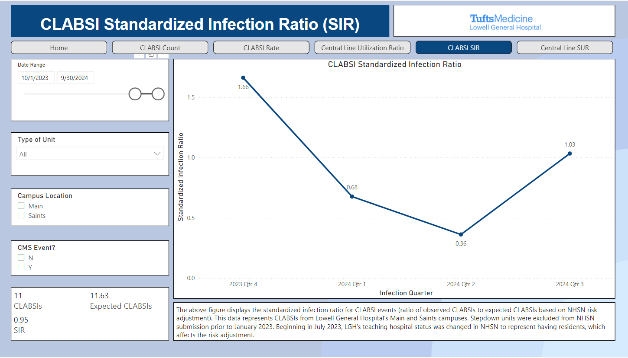

Slide 26
Clostridioides Difficile

Slide 27
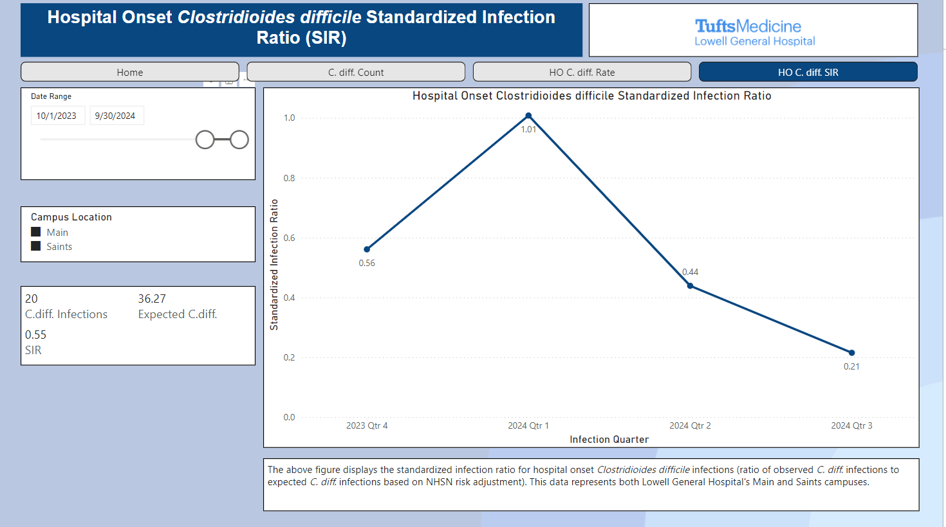

Slide 28
C.Diff Prevention Measures
Antimicrobial Stewardship Committee collaboration
Prompt identification and isolation
Collaboration with Environmental Services on cleaning protocols
Active surveillance of C.diff infections

Slide 29
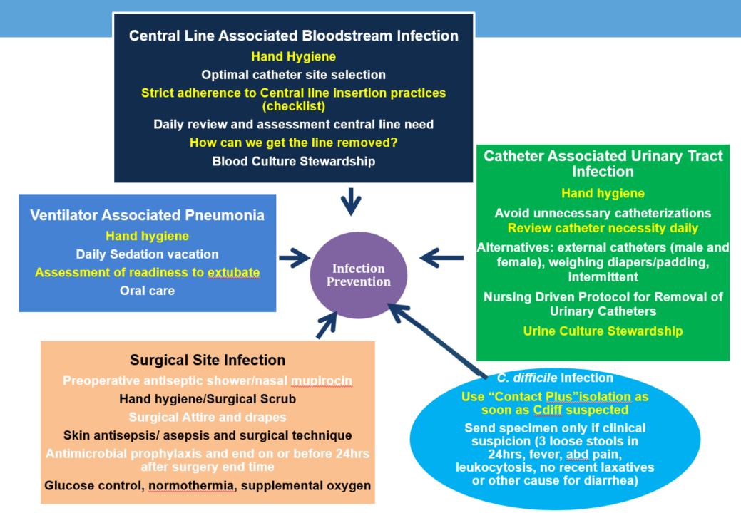
Best Practices Strategies for Prevention of Infection

Slide 30
Antimicrobial Stewardship
Antimicrobial Stewardship works to improve the appropriate use of antimicrobials by promoting the selection of the optimal antimicrobial drug regimen, dose, duration of therapy, and route of administration.
Aims of stewardship:
To achieve optimal clinical outcomes related to antimicrobial use
Minimize toxicity and other adverse events
Reduce the costs of health care for infections
Limit the selection for antimicrobial resistant strains
General principles:
Antibiotic-resistant bacteria are unlikely to be causative pathogens for community-acquired infections in immune-competent hosts.
Not all positive cultures represent infection. Colonization should not be treated with antimicrobials.
Utilize information from the microbiology lab to tailor and optimize therapy as soon as possible.
Re-assess antibiotic necessity on a daily basis.

Slide 31

Antimicrobial Stewardship
Antibiotics have helped make once lethal infections readily treatable
20-50% of all antibiotics prescribed in U.S. are either unnecessary or inappropriate
The misuse of antibiotics has also contributed to the growing problem of antimicrobial resistance
This has become one of the most serious and growing threats to public health!!
The CDC estimates more than 2.8 million people will be infected by MDRO’s, and will result in approximately 35,000 deaths annually!

Slide 32
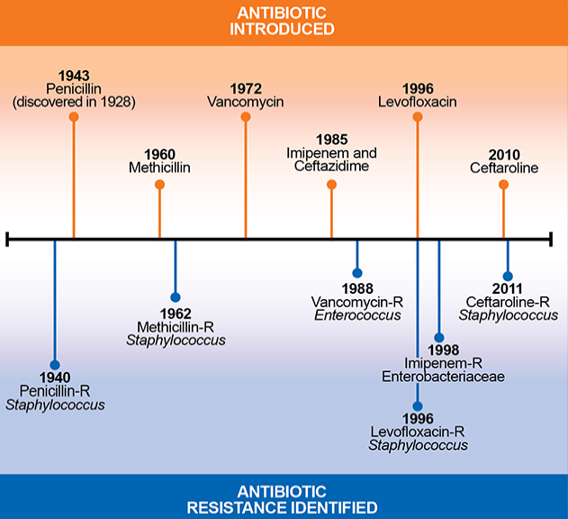
What causes AMR
Use of antibiotic is the most important modifiable factor leading to AMR.
> 50% all antibiotic use are inappropriate or unnecessary in the inpatient setting.
https://www.cdc.gov/drugresistance/pdf/threats-report/2019-ar-threats-report-508.pdf
Magill SS et al,. JAMA Netw Open. 2021 Mar 1;4(3):e212007

Slide 33
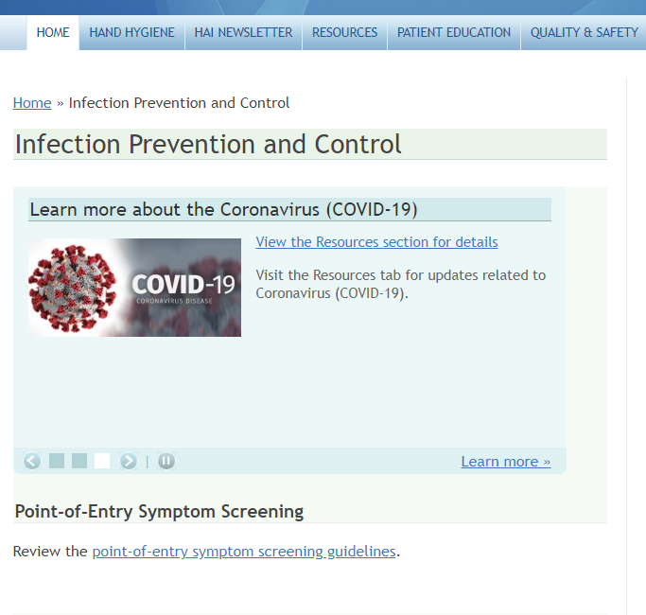
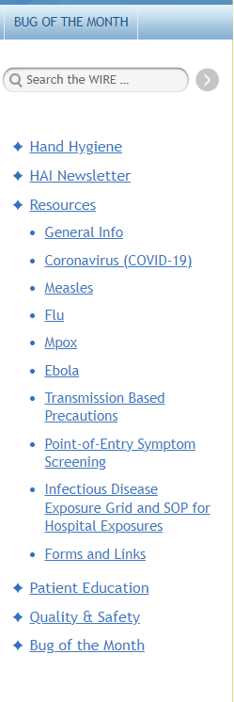
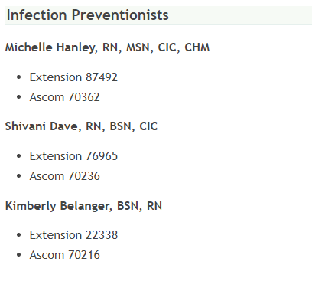
WIRE Infection Prevention Page
Here you can find all guidance related to infection prevention including what isolation precautions are indicated for a specific disease.

Slide 34
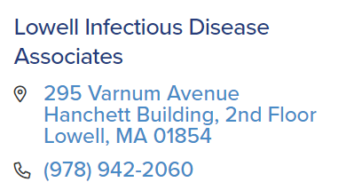

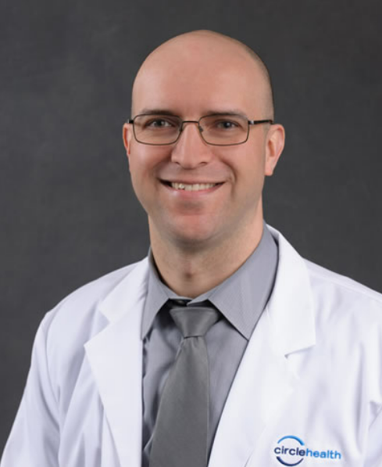
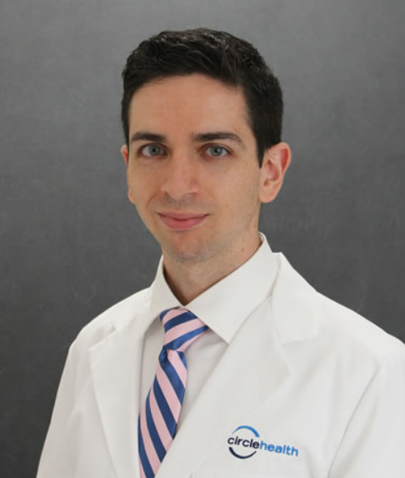
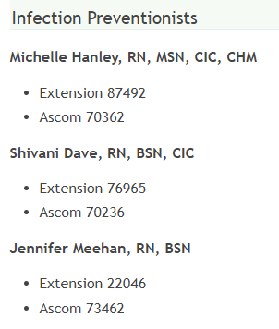
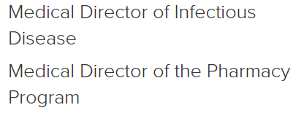
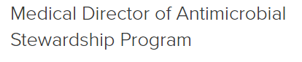
Infectious Disease (ID) Team
Please reach out to an ID team member with questions/concerns:
David Sidebottom, MD Adam Weston, MD Francis Magro, MD

