Slide 1
FORENSIC ANTHROPOLOGY
FORCE AND TYPE OF BONE FRACTURES
AND SKELETAL TRAUMA

Slide 2
Bone Fractures
Five Manners of Death
Accident, homicide, natural, suicide, unknown
Bones gives clues to violent deaths
Skeletal Trauma (broken bones)is most evident in homicide, suicide or accident

Slide 3
Five Types of Force that Cause Fractures
Compression (Depression)
Shearing
Bending
Torsion
Tension

Slide 4
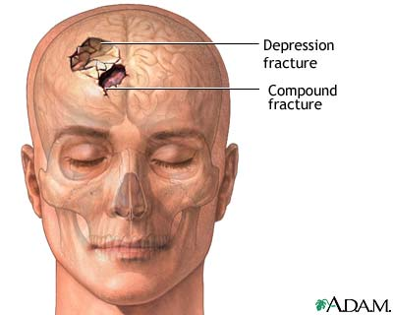
COMPRESSION
Force pushes down on bone
Numerous fracture lines radiating outward from point of impact
Blunt Force Trauma
Ex.- Tool Marks on Skull

Slide 5
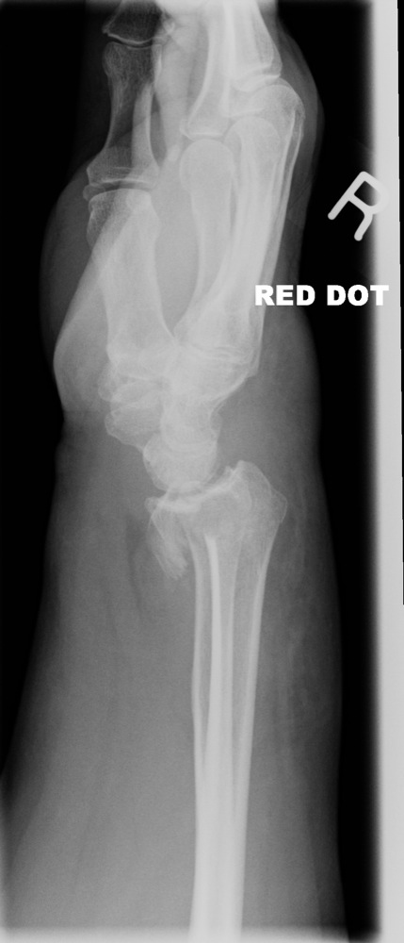
SHEARING
Immobilization of one bone segment
Linear “shearing” fracture
Ex- Stopping from falling (Accident)
Ex- Dismembering with sharp instrument

Slide 6
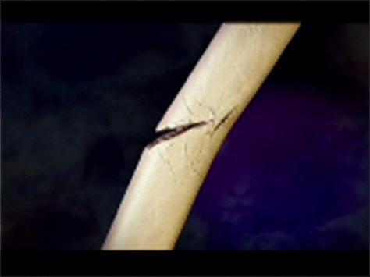
BENDING
Most Common
Force at Right Angle to Bone
Triangular Break
Fracture Lines
Green-Stick (Children)
Parry Fracture- Inward displacement of Bone (holding up arm for protection)

Slide 7

TORSION
Twisting
Spiral fracture down long axis of bone
Accidents
Child Abuse

Slide 8
TENSION
Pulling usually causes dislocation but may cause a break
Few fracture lines
Usually accidents

Slide 9
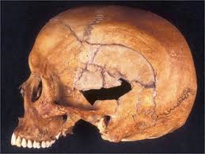
BLUNT FORCE TRAUMA
Blow with wide instrument with flat/broad surface
Wide surface area of bone is affected
Compression, Bending, Shearing
Many Bone Fragments
Assaults, Accidents

Slide 10
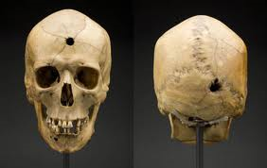
PROJECTILE TRAUMA
Radiating fractures lines from point of impact
Compression or Bending Force
Bullets

Slide 11
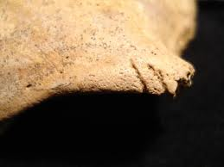
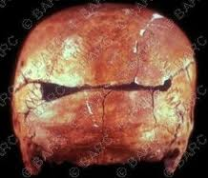
SHARP FORCE
Compression or shearing
Narrow focus
Puncture (perpendicular force)
Grazing (angular force)
Knife, axe

Slide 12

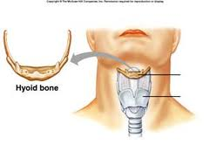
STRANGULATION
Broken Hyoid Bone?
Hanging
Difficult in Children

