Slide 1
FORENSIC ANTHROPOLOGY
BODY IDENTIFICATION
DETERMINING SEX, AGE , and RACE

Slide 2
DETERMINING AGE
Changes occur as age increases (25-30) then degeneration begins
Cranial sutures close as age increases (fontanelle/soft spot))
Epiphyses- growth plate closes as age increases
Ossification- the hardening of bone, increases as age increases

Slide 3
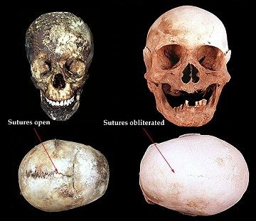

Slide 4
DETERMINING SEX
Skull Differences- female is rounder and smaller
Supraorbital ridges more pronounced in males
Male chin is square, Female chin is round
Muscle Attachment (indentations) more pronounced in males

Slide 5
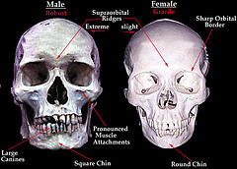

Slide 6
DETERMINING SEX
Sacrum (wider and shorter in female)
Coccyx is more movable in female
Pelvis (Os Pubis)Differences
1-Width of pubic arch (female is larger)
2- Width of pubic body (female is wider)

Slide 7
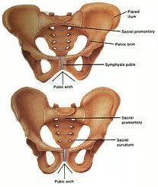

Slide 8
DETERMINING RACE- Skull Features
Caucasoid – (European, Middle Eastern, East Indian)-
Negroid- African, Aborigine, Melanesian
Mongoloid- Asian, Native American, Polynesian

Slide 9
DETERMINING RACE- Skull Features
Examine:
Mandible (lower jaw bone)
Nasal aperture (nose bone)
Palate (roof of mouth)
Orbitals (eye sockets)
Zygomatic arches (cheek bones)

Slide 10
DETERMINING RACE- Skull Features
Caucasoid:
1-long , narrow nasal aperture
2- triangular palate
3- oval orbits
4- narrow zygomatic arches
5- narrow mandibles

Slide 11
DETERMINING RACE- Skull Features
Mongoloid
1- Rounded nasal aperture
2- Parabolic palate
3- Round orbits
4- Wide zygomatic arches
5- Pointed mandibles

Slide 12
DETERMINING RACE- Skull Features
Negroid
1- Wide nasal aperture
2- Rectangular palate
3- Square Orbits
4- pronounced zygomatic arches

Slide 13
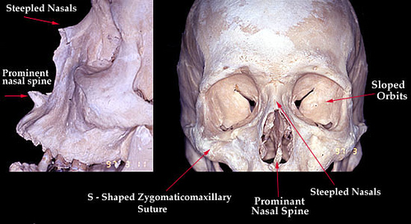

Slide 14
DETERMINING HEIGHT
Male
Humerus:
Height (cm)= (Length of Humerus) x (2.89 + 70.64
Femur:

Slide 15
DETERMINING HEIGHT
Forensic anthropologists can estimate a person’s stature (height) based on long bone measurements.
Different formulas are used for men and women since they have different proportions of long bones to total height.
Formulas are used to estimate height within 7.5 cm

Slide 16
FEMALE
H= femur length x 2.21 + 61.41
H= tibia length x 2.53 + 72.57
H= humerus length x 2.79 + 71.48
H= radius length X 3.87 + 73.50

Slide 17
MALE
H= femur length X 2.23 + 69.08
H= tibia length x 2.39 + 81.68
H= humerus length X 2.89 + 70.64
H= radius length x 3.65 + 80.40

