Slide 1
FORENSIC ODONTOLOGY
Dental Forensics
Forensic Dentistry

Slide 2
Forensic odontology
Application of Dentistry to Law
Establish identities of :
homicide victims
missing persons
Establish relationship between victim and suspect and crime scene

Slide 3
Forensic odontology
The average adult’s have 32 teeth
The average adult has dental records
Bite marks are Individual (everyone’s is unique)
Bite Marks can be compared to person or dental records

Slide 4
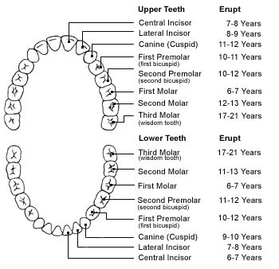

Slide 5
NAMING VICTIMS of Mass Disasters
1995 Murrah Building Bombing , Oklahoma City -25 % named by dentists
1994 Indiana American Eagle ATR 72 plane crash- 9% of teeth identified 50% of victims
1996- TWA Flight 800
2001- WTC Bombing

Slide 6
Naming Victims of Crimes
Jeffrey Dahmer- serial killer
Bones , Skulls, Loose Teeth
Teeth back in skulls
Match dental records
Identify victims

Slide 7
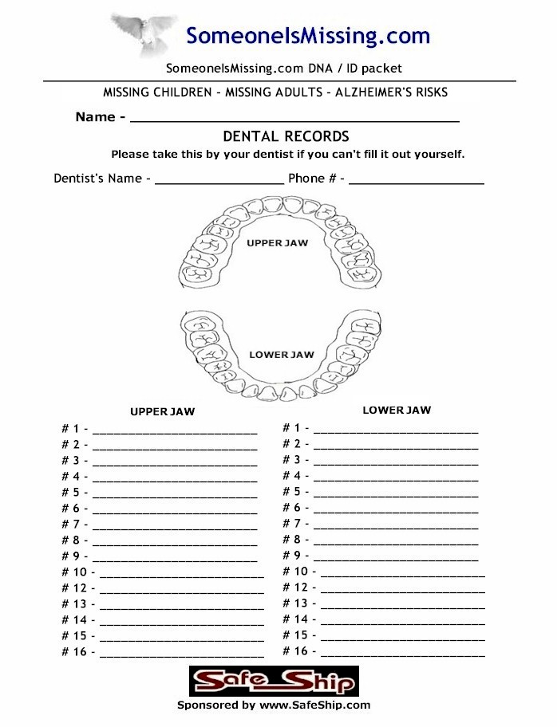
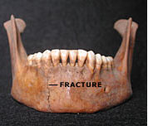

Slide 8
Establish relationship between suspect and crime
Bite marks on victim from assailant
Bite marks on assailant from victim
Bite marks on evidence at crime scene- gum, food, etc.
Usually sexual assault, child abuse, violent crimes
Ted Bundy- serial killer bit victim

Slide 9
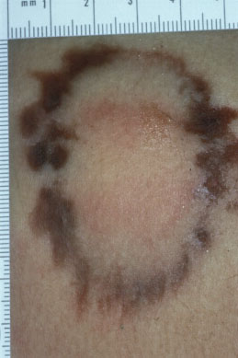
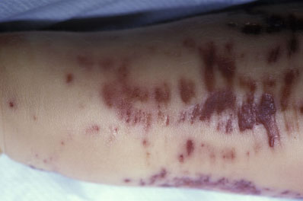

Slide 10
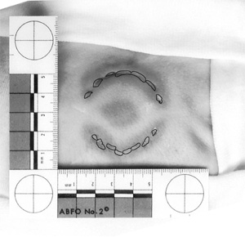

Slide 11
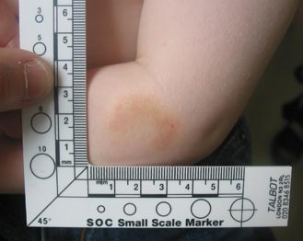

Slide 12
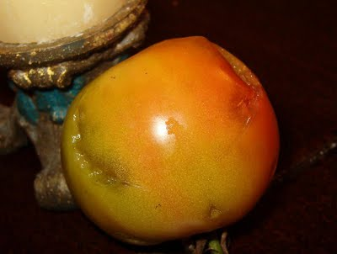
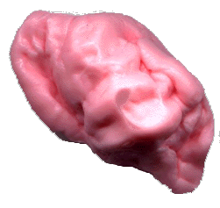

Slide 13
http://investigation.discovery.com/videos/solved-body-identification.html
http://investigation.discovery.com/videos/deranged-ted-bundy-in-his-owns-words.html
http://investigation.discovery.com/videos/deranged-ted-bundy-coincidences.html
http://investigation.discovery.com/videos/deranged-ted-bundys-unique-insight.html
http://investigation.discovery.com/investigation/quiz-central/criminals/ted-bundy.html
http://investigation.discovery.com/investigation/quiz-central/criminals/ted-bundy.html
http://investigation.discovery.com/investigation/quiz-central/dna-forensics/forensic-dentistry.html

