Slide 1
Chapter 6 Notes
Empire building and cultural exchange from India to the Mediterranean
Persian Empire, Macedonian Empire, Mauryan Empire, and nomads ☺

Slide 2
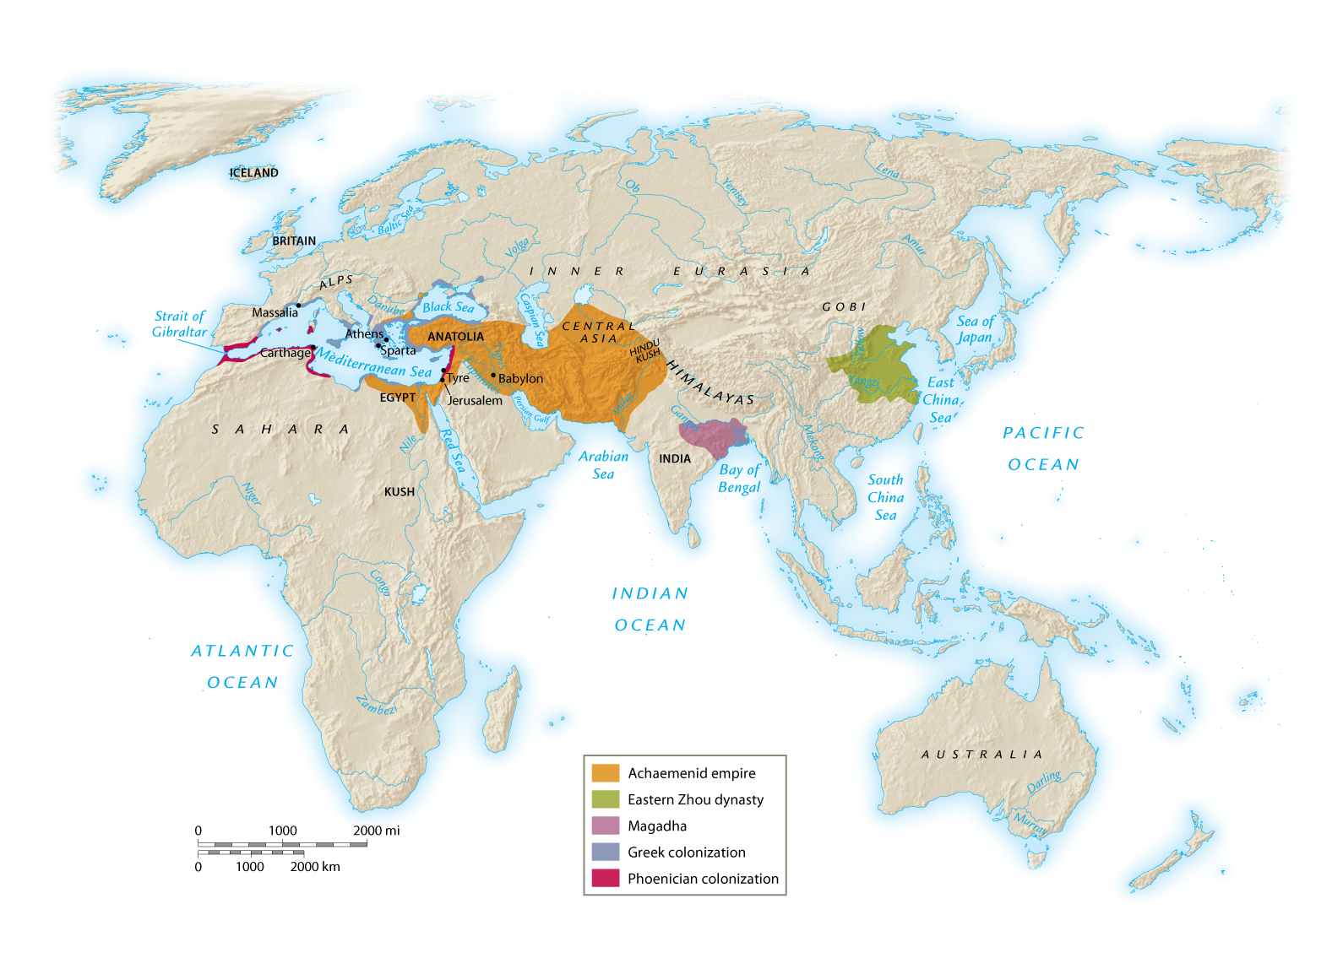

Slide 3
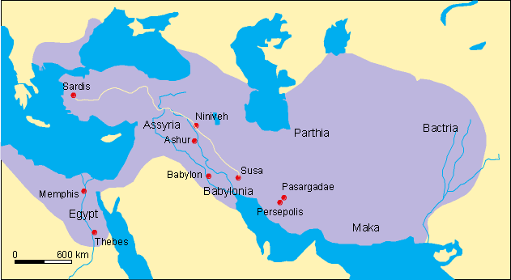
Persian Empire

Slide 4
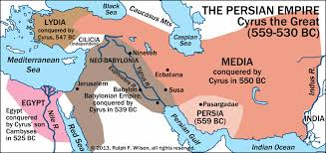
Persian Empire

Slide 5
Rise of Empires
Charismatic Leaders
Awesome militaries
Political vacuums- opportunity
Cultural unity- religion (Chavin)
Trade routes- $ facilitates growth
Supportive imperial governments
Technology: farming, military, government etc

Slide 6
Fall of Empires
Internal vs. External
Political-rebellions and invaded!
civil wars (leaders killed)
Administrative-corruption
over crowded government
dynastic problems
Cultural-fall of tied that pulled people together

Slide 7
Persia/ Achaemenid Empire
Largest state in territory and population we have studied to this point in history
Middle East/ Iranian plateau
Indo-European migrates who spoke Farsi started the empire roughly in 550 BCE
The were primarily cavalry with some infantry
Conquered lands from the Middle East to Egypt and parts of the Mediterranean
1st time in history that the Tigris-Euphrates, Nile, and Indus were all united under one Empire!!!

Slide 8
Persian Empire
The empire was created under the leadership of Cyrus the Great (II) r. 559-530 BCE
Cyrus the Great was known for being a brilliant military strategist and being tolerant towards conquered peoples.
Great military due to nomadic roots and large cavalry
Made generals enforce strict discipline against looting and pillaging. He actually respected local beliefs and didn’t destroy temples, but worshipped at them! Ended Babylonian Captivity by ending Jewish persecution. Much of the Torah or Old Testament was written after the Persians conquered the Middle East.
Defeated the Medes, Mesopotamians, Lydia, Anatolia, parts of the Aegean, Iran, parts of Inner Eurasia, Egypt (525-523 BCE), and the Indus River Valley (518 BCE)
Aegean Sea- moved into further areas of the Anatolia (Ionia) and took over some Greek city-states. Some Ionian Greeks didn’t like this and began to revolt!

Slide 9
Persian Wars 490-479 BCE
Persian Wars-epic war between the Persians in the Middle East and the Greeks. The Persians were the greatest threat to Greek independence. Some Greeks had settled in modern day Turkey (Asia Minor). There they came under Persian dominance. Some began to revolt against the Persians. Soon Athens sent aid to help fight against the Persians. The Persians responded by sending a fleet to attack the Greeks and the war started under King Darius I.
The most famous battles are
-Marathon in 490 BCE- about 25 miles north of the Athens fighting occurred. The Spartans didn’t help because they were too busy celebrating a local festival! So the Athenians were left to fight the invading Persian force under King Darius. Although the Persian army was much larger than the Athenians, the Athenians managed to successfully defeat the Persians by tactics! The encircled and literally forced the Persians into the water. With heavy causalities the Persians decided to pack up and leave and sail to pillage the undefended city of Athens. The army then made a quick march back to Athens to warn the inhabitants and wait for the Persians. It is said when the Persians reached the port of Athens and saw the army they turned away and sailed home! The term marathon also originates from this story: a young man, Pheidippides, ran about 25 miles back to Athens to announce the Persian defeat only to die at the end of the run of exhaustion! Very important battle because it saved Greek culture ☺

Slide 10
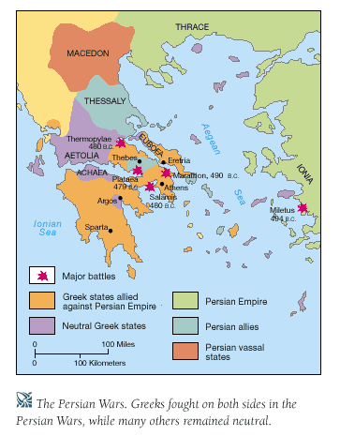

Slide 11
Persian Wars
Battle of Thermopylae – 480 BCE
Xerxes, the new king of the Persians (son of Darius) decided to once again fight the Greeks. He amassed a huge army that many of the Greek city-states feared. Many Greeks refused to fight Xerxes because they felt they was no chance of victory! Some Greeks wanted to fight and made a stand at Thermopylae (a small passage between the mountains and the sea). Because of the vast size of the army there was no way that all the men could move through the corridor at once thus the Persian army’s numbers wouldn’t count! Themistocles (Athenian leader) and Leonidas (King of Sparta) led the assault. Themistocles tricked Xerxes into believing that the Greeks were fighting among themselves and that this was an opportunity to attack. Xerxes led his men into fighting what he believed to be a weak opponent, but instead he found a united force of Greeks under Leonidas. The Greeks held off and killed thousands of Persians until the Greeks were betrayed by Ephialtes who showed the Persians a secret pass. The Greeks expected the fight to continue for some time, but after the Persians discovered the pass the battle soon ended ☹ Leonidas and his Spartan soldiers sent away the other Greeks with them and fought until the death against the Persians. This sacrifice encouraged the Greeks to fight against the Persians. The Persians won the battle of Thermopylae, but the Greeks won the war! The Persians continued onto Athens (which had been evacuated) and looted and burned the city. Then they were stopped at the naval battle of Salamis. This basically ended the Persian quest for conquering Greece.

Slide 12
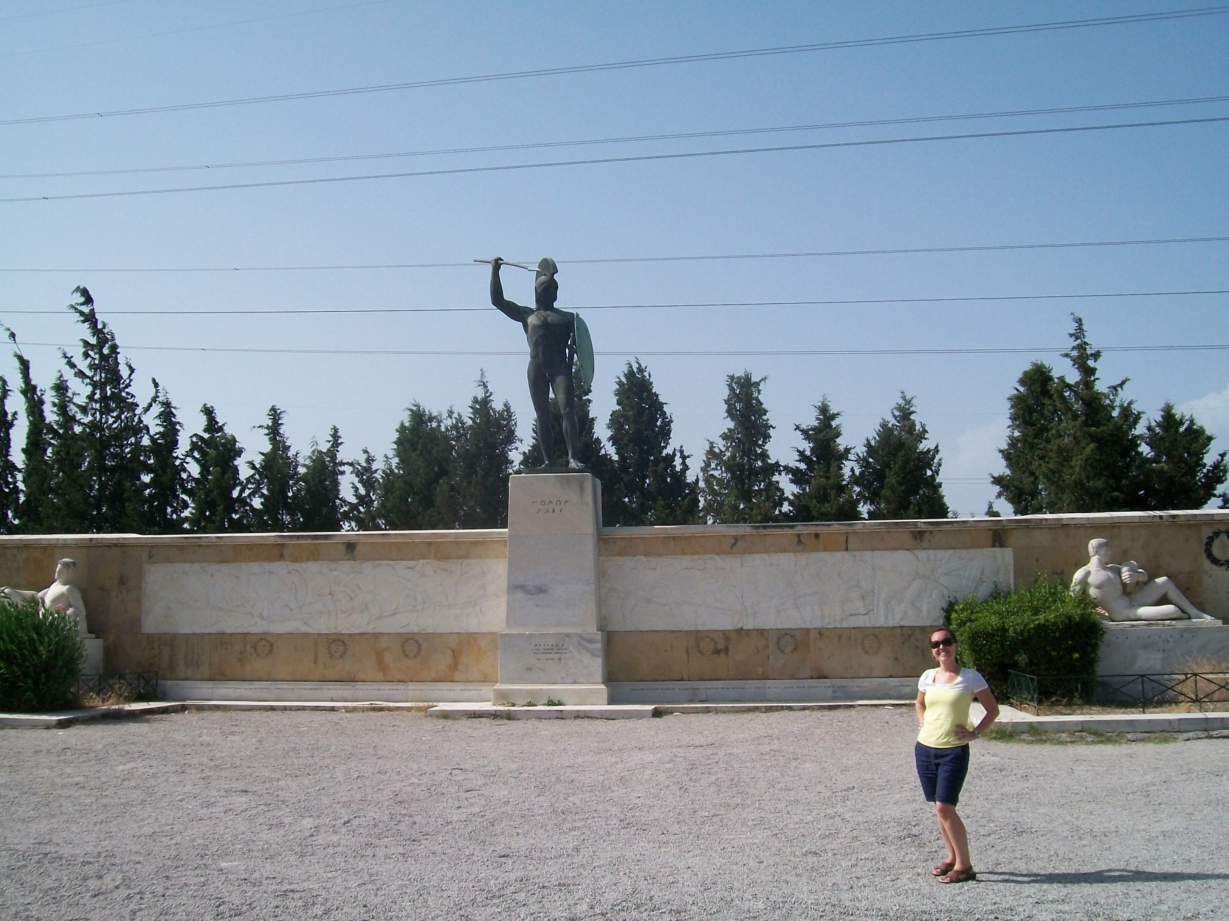
Standing where the Battle of Thermopylae happened! Best day EVER!!!!

Slide 13
Persian/ Achaemenid Government
King “King of Kings”. Universal rulers-have the right to rule all of humanity. Not gods, but did have divine authority to rule.
Under king was the bureaucracy of Persia:
Vizier –chief minister
departments/ royal admin –families of nobles and aristocrats
satrapy-provinces (20 +) with local governor or satrap (had to be Persian and responsible for keeping order, garrisons, and collecting taxes to provide to the royal treasury. Worked with local tax and military commanders and this systems was kept in check with secret spies!)
-Mulitple capitals that the emperor or king moved around to: Persepolis, Susa, Ecbatana etc.

Slide 14
Persia
Standardized a tax system for each satrapy
Issued and standardized coins
Codified law codes for the empire- but allowed locals to maintain their religious and traditional codes when desired
Built the Royal Road (1300 miles) that connected the empire and facilitated expansion and growth

Slide 15
Persian Technology
Royal Road- built specifically to not be washed away by rains/ storms. Had stations and inns along the way. Helped trade to flourish!
Postal Stations-11 along the Royal Road where urgent message could be delivered in 2 weeks as opposed to the 90 days it took to travel to road!!!
Qanat- underground irrigation system that enhanced agricultural production

Slide 16
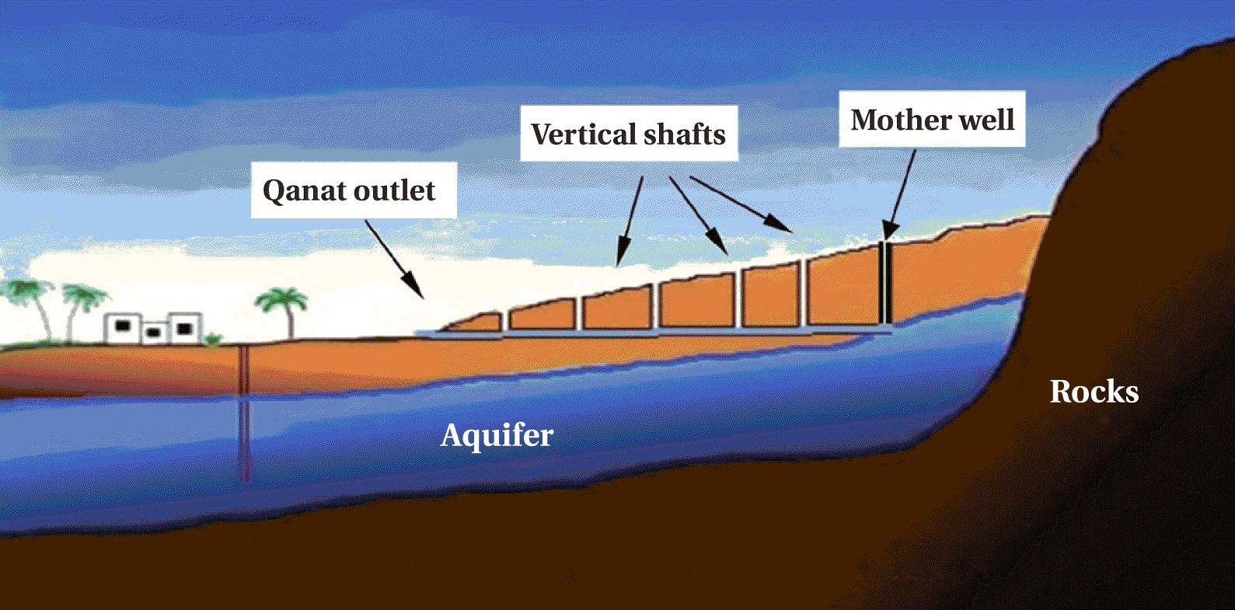

Slide 17
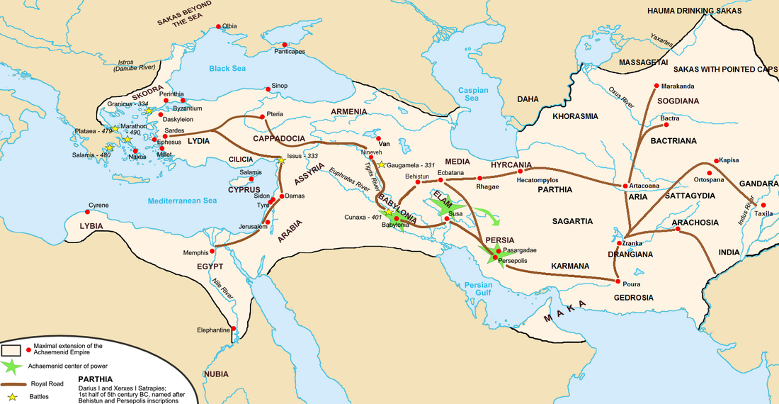
Royal Road

Slide 18
Social System
Persian government more open to women and women had more opportunities like in the royal court. They could also own their own land.
King/ Nobles
Priests, Professionals
Farmers , herders, and those who sell their labor
slaves: POW (prisoners of war)

Slide 19
Zoroastrianism
Early days Persians were a mix of shamanism and polytheism worshipping gods of nature like the Sky and Earth Gods, but this later changed.
Zoroaster-Not sure when he lived, but he is a sage or prophet. It was believed that Ahura Mazda (universal god) appointed Zoroaster to preach his divine message to the world and aligning with good or evil and judgment. He wasn’t accept by his own society and began wondering and attracting disciplines around Persia.
Zoroastrian hymns were transmitted orally (like the Vedas) and later only 17 hymns (Gathas) from Zoroaster survived and these and other scared information were written into the Avesta (Holy Book)

Slide 20
Zoroastrianism
Monotheistic! Believed in one main universal god called Ahura Mazda so monotheistic.
Good, universal god (Ahura Mazda) vs. evil god (Angra Mainyu)
Everyone had to make moral choices between the good and evil forces. If you made good choices then you get to ascend at death to be with Ahura Mazda, if bad then you went to a version of hell with Angra Mainyu. There, daeva (devil) or malign spirits worked with Angra Mainyu.
You didn’t have to give up worldly pleasures to be good. You needed to be honest, just, compassionate, and overall a good person.
*Dualism* -describing a universe of good and evil (light and dark)was introduced for the first time. This ideas were of course picked up and furthered in famous world religions of Christianity and Islam.

Slide 21
Decline of the Persian Empire
Internal and External
-Fought in Persian Wars and supported Sparta in the Peloponnesian Wars. This really drained the state. Plus weaker rulers, like Darius III, came to power.
-Conquered by Macedonia, Alexander the Great, by 331 BCE –battle of Gaugamela.

Slide 22
Greece
Greeks were Indo-Europeans who migrated and began establishing themselves by 1700 BCE. By 1400 BCE a major kingdom developed-Mycenae
Greece had few fertile plains and had many mountains and over 1400 islands! Only 20% of the land was arable (farmable). Greeks became skilled sailors. The temperature was moderate ranging from 48-80 degrees as averages…of course it does get very hot in the middle of summer!
Mycenaeans invaded the island of Crete (Minoans) and adopted much of their culture. Crete gained much of its culture from Egypt. The Myceanaeans took the Minoan values of sea trade, writing system, and legends that helped form Greek religion, art, politics, and literature.
Greatest Mycenaean epic: The Trojan War
It was a war waged, according to legend, against the city of Troy in Asia Minor (present-day Turkey), by the armies of the Mycenaeans, after Paris of Troy stole Helen from her husband Menelaus, king of Sparta. The war is among the most important events in Greek mythology and was narrated in many works of Greek literature, of which the two most famous are the Iliad and the Odyssey of Homer
Not long after the Trojan War the Mycenaean civilization collapsed by subsequent waves of Indo-Europeans invaders.
From 800-600 BCE strong city-states, polis, started to develop in Greece

Slide 23
Mycenaeans:
Indo-Europeans moved to southern Greece and started settlements. They mimicked many Minoan ideas like construction projects and built fortified areas to build their empire. By 1600 BCE they started to trade with the Minions and by 1400 BCE they conquered the Minoans. (Adopted maritime trade, construction, artwork, and linear B writing system).
-Know for the Trojan War- 1200 BCE ish war between Mycenaeans and the Trojans over control of the Aegean Sea, legendary story of Helen and Paris (read apple story). Built the Trojan horse and famously creped out and attacked Troy. Achilles Heal (dipped into the river to make invincible) and Hector from Troy. Achilles died and due to being shot in his heal…his weakness.
-Iliad and Odyssey represent characteristics important to Greeks: strength, honor, courage, and eloquence.
-Mycenaeans –empire grew, but then declined due to invasions, wars, and internal rebellions.
-Dark Ages 1100-800 BCE-population decline and people left after the fall of the Mycenaeans. Dorians moved in and settled areas, but no real learning or scholarship occurred during this time period. Linear A and B disappeared.

Slide 24
Greece
Polis = city-state was the Greek political unit. This included the city and all surrounding areas that took to support it (farm lands). Each city-state had its own unique form of government ranging from oligarchy to monarchy. Most city-states were ruled by a king or an aristocratic council. At the center of the polis was the acropolis –fortified centers on hills dedicated to the gods like the one in Athens!
Polis restored political order in Greece and over time attracted increasing populations and many became lively commercial centers. By 800 BCE they were the principle centers of Greek society.
There were no large empires because of the geography of Greece. It was separated by both mountains and islands.
Trade became very popular under the regulation of the city-states
Adopted common culture: religion and activities like the Olympic games
Two leading city-states: Athens (more artistic and intellectual) and Sparta (militant). During Persians War the two city-states cooperated to defeat the Persian Empire. Under Athenian leadership the Delian League was established to continue the fight against the Persians. With Athens in control it grew increasingly powerful and rich. Soon Athens was developing colonies! This is known as the Golden Age of Greece: plays became popular,
Athens- greatest politician was Pericles. He believed in the democratic structure of Athenian society and wanted to beautify Athens

Slide 25
Sparta: Dorians conquered and established Sparta. Expanded over the Peloponnesus in Greece. As they expanded the conquered peoples became helots-servants to the Spartan states. They had to provide agriculture to keep Sparta supplied with food. They outnumber Spartans! Therefore, they faced many potential rebellions and this society responded by devoting its resources to maintaining powerful and discipline military machine! Sparta was ruled by two kings and a council of elders who then advised the monarchs. An assembly of citizens was created to approve all major decisions of the government. Citizen = native male Spartan who was 30 years. The assembly elected 5 ephors (officials) who ran the day to day affairs of the state.
-Spartans all equal in status-but observed an austere/ ascetic lifestyle (couldn’t wear jewelry-didn’t pamper themselves). The adj. spartan then also comes to refer to their lifestyle of simplicity, frugality, and austerity. Distinctions came from discipline and military talents. Society: Newborns examined and sickly children were abandoned to die b/c Sparta wanted healthy future soldiers and mothers. (Patriarchy-fathers would make this decision) Females-expected to produce healthy sons so they exercised too and had established patriarchy-expected to obey fathers and husbands. Had legal rights to inherit property, but were responsible for running estate while men were away training and fighting.

Slide 26
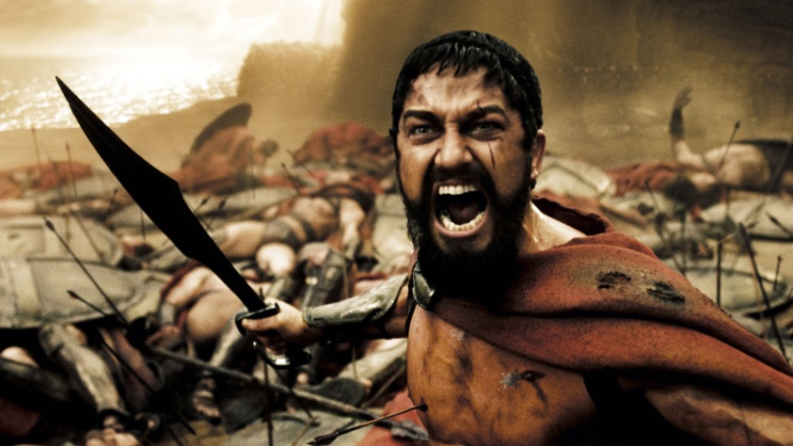
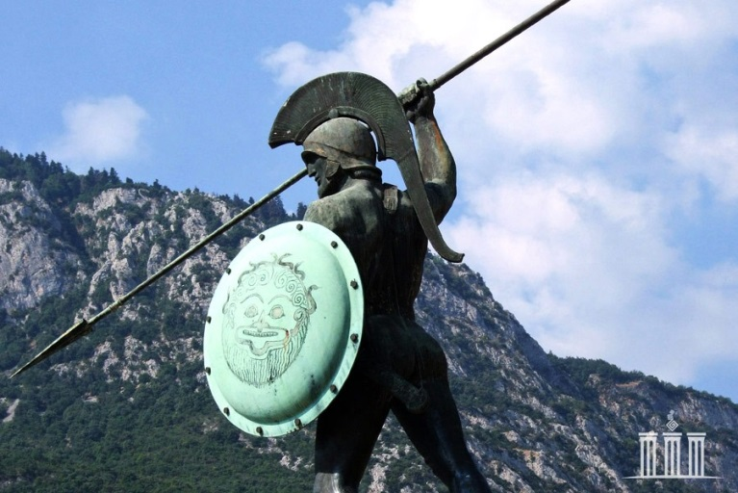
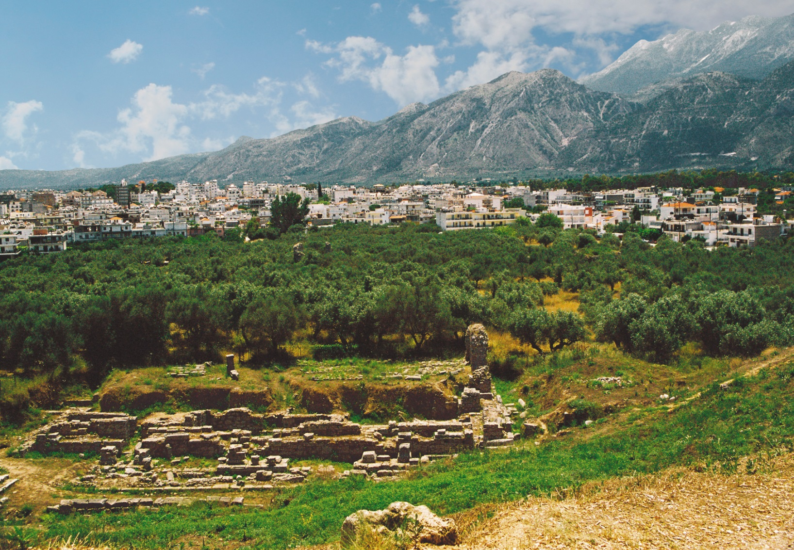

Slide 27
Like other city-states, Athens went through a power struggle between the rich and poor instead of imposing order by military means like Sparta they chose to avoid civil war by making reforms and creating a democracy or rule by the people. In Athens, citizens participated directly in political decision making. Clashes occurred between aristocratic landowners and the poor (small farmers some of whom had to sell their lands and then themselves into slavery to pay off debts-sound like Han). 594 BCE Solon-aristocrats chose this statesman to head the government and reform the laws to prevent a civil war. He outlawed slavery and allowed all citizens to participate and debate policies of the Assembly. He introduced the legal concept that any citizen could bring charges against wrongdoers, and made economic reforms that benefited many (encouraged export of grapes and loves that initiated a profitable overseas trade). Although he did many great reforms, Solon neglected land reform-in part b/c aristocrats put him in power! Later reformers like Cleisthenes would enhance democracy by increasing the powers of the assembly against the nobles (limited democracy). Later, under Pericles, Athens developed a direct democracy. Pericles had popular support for 32 years and was a skillful politician and inspiring speaker. He dominated politics in Athens from 461-429 BCE and this time is also referred to as the Age of Pericles! He had three goals (1) strengthen Athenian democracy (2) hold and strengthen the empire (3) glorify Athens.
Pericles increased number of paid official in government so now even the poorest citizen could serve if elected or chosen by lot to fill a government position. This reform made Athens truly one of the most democratic states in all of history! Direct democracy was introduced where citizens directly proposed and voted on laws/ policies in the assembly (had to be 18, male, and Athenian).
Empire-tried to enlarge the wealth and power of Athens via using money from the Delian league!!! He built up the Athenian navy to the strongest in the Mediterranean.
Used money from the empire to beautify Athens…but without the Delian League’s approve. He used much of their money to buy gold, ivory, and marble for the city. Still more $ went to a small army of artisans who worked for 15 years to built the Parthenon!!!

Slide 28
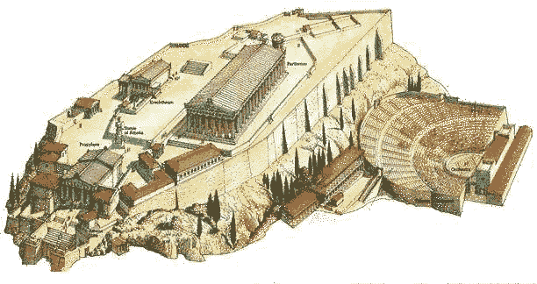
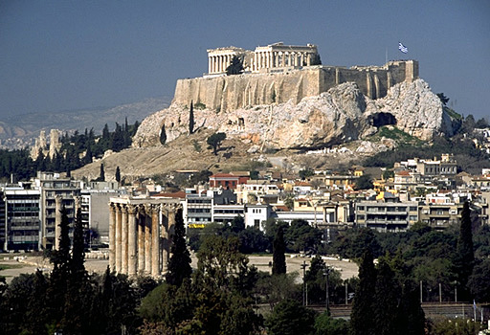
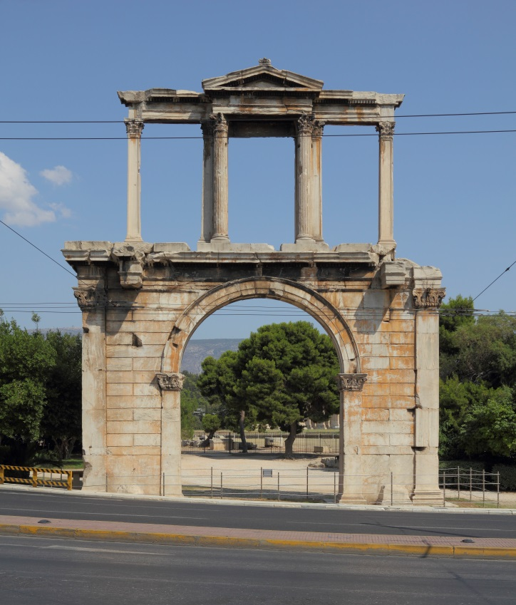
Athens

Slide 29
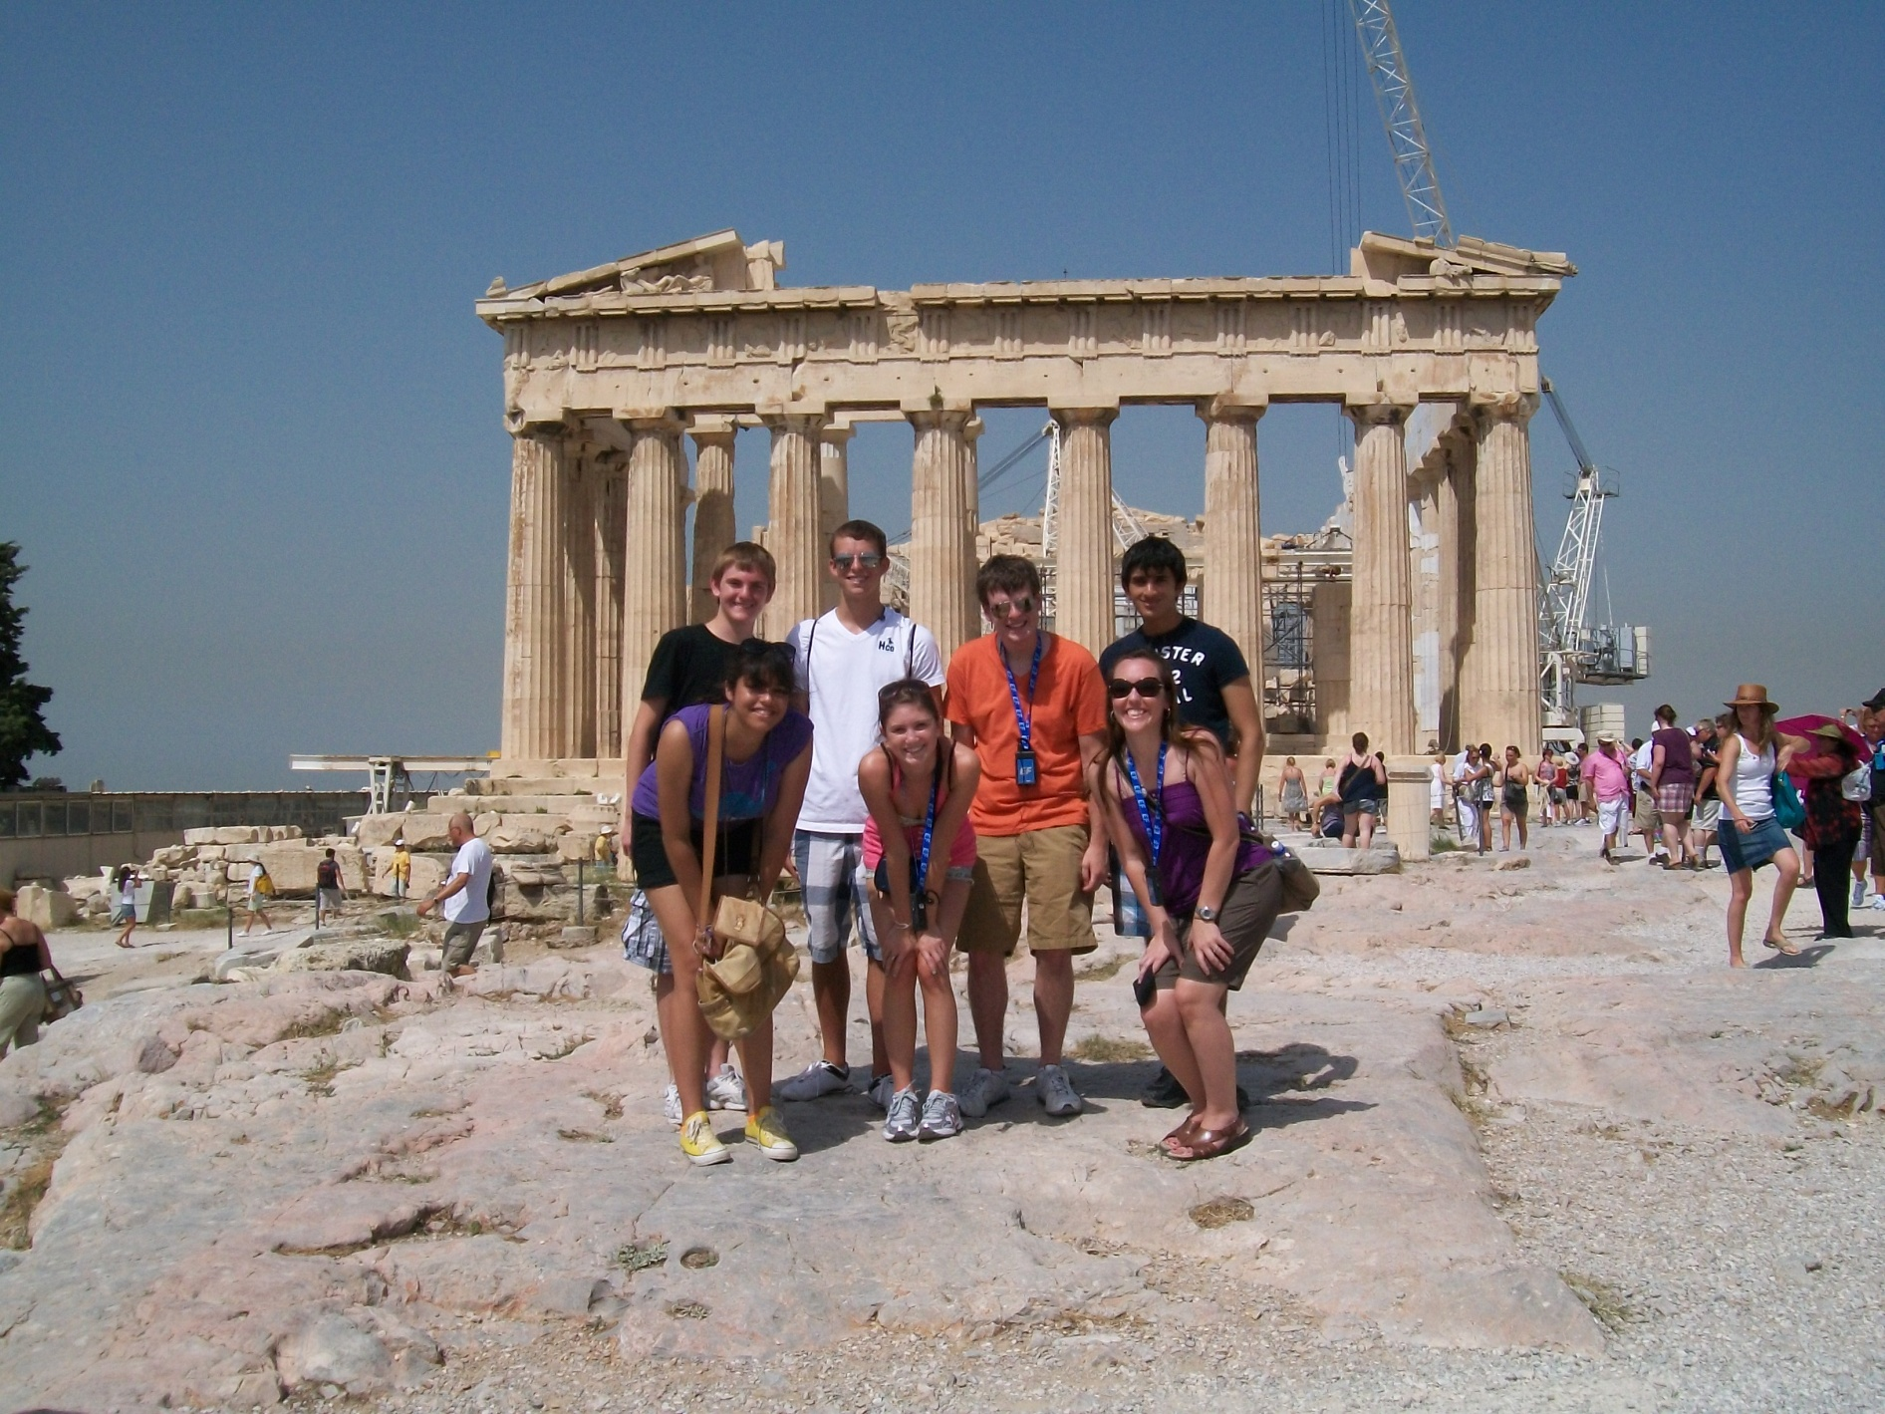
2010 Trip to Greece, Italy, and Spain

Slide 30
TRADE: Colonies-due to population pressures the Greeks began to set up colonies around the Mediterranean: Sicily, Southern Italy-Naples-called Neapolis (new polis), southern France, islands, Anatolia, and even the Black Sea (grain, fish, furs, timber, honey, wax, gold, amber, and slaves). Provided agricultural products and copper, zinc, tin, and iron. By 600 BCE more Greeks lived in the colonies than the peninsula itself!
*Didn’t build an imperial states like Persia, China, and India!!! Colonization built communication, trade, and the spread of Greek language and culture.
Greek Trade: Maritime trade!
Small amount of arable (farmable lands)-Greece very mountains with many islands so much grain would have to be imported. Most of Greece was more accessible by sea rather than land.
-grapes and olives produced = olive oil and wine traded for grains and other products
-Egypt, Sicily, and S. Russia= grains Macedon-timber
-Spain and Black Sea= salted fish Anatolia = tin
-Egypt and Russia = slaves
-Cities rose up around the merchant/ commercial success rather than agricultural production
-Ships-could carry 400 tons and a few could carry 1000 tons!
-Economic organization=ship-owners, bankers, and merchants formed partnerships and shared in the risk of commercial ventures. Merchant borrowed $ from banker to purchase cargo and rent space from a ship-owner who transported the cargo and returned the profits to the merchant. In the event of a shipwreck then the merchant and lender absorbed the loss.
-Many small business that popped up across the Mediterranean
*Later, under Alexander Greek culture would reach Persia/ Bactria by way of horses, donkey, and caravans.

Slide 31
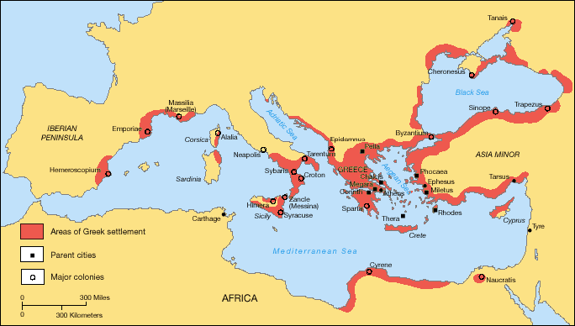
Greek Colonies

Slide 32
Panhellenic Festivals: trade linked Greek city-states and colonies to form a larger Greek community. Colonist recognized the small gods, spoke Greek dialects, and maintained commercial relationships with the native communities. All Greeks gathered periodically to participate in panhellenic festivals that reinforced their common bonds. Festivals featured: athletic, literary, or musical contests in which individuals sought to win for the glory of their polis.
-Olympic Games= best known panhellenic festival. 776 BCE Greeks sent best athletes to the polis of Olympia to compete in speed, strength, and skill contests. Events included: foot racing, long jump, boxing, wrestling, javelin toss, and discus throwing. Winner received a olive wreaths and became celebrated heroes in their home poleis. The games took place every 4 years for more than a thousand years before disappearing.
Society:
Patriarchal –fathers had the right to decided whether to keep infant born to their wives! Couldn’t legally kill infants, but could abandon them in mountains or rural areas where they would quickly succumb to the elements. Women under authority of father, husband, and sons; they often wore veils to discourage male attention. Women could become priestesses in a cult, but most married. In Sparta women had more freedom-they could inherit land, participated in athletic contests, joined festivals, and even defended the polis sometimes! Slavery!!!

Slide 33
Knowledge:
-Egypt and Mesopotamian knowledge adopted by the Greeks
Astronomy, science, math, medicine, magic, divination (prediction)
-adapted Phoenician alphabet by 800 BCE –Greeks added vowels to their consonants
-Science and philosophical ideas merge: to answer a question one must observe evidence, possess rational thoughts, and use human reason –not just reliant on the gods!
-Pythagoras (math-right angles)
-Hippocrates (medicine-study body-Hippocratic Oath)
-Democritus-suggested that all physical things were composed of indivisible particles he called atoms
Philosophy:
-power of human reason applied to human issues and natural world
Socrates: (470-399 BCE) –Athenian philosopher: encouraged a reflection on human issues, particularly on matters of ethics and morality. Socrates subjected traditional ethical teachings to scrutiny. Believed people should live honest and honorable lives and should aspire for personal integrity NOT for wealth, fame, and other superficial attributes!
-Brought on trial in Athens for corrupting the youth with his questions that led some away for traditional beliefs/ ethics. He was found guilty and sentenced to death-died by taking hemlock sap. (Poison)
Plato: Student of Socrates who wrote dialogue in the Republic. Developed distrust for government for Socrates murder and in the Republic the concept of the perfect form of government was explored = philosopher king and intellectual aristocracy to rule
-Concept of Forms and Ideal: the world we live in isn’t the only world, but only a pale reflection of the world of forms and ideas. Qualities (like virtue) are imperfectly reflected in our world and only by entering the world of forms and ideas can one understand the true nature of qualities. Only philosopher (people who applied rational thinking) could understand this world.
-Virtue-obey parents, but disobey if parents are doing something illegal
Aristotle: Student of Plato who came to distrust his concept of forms and ideas. He promoted a person to rely on senses to provide accurate information on the world. He advocated exploring the nature of reality and applied rigorous rules of logic to construct powerful arguments. He was called later by Christian scholastic scholars as the “master of those who know”.
-Provided the intellectual framework that would shape thought to this day! Especially in Christian and Muslim societies. Scholars from these religions often strove to harmonize philosophy and religion.

Slide 34
Religion: Indo-European roots with recognizing elements as supernatural-this led to Greeks personifying these powers into gods and the construction of myths
-many gods and many stories
-Beginning-there was chaos out of which came the earth which is the mother and creator of all. Earth generate the sky and together they made the night, day, sun, moon , and other natural phenomena. (all god/ goddess). Struggles between the gods led eventually to the rise of Zeus and he became the ruler of the gods (son of earth and sky gods). The subordinate deities were responsible for performing specific duties.
Religious cults-around a particular god/ goddess –some only admitted women like the cult to Demeter (fertility). The cult of Dionysus (wine) mostly women who upon grape ripening would go into the mts. and celebrate via song and dance. Over time, the cults disappears and polis power became more concentrated.
-Religion changed as Greece became part of the Hellenistic Empire-associated more with individuals and not loyal to a particular patron god of a city.
Plays: tragedy (Sophocles and Euripides) and comedies (Aristophanes)
Philosophy: Epicureans, Skeptics, and Stoics
Epicureans-pleasure is the greatest good (pleasure-a place of quiet satisfaction to shield from the pressures of this world). But one should limit pleasure so that when they part take in that pleasure it is more greatly appreciated. (If you eat cupcakes everyday they make you sick)
Skeptics-doubted possibility of anything for certain so didn’t take a strong position –sought equanimity (calmness) rather than debate
Stoics-happiness created by recognizing that all events are neutral and we assign them all the meaning they have. So don’t assign meaning and things cannot make you unhappy.
-people had a duty to led others and led virtuous lives/ said to not be very emotional
-All sought a way of bringing inner peace and tranquility to people –sound familiar –China (Confucianism, Daoism, and India-Buddhism and Jainism)

Slide 35
Peloponnesian War (431-404 BCE)
Sparta was angry at the ambitions and control of Athens so they made alliances with other Greek city-states and launched war! Sparta had a great army while Athens had a great navy! Delian League
Pericles didn’t want to fight a land battle with the superior Spartan military –navy battles. Sparta swept through the Athenian countryside and burnt their crops. Pericles pulled residents inside the walled protection of Athens. Ships would have to import food
A plague swept through Athens, killing 1/3-2/3 of the population including Pericles and a huge defeat of the Athenians navy at Syracuse.
After 27 years of fighting Athens and its allies lost. There was no real winner because all the years of fighting just weakened all of the Greek city-states! Soon kings from Macedonia (to the north) moved in on their chance to conquer the Greek city-states!

Slide 36
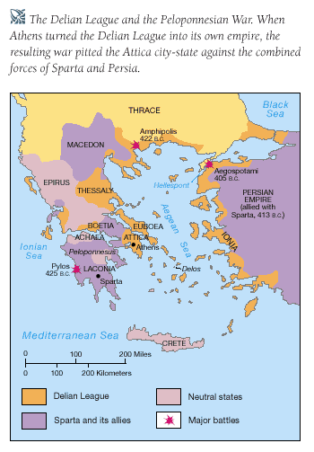
Peloponnesian War and the Delian League. When Athens turned the Delian League into its own empire the resulting war pitted it against the combined forces of Sparta and Persia

Slide 37
Decline of Greece:
Persian Wars (500-479 BCE)
Peloponnesian Wars (432-404 BCE)
-King Philip II of Macedon conquerors the Greeks at the Battle of Chaeronea (338 BCE)
-Alexander the Great then conqueror the Persians at Gaugamela (331 BCE)
Spread Hellenistic Culture (Hellas = beyond Greece)
Alexander died around 324 BCE and his empire fractioned between generals:
Macedon and Greece = Antigonus
Egypt = Ptolemy
Persia = Seleucus
As Macedon became weak the Greeks started to shake off their rule. At the same time Rome began to grow in power and kept Macedon from reasserting its control over Greece because they had interests in the area.
Crash Course Video on the Greeks and Persians

Slide 38
Macedonia
The rulers of Macedonia were kings chosen from among the clan leaders. Macedonians existed on the frontiers of the Greek world and served as a barrier to even more primitive barbarians
Under the leadership of King Philip II, Macedonia prepared to move into the political vacuum created in the aftermath of the Peloponnesian War. Philip secured his the throne by assassinations.
He then defeated the traditional Macedonian enemies on his borders before preparing a campaign against the Greek polis.
The Greek campaigns began in 346 B.C. and ended with his victory over the Greek city-states at the battle of Chaeronea in 338 B.C.
However, King Philip II was assassinated on his daughter’s wedding day before he could continue expansion into the Middle East.
Alexander (Philip’s son) immediately proclaimed himself the king.

Slide 39
Alexander the Great
The assault on the Persian Empire began in 334 B.C. Under the brilliant generalship of the young Macedonian king. Greek armies swept through Asia Minor, Palestine, Egypt, and Persia. In three years, the Persian Empire recognized Alexander as its new leader.
Conquered Persia in 331 BCE battle of Gaugamela
Alexander pressed his armies eastward from the Persian capital farther into Asia-Afghanistan and Pakistan/ India
When his armies at last refused to continue, Alexander reluctantly returned to Persia in 324 B.C.
Alexander fostered the construction of cities on the Greek model, but he carefully protected indigenous customs and social organization. Despite the success of Alexander's program of cultural amalgamation, his empire was in many ways a personal one. When the emperor died in 323, the empire fragmented into smaller political units.
Introduced Hellenistic period: mix of Greek, Egyptian, Persian, and India culture and ideas! Main influence Greek.

Slide 40
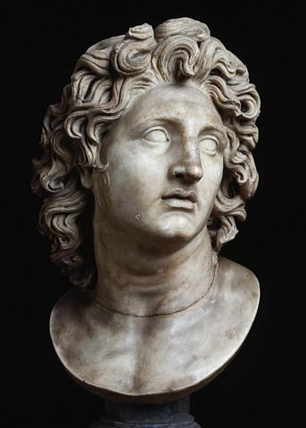
Alexander the Great
Empire centered in the Middle East
Introduced elaborate Persian rituals to his court and dressed in the Achaemenid fashion. He linked his authority to Egyptian and Mesopotamian notions of divine monarchy making himself a god (a change from Greece).
Built 25+ new “Greek” cities in Persia alone that served as admin and military centers. Army veterans and civilians from crowded Greek cities were encouraged to move. These elites formed an elite group over the locals.
Alexander did permit locals to participate in government (not at the top thought) as well as a degree of self-government too.

Slide 41
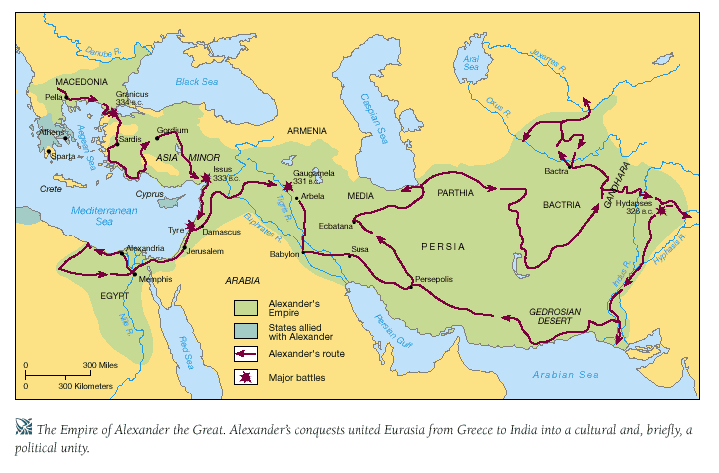

Slide 42
Hellenistic World
Relating to the interaction between Greek languages and culture and the culture and languages of others in the Mediterranean, Black Sea region, Nile Valley, and Southwest Asia (Middle East).
Hellenistic refers to the political and cultural developments across India to the Mediterranean as a result of Alexander and his successor states. Greek speakers interacted with many others during this period creating a cultural amalgamation.
After his death, Alexanders commanders competed for his throne. They then founded regional monarchies whose highest officials were Macedonian or Greek.
Seleucid Empire (Middle East) (absolute power)
Ptolemaic Empire (Egypt-Cleopatra from this family) (absolute power)
Antigonid Empire (Greece)
Most had absolute power of leader and leader performed religious rituals to maintain the approval of the god(s). Ruled by Greco-Macedonian peoples. Governments were organized and centralized. They focused on collecting taxes. Ptolemaic rulers managed the economy to a great deal-supervising state works projects like irrigation and regulating farming while also monopolizing manufacturing of papyrus, linen, oil, and beer.

Slide 43
Hellenistic Society/ thinking
Many cities created by Alexander and ruled by a Greco-Macedonia elite became major trade centers: Alexandria, Antioch, Seleucia, Pergamum.
These cities were again built on the Greek model: temples, theaters, marketplaces, gymnasium, and villas.
Society was patriarchal, although in some cases women did have the ability to pursue interests (upper class). Some Ptolemaic monarchs married their sisters to keep the Macedonian blood line strong??? Queen Arsinoe II married and co-ruled with her brother, Ptolemy II, for a few years.
Greek language, religious ideas, artistic concepts, and political theories spread. (Koine –common language)
Spread Greek thinking, but also lead to new ideas and movements too:
Cynicism
Epicureanism
Stoicism
Aristarchus-Heliocentric solar system
Eratosthenes-circumference of the Earth
Euclid-geometry
Archimedes-value of pi and geometry of a cylinder and sphere
-New centers of learning beyond Athens: Pergamum, Alexandria in Egypt (library)
-Greek also adopted Egyptian or Persian gods to their pantheon by associated thing with others god(dess) with similar characteristics. Some mysterious religious cults formed around the Mediterranean to specific quasi-Greek deities like Isis (Egyptian goddess). South Asian slaves also very popular (female) to show status of rich.
-Jewish intellectuals also produced lots of religious, philosophical, and dramatic literature at this time as well. King Ptolemy II sponsored translations of Hebrew scripture into Greek (Septuagint)

Slide 44
India-Mauryan Empire
After the death of Alexander the Great, Chandragupta Maurya rose to power. He conquered the kingdom of Magadha and subdued neighboring states. By 303 BCE he defeated Greco-Macedonian kings in India.
Mauryan Empire- 321-185 BCE
Maintained order through a well-organized bureaucracy with royal officials who supervised road construction and harbors to benefit trade. Officials also collected taxes and managed state-owned factories and shipyards. The emperor also personally heard court cases. Chandragupta was also a harsh ruler who utilized a brutal secret police force to report corruption, crime, and dissenting ideas against the government. He also had an elite group of female guards who protected his palace and secured his personal safety.

Slide 45
Mauryan Empire
Ashoka -273-232 BCE- Great Mauryan leader who extended the empire and attacked the kingdom of Kalinga.
He was horrified at the carnage and slaughter that took place at this battle and adopted the religion of Buddhism and became non-violent or practiced ahimsa.
He than lessened punishments and began promoting Buddhist ideas in government and society. He sent missionaries out to spread the religion which helped it take root in places in Asia including China! He even stopped eating most meat and respected all human life.
He built things to help improve his citizens lives like hospitals, roads, and rest houses for travelers.
His rule brought peace and prosperity and united the empire, but later rulers were not so charismatic or driven. By 185 BCE his successors lost control of the state. They were not as driven or serious about religious observation and hence the movement of Buddhism stalled in India. Although Buddhism becomes very popular in Asia, especially China during the decline of the Han dynasty (100 CE). While in India, over time, Buddhism got gobbled up by the openness of Hinduism. Many Hinduism believe Buddha is an avatar of a Hindu God (Vishnu) sent to help and aid the people.

Slide 46
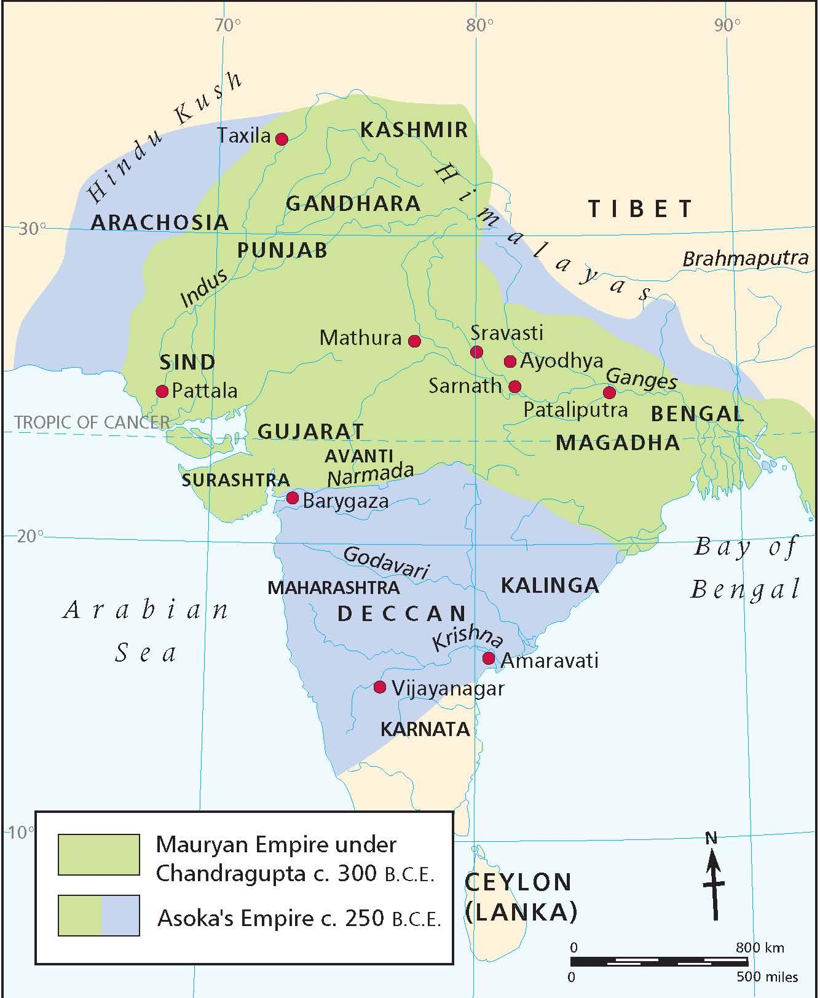
Mauryan Empire

Slide 47
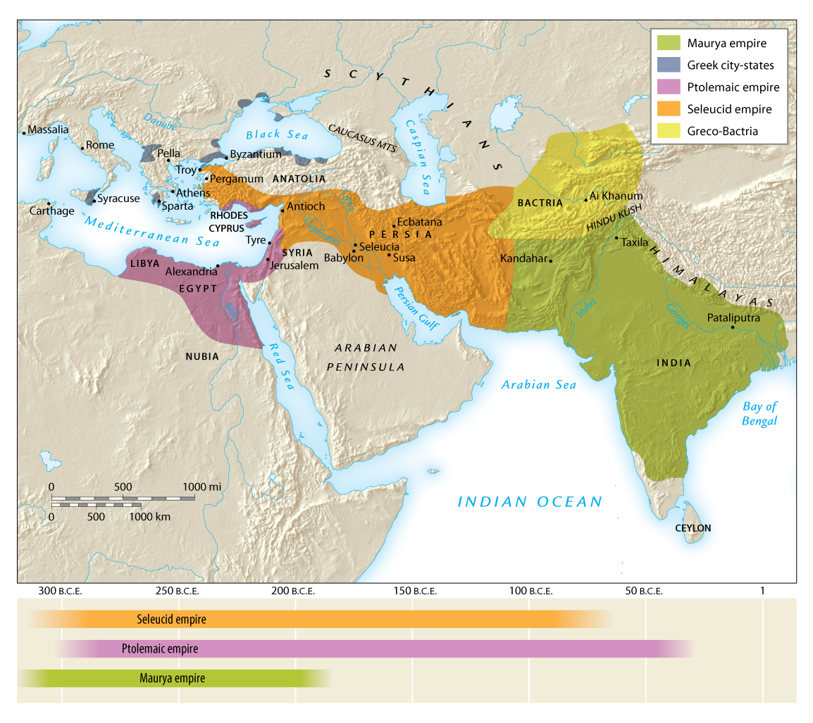

Slide 48
Buddhism
Started by the sage, Siddhartha Gautama (cir 563 BCE) of Nepal
Hinduism and Brahmanism began to focus on the upper class and sometimes neglected the needs and longings of ordinary people for spiritual salvation and Buddhism filled that gap.
According to legend there was a prophecy given at his birth indicating his specialness.
He was kept on his parents property/ grounds. He married a cousin and one day began to wonder about the outside world. So he snuck out!!! He saw old man, a sick man, and a corpse. He realized that life was full of pain and suffering. He sought to end this cycle and began visiting Hindu gurus.
He didn’t find the answer to his question and began meditating. After days of meditating he found the answer and reached enlightenment and became the Buddha.

Slide 49
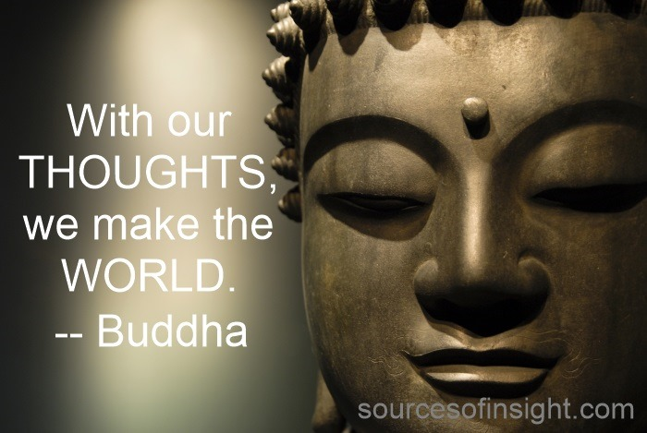
Buddhism
Four Noble Truths
Eightfold Path
Nirvana

Slide 50
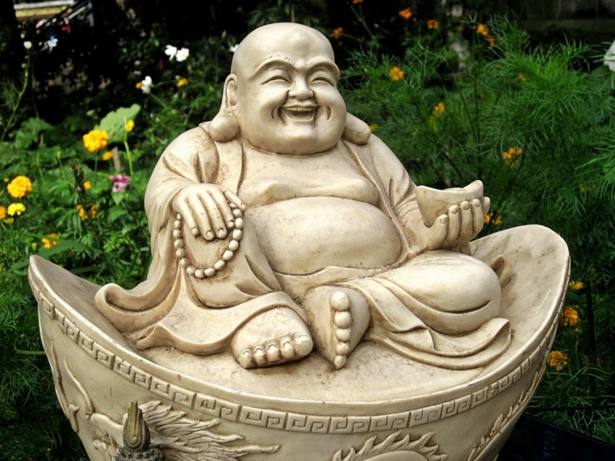
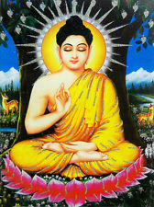
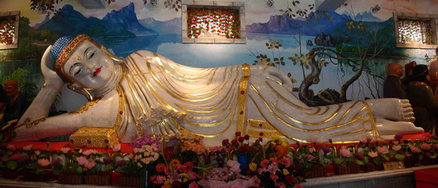
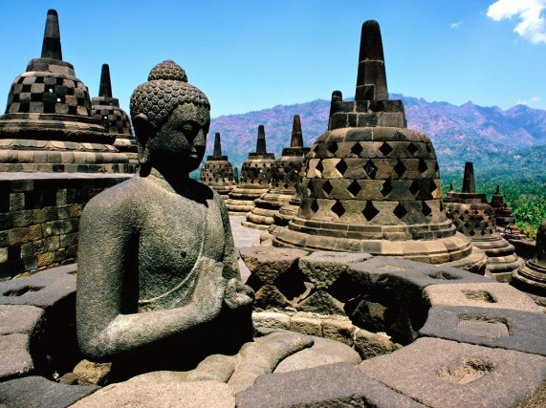

Slide 51
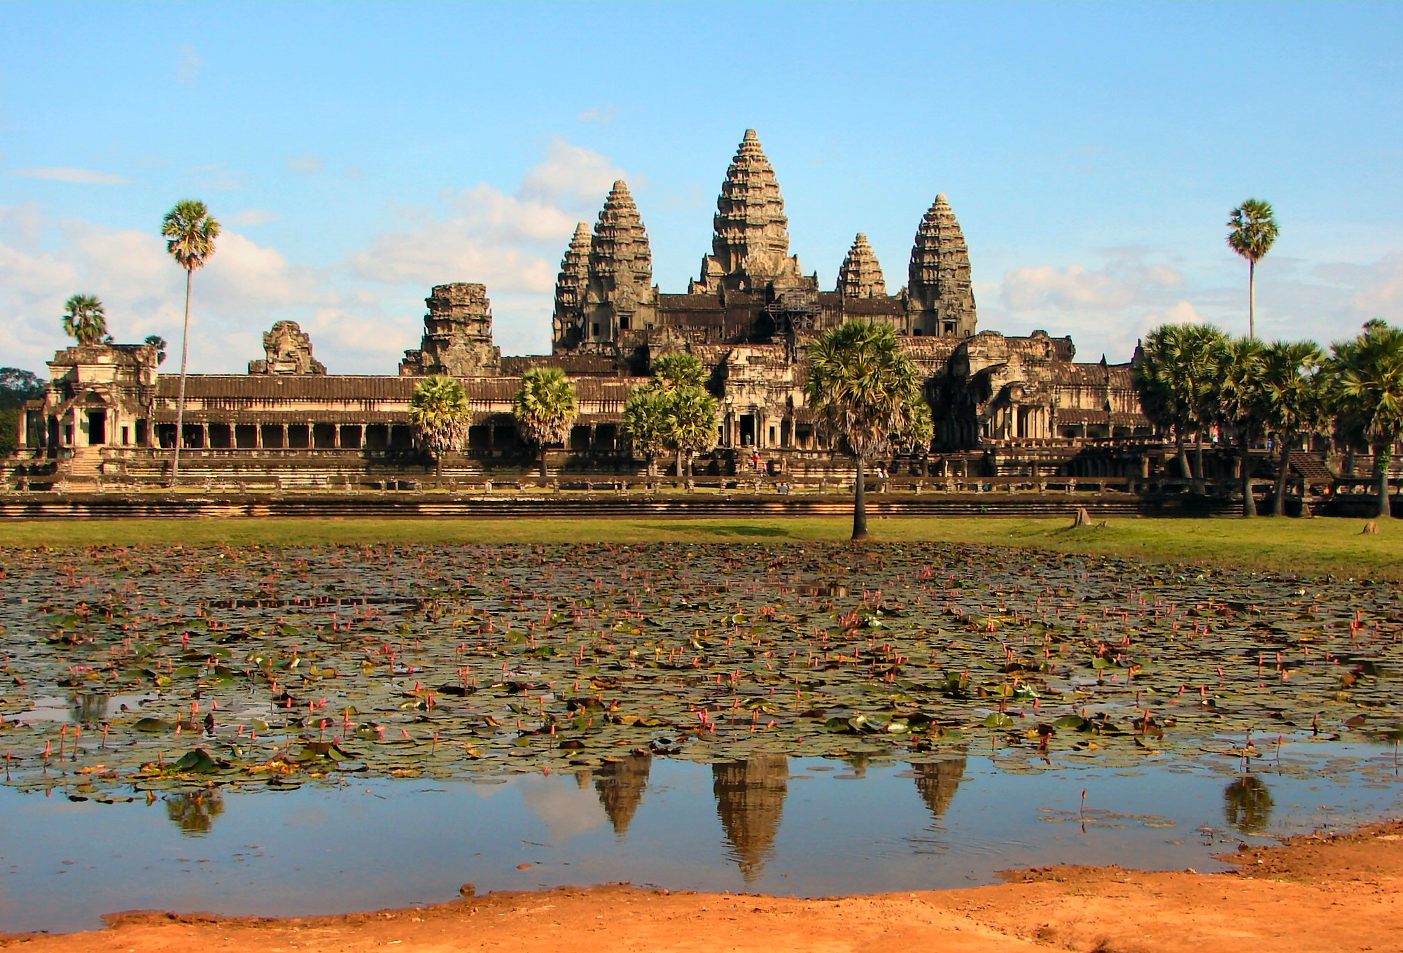
Angkor Wat – Buddhist temple (stupas)

Slide 52
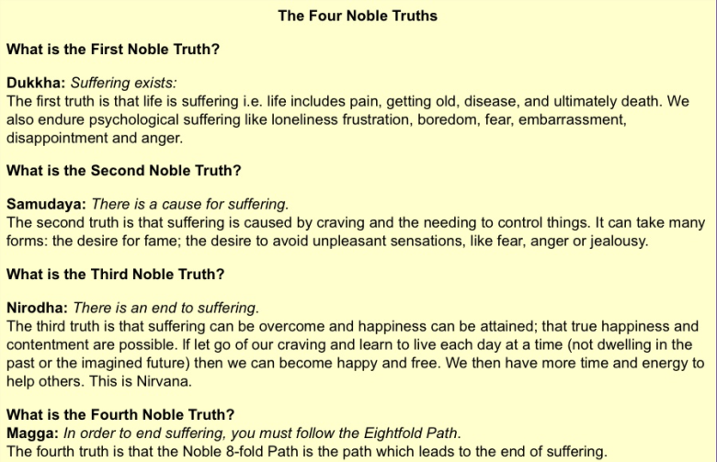

Slide 53
Buddhism
“The Buddha does not say that the world is inherently evil. Rather he says that life is suffering because we try to get something out of the world that it does not have the capacity to grant. We expect the world to provide us with lasting happiness and satisfaction. It can’t provide these because of its evanescent (ever-changing) nature” -Heine

Slide 54
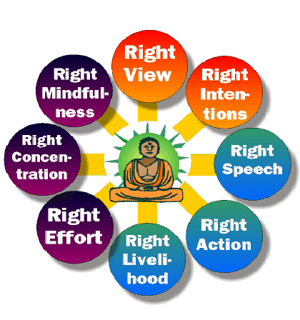

Slide 55
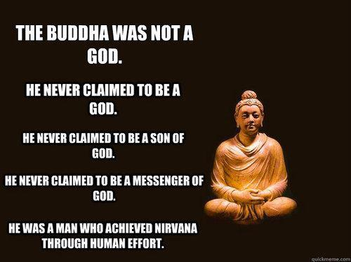
Buddhism and Ashoka Crash Course Video

Slide 56
Buddhism
Came from Hinduism and really not in opposition to most main ideas
believed in samara or reincarnation
believed in karma
However, Buddhism did not support the caste system. He preached people of ALL social ranks could escape from suffering if they fulfilled the demands of the Eightfold Path. He clearly attracted many poor people that were further on the samara cycle than Brahmins.
The original teachings of Buddha where he is not a god is referred to as Theravada Buddhism
Later, as Buddhism spread, a new version called Mahayana Buddhism developed that worshipped Buddha as a god. This became more popular with the poor especially in China.

Slide 57
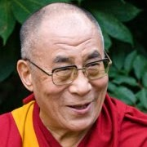
Dalai Lama
The spiritual head of Tibetan Buddhism and, until the establishment of Chinese communist rule, the spiritual and temporal ruler of Tibet.
A religious and political leader
The Dalai Lama is considered the incarnation of Buddha during his lifetime and monks go in search for the next incarnation when the current Dalai Lama gets older. They comb the countryside of Tibet in search of a young boy who can pass a set of tests proving his holiness. The boy is then taken by monks and trained until his is old enough to take over as both the religious and political leader of Tibet.
The current Dalai Lama fled Tibet, after Chinese conquest, to India and has lived in India ever since. It is believed that he will be the last Dalai Lama for China has moved to suppress traditional Tibetan Buddhism aggressively.

Slide 58
Inner Eurasia
Inner Eurasian pastoral groups grew and began to organize politically on a larger scale
Trade across Inner Eurasia (Silk Road) grew and nomadic groups were often the people who connected the routes
Nomads: organized into extended kinship (family) groups. They identified with who they lived with and shared ancestors with as opposed to where they lived. Larger groups were tied together by common lineage patterns = clan. On a larger scale, several clans may share common ancestors and see themselves as related = tribe. Clan and tribal levels were only called up on irregularly for larger war defense and war campaigns.

Slide 59
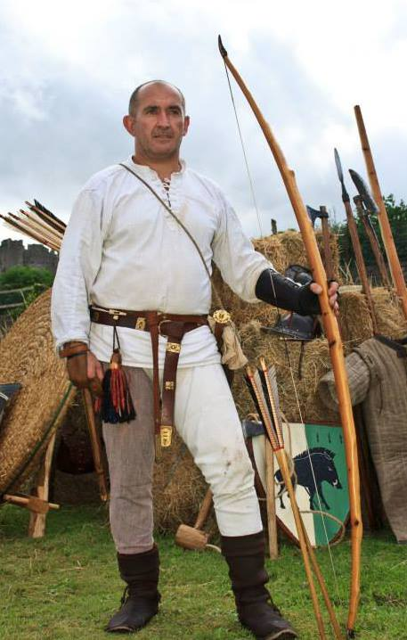
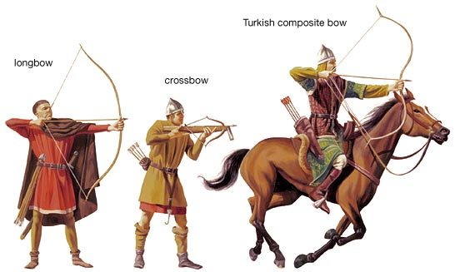
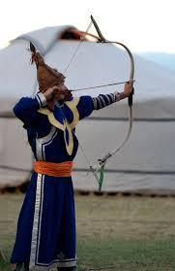
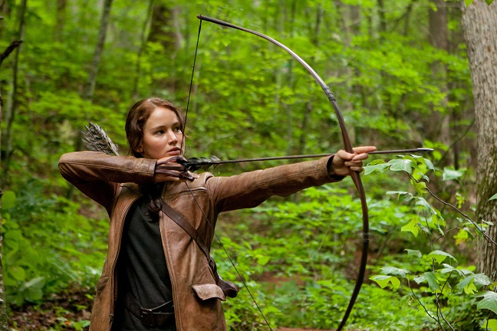
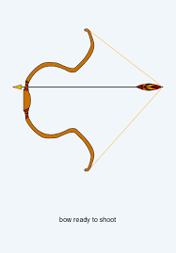
Inner Eurasia
By 8th century BCE they began forming larger political coalitions to fight enemies
Had horses (Calvary) with mounted arches, leather and metal horse harnesses, riding saddles (no stirrup yet), iron and bronze weaponry, and light weight composite bow

Slide 60
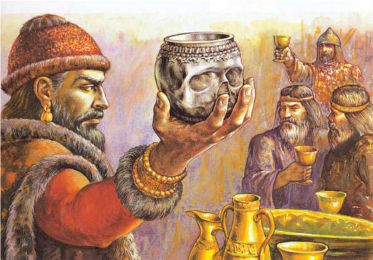
Inner Eurasia
Pastoral peoples periodically attacked settlements –creating persistent political tension and periodic warfare between nomads and settled peoples. This led to the creation of things like the Great Wall.
Many groups became conduits for trade and technology.
Nomads often had fun tradition like the Scythians and drinking out of skull mugs of their murdered enemies!!!

Slide 61
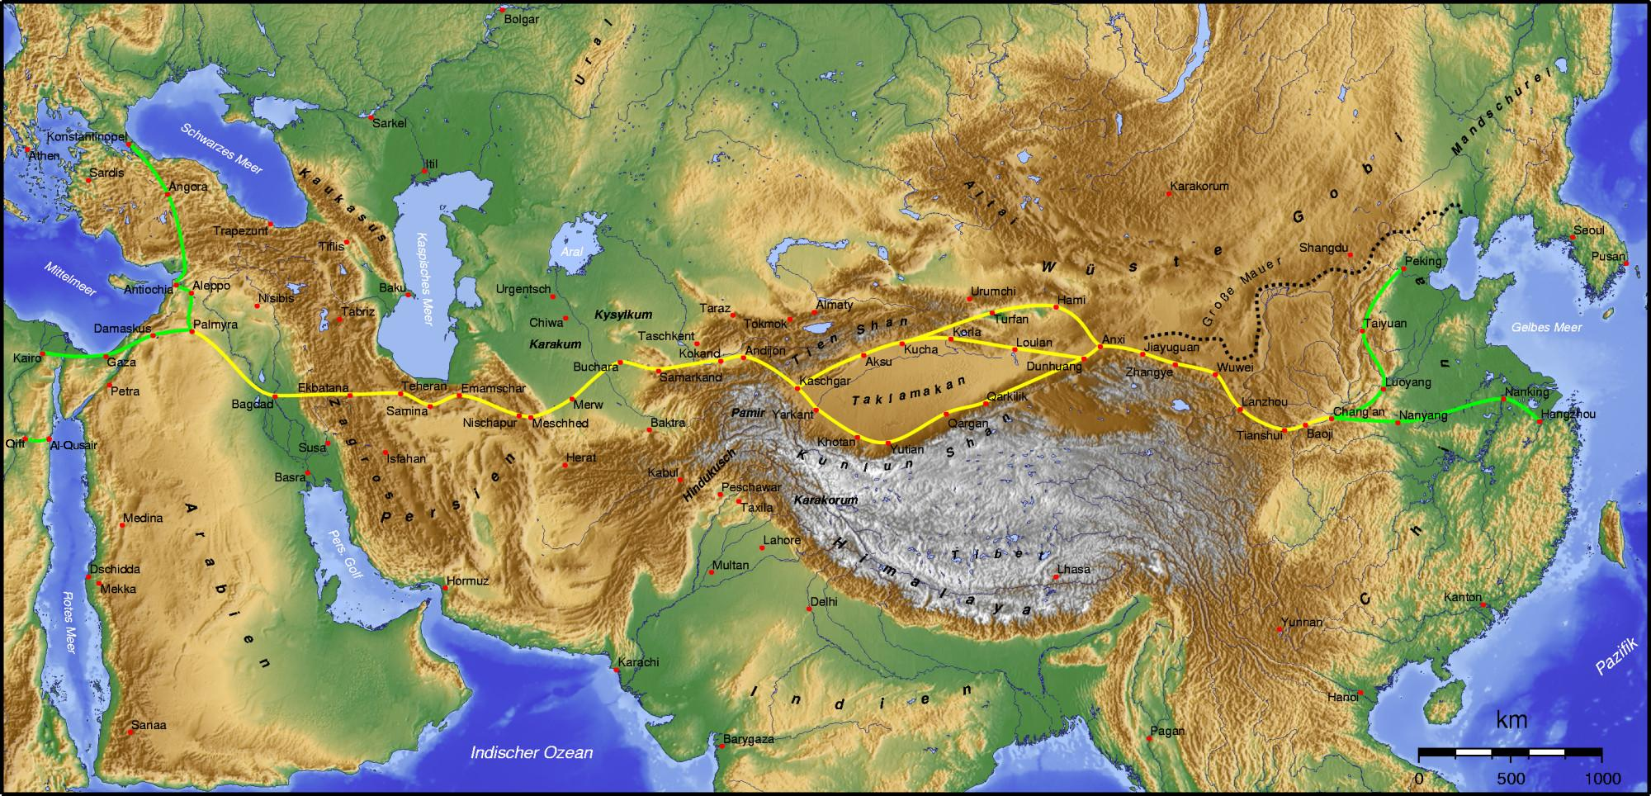
Silk Roads

Slide 62
Focus Questions
In what ways did the Achaemenid empire of Persia contribute to increasing commercial and cultural exchange in Afroeurasia?
What factors contributed to the emergence of Greek city-states as important centers of political and cultural innovation from the sixth century BCE?
To what extent did societies within the region from northern India to the eastern Mediterranean embrace Greek-style cultural and political forms between the fourth and second centuries BCE.
In what circumstances did Buddhist beliefs and practices achieve success among growing numbers in South Asia between the fifth and third centuries BCE?
How did dense agrarian societies from the Mediterranean to China change as a result of developments in Inner Eurasia in the 600-200 BCE period?

Slide 63
Some of the maps from Dunn powerpoint
Many resources/pics from wiki
This is strictly for educational purposes

