Slide 1
Chapter 7 Notes
Roman Republic, Roman Empire, Qin China, Han China, Xiongu, Parthian and Kushana Empires, Kush and Axum, and missionaries

Slide 2

ROME
Rome was built along the Tiber River and was located in a very fertile area (foundation story)
The Roman state began as a monarchy
The last king was Tarquin the Proud who was a harsh tyrant-and was overthrown. After deposing the monarch, Romans started a new government, a republic.
Republic-form of government in which power rests with citizens who have the right to vote to select their leaders. Citizenship was granted only to free-born male citizens
Rome had subjugated Greece and other Hellenistic kingdoms. Romans borrowed many ideas from the Greeks including religion.

Slide 3
2000 BCE Indo-Europeans migrated down to the Italian peninsula and settled
By 700 ish BCE Etruscans had come to dominate the Italian peninsula. Most think they were probably from the Anatolia? They established cities, participated in Mediterranean trade, made metal wares, and were known for their gold and silver jewelry skills. But by 500 BCE they began to decline to invasion (Celtics from Gaul) and competition (Greeks).
Rome-established in 700 BCE ish and it was originally a city-state with a king and monarchy. For a few hundred years, Etruscans ruled as kings of Rome, but the last king, Tarquin the Proud was really harsh and the citizens of Rome united to overthrow him. They then established a Republic in 509 BCE.
-(Aristocratic Republic) only the nobles/ aristocracy ruled via the Senate
Patricians vs. Plebeians
The Republic would rule Rome for some 500 years until Julius Caesar and Augustus!!!!

Slide 4
Roman Republic
Different groups of Romans struggled for power: Patricians (aristocratic landowners) and the plebeians (common farmers, merchants, and etc.)
Heads of the patrician families composed an aristocratic council, the Senate. In addition to the Senate, an assembly of all male citizens selected kings. Kingship was largely a ritual position
400’s BCE the plebeians threatened to secede and start their own city-state so the patricians reformed and allowed increased access to government
Tribune of the Plebs (2 then 10) –elected by plebeians and represented the concerns of this class
In time the Senate allowed for the plebeians to form an assembly called the tribune, which protected them from unfair acts under the patricians-listed above-see list on next slide
Plebeians were able to force the creation of a written law code to help protect their rights (The Twelve Tables)

Slide 5
Roman Government
Each legion was divided in smaller independent units of 80 men, called a century. Strength of the legion lay in its flexibility due to the independent centuries. The Roman army was key to Rome’s rise to power.
Rome fought for control of Italy and had to fight off the Gauls who sacked Rome, the Latins, and Etruscans
Lenient policy toward conquered people-citizen, citizen w/o vote, or ally of Rome
Consul-367 BCE-one started to be plebeian
Quaestors (treasury) 421 BCE (20 people) added plebeians
Censor (2 people) –added 1 pleb in 339 BCE
180 BCE Cursus Honorum –path to office and set age requirements for office
-Must serve at least 10 years in military to be in office
Loosely divided into 3 branches (executive, legislative, and judicial) Judicial branch ran by praetors-judges
Times of crisis the republic would appoint a dictator (6 month limit)
Army: all citizens that owned land had to serve in the army. Those who wanted a political career had to serve longer terms. Army organized into units called legions (5000 men). Calvary supported each legion.

Slide 6
Expansion of Rome –From city-state to EMPIRE
-300-200 BCE expanded from Rome all over the Italian peninsula
*used Etruscan iron industry to fuel conquests
-Created military colonies in conquered lands of Italy
-Generous policies: exempt from taxes, governed their internal affairs, right to trade in Rome, could take Roman spouse, and sometimes given Roman citizenship
Supported military machine:
-citizen soldier of Rome: Legion (5000 men), centuries (80 men) and supported by the cavalry. In conquered lands the people needed to provide soldiers= Auxiliary forces that supported the Roman legions. These lands forbidden from making military or political alliances outside of Rome!

Slide 7
Rome
2nd war Hannibal led Carthage in a secret attack of Rome via Spain-invading from the north-although unsuccessful led troops for 10 years around northern Italy
3rd war-Rome attacked Carthage to make Hannibal and his men flee to protect the city. Carthage was set afire, inhabitants sold into slavery, and city made into a province. The Romans were said to have salted the earth to ensure another city could not rise again!
By 70 B.C. Rome controlled from the Anatolia to Spain
Rome’s location gave it access to the riches of trade within the Mediterranean Sea. Eventually Rome became rivals to Carthage (once a colony of Phoenicia)
Rome and Carthage would wage a bitter series of wars for control of the Mediterranean known as the Punic Wars (264-146 B.C.)
1st war for control of Sicily-Carthage lost

Slide 8
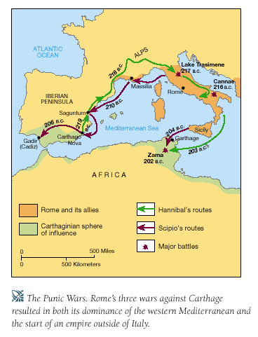

Slide 9
BEYOND ITALY:
Carthage-dominant power of the western Mediterranean
Hellenistic Empires (3-egypt, macedon, Seleucid-parthian) –powers in Eastern Mediterranean
West: PUNIC WARS [Rome vs. Carthage] 264-146 BCE
3 wars 1) over control of Sicily (Carthage) b/c massive amounts of grains came out of it and Rome won the war
2) Hannibal led assault through Spain and over Alps with war elephants into Italy…proceeded created chaos for 10 years in Italy-battle of Cannae (couldn’t take Rome). Scipio then attacked Carthage forcing Hannibal to leave Italy –battle of Zama –Hannibal loses
3) Fears over Carthage potentially growing in power led to Rome destroying Carthage: burned, slaughtered, and sold people into slavery. Salted the earth!!!
*Victory over Carthage allowed the Romans to be masters of the Western Mediterranean
Eastern Mediterranean:
Rome sent armies to fight between 214-148 BCE to protect Roman citizens and merchant interests in the area. R
-5 major wars with Macedon and Seleucid/ Parthian
Rome didn’t annex lands right away…instead they left their allies to rule the lands
Rome now has total control over the Mediterranean!!!

Slide 10
Rome and the end of the Republic
Problems: after the Punic wars soldier return home to find their farm lands taken by rich or that they couldn’t compete with the larger farms. They were forced to sell. Then a much larger portion of the population becomes poor.
2 brothers attempted to reform Rome: Tiberius and Gaius Gracchus. Ideas of limiting estate size and giving land to poor made them very popular with the lower classes. Strongly opposed by senators-and each meant violent deaths ☹
Following their deaths, Rome was plunged into a blood civil war. Soldiers were loyal to generals not the state!
3 men were able to end the civil war and rule together in a triumvirate: Julius Caesar, Crassus, and Pompey
Caesar ruled one year as consul and then went to Gaul to fight. His conquests made him popular and soon a rival against Pompey. Eventually Caesar destroyed Pompey’s army and became dictator for life of Rome
Caesar become an absolute ruler and made sweeping changes including granting citizenship, creating jobs, and increasing soldiers pay. These all made the senate nervous that they were losing their powers. Caesar was assassinated by Marcus Brutus (his BF) and Gaius Cassius in 44 B.C. (he was stabbed to death)

Slide 11
Social tension was created from land distribution questions-just like Han and Greece
As Rome expanded and took over more territories, lands were given to the patricians who created huge plantations (latifundas). These plantations employed slave labor and drove the prince of certain goods down. Small farmers couldn’t compete and were forced to mortgage their lands and later sell them (or taken when defaulted). This created a surge in the landless and unemployed. Often they came to Rome looking for work.
-Gracchi Brothers- 2 brothers who wanted to reform Rome along similar lines of Wang Mang and China = land redistribution. These brothers advocated that only a person should be able to hold so much land. When they owned too much the land, it would be taken away and given to small and poor farmers.
132 Tiberius Gracchus assassinated
121 Gauis Gracchus put up on false charges and then executed!
-Plebeians saw Graccus brothers as their hope and with their death Rome again fell into a state of civil war
-At the same time of rising social tension was also rising political jockeying between politicians and generals. Soldiers became increasingly loyal to their generals as their lands were taken away and they didn’t have a home to return to ☹

Slide 12
87 BCE CIVIL WAR
General Gauis Marius (liberal and in favor of social reforms)
General Lucius Cornelius Sulla (conservative with patricians)
87 BCE Marius stormed into Rome and took over establishing a military dictatorship! He famously got rid of enemies!
83 BCE Sulla marched on Rome to take after the death of Marius. He famously created the list of “enemies of the states”. It is said he was responsible for having more than 10,000 people killed he considered “enemies”. After his death in 78 BCE Rome again erupted into civil war-for his policies never corrected the problem of land distribution in Rome.
Julius Caesar: nephew of General Marius –alive b/c Sulla thought he was too young to be a threat and when he got older he as forced to go abroad and study. After Sulla’s death, Caesar become increasingly involved in Roman politics.
-Popular due to military exploits (esp. conquest of Gaul/ France) and for sponsoring public games at the colosseum.
-1st triumvirate –Caesar, Pompey, Crassus –Caesar won this battle named himself dictator of Rome for life.
-increased Roman citizenship, put unemployed to work in public projects, and increased soldier pay =made him very popular
-Senate thought Caesar was becoming too power because he had so much popular support and a plot to assassinate Caesar was developed. In 44 BCE Caesar was killed and a good friend even helped in the attack “you too Brutus”

Slide 13
-After assassination of Caesar Rome was again thrown into a state of civil war
2 Triumvirate: Octavian, Mark Antony and Cleopatra
-Each ruled their own territory, but soon Mark Antony and Octavian emerged in a power struggle. Mark Antony was married to Octavian’s sister, Octavia (super creative) and he fell in love and married Cleopatra, Queen of Egypt while still being married to Octavia…straining Mark Antony and Octavian’s relationship. Plus, Mark Antony launched an attacked on the Parthian Empire, but lost many people. He then had to run to the aid of Cleopatra and Egypt which made Rome indebted to Egypt. This poor diplomatic move gave Octavian justification for launching a war against Mark Antony and Cleopatra.
-Battle of Actium 31 BCE -Octavian won and then became the emperor of Rome
-After the battle, Octavian wanted total power of Rome, but knew if he took autocratic power he would end up like his uncle and be assassinated ☹ So, he pretended that he didn’t want power and upheld the power of the senate. Soon his modestly won so much popular support that Rome begged him to become the emperor of Rome.
Octavian became the 1st emperor of Rome and changed his name to Augustus!

Slide 14
Augustus –Octavian
After assassination of Julius Caesar the second triumvirate came to power following a civil war: Octavian, Mark Antony, and Lepidus. Octavian vs. Mark Antony
The contest resulted in the total victory of Octavian and the death of Antony and his supporter, Cleopatra, Queen of Egypt
200 years of peace starts with his rule-known as Pax Romana. As Caesar, Octavian is known as Augustus. Augustus restored Rome, supported a massive trade network (roads and coinage), maintained control by auxiliary forces, and set up a civil service
Roman emperor’s game: http://www.pbs.org/empires/romans/special/emperor_game.html
***Augustus’s government was a monarchy disguised as a republic. He ruled by centralized political and military power. He preserved traditional republican offices and forms of government…but fundamentally altered the nature of it. He took all responsibility for important government functions. He reorganized the military (standing army) with commanders owning allegiance directly to him. He placed people very loyal to him in important political offices.

Slide 15
Octavian became the 1st emperor of Rome and his was then known as Augustus “exalted one”.
Began Pax Romana-Roman Peace (27 BCE -180). Roman Empire enjoyed the longest period of unity, peace, and prosperity of its history!
Great patron of the arts (buildings)
Reformed military: regulating pay, pensions, and length of service
Promoted trade by improving roads and spreading peace: Mural from Pompeii show Roman nobles dressed in silk from China –Silk Roads
Ended the Republic -common coinage (denarius)
August named after Augustus!!!
Established a civil service (paid workers to manage gov) –grain supply, tax collection, and even a postal system. The senate still functioned, but civil servants could be drawn from plebeians or even formers slaves!
Literary Arts during Silver Age (age of Augustus is the silver age of roman culture)
Ovid (43 BCE -17 CE) –The Art of Love (studied law and rhetoric)
Horace (65 BCE-8 CE) –carpe diem “seize the day” is taken from his work Odes. He was a great Roman poet!
Virgil (70-19 BCE) –commissioned by Augustus to write a poem glorifying Rome during his reign = result = Aeneid. Epic story of the Trojan hero Aeneas and the founding of Rome. Even unfinished, Emperor Augustus printed. Later, Dante utilized Virgil in the Inferno and Purgatorio as his guide, but denied access to paradise because he wasn’t a Christian ☺
Livy (64 BCE -17 CE)-wrote 142 books of history of Rome! 35 survive –patriotic feeling
After Augustus’ death in 14 there was no procedure to replace him so the Romans choose heredity solution and picked Tiberius, the son of Augustus’s wife, to rule. [Jesus was alive during the reign of Tiberius and Tiberius was known for his moral corruptness]
-Emperor Caligula (37-41) also very corrupt and had himself proclaimed a god. Assassinated after his short, but brutal reign!
-Emperor Claudius (uncle of Caligula)-had physical disability and a bad stutter so people made fun of him a lot! He surprisingly had success in conquering Britain though! Killed by his wife, Agrippina) to make way for her son, Nero, to become the emperor!
-Emperor Nero (54-68) –great patron of the arts, kicked his pregnant wife to death, had his own mother murdered, blamed the great fire of Rome on Christians and publicly persecuted them!
Good Emperors from Augustus’ line: Hadrian (117-138) built Hadrian’s Wall in England which still stands today. Known for consolidating earlier conquests of Rome and reorganized the bureaucracy. Marcus Aurelius (161-180) brought the empire to height of economic prosperity and defeated invaders.

Slide 16
Trade: Pax Romana ushered in time of peace and prosperity in Rome. Rome like Persia, China, India, and Hellenistic kingdoms built giant roads along the empire. Main roads were 6-8 meters wide thus allowing for 2 way traffic. Builders were placed to mark important milestones along the way. An imperial postal system maintained stations for couriers-allowing for quick transfer of information.
Sea lane-Mediterranean and the Black Sea –Mediterranean famously was called a Roman lake “mare nostrum “our sea”. Roman military and naval powers kept sea lanes mostly free from pirates.
-under the empire latifundias concentrated on growing exports instead of crops to be immediately consumed in the local area. Latifundias in Sicily, n. Africa, and Egypt produced mass amounts of grain. This allowed other areas to specialize in other industries: Greece (olives and grapes), Syria and Palestine (fruits, nuts, and wool), Gaul (grain and copper), Spain (olive oil, wine, horses, and precious metals), Italy (pottery, glassware, and bronze goods).
Religion: Polytheistic-Mythology- renamed the Greek gods
Zeus (king of the gods)-Jupiter Apollo (sun god)-same
Poseidon (water god) -Neptune Athena (wisdom/ war strategy)-Minerva
-In Rome, government and religion were lined. Deities were symbols of the state and Romans were expected to honor them at home and in public. Also, during the empire, worship of the emperor also became part of the official religion of Rome.
-To distract and control the masses of Romans, the government provided free games, races, mock battles, and gladiator contests. By 250 there were 150 holidays a year! Arenas like the Colosseum were filled on these holidays. Would watch exotic animals fight to the death or gladiators engaged in combat with animals or people. Much of the city of Rome was unemployed during the empire and the government supported the population with rations of grain. Bread was also given away at many of these contests

Slide 17
Rome conquers Judea-63 BCE –allowed Jews to keep their monotheistic religion because it was so old and the Romans were fairly tolerant of conquered lands.
-66 Jewish rebellion-Romans crushed rebels, captured Jerusalem, and destroyed the great temple. Later revolts also resulted in Roman armies leveling Jerusalem, killing thousands, and even enslaving Jews.
-Some Jews were upset with Hellenistic culture influencing Jews and many believed that a messiah (anointed king sent by God) that would free Jews from Rome.
Jesus (4 BCE)-age 30 began to preach and recruited 12 disciples (apostles) to help him on his mission. Beliefs-rooted in Jewish tradition (one god, 10 commandments, and defended Jewish prophets), however, he preached that he was the son of God and that his mission was to bring spiritual salvation and eternal life to anyone who believed in him. He emphasized God’s love and taught morality like Judaism. Many Jews believed Jesus to be the long awaited messiah who would free them of Roman subjugation.
-Jesus traveled to Jerusalem around Passover (big time of celebration marking the exodus of Jews from Egypt). Romans considered him a threat because he could inflame-especially during this time-resistance to Roman rule.
-eventually Jesus was condemned to death and executed via crucifixion- very normal for the time period—hec, that’s how the Romans dealt with Spartacus and the slave revolt…crucified over 6,000 slaves along the main road of the province in which the revolt occurred.
-Gospels say that Jesus rose from the grave to command the disciples to spread his teachings and then ascended to heaven. Some Jews accepted the teachings that Jesus was the messiah, or Christ from the Greek word for anointed one = Christos. Hence followers were called Christians!
-Paul was known for spreading Christianity all over the Mediterranean
-Peter was known for establishing Christianity in Rome itself (later bishops of Rome claimed that Peter was the 1st pope (the father or head of the Christian Church) and that they were the heirs of Peter. Whoever was the bishop of Rome was also the overall leader of the Christian Church.
-For hundreds of years Christians were persecuted in Rome. Seen as kinda a wayward cult of Judaism which the Roman government resisted because Christian followers didn’t worship state gods or the emperor! Nero blamed the great fire of Rome on them and had many killed. Diocletian also blamed many problems of the empire on the Christians.
*** Constantine –was the emperor who legalized Christianity and converted. At the battle of Milvian Bridge (312) he had a vision that if he fought in the symbol of the Christian God that he would win. Constantine did win and as a result, he converted and quickly passed the Edict of Milan 313 which granted Christians tolerance!
****Emperor Theodosius- made Christianity the official religion of the Roman Empire and repressed the practices of other faiths in 380

Slide 18
ART: borrowed much from Greeks! Art stressed realism like in Greece and focused on revealing individual character of subject (Augustus artwork was idealistic though?), mosaics were popular-Pompeii –(after Mt. Vesuvius erupted left city intact and much evidence of how Roman’s lived). Romans emphasized grandeur in architecture compared to Greeks who stress elegance. They improved on columns/ arches and utilized concrete as a building material. (Pantheon-famous roman building still around today)
Intellectualism: Excellent at engineering!!!! Romans built many roads, bridge, aqueducts, and harbors across their empire. Had many public baths and the very wealthy had water piped into their homes!
Left science to the Greeks
**Ptolemy –Greek-proposed that the Earth was the center of the universe which was accepted by the Western world (next 1,500 years) and became a big thing the Western Church-Galileo anyone?
**Galen-Greek doctor who complied a medical encyclopedia summarizing everything known in the field at the time. This was the standard text for the next 1,000 years!

Slide 19
Reforming Emperors:
Diocletian 284- to better hand the challenges of ruling he divided the empire into two parts and ruled the wealthier parts himself and appointed a co-emperor (Maximian) to rule the western part.
Governed as absolute ruler
Severely limited personal freedoms
Doubled the size of the Roman army-drafted POW’s and mercenaries
Ordered farmers to remained on their lands and other workers to stay in their jobs for life
Claimed to descent from the ancient Roman gods and viewed Christianity as a threat and passed decrees to persecute Christians
Divided empire-Greek speaking East and Latin speaking West
Retired in 305 because of poor health
-By 311 four rivals for powers which Constantine won!!!
Constantine-312-
324 secured control of the Eastern part of the empire
Restored concept of a single ruler!!!
330 he created a second capital in the East in the Greek city of Byzantium which he renamed: Constantinople!!!
Edict of Milan 313 granted religious tolerance to Christians and his conversion led to most of Rome converting which led to later Franks converting and later most of Europe!

Slide 20
4: Decline of Rome
Third century A.D. hostile tribes and pirates disrupted Roman lucrative trade, frequent wars were expensive, wealthy sent gold and silver out of empire to buy luxury items, and agriculture waned due to overworked soil, use of slaves (competition and no new technology).
Used taxation as a way of gaining more revenue
Created new coins with less silver, which led to inflation (drop in value of money coupled with rise in prices)
A.D. 284 Diocletian becomes emperor and begins reforming Rome. He rules as an absolute monarch to complete his policies
Doubles size of Roman army, set fixed prices on goods, ordered farmers and workers to stay in their jobs for life, claimed himself to come from Roman gods, passed decrees to persecute Christians, and divided the empire in 2 halves (West-Rome and East-Byzantium)

Slide 21
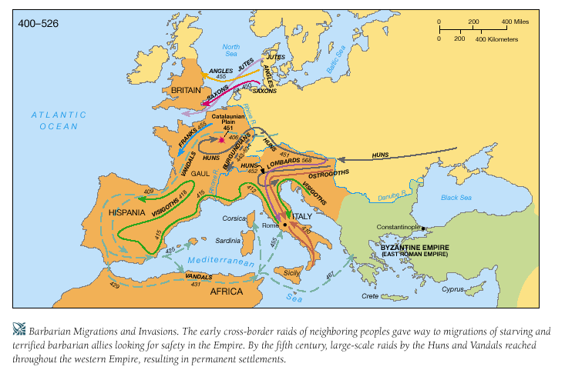

Slide 22
Decline
Diocletian was a strong leader who divided the emperor with General Maximian. Each choose an assistant or successor
After Diocletian retire due to failing health the empire plunged itself into civil war
Constantine emerged as emperor as a result of this event (he ended the persecution of Christians). He continued many of Diocletian’s policies except keeping the empire divided
Constantine took control of the East in 324
He moved the capital from Rome to Byzantium and renamed the city Constantinople
A.D. 312: Roman Emperor Constantine was fighting 3 rivals at the Tiber River and prayer for divine help. He saw the Christian symbol and had it painted on his men. They were victorious. 313 passed the Edict of Milan that granted all to follow the religion they choose
380 emperor Theodosius made Christianity the official religion of Rome

Slide 23
Decline
Germanic invasions continued to be a major problem in the West. 408 Visigoths under king Alaric sacked Rome
Next came the Huns under Attila who pushed the Germans into the Roman Empire and eventually attempted to conquer –(disease spread)
455 the Vandals sacked Rome and its population dropped for 1 million to 20,000 due to famine
Western Rome fell, but the East continued to prospered. Rome fell in stages
Reasons why Western Roman Empire fell: political, social, economic, and military (see chart on next slide)
Eastern half became Byzantine Empire and lasted until it was conquered by the Ottoman Empire in 1453

Slide 24
Decline of Rome
Political | Social | Economic | Military
Political office seen as burden, not a reward | Decline in interest in public affairs | Poor harvest | Threat from northern European tribes
Military interference in politics | Low confidence in empire | Disruption of trade | Low funds for defense
Civil war and unrest | Disloyalty, lack of patriotism, corruption | No more war plunder | Problems recruiting Roman citizens; recruiting of non-Romans
Division of the empire | Contrast between rich and poor | Gold and silver drain | Decline of patriotism and loyalty among soldiers
Moving of capital to Byzantium |  | Inflation
 |  | Crushing tax burden
 |  | Widening gap between rich and poor and increasingly impoverished Western empire
 | Immediate | Causes
Pressure from the Huns | Invasion by Germanic tribes and by the Huns | Sack of Rome | Conquest by invaders

Slide 25
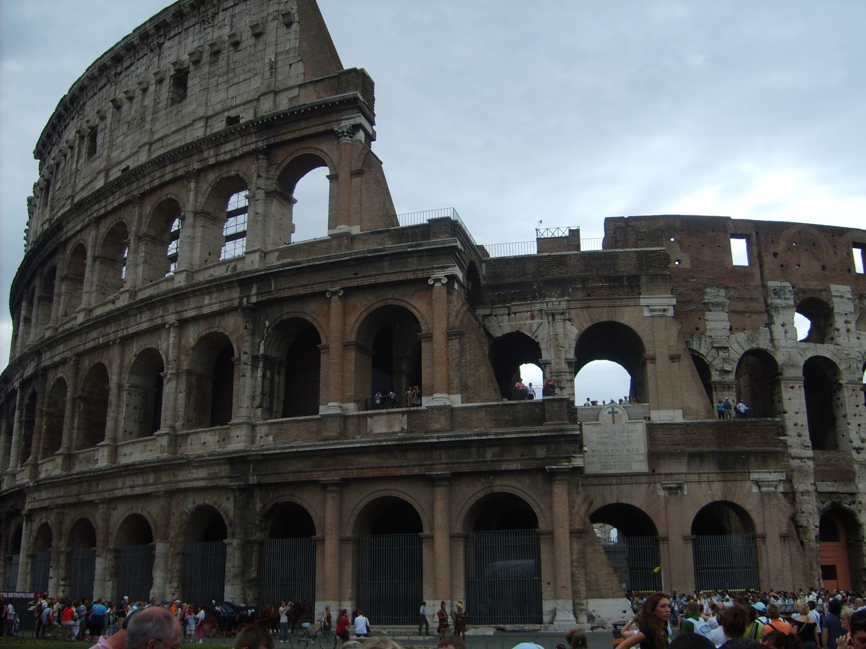
ITALY
2008

Slide 26
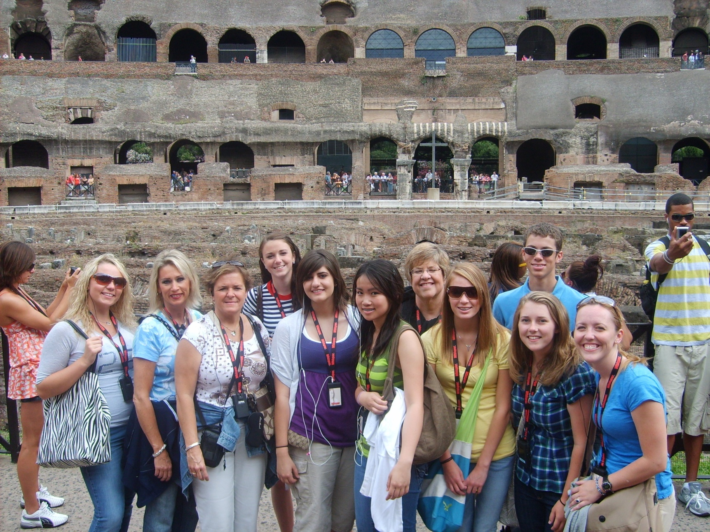
ITALY
2008

Slide 27
Politics in Greece and Rome
Greece-polis –term from which politics comes!
Believed in active participation in politics and discussed the affairs of the state. They also participated in the military too which increased this interest in politics.
China vs. Greco-Rome: Both had strong political ideal and interests. However, China didn’t have the concept of citizen, but Greco-Rome didn’t have divine emperor or elaborate bureaucracy. Greco-Rome had mc political diversity more like India than China.
Greece-democracy: demos “the people” –Athens had a direct democracy where an assembly met every 10 days to make decisions. Women had no rights and only 50% of men were citizens!
Aristocratic assembly = most widely preferred political unit of classical Mediterranean. Sparta governed by a militaristic aristocracy! Aristocracy “rule of the best”
Rome-balance Greek political theory and aristocracy! Power lay in the Senate (patricians) and the two consuls (kings). Many local assemblies too for lower class Roman citizens. Roman Empire successful at ruling because: the kept much local autonomy in areas conquered, had a large organized government, had carefully crafted laws that could evolve over time and that became the regulator of social life, a strong military, commerce, religion that expressed loyalty to the state, and public forms of entertainment to distract their subjects! (attacked Christians b/c they refused to place the state first before their religion, but to other religions who did accept they were tolerant)
*Diversity of political forms
*Importance in participating in politics

Slide 28
Religion
Believed in different gods and goddess who regulated human life
Zeus (Greek) or Jupiter (Roman) presided over god and goddess. Romans had same gods, but different names!
Specific gods were patrons of human activities: hunt, war, or metalworking
Many fun stories of the gods that people found very entertaining. (Greco-Roman and Indian religious lore reflected common heritage of Indo-European invaders. India was more interested in spirituality than the Greeks/ Romans).
Problem: lack of spiritual passion to many especially in times of chaos/ trouble.
Promoted political loyalty it didn’t provide ethics thus arose philosophers
Stoicism, Zeno, believed that the entire universe was ordered according to natural laws. Each person is consigned a role in the natural system and must seek to discover and fulfill that vocation. Stressed an inner moral independence that was cultivated by strict discipline of the body and personal bravery.
Mithraism-a cult dedicated to the Persian deity Mithras-identified with sun and light (goodness). Only men-strength, courage, discipline, morals
Cult of Isis-admitted women-benevolent and protective deity who nurtured worshipers and helped them cope with stresses of life. Both Mithraism and Cult of Isis were religions of salvation-very popular prior to Christainity

Slide 29
Greek Creation Story
At first there was chaos and then came Gaia (earth) and Uranus (sky). Gaia and Uranus (Ouranos) had the titans, children, and 3 Cyclopes. Uranus didn’t like his children so he pushed them back inside Gaia’s womb! This pained Gaia and she planned for revenge. Gaia’s youngest, Cronus, helped her. One night while they laid together she had Cronus cut off the genitals of Uranus with a sickle. Cronus cast his father’s genitals into the sea out of which Aphrodite was created.
Afterwards, Cronus married his sister Rhea. They had six children including Poseidon and Zeus. Cronus swallowed his children because of a prophecy stating that one of his children would overthrow him. Rhea tricked Cronus with their sixth child, Zeus, and instead of giving him the child to eat she gave him a stone. Then she smuggled the baby to Crete. He later returned to the world of the gods and he became Cronus’ cupbearer. He poisoned his wine which made his father throw up the rest of his siblings. They united and fought against their father and the Titans and won! Zeus became the king of the gods.

Slide 30
Greco-Roman
Few scientific innovations
In order to better understand nature there was a focus on math, astronomy,
-Pythagoras (math) -Euclid (geometry)
- Galen (medicine) -Ptolemy (astronomy)
Rome didn’t really add much, but preserved and taught. However, they were much better at engineering and architecture (aqueducts and Colosseum-still around today!).
Art and literature (Odyssey and Iliad) important-plays –both comedies and tragedies (Sappho –a female author) (Oedipus was the main character in a play by Sophocles, but he did such a good job explaining psychological flaws that psychologists used it long afterwards to explain an unhealthy relationship between a son and his mother-Oedipus complex.)
Greeks great at realistic sculpture and ceramic work while Romans great at painting
Greek architecture: columns : Doric, Ionic, and Corinthian styles –Greeks invented “classical architecture”
Cicero-Roman-adopted Stoicism: helped to established Stoicism as the most prominent school of moral philosophy in Rome. He emphasized a person’s duty to live in accordance with nature and reason. He argued the individual’s highest public duty was the pursuit of justice and scorned those who sought wealth or became powerful via corruption.

Slide 31
Greek tradition
Euclid created a system of geometry that continues to exist
Archimedes was renowned for his application of (pi) mathematical theory to ancient engineering
Astronomy- Aristarchus discovered the sun was indeed larger than Greece and proposed that the earth and planets revolved around the sun
Ptolemy didn’t accept this view and placed the earth at the center of the solar system-accepted for the next 14 centuries

Slide 32
Economy and Society
Most people were farmers and were tied to local rituals not urban ones, which were political and formal culture. New social classes of merchants, landowners, and construction contractors who became super wealthy. Patricians relied on slaves.
There were free farmers, but later in Rome many larger farmers squeezed them out and they became tenant farmers or laborers.
Land not ideal for grain growing, yet, it had to be done! Land best for olive and grape growing which required much capital/land and maintenance-took 5 years to bear fruit! Developed colonies in Middle East/ Sicily to gain access to grain production. Many private merchants involved, but trade regulated by governments.
Trade-luxury products-goods from India and China! Mediterranean produced less sophisticated products than Asia so they exchanged animals skins, exotic animals, and metals for goods.
Merchants did well in Mediterranean, but not as high socially as in India.
Slavery: household servants, tutors, workers in mines/ farms. Slaves used by both societies. Slaves were POWs and the need for slaves drove the military to conquer new lands unlike in India and China. Not interested in technological innovations in agriculture/ food production b/c of large slave force so they didn’t improve their industries. China and India didn’t have this force and you see study innovations –especially in China!
Families: patriarchal, women role important to families-helped farm, were artisans, and would run estate while husband was away fighting. Legally inferior, large families sometimes killed female infants because of low status and potential drain on the family. Early Roman law stated that husband would punish the wife is she did something wrong-could kill her for cheating! Later, family courts handled such problems-if woman found guilty lost 1/3 of her property and had to wear a special garment like a prostitute! ☹ Less severe than China! Paterfamilias=father of the family –eldest male ruled household

Slide 33
Global Connections
Like the Chinese, the Greeks saw non-Greeks as barbarians
Trading and expansionist people too
Alexander the Great created Hellenistic culture and tried to expand his system into Asia. Mediterranean looked eastward!
Wars with competitors-Carthage
Rome’s territory surpassed any empire ever established in the Mediterranean
Tolerant of local diversities and customs

Slide 34
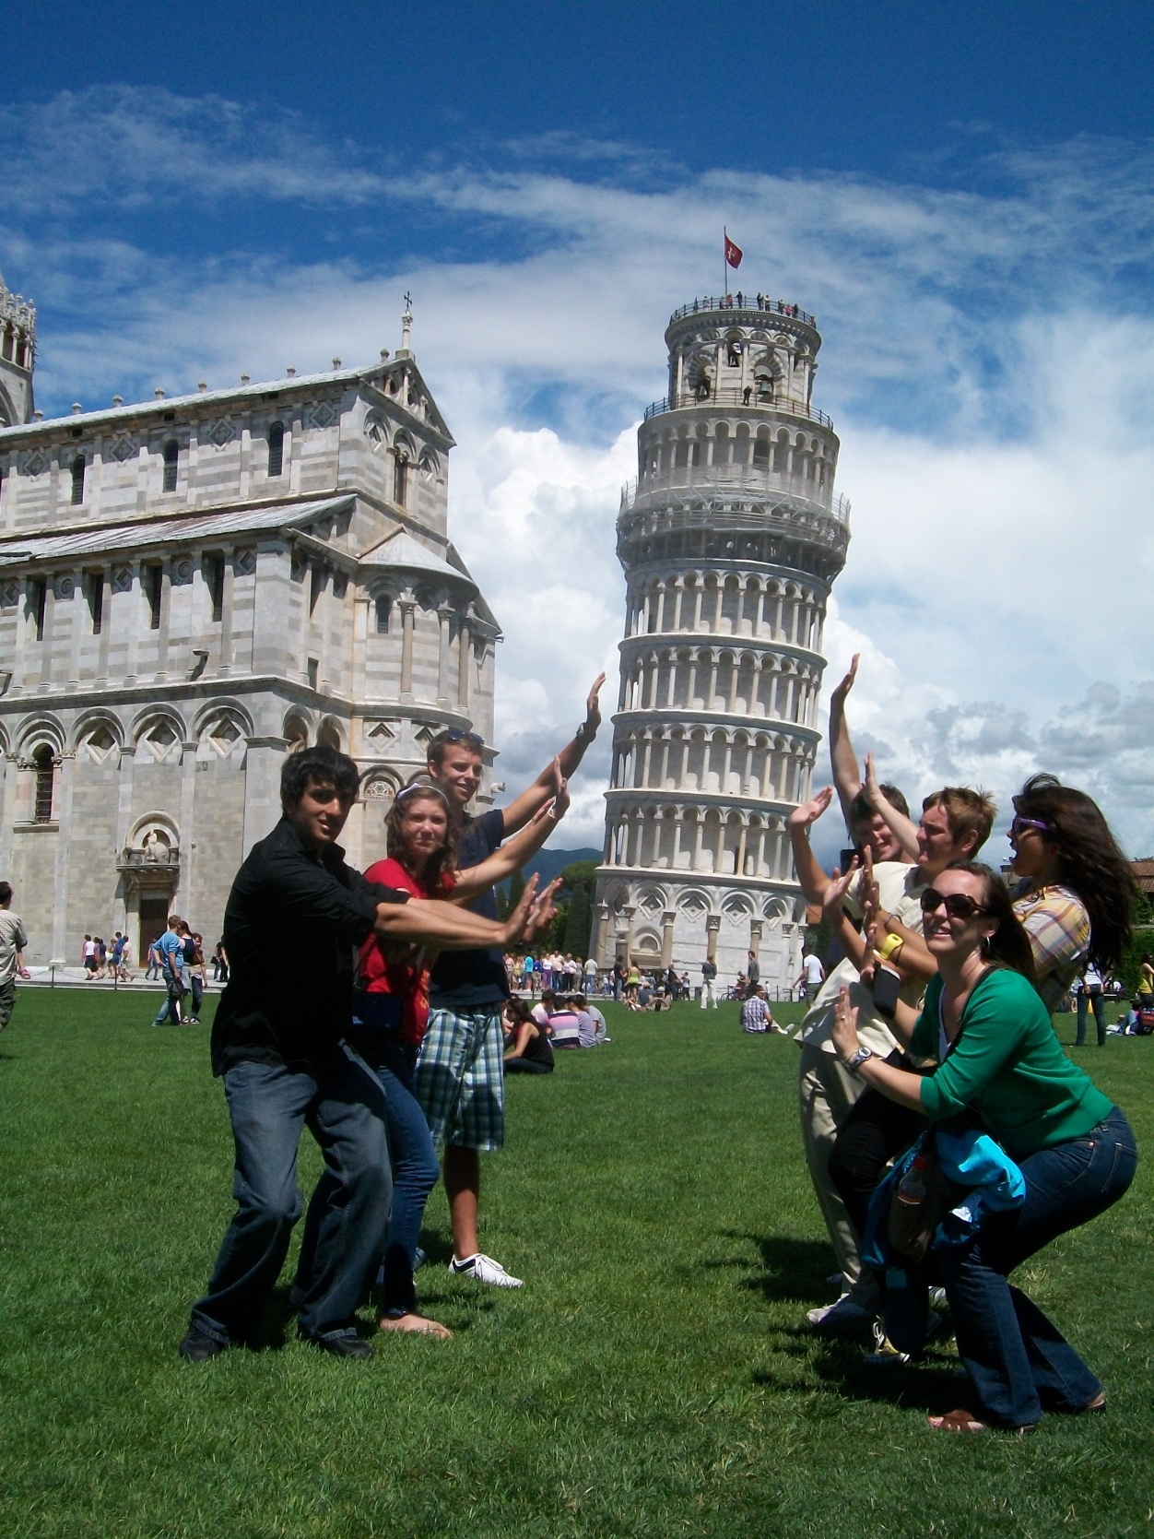

Slide 35
Qin Dynasty
221-206 BCE Shi Huangdi
He won power out of the times of the warring states. He had a major obstacle to overcome: to unite China after years of fighting! He decided to unite China through adopting Legalism.
Legalism-created by Hanfeizi. This system believes that man is evil and it is necessary for very harsh punishments to discourage man from breaking rules. Emperor Shi Huangdi became very harsh as a means of achieving unification…which did happen. However, the people of China didn’t really like this guy. He is also the man known for his terra cotta soldier tomb!
He murder and tortured thousands of people in order for them to follow his rule. He forced the regional nobles to move to his new capital to watch them-took away their land, his burned books, took a national census for tax collection purposes, created a single law code of the empire, minted coins, standardized weights and measurements, standardized axle size on carts, standardized the writing system, increased public projects-especially irrigation projects, increased the output of the silk industry, AND he built the Great Wall of China (Longest Graveyard) on conscripted peasant labor.
He did achieve unity, but at a great cost to the freedom of his people
When Shi Huangdi died in 210 BCE a revolt broke out against his harsh rule and again a war broke out among the Chinese for power!

Slide 36
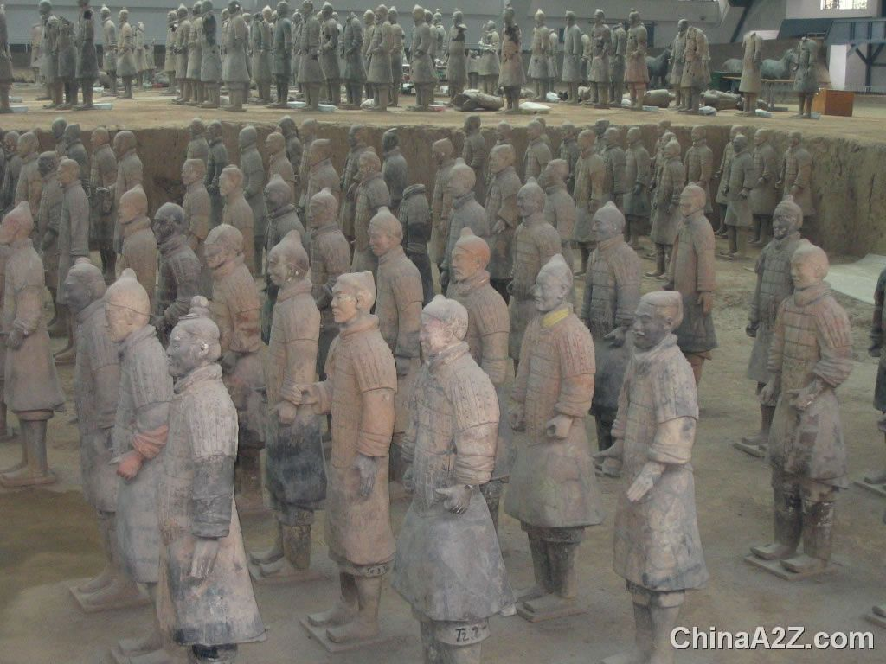
Qin Shi Huangdi’s Tomb

Slide 37
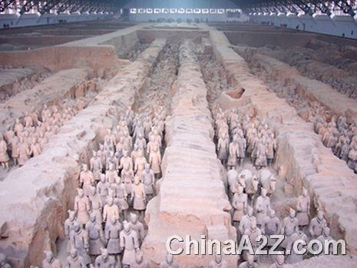
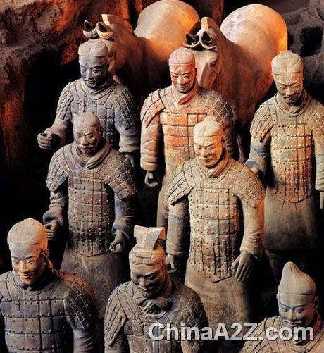

Slide 38
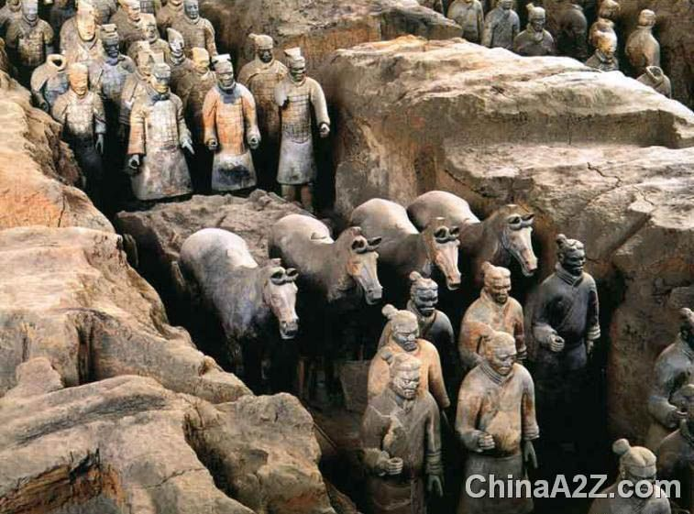

Slide 39
Han dynasty
202 BCE-220 CE
Retained the centralized administration set up in the Qin dynasty yet it limited legalist policies.
Expanded the territory of China
Improved, built, or repaired public works projects allowing for better trade-created network that would become the Silk Road
Established Confucian scholars as bureaucrats in government
Created schools to train Confucian scholars and established the civil service exam. Position in government should be based on merit NOT heritage. Peasants too could participate, but difficult b/c you had to pay for tutors.

Slide 40
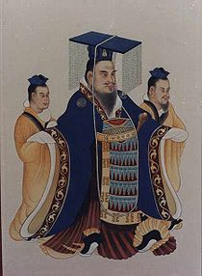
Wu Ti
Wu Ti (140-87 BCE) –
famous Han emperor. He lowered
taxes by establishing state
monopolies on industries like salt. The government used the proceeds from the industies and didn’t have to rely so heavily on peasant taxes. He established granaries to regulate food prices. These also came in very handy during famines and natural disasters. Additionally, increased the size of China under the Han dynasty!

Slide 41
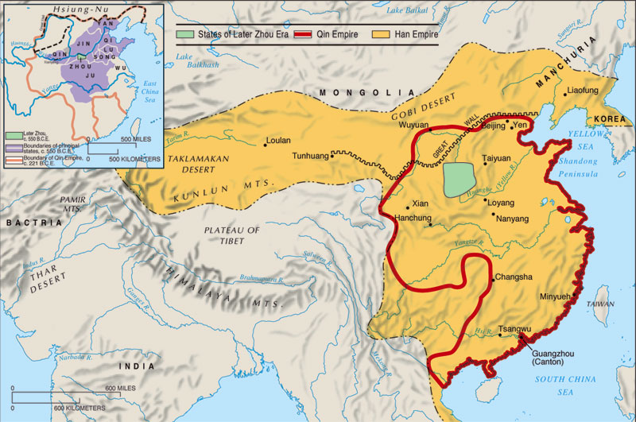

Slide 42
Chinese Religion
Set of complex ideas spanning from ancient beliefs and practices to philosophies. Chinese would pull ideas from religion, philosophy, ethics, and even government to form their belief system. However, there were religions that had hostility between them like Confucianism and Daoism…yet…some people also practiced both concepts at the same time too!
Chinese river valley civilizations believed in many gods, goddess, and nature spirits. They also believed in a supreme god-during Shang dynasty the supreme god was Shang Di and the king was the link between the people and the god.

Slide 43
Ancestor Worship
People were so far beneath gods that they couldn’t communicate with them. Instead they prayed to the spirits of the most important people who had passed…like kings. They could hear them and communicate with the gods on their behalf. Over time lower classes began this practice and it spread to praying directly to ancestors-westerners referred to this as ancestor worship (even though they are not directly worshipping their relatives). Similar to Catholics and praying to saints who will take your concerns to god.

Slide 44
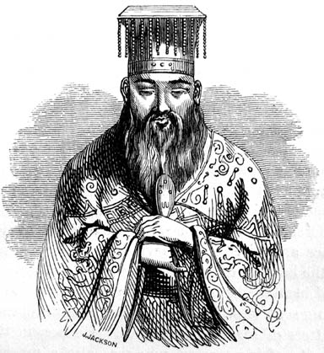
Confucius
During the Han dynasty, emperors made this
the official religion and Confucius became
worshipped as a god.
Confucianism is grounded in the ethical ideas of Confucius: obedience and respect!
#1 Duty = Filial Pity or Respect for Parents
Inferiors must obey and respect superiors/ elders. While superiors need to treat inferiors fairly.
Leaders must be virtuous because the masses will imitate them. The people will rise to follow a good man.
Confucius stressed honesty, hard work, and concern for others. Taught the concept of the Golden Rule.
Control emotions and balance the powers of yin and yang. Also supported reverence for ancestors or elders. However, Confucianism couldn’t answer questions about the mysteries of nature so some Chinese turned to another religion that developed during the classical time…Daoism.

Slide 45

Daoism
Laozi “old master”-time of the Zhou and warring states
Daoism is not concerned with the order of society, but rather they want to live in harmony with nature.
Look beyond everyday cares to focus of the Dao or “the way”. Accept the simple way of nature and the virtue of yielding!
-Water: it doesn’t resist, but yields to outside pressures yet it is an unstoppable force!
Go with the flow! Symbol = yin and yang
Daoist saw society and government as unnatural. For the most part supported Chinese government and the sons of heaven. Occasionally had some problems. Many Daoists lived as hermits, artists, or poets) Best government was one that governed the least!

Slide 46
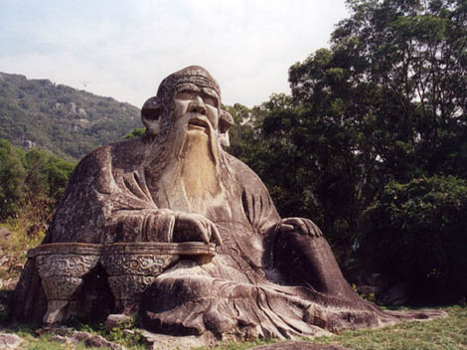
Laozi (Qingyuan Mountain in China)

Slide 47
Classical Chinese Society
Center of society was the family! The family laid the foundation for the society and taught filial piety! This then led to respect for elders, government, and the emperor. Respect also meant obedience so the government became seen as an extension of the family with the emperor as the father of the people.
Primogeniture-the eldest son inherited all the property and title of the father. Younger son of nobility went into scholarly ranks.
Nobles: 2%
Emperor
Rank
Emperor and family
Landed or scholar gentry
Peasants
Means-performers
Merchants –scorned! ☹
Peasants and Means: 98%

Slide 48
Trade
Trade increased during the classical civilizations. China traded as far as the Roman Empire!
Upper class desired luxury items like silk and jewelry. While the peasants traded farm products like wheat for rice.
Trade increased due to the use of copper coins, improved technologies in industries, and increased public projects! ☺ Silk Road
Technology: compass, porcelain (China), the ox pulled plow, new collars for animals that didn’t choke, iron mining, iron tools, textile and pottery improved, PAPER, and water powered mills.
100 CE Buddhism spread from India to China and became popular!
China was far advanced compared to many civilizations of the ancient world. They were also surrounded by what they concerned “barbarians” or the uncultured. The didn’t look to learn from others because they were superior to many already. This supported that China needed to remain somewhat isolated. Later emperors felt it was their duty to protect Chinese culture from outside ideas.

Slide 49
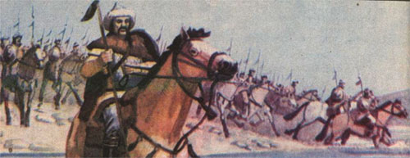
Xiongnu
Nomadic peoples north of China that often fought and raided villages. Resulted in the Chinese building the Great Wall. During the early Han years the Chinese were forced to pay tribute to the Xiongnu. Eventually, WuTi was able to break their hold over China, but at a large cost!!!

Slide 50
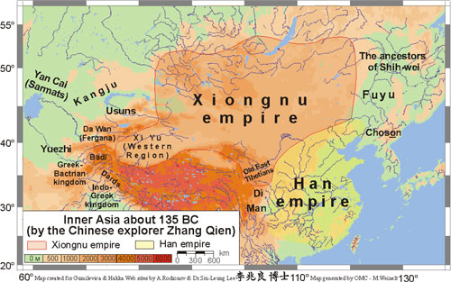
Xiongnu

Slide 51
Parthian Empire
One of the Hellenistic Empires of the Middle East that rose to power after the death of Alexander the Great and fall of Macedonian Empire (after Seleucids).
Midthridates I (171-138 r)captured Babylon and lead to the fall of the Seleucid empire thus starting the Parthian Empire.
Followed the Seleucid and Persian Achaemenid traditions. Claimed to be “King of Kings”. They dominated Iran and Mesopotamia for more than 400 years!!!! They were not very centralized though. They ruled via a federation of tribal groups and small kingdoms. Depended on local aristocrats to collect taxes/ tribute to send to capital.
Fought against Rome as they expanded further into the Middle East. (Seleucids had lost some of that land to Rome too). They would fight some 250 years, but they were unable to drive the Romans out of the Middle East.

Slide 52
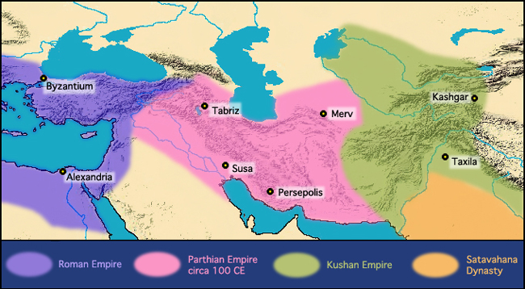
Parthian Empire

Slide 53
Africa
Following the battle of Actium (31 BCE) Egypt came under the control of the Roman Empire.
Below Egypt was the empire Kush (not related to the Kushana Empire found in India following fall of Mauryan Empire)
This empire encompassed Nubia along the Nile and became the link between the Roman Empire and Africa.
Capital = Meroe
Grasslands for herding and iron making which developed into a smelting industry there.
As Kush shifted southward the influence of Egypt faded and they developed more of their own culture: Apedemak (God) nubian god that looked like a lion. Meroe kings were buried in small pyramids, women who were important wives/ mothers played important political roles, had Meroitic writing system,.
Kush profited off of trade with Hellenistic empires and Rome: Nubian merchants-ironware, cotton textiles, war elephants, gold ivory, ebony, and slaves. Imported: wine, olives, ceramics, and precious metalwork.
Rome sent military forces to conquer Kush, but they fought back and agreed to a truce.
Unfortunately, Kush eventually went into a state of decline by 300 CE. The decline of Rome negatively impacted Kush.
Axum- another African empire beyond Egypt by the Red Sea. Grew from a cluster of trade ports along this sea to a small kingdom. They shipped frankincense and myrrh. They were also located along the camel caravan routes too. (Today this is northern Ethiopia). The capital was Axum and were ruled by kings. There were farmers, herders, and of course merchants very active here. Trade allowed for the development of the empire, rulers built entrepots (ports).

Slide 54
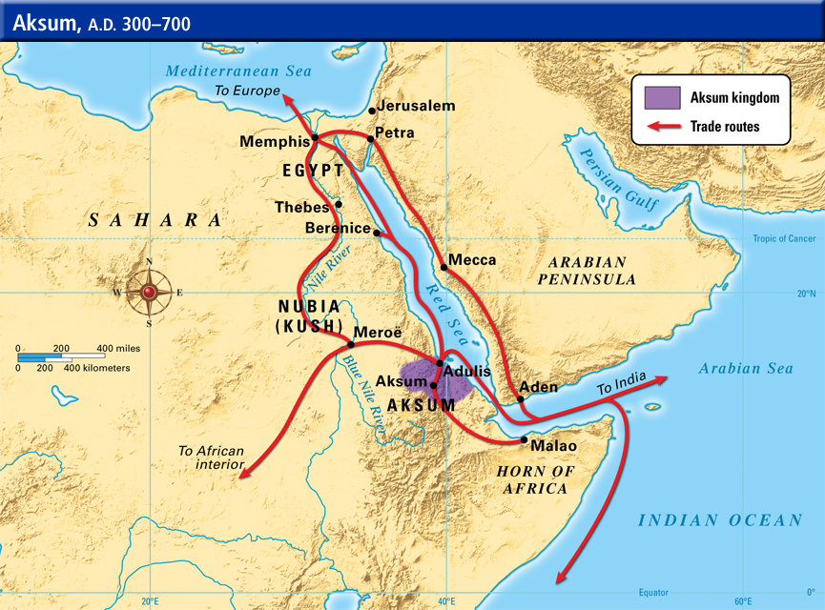

Slide 55
Silk Roads
Long-distance trade and the silk roads network (Zhang Qian's mission to the west)
  Held by Xiongnu for years
  Told Han Wudi of possibility of establishing trade relations to Bactria
  Han emperor Wudi subdued Xiongnu, opening up region to safe trade routes. Expanded Han
  China in that direction
The silk roads
  Trade routes
    Overland trade routes linked China to Roman empire
    Sea lanes joined Asia, Africa, and Mediterranean basin into one network
  Trade goods
    Silk and spices traveled west
    Central Asia produced large horses and jade, sold in China
    Roman empire provided glassware, jewelry, artworks, perfumes, textiles
  The organization of long-distance trade
    Merchants of different regions handled long-distance trade in stages
    On the seas, long-distance trade was dominated by different empires
Cultural and biological exchanges along the silk roads
The spread of Buddhism, Hinduism, Manichaeism, and Christianity
    First present in oasis towns of central Asia along silk roads, then merchants spread, then missionaries spread
The spread of epidemic disease Epidemic diseases
  Common epidemics in Rome and China: smallpox, measles, bubonic plague
  Roman Empire: population dropped by a quarter from the first to tenth century C.E.
  China: population dropped by a quarter from the first to seventh century C.E.
Effects of epidemic diseases
  Both Chinese and Roman economies contracted
  Small regional economies emerged
  Epidemics weakened Han and Roman empires
http://glencoe.mheducation.com/sites/0024122010/student_view0/chapter12/chapter_outline.html (from)

Slide 56
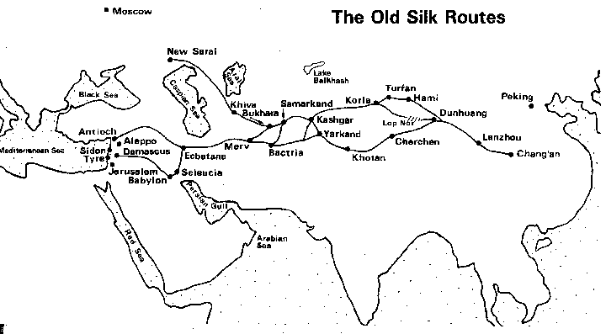
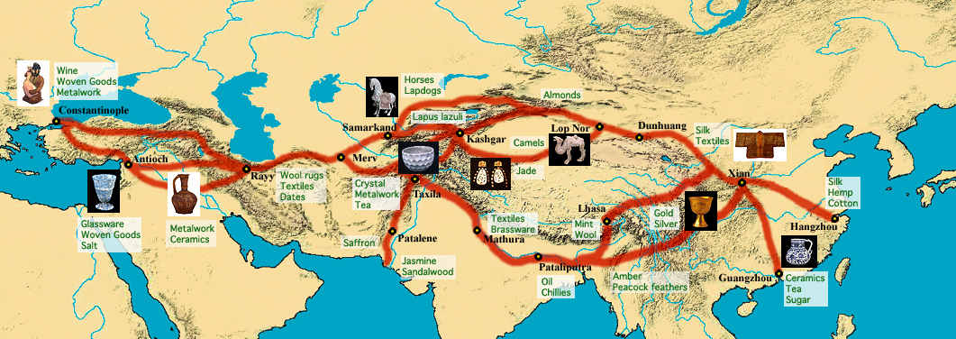
Silk Road

Slide 57
Missionaries
They used the major trade routes springing up to facilitated the spread of their religions.
Pax Romana-Roman Peace helped for the spread of religion AND many areas were in a state of decline that created the opportunity for the spread of those religions.
Religions that spread: Buddhism, Hinduism, and Christianity.

Slide 58
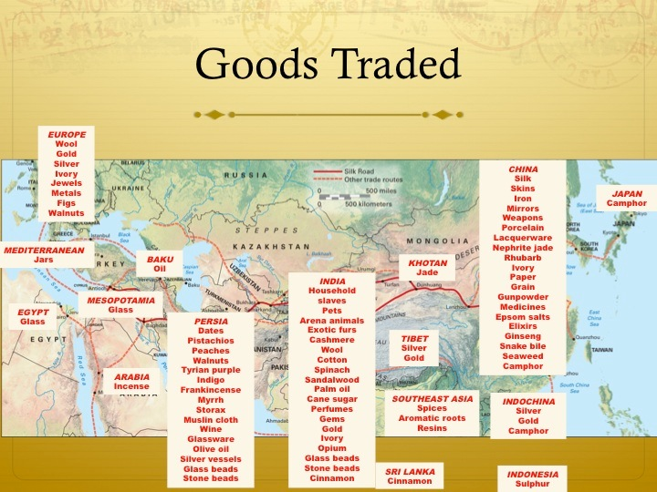

Slide 59
Works cited
This is an educational PowerPoint
I got many pictures etc. from simple google searches

