Slide 1
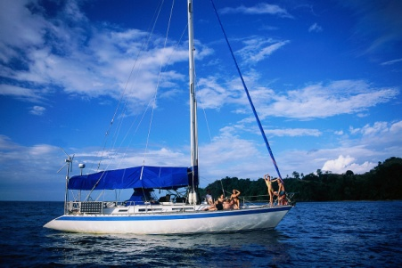
The Wanderer
The sea, the sea, the sea. It rolled and rolled and called to me. Come in, it said, come in.
~Sophie
By Sharon Creech
Mrs. Lavallee 304

Slide 2
The Wanderer
Song | Artist
My Heart Will Go On | Celine Dion

