Slide 1




2024 VNS Health Medicare Plan Benefits

Slide 2


Our Medicare Plans
Service area, supplemental benefits, partners
Training Agenda
2024 Plans & Benefits Highlights
All benefits are pending approval
2024 Plan Comparisons
Dental Benefits
Prescription Drug Coverage by Plan

Slide 3












Our Medicare Plans
Meeting members’ needs as they change over time.
EasyCare (HMO)
Medicare (LIS lowers Rx costs for those eligible)
EasyCare Plus (HMO D-SNP)
Medicare
Medicaid
Total (HMO D-SNP)
Medicare
Medicaid
Long-term care
Plans include valuable supplemental benefits and personalized clinical support.

Slide 4
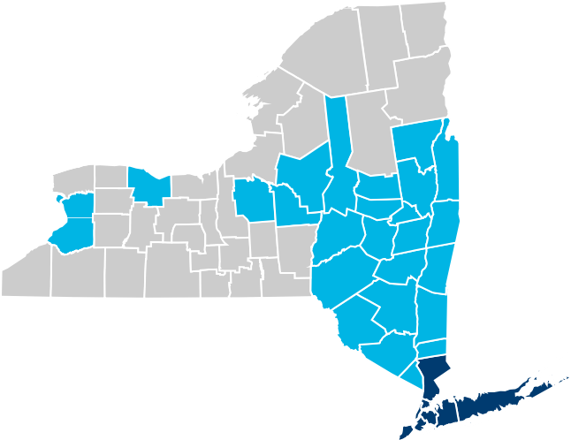



2024 Medicare Health Plans Service Area
Medicare Service Area
Medicare
NYC 5 boroughs
Counties of:
Nassau
Suffolk
Westchester
Westchester
Albany
Rensselaer
Schenectady
Bronx
Suffolk
New York
Brooklyn
Queens
Nassau
Staten Island
* Pending regulatory approval

Slide 5











2024 Supplemental Benefits
Dental
OTC/Grocery
Acupuncture
Vision
Podiatry
Hearing
Worldwide Coverage for Urgent Care & Emergencies
Non-emergency Transportation
Note: Total and EasyCare Plus also offer a Flex card for dental, vision, hearing and utilities.
Fitness
© Copyright 2023 VNS Health. All rights reserved.
Confidential and proprietary. Not to be distributed or shared with Medicare beneficiaries
7

Slide 6






MedImpact Pharmacy
Carelon (Formerly Beacon)
Behavioral Health
Key Partners
HealthPlex Dental
Superior Vision Vision
SilverSneakers Fitness
Incomm (OTC Network) OTC/Grocery

Slide 7

2024 Plans & Benefits Highlights

Slide 8
VNS Health
Medicare
VNS Health EasyCare Plan
HMO-MAPD
EasyCare
HMO MAPD
2024
Notes:
EasyCare MAPD Plan for Medicare beneficiaries without Medicaid.

Slide 9
VNS Health EasyCare
HMO Medicare Advantage Prescription Drug (MAPD) plan designed to make medical care more affordable.
$25 Monthly Part D premium . What a member pays depends on their level of Extra Help (Low Income Subsidy). Can be $0 – 25 depending on level of Extra Help. (There is no Part C premium)
Those with Full Low-Income Subsidy will pay $0 monthly Part D premium.
Includes extra benefits that are not covered by Medicare such as Dental, Vision, Fitness, Transportation and Quarterly Over-the-Counter (OTC) health items.
VNS Health
Medicare
EasyCare
HMO MAPD
2024
Notes:
The EasyCare plan has a $0 to $25 monthly premium for Part D depending on the member’s level of Low -Income Subsidy (also called Extra Help) . Members with Full Low-Income Subsidy will pay $0 monthly premium. The plan offers extra benefits not covered by Medicare.

Slide 10
Eligibility
To be eligible for EasyCare, a beneficiary must have:
  Evidence of Medicare Part A & Part B coverage
  Live in the service area
VNS Health
Medicare
EasyCare
HMO MAPD
2024
Notes:
Please note the eligibility for EasyCare .

Slide 11
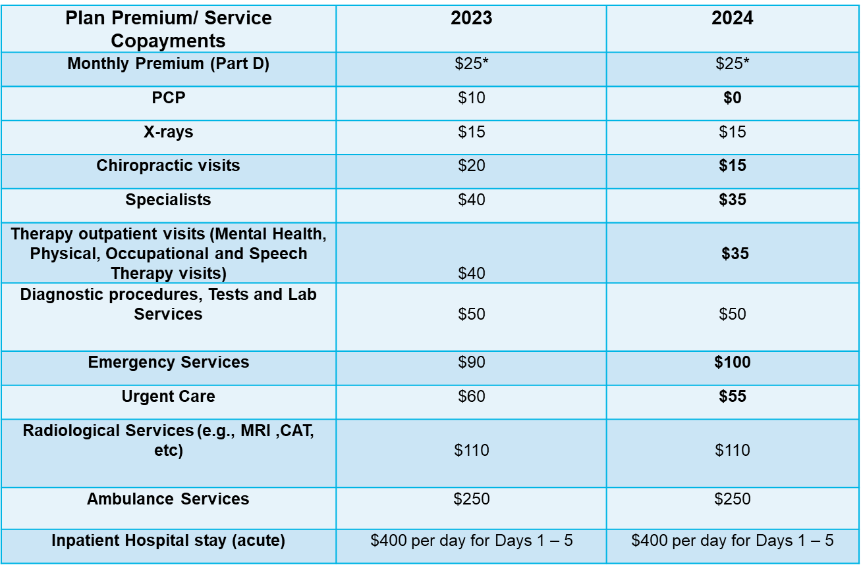
VNS Health EasyCare MAPD covers all services under Original Medicare. This is a Comparison Benefits Chart of some services:
*May be $0 with Low Income Subsidy
VNS Health
Medicare
EasyCare
HMO MAPD
2024
*Those with low-income subsidy will pay $0 premium
Notes:
Those with low-income subsidy will pay $0 premium. These are some of the copayments EasyCare members will have for their medical services. Those in bold in 2024 show changes from 2023.

Slide 12
2024 EasyCare Supplemental Benefits
  $87 quarterly Over-the-Counter (OTC) Card for non-prescription drug items (Does not roll over) (Increase from 2023)
  Silver Sneakers Fitness Benefit
  Routine eye exams and $200 toward eyeglass frames and lenses or contact lenses every year
  Routine podiatry visits (6 per year)
  $2000 towards Comprehensive and Preventive Dental.
  Hearing - $0 copay for exam, $1000 towards hardware every 3 years, $500 per ear
  Acupuncture – 12 visits
  11 round-trips or 22 one-way trips transportation visits to medical appointments per year
  $50,000 annually for Worldwide Coverage for emergency services and urgent care
VNS Health
Medicare
EasyCare
HMO MAPD
2024
Notes:
Note the extra benefits that EasyCare provides that are not covered by Original Medicare. On the following slide is a comparison chart of supplemental benefits of 2023 vs. 2024.

Slide 13
2024 EasyCare Plan Supplemental Benefits Comparison
EasyCare Supplemental Benefits Comparison | 2023 | 2024
Over the Counter (OTC) and Grocery Card | $70 Quarterly OTC (does not roll over) | $87 Quarterly OTC (does not roll over)
Vision | $200/eyeglasses or contact lenses every year | $200/eyeglasses or contact lenses every year
Dental | $0 Copay Maximum plan coverage- $2000 of preventive and comprehensive coverage | $0 Copay Maximum plan coverage- $2000 of preventive and comprehensive coverage
Hearing | $0 copay for exam, $1000 towards hardware every 3 years, $500 per ear | $0 copay for exam, $1000 towards hardware every 3 years, $500 per ear
Fitness | Silver Sneakers | Silver Sneakers
Transportation Benefit | 22 trips to non-emergency healthcare appointments | 22 trips to non-emergency healthcare appointments
Acupuncture | 12 | 12
Worldwide Coverage | Up to $50,000 per year for emergency and urgent care outside the United States and its territories. | Up to $50,000 per year for emergency and urgent care outside the United States and its territories.
VNS Health
Medicare
EasyCare
HMO MAPD
2024
Notes:
Note the changes in Supplemental benefits for EasyCare from 2023.

Slide 14
VNS Health
Medicare
VNS Health EasyCare Plus Plan
D-SNP
EasyCare Plus
HMO D-SNP
2024
Notes:
Now, let’s look at our New 2024 VNS Health EasyCare Plus Dual Special Needs Plan.

Slide 15
EasyCare Plus
  HMO Special Needs Plan (D-SNP) designed to offer focused care management to individuals that have both Medicare & Medicaid.*
  Includes extra benefits like coverage for over-the-counter (OTC) health items and groceries, Flex card (for utilities, additional dental, vision and hearing), acupuncture and more, all at $0 cost.
* Plan is not integrated with Medicaid. Plan pays Medicare benefit first and Medicaid is secondary payer.
VNS Health
Medicare
EasyCare Plus
HMO D-SNP
2024
Notes:
This a plan for those who have Medicare and Medicaid and offers additional benefits. The plan is not integrated with Medicaid. Medicaid is the secondary payer.

Slide 16
Eligibility:
  To be eligible for EasyCare Plus, a beneficiary must have:
  Evidence of Medicare Part A & Part B coverage
  Medicaid *
  Live in the service area
  *Medicaid benefits vary based on income and resources
VNS Health
Medicare
EasyCare Plus
HMO D-SNP
2024
Notes:
Please not the eligibility for EasyCare Plus.

Slide 17
VNS Health EasyCare Plus covers all services under Original Medicare and includes:
0%* or 20% co-insurance for Medicare covered Outpatient services such as doctor visits, care, home health care, vaccines.
Deductibles and Co-insurance for In-Patient services.*
  * Deductibles and Co-insurance covered by Medicaid.
VNS Health
Medicare
EasyCare Plus
HMO D-SNP
2024
Notes:
EasyCare Plus covers all the services under Original Medicare and Medicaid covers all out of pocket costs for medical services.

Slide 18
2024 EasyCare Plus Supplemental Benefits
  $225 monthly Over-the-Counter (OTC) and Grocery Card (Does not roll over)* (Increase from 2023)
  $350 Flex card annual benefit; dental, vision, hearing and utilities (New)
  Silver Sneakers Fitness
  Acupuncture – 30 visits per year at $0 copay
  Routine eye exams and $200 toward eyeglass frames and lenses or contact lenses every year
  $2750 towards Comprehensive Dental
  Hearing - $0 copay for exam, $1400 for hardware every 3 years; $700 per ear limit
  14 non-emergency or 7 R/T transportation visits to medical appointments per year
  Routine podiatry visits (6 per year)
  $50,000 annually for Worldwide Coverage for emergency services and urgent care
VNS Health
Medicare
EasyCare Plus
HMO D-SNP
2024
Notes:
These are the additional benefits that are offered in the EasyCare Plus plan.

Slide 19
2024 Supplemental Benefits Comparison for EasyCare Plus
EasyCare Plus Supplemental Benefits | 2023 | 2024
Over the Counter (OTC) and Grocery Card | $160 monthly OTC and grocery (does not roll over) | $225/month for OTC items & healthy foods, including fresh produce and prepared meals. (Increase from 2023)
Flex Card | NA | $350 annual benefit; dental, vision, hearing and utilities. ($87.50 first quarter, then $29.33 monthly April – December) (New)
Vision | $200/eyeglasses or contact lenses every year | $200/eyeglasses or contact lenses every year
Dental | $0 Copay Maximum plan coverage- $2750 comprehensive coverage | $0 Copay Maximum plan coverage- $2750 comprehensive coverage
Hearing | $0 copay for exam, $1400 for hardware every 3 years; $750 per ear limit | $0 copay for exam, $1400 for hardware every 3 years; $750 per ear limit
Fitness | Silver Sneakers | Silver Sneakers
Transportation Benefit | 14 trips to medical appointments | 14 trips to medical appointments
Acupuncture | 30 visits per year at $0 copay | 30 visits per year at $0 copay
Worldwide Coverage | Up to $50,000 per year for emergency and urgent care outside the United States and its territories. | Up to $50,000 per year for emergency and urgent care outside the United States and its territories.
VNS Health
Medicare
EasyCare Plus
HMO D-SNP
2024

Slide 20
VNS Health Total Plan
2024
VNS Health
Medicare
Total
HMO D-SNP
2024
Notes:
First, let’s take a closer look at our 2024 Total Special Needs Plan.

Slide 21

VNS Health Total
Total is a Medicare Advantage HMO Dual Special Needs Plan (D-SNP) for individuals who have both Medicare and Medicaid and require long term services and supports (LTSS) to remain safely in their homes. Total also is known as a Medicaid Advantage Plus Plan (MAP) which:
  Integrates the benefits of Medicaid long-term care services and a Medicare Advantage plan into one comprehensive program.
  Includes extra benefits like coverage for over-the-counter (OTC) health items and groceries, Flex card, acupuncture and more, all at $0 cost.
VNS Health
Medicare
Total (MAP)
HMO D-SNP
2024
Notes:
Total is a Medicare Advantage HMO Special Needs Plan (SNP) for individuals who have both Medicare and Medicaid and require long-term services and supports to remain safely in their homes.

Slide 22
Eligibility:
To be eligible for Total, a beneficiary must:
  Have both Medicare and Medicaid
  Be 18 years of age or older
  Live in the service area
  Be able to stay safely at home at the time of enrollment
  Require care management and expected to need Community Based Long term Care Services for more than 120 days from time of enrollment.
VNS Health
Medicare
Total (MAP)
HMO D-SNP
2024
Notes:
Please review eligibility for our Total plan.

Slide 23
2024 Total Supplemental Benefits
Over the Counter (OTC) and Grocery Card | $266 monthly OTC and grocery items (does not roll over)
Flex Card | $760 per year towards Dental, Vision, Hearing and Utilities($190 first quarter, then $63.33 monthly for April to December)
Vision | One eye exam and $300/eyeglasses or contact lenses every year
Dental | $0 Copay Maximum plan coverage- $3000 comprehensive coverage
Hearing | $0 copay for exam, $1500 for hardware every 3 years; $750 per ear limit
Fitness | Silver Sneakers
Transportation Benefit | Unlimited to medical appointments
Acupuncture | 30 visits per year at $0 copay
Podiatry | 6 routine visits per year
Worldwide Coverage | Up to $50,000 per year for emergency and urgent care outside the United States and its territories.
VNS Health
Medicare
Total (MAP)
HMO D-SNP
2024
Notes:
Here is a chart of the 2024 Total Additional Benefits. Those in bold are increased from 2023. See the chart on the following slide for comparison with 2023 additional benefits.

Slide 24
2024 Supplemental Benefits Comparison for Total
Total Supplemental Benefits | 2023 | 2024
OTC and Grocery Card | $232 monthly | $266/month for OTC items & healthy foods, including fresh produce and prepared meals.(Increase)
Fitness | Silver Sneakers | Silver Sneakers
Flex Card | $750 per year towards Dental Vision and Hearing | $760 per year towards Dental Vision, Hearing and Utilities. (New for utilities)
Dental | $3000 towards Comprehensive Dental | $3000 towards Comprehensive Dental
Vision | One eye exam and $300 towards eyeglasses or contact lenses every year | One eye exam and $300 towards eyeglasses or contact lenses every year
Hearing | $1500 towards Hearing Aids every 3 years ($750 per ear) | $1500 towards Hearing Aids every 3 years ($750 per ear)
Podiatry | 6 Routine visits per year | 6 Routine visits per year
Worldwide Coverage | Up to $50,000 per year for emergency and urgent care outside the United States and its territories. | Up to $50,000 per year for emergency and urgent care outside the United States and its territories.
VNS Health
Medicare
Total (MAP)
HMO D-SNP
2024
Notes:
Please note the changes in Supplemental benefits for the Total Plan from 2023.

Slide 25
Levels of Medicaid Eligibility based on Income and Resources
Medicaid
Definitions
Full Benefit Dual Eligible Beneficiaries (Full Medicaid) | FBDE
Qualified Medicare Beneficiaries without Medicaid (aka Partial Medicaid)| QMB
Qualified Medicare Beneficiaries with Full Medicaid | QMB Plus

Slide 26
2024 VNS Health Medicare Plans Comparison Chart
 | VNS Heath EasyCare (HMO) | VNS Heath EasyCare Plus (HMO DSNP) | VNS Heath Total (HMO DSNP)
Medicaid Levels | n/a | FBDE, QMB, QMB+ | FBDE, QMB+
Monthly Plan Premium (Part C) | $0 | $0 | $0
PCP visit | $0 Copay (Decrease from 2023) | 0% or 20% Coinsurance* | $0 Copay
Annual Wellness Visit | $0 Copay | 0% or 20% Coinsurance* | $0 Copay
Specialist | $35 Copay | 0% or 20% Coinsurance* | $0 copay
Inpatient Hospital | $400 Days 1-5; $0 6-90 | Coinsurance & Medicare defined cost shares | $0
Emergency Care | $100 Copay (Increase from 2023) | 0% or 20% Coinsurance* | $0 Cost-Share/Copay
Urgent Care | $55 Copay (Decrease from 2023) | 0% or 20% Coinsurance* | $0 Cost-Share/Copay
Maximum out-of-pocket |  |  | $0
Prescription Drug Premium (Part D) | $25** | $0 ($38.90*) | $0
Part D Deductible | $0 - $145 (Decrease from 2023) | $0** | $0
© Copyright 2023 VNS Health. All rights reserved.
Depending on your level of Medicaid eligibility. ** 2023 Premium - Covered by LIS if you get Extra Help. If you lose Extra Help, your monthly premium may be $25
Confidential and proprietary. Not to be distributed or shared with Medicare beneficiaries
Notes:
This is a Comparison of our three plans’ benefits for 2024.

Slide 27
VNS Health Medicare 2024 Plans Comparison Chart
 | VNS Heath EasyCare (HMO) | VNS Heath EasyCare Plus (HMO DSNP) | VNS Heath Total (HMO DSNP)
OTC/Grocery Card | $87/quarter for OTC items. Grocery benefit n/a (Increase from 2023) | $225/month for OTC items & healthy foods, including fresh produce and prepared meals.^ (Increase from 2023) | $266/month for OTC items & healthy foods, including fresh produce and prepared meals.(Increase from 2023)
Dental | $2,000 annual benefit $0 cost-share/copay for preventative & comprehensive coverage | $2,750 annual benefit $0 cost-share/copay for comprehensive coverage | $3,000 annual benefit $0 cost-share/copay for comprehensive coverage
Vision | $0 for 2 routine eye exams/year; $200 allowance for eyeglasses + standard lenses or $200 for contact lenses. | $0 annual eye exam; $200 allowance for eyeglasses + standard lenses or $200 for contact lenses. | $0 annual eye exam; $300 allowance for eyeglasses + standard lenses or $300 for contact lenses.
Hearing | $0 routine hearing exams; $0 copay for hearing aid(s) every 3 years; $1,000 for hearing aids limited to $500/ear, every 3 years. | $0 routine hearing exams; $0 copay for hearing aid(s) every 3 years; $1,400 for hearing aids limited to $700/ear, every 3 years. | $0 for routine hearing exams; $0 copay for hearing aid(s) every 3 years; $1,500 for hearing aids limited to $750/ear, every 3 years
Flex Card | Not covered | $350 annual benefit; dental, vision, hearing and utilities (New) | $760 annual benefit; dental, vision, hearing and utilities (New for utilities)
Fitness | Silver Sneakers | Silver Sneakers | Silver Sneakers
Transportation | 11 round-trips per year or 22 single-trips to approved healthcare locations | 7 round-trips per year or 14 single-trips to approved healthcare locations | Unlimited to approved healthcare locations
^ The grocery benefit is a part of special supplemental program for the chronically ill. Not all members qualify.
Confidential and proprietary. Not to be distributed or shared with Medicare beneficiaries.
Notes:
This is a Comparison of our three plans’ supplemental benefits for 2024.

Slide 28
VNS Health Medicare 2024 Comparison
 | VNS Heath EasyCare (HMO) | VNS Heath EasyCare Plus (HMO DSNP) | VNS Heath Total (HMO DSNP)
Acupuncture | 12 visits | 30 visits | 30 visits
Podiatry | 6 routine visits/year | 6 routine visits/year | 6 routine visits/year
Chiropractic Services | $15 copay (Decrease from 2023) | 0 or 20% Coinsurance* | $0 Cost-Share/Copay
 |  |  | 28 Meals (2 weeks) for IP Acute only - up to 3x per year
(New) Post Acute Hospital Meals | 28 Meals (2 weeks) for IP Acute only - up to 3x per year | 28 Meals (2 weeks) for IP Acute only - up to 3x per year
Worldwide Coverage | $50,000 limit every year for emergency care and urgently needed services outside the United States & territories | $50,000 limit every year for emergency care and urgently needed services outside the United States & territories | $50,000 limit every year for emergency care and urgently needed services outside the United States & territories
Depending on your level of Medicaid eligibility. ** Covered by LIS if you get Extra Help. If you lose Extra Help, your monthly premium may be $23.20
Confidential and proprietary. Not to be distributed or shared with Medicare beneficiaries.

Slide 29
VNS Health Dental Benefits
  VNS Health EasyCare:
    Preventative dental services are covered by the plan, including oral exams, cleanings and x-rays. Certain procedures, like root canal require prior authorization. EasyCare plan members have a $2,000 annual benefit to cover all dental services.
    Implants are covered up to the maximum benefit.*
  VNS Health EasyCare Plus & VNS Health Total
    Preventative and routine dental services are covered by Medicaid (FBDE and QMB Plus only eligible beneficiaries).
    Comprehensive dental is covered by the plan, including fillings, extractions, bridges, crowns and dentures.
    EasyCare Plus plan members have a $2,750 annual dental benefit
    Total plan members have a $3,000 annual dental benefit
    Implants are covered up to the maximum benefit.*
* Implants are typically more expensive than the maximum benefit, so out of pocket expenses may occur for implants.

Slide 30
Part D
VNS Health Medicare Prescription Drug Coverage
Notes:
We are now going to review VNS Health Medicare prescription drug coverage.

Slide 31
Part D
VNS Health Medicare
Prescription Drug Coverage
is currently administered by MedImpact
Notes:
VNS Health Medicare Prescription Drug Coverageis currently administered by MedImpact

Slide 32
Part D
EasyCare
VNS Health 2024 EasyCare Formulary (What a member pays without LIS)
Premium | $25 | No Change
Formulary (Plan Design) | Enhanced Basic | No Change
Deductible | $145 * | New
Initial Coverage Limit | $5030 | Revised
OON Cost-Sharing Structure | Standard Retail $0 Copay/Coinsurance | No Change
Tier 1
Preferred Generic | $15 (30-day supply) | No Change
Tier 2
Generic | $20 (30-day supply) | No Change
Tier 3
Preferred Brand | $47 (30-day supply) | No Change
Tier 4
Non-Preferred Brand | $100 (30-day supply) | No Change
Tier 5
Specialty Drugs (Generic/Brand) | 31% Coinsurance | No Change
Tier 6
Select Care Drugs | $0 Copay | No Change
Mail Order (3M Supply) | 100 days for all tiers | New
* Deductible applies only to Tiers 2 – 5. No deductible for Tiers 1 and 6
Notes:
This is what members will pay without low-income subsidy. Note Deductible applies only to Tiers 2 – 5. No deductible for Tiers 1 and 6.

Slide 33
Part D
EasyCare Plus
VNS Health 2024 EasyCare Plus D-SNP Formulary
EasyCare Plus D-SNP will have a formulary based on the Defined Standard Benefit (no drug tiers). Because all members of this plan have some level of Medicaid and Low-Income Subsidy, they pay small copays for their Generic and Other prescription drugs.
Notes:
EasyCare Plus D-SNP will have a formulary based on the Defined Standard Benefit (no drug tiers). Because all members of this plan have some level of Medicaid and Full Low-Income Subsidy, they pay small copays for their Generic and other prescription drugs.

Slide 34
Part D
Total
VNS Health 2024 Total Formulary
In 2024, the Total formulary will be based on the Defined Standard Benefit (no drug tiers). Because members of this plan are Full Benefits Dual Eligible (FBDE) Beneficiaries Receiving Home and Community Based Services, they pay $0 for both Generic and Other drugs.
Notes:
In 2024, the Total Plan will be based on the Defined Standard Benefit (no drug tiers). Because members of this plan are Full Benefits Dual Eligible (FBDE) Beneficiaries Receiving Home and Community Based Services, they pay $0 for both Generic and Other drugs.

Slide 35





Thank you

