Slide 1
Opening
Name the polygon
Triangle
Pentagon
Hexagon
Octagon
Quadrilateral
Decagon

Slide 2
Lesson 1-1
Points, Lines & Planes

Slide 3
Lesson Outline
Opening
Five-Minute Check
Objectives
Vocabulary
Core Concepts
Examples
Summary and Homework

Slide 4
5-Minute Check on Algebra
6x + 45 = 18 – 3x
x² – 45 = 4
(3x + 4) + (4x – 7) = 11
(4x – 10) + (6x +30) = 180
Find the slope of the line k.
Find the slope of a parallel line to k
9x +45 = 18 9x = -27 x = -3
x² = 49 x = √49 x = +/- 7
7x - 3 = 11 7x = 14 x = 2
10x + 20 = 180 10x = 160 x = 16
y
k
∆y y₂ – y₁ 4 – 1 3 1
m = ----- = ----------- = -------- = ------ = ----
∆x x₂ – x₁ 6 – 0 6 2
(6,4)
(0,1)
∆y
C
∆x
x
(-6,-2)
A
B
A
A
1/2
B
2
C
-1/2
D
-2
Click the mouse button or press the
Space Bar to display the answers.

Slide 5
Objectives
Identify and model points, lines, and planes.
Identify intersecting lines and planes.

Slide 6
Vocabulary
Collinear points – points on the same line are called collinear
Coplanar points – points lying on the same plane are called coplanar
Defined terms – terms that can be described using know words (like point or line)
Intersection – the set of points the figures have in common
Line segment – a collection of collinear points between two endpoints; can be measured
Line – has one dimension; a collection of points that goes on forever, defined by two points; represented by a line with arrowheads on the ends

Slide 7
Vocabulary - cont
Opposite Rays – two rays that together make a line
Plane – has two dimension; flat surface made up of points that extends without end; defined by at least three points (or two intersecting lines); represented by a shape that looks like a wall or piece of paper
Point – has no dimension; a location in space; usually named by coordinate location; represented by a dot
Ray – a part of a line with an endpoint and extending forever in only one direction
Space – is a boundless, three dimensional set of all points
Undefined terms – points, lines and planes – no formal definitions, but agreed upon meaning

Slide 8
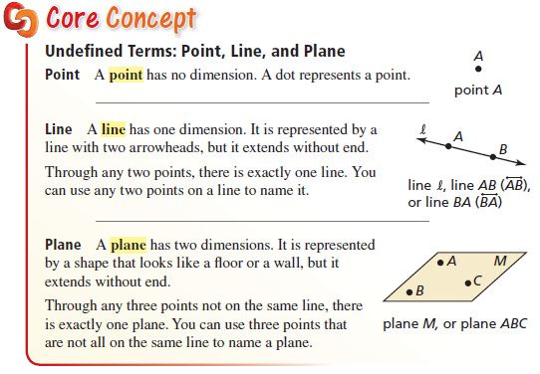
Core Concept

Slide 9
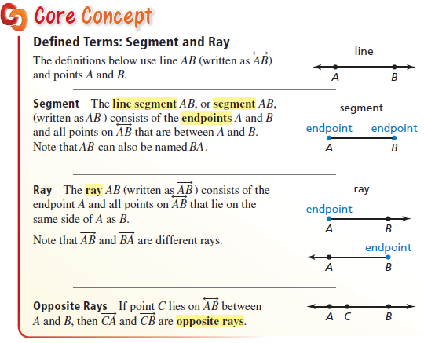
Core Concept

Slide 10
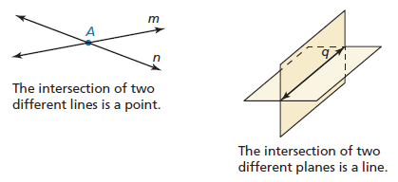
Core Concept
Look around the room and see if you can answer the following questions:
What do three different lines intersect in?
What do three different planes intersect in?
A single point
A single point

Slide 11
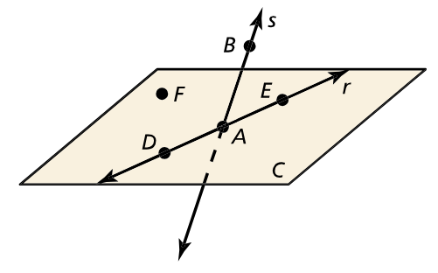

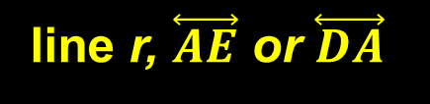
Example 1
plane DEF, plane ADF, or plane AEF
ADE F is not collinear
ADEF B is not coplanar

Slide 12
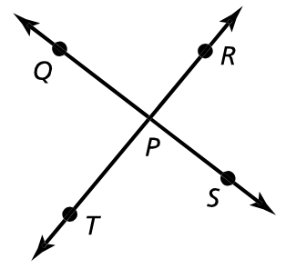




Example 2

Slide 13

Example 3
a
P
B
A
Q
b
D
X

Slide 14
Example 4
R
A
B
S

Slide 15

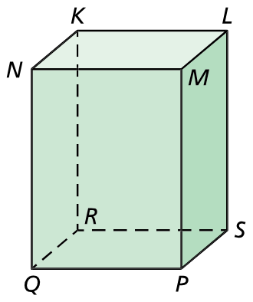
Example 5
Plane QPSR (the bottom)
and
plane QNMP (the front)

Slide 16
Summary & Homework
Summary:
  Two points determine a line
  Points on the same line are collinear
  Three noncollinear points determine a plane
  Two intersecting lines determine a plane
  Points or lines on the same plane are coplanar
  Two lines intersect in a point
  Two planes intersect in a line
Homework:
  Geometric Concepts WS

