Slide 1
Opening
Plot the point in the coordinate plane.
A(8, -5)
B(2, 0)
C(5, -1)
D(1, 3)
E(1, -3)
F(4, 4)
G(6, 4)
H(-3, 1)
y
x

Slide 2
Lesson 1-2
Measuring and Constructing Segments

Slide 3
Lesson Outline
Five-Minute Check
Objectives
Vocabulary
Core Concepts
Examples
Constructions
Summary and Homework

Slide 4
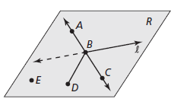



5-Minute Check on Lesson 1-1
Find the following from the picture
A point
A line
A ray
A line segment
A plane
3 collinear points
3 non-collinear points
A line not in the plane
E
$\overset{⃡}{AB}$ or line l
$\vec{BA}$ or $\vec{BC}$
$$\overline{DB}$$
R
A, B, C
E, B, C
line l
Click the mouse button or press the
Space Bar to display the answers.

Slide 5
Objectives
Use the Ruler Postulate
  Determine accuracy of measurement
Copy segments and compare segments for congruence
Use the Segment Addition Postulate
    Sum of the parts equals the whole

Slide 6
Vocabulary
Axiom – a rule that is accepted without proof; also called an postulate
Between – with three collinear points, one is between the other two
Coordinate – location of points on a number line or the x-y coordinate plane
Congruent Segments – when line segments have the same length, they are congruent (≅)
Construction – a geometric drawing that uses a limited set of tools, usually a compass and straightedge
Distance – length between points
Postulate – a rule that is accepted without proof; also called an axiom

Slide 7
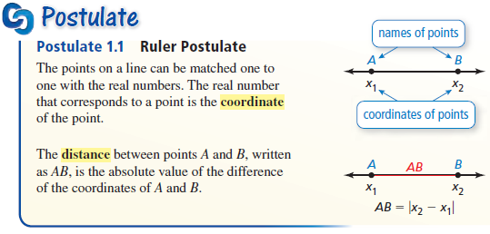
Core Concept
Distances between points on a line can be measured

Slide 8

Example 1
Measure the length of AB to the nearest tenth of a centimeter.

Slide 9
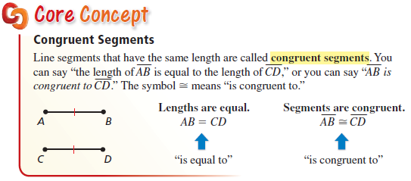
Core Concept
Congruent is more than just equal
  similar sign ≅ to the equal sign =
  equal measures in line segments (or in angles)
  same shape and size (measure) in other things

Slide 10

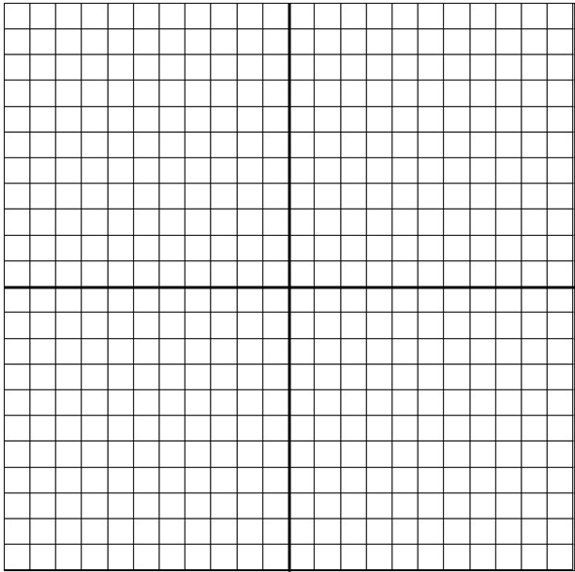
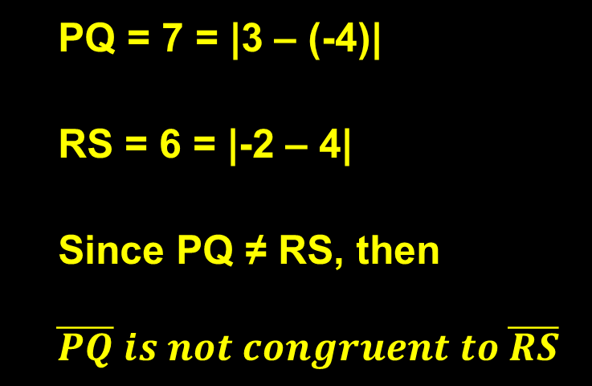
Example 2
R
P
Q
S

Slide 11
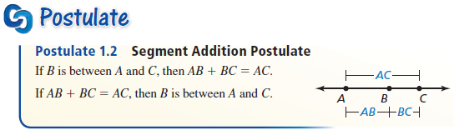
Core Concept
The equation above is also known by “the sum of the parts is equal to the whole”
Example: Distance from Abingdon to Marion is equal to distance from Abingdon to Chilhowie added to the distance from Chilhowie to Marion

Slide 12
Whole = Sum of its Parts
Any distance can be broken into pieces and the sum of those pieces is equal to the whole distance
11
14
6
A
B
C
D
32
The whole length, AD, is equal to the sum of its parts, AB + BC + CD
AD = AB + BC + CD
32 = 11 + 14 + 6

Slide 13

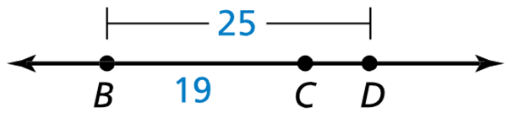
Example 3
Find XZ
Find CD.
Sum of parts = whole
14 + 27 = 41
25 = 19 + CD
25 – 19 = 19 – 19 + CD
6 = CD

Slide 14
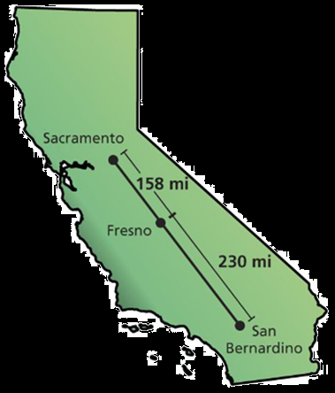
Example 4
The cities shown on the map lie approximately on a straight line. Find the distance from Sacramento, California, to San Bernardino, California.
Answer: The distance from Sacramento to San Bernardino California is the sum of the parts:
158 + 230 = 388 miles

Slide 15

Construction
C
D
Answer:
Use a straightedge to draw a segment longer than AB. Label point C on the new segment
Set your compass at the length of AB.
Place the compass on C. Mark point D on the new segment. So CD has the same length as AB

Slide 16
Precision
4
Precision – ½ the smallest unit of measure on the measuring device
¾
½
70°F
¼
Smallest Unit of Measure = 1/8 ^{th} inch
Precision = (1/8)/2 = 1/16 ^{th} inch
String Length is 2 ¼ ± 1/16 or
between 2 3/16 and 2 5/16 inches long
3
60°F
¾
½
50°F
¼
2
40°F
¾
Smallest Unit of Measure = 2°F
Precision = (2°F)/2 = 1°F
Temperature is 60°F ± 1°F or
between 59°F and 61°F
½
¼
1

Slide 17
Summary & Homework
Summary:
  The measure of a line segment is the sum of the measure of its parts
  WHOLE = SUM OF PARTS
  The precision of any measurement depends on the smallest unit available on the measuring device
  Precision = ½ (Smallest Unit)
Homework:
  Parts is Parts WS

