Slide 1
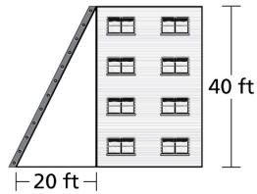
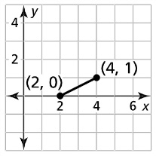



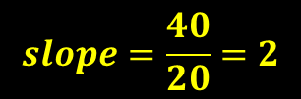

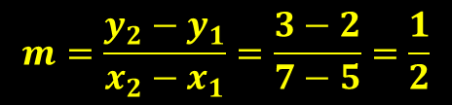
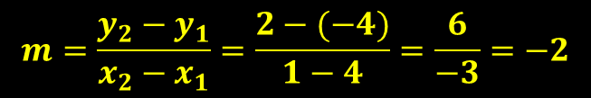
Opening
Find the slope
$$slope=\frac{rise}{run}$$
$$slope=\frac{1}{2}$$
$$slope=\frac{40}{20}=2$$
$$m=\frac{y_{2}−y_{1}}{x_{2}−x_{1}}$$
(4, -4), (1, 2)
$$m=\frac{y_{2}−y_{1}}{x_{2}−x_{1}}=\frac{2−(−4)}{1−4}=\frac{6}{−3}=−2$$
$$m=\frac{y_{2}−y_{1}}{x_{2}−x_{1}}=\frac{3−2}{7−5}=\frac{1}{2}$$

Slide 2
Lesson 1-3
Using Midpoint and Distance Formulas

Slide 3
Lesson Outline
Five-Minute Check
Objectives
Vocabulary
Core Concepts
Examples
Summary and Homework

Slide 4


5-Minute Check on Lesson 1-2
Find BD in the following drawings
BD = 21 + 7 = 28
73 = 17 + BD BD = 56
C
D
CD = 60
CB = 2x + 5
BD = 9x
60 = (2x + 5) + (9x)
60 = 11x + 5
55 = 11x
5 = x BD = 45
B
CB = 12x – 15
BD = 9x
DC = 18
12x – 15 = 9x + 18
12x = 9x + 33
3x = 33
x = 11 BD = 99
D
B
C
Click the mouse button or press the
Space Bar to display the answers.

Slide 5
Objectives
Find segment lengths using midpoints and segment bisectors
Use the Midpoint Formula
Use the Distance Formula

Slide 6
Vocabulary
Approximate – close to this value, but not exactly (math symbol: ≈)
Bisect – to cut into two equal parts
Distance – the length of a segment connecting two points
Midpoint – the point that divides the segment into two congruent segments; bisects a segment
Right angle – an angle that measures 90 degrees; in the corner of a Pythagorean triangle; usually denoted as a red square
Segment Bisector – a point, ray, line, line segment or plane that intersects the segment at its midpoint

Slide 7
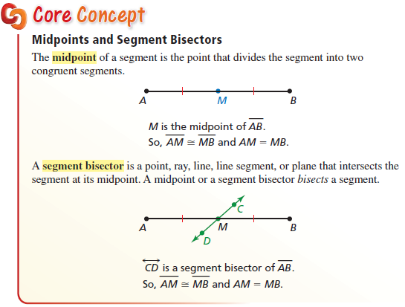
Core Concept

Slide 8
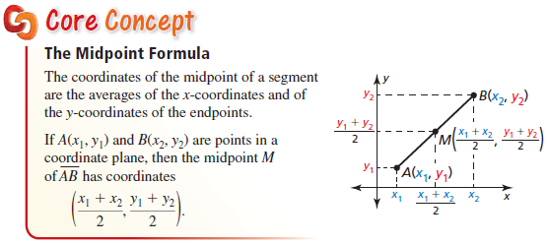
Midpoint Formula

Slide 9
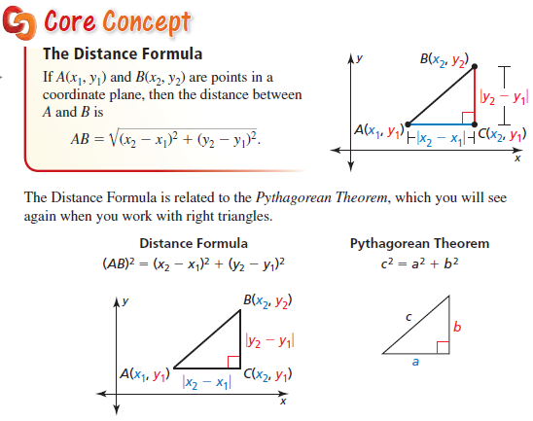
Distance Formula

Slide 10
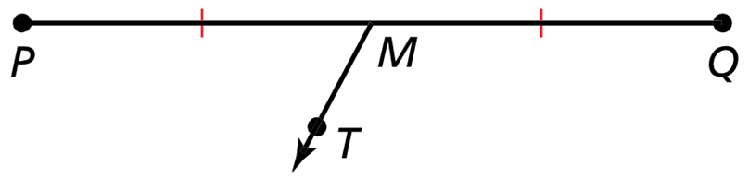


Example 1
In the figure, $PM=1.8 mm$. Identify the segment bisector of $\overline{PQ}$. Then find $PQ$.
Ray $\vec{MT}$ is the segment bisector
PM is ½ of PQ; so 2(1.8) = 3.6 = PQ

Slide 11
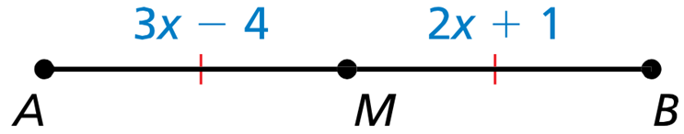

Example 2
Point $M$ is the midpoint of $\overline{AB}$. Find the length of $\overline{AB}$.
M divides AB into equal halves
3x – 4 = 2x + 1
x – 4 = 1
x = 5

Slide 12

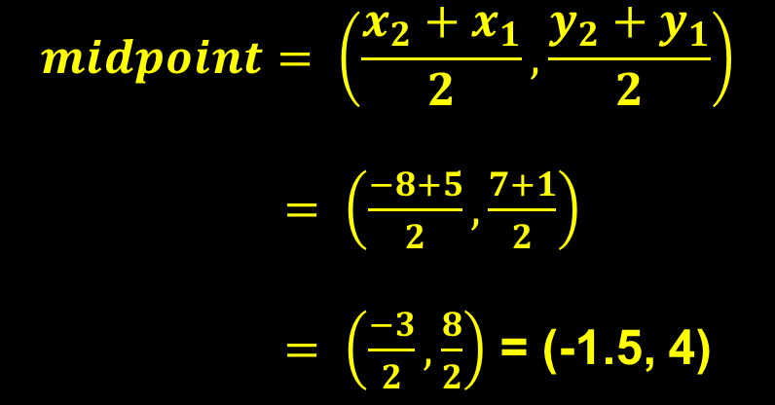
Example 3a
The endpoints of $\overline{AB}$ are $A(−8, 7)$ and $B(5, 1)$. Find the coordinates of the midpoint $M$.
Use midpoint formula (or graph)
$$midpoint= \left(\frac{x_{2}+x_{1}}{2},\frac{y_{2}+y_{1}}{2}\right)$$
$= \left(\frac{−8+5}{2},\frac{7+1}{2}\right)$
$= \left(\frac{−3}{2},\frac{8}{2}\right)$ = (-1.5, 4)

Slide 13
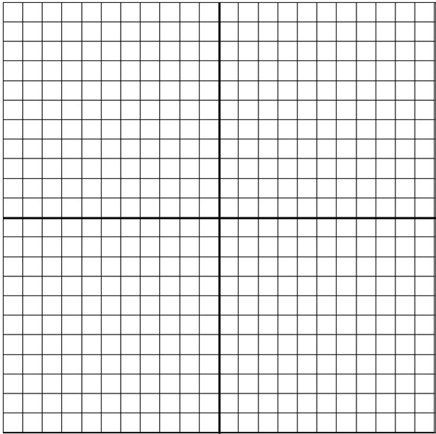

Example 3b
The midpoint of $\overline{PQ}$ is $M(2, −3)$. One endpoint is $P(4, 1)$. Find the coordinates of endpoint $Q$.
Travel problem (graph it!)
(2, -3) Midpoint (M)
(4, 1) Endpoint (P)
(-2, -4) Travel
(2, -3) Midpoint (M)
(0, -7) Other Endpoint (Q)
P
Travel: Left 2 and Down 4
M
Q

Slide 14
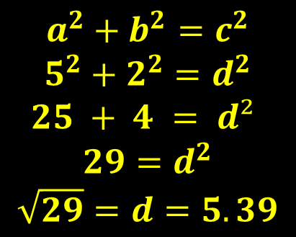
Example 4
Your school is 4 miles east and 1 mile south of your apartment. You bicycle 5 miles east and then 2 miles north from your apartment to a friend’s house. Estimate the distance between your friend’s house and your school.
$$a^{2}+b^{2}=c^{2}$$
$$5^{2}+2^{2}=d^{2}$$
$25 + 4 = d²$
$$29=d^{2}$$
$$\sqrt{29}=d=5.39$$
Friends
Home
School

Slide 15
Summary & Homework
Summary:
  Distances can be determined on a number line or a coordinate plane by
    using the Distance Formula or
    Pythagorean Theorem (on SOL formula sheet)
  The midpoint of a segment is the point halfway between the segment’s endpoints
  If given an endpoint and a midpoint, then find the other end by “traveling” the same distance (using a graph or equations)
Homework:
  Midpoint WS 1, Midpoint WS 2, Distance WS

