Slide 1
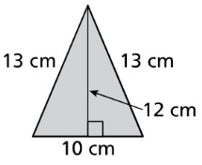
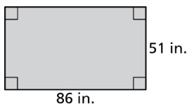
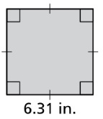
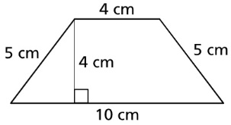
Opening
Find the perimeter and area of the polygon
A = bh
= (10)(12)
= 120
A = lw
= (86)(51)
= 4386
P = 2(l + w)
= 2(86 + 51) = 274
P = 13 + 13 + 12 = 38
A = s²
= (6.31)²
= 39.82
A = ½ h(b₁ + b₂)
= ½ 4(4 + 10)
= 2(14)
= 28
P = 4s
= 4(6.31) = 25.24
P = 4 + 5 + 10 + 5
= 24

Slide 2
Lesson 1-4
Perimeter and Area in the Coordinate Plane

Slide 3
Lesson Outline
Five-Minute Check
Objectives
Vocabulary
Core Concepts
Examples
Summary and Homework

Slide 4



5-Minute Check on Lesson 1-3
The endpoints of QR are Q(1, 6) and R(-7, 3). Find the coordinates of the midpoint M.
Find the distance between S(-5, -2) and T(-3, 4).
Identify the segment bisector of QR and then find QR.
The midpoint of GH is M(4, -3). If G(-2, 2), then find H’s coordinates.
M = $\left(\frac{1+−7}{2},\frac{6+3}{2}\right)$ = (-3, 4.5)
d = $\sqrt{2^{2}+6^{2}}=\sqrt{40}=6.32$
Line l is the bisector
2x + 6 = 5x – 9 x = 5 QR = 7(5) – 3 = 32
Midpoint (4, -3) Midpoint (4, -3)
- Endpoint (-2, 2) + Travel (6, -5)
Travel (6, -5) Other Endpoint (10, -8)
Click the mouse button or press the
Space Bar to display the answers.

Slide 5
Objectives
Classify polygons
Find perimeters and areas of polygons in the coordinate plane

Slide 6
Vocabulary
Concave – if any line aligned to the sides of the figure passes through its interior
Convex – not concave (“side line” does not passes through interior)
Irregular polygon – not regular (not all angles equal or not all sides equal)
n-gon – a polygon with n sides
Perimeter – the sum of the lengths of sides of the polygon
Polygon – a closed plane figure formed by three or more line segments called sides
Regular polygon – a convex polygon with all segments congruent & all angles congruent
Sides – line segments that make up a polygon

Slide 7
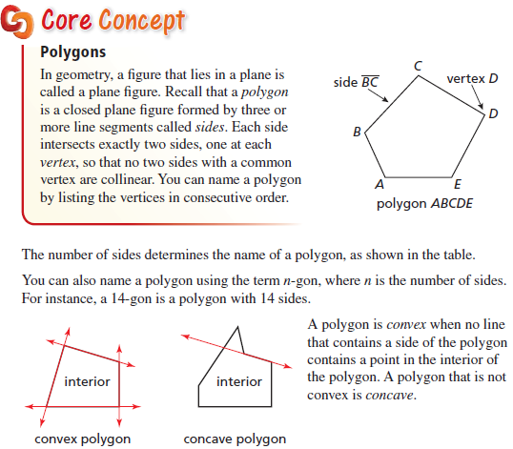
Core Concept
Sides | Name
3 | Triangle
4 | Quadrilateral
5 | Pentagon
6 | Hexagon
7 | Heptagon
8 | Octagon
9 | Nonagon
10 | Decagon
12 | Dodecagon
N | N - gon

Slide 8
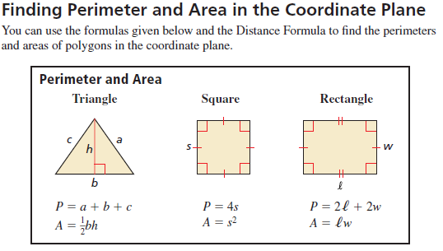
Perimeter and Area

Slide 9
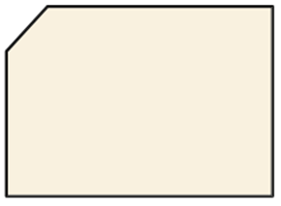

Example 1
Classify each polygon by the number of sides. Tell whether it is convex or concave.
Pentagon
Convex
Dodecagon
Concave

Slide 10
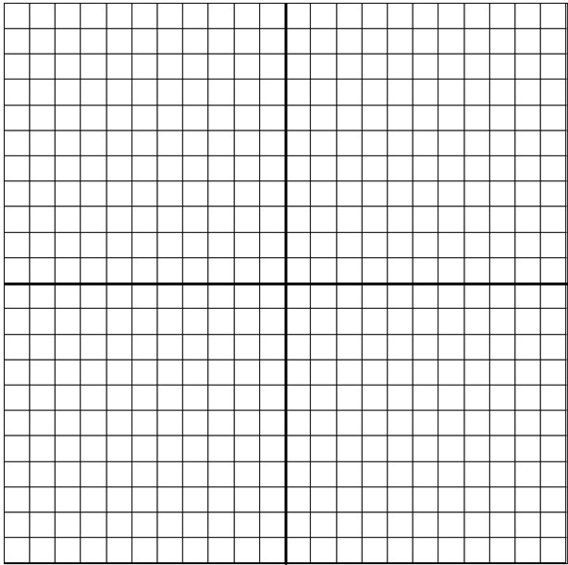
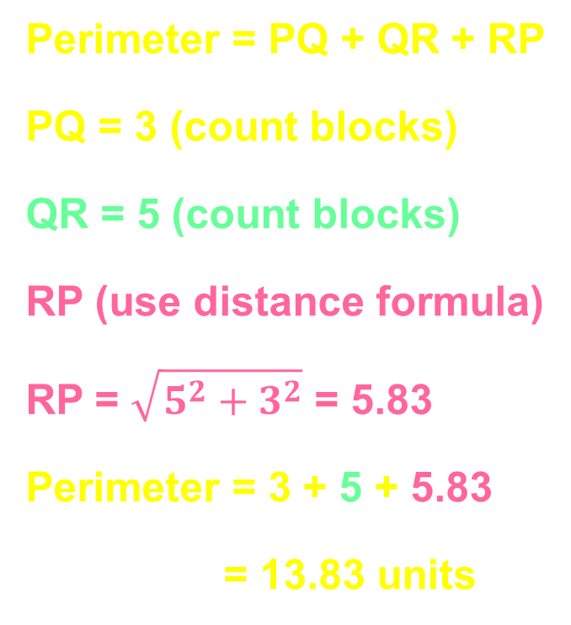

Example 2
Find the perimeter of $∆PQR$ with vertices $P(−1, 4)$, $Q(2, 4)$, and $R(2, −1)$.
Perimeter = PQ + QR + RP
PQ = 3 (count blocks)
QR = 5 (count blocks)
RP (use distance formula)
RP = $\sqrt{5^{2}+3^{2}}$ = 5.83
Perimeter = 3 + 5 + 5.83
= 13.83 units
P
Q
R

Slide 11
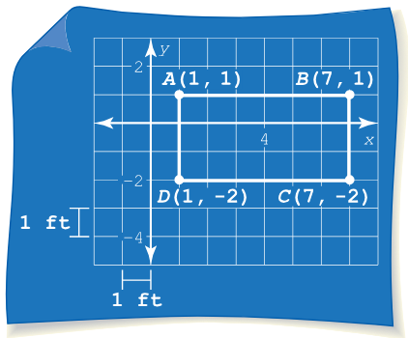

Example 3
You are making a banner for the school basketball game. The diagram shows the four vertices of the banner. Each unit in the coordinate plane represents $1$ foot. Find the area of the banner.
Area of a rectangle
A = l × w
A = 6 × 3
A = 18 sq ft

Slide 12

Example 4
Find the area of $∆ABC$ with vertices $A(1, 3)$, $B(3, −3)$, and $C(−2, −3)$.
Area of a triangle
A = ½ bh
A = ½ (5)(6)
A = 15 sq units
A
height
C
base
B

Slide 13
Summary & Homework
Summary:
  Figures are either concave or convex, regular or irregular
  Concave has one interior angle greater than 180 (or a “cave” like indentation)
  Regular means all parts (sides or angles) are equal
  Perimeter is a one-dimensional measure of length around a figure (add up its sides)
  Area is a two-dimensional measure of surface (square feet or feet² -- square units of measure)
  Area of commonly used figures are on SOL formula sheet (but not always perimeter formulas)
    Square: Perimeter = 4s Area = s²
    Rectangle: Perimeter = 2l + 2w Area = lw
    Triangle: Perimeter = all sides added Area = ½ bh
Homework:
  Figures WS

