Slide 1
Opening
Solve the equation to find the value of the variable
x° + 40° = 110°
r° – 44° = 135°
n° – 19° = 125°
y° – 55° = 35°
2t° + 10° = 140°
2w° – 65° = 175°
x = 70°
r = 179°
n = 144°
y = 90°
t = 65°
w= 120°

Slide 2
Lesson 1-5
Measuring and
Constructing Angles

Slide 3
Lesson Outline
Five-Minute Check
Objectives
Vocabulary
Core Concepts
Examples
Constructions
Summary and Homework

Slide 4
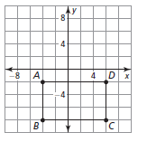
5-Minute Check on Lesson 1-5
Find the perimeter and area of the figure shown.
Find the area and perimeter of a rectangle with width 10 and length of 15.
Find the area and perimeter of a square with a side of 6.
Name and classify the following:
P = 2(l + w) = 2(5 + 3) = 16
A = lw = 5(3) = 15
P = 2(l + w) = 2(15 + 10) = 50 A = lw = 15(10) = 150
P = 4s = 4(6) = 24 A = s² = 6² = 36
Heptagon
convex
Hexagon
concave

Slide 5
Objectives
Name angles
Measure and classify angles
Identify congruent angles
Use the Angle Addition Postulate to find angle measures
Bisect angles

Slide 6
Vocabulary
Angle – set of all points consisting of two different rays that have the same endpoint (vertex)
Angle Bisector – a ray that divides an angle into two congruent angles
Congruent angles – have the same measure
Degree – one three hundred and sixtieth of a circle
Exterior – region of all points not between the two rays that form the angle
Interior – region of all points between the two rays that form the angle
Opposite rays – are collinear rays with the same end point (& form a 180 degree angle)

Slide 7
Vocabulary (cont)
Ray – part of a line with one end point
Sides – composed of rays
Types of angles:
  Right angle – measure of the angle equal 90 degrees
  Acute angle – measure of the angle is less than 90 degrees
  Obtuse angle – measure of the angle is greater than 90 degrees (but less than 180)
  Straight angle – measures 180 degrees (a line)
Vertex – is the common endpoint (hinge of an angle)

Slide 8
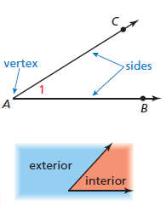

Core Concept
Vertex is always in the middle of a three letter angle name.
Angle Names:
Angle Sides
∠1
∠A (if not confusing)
∠CAB
∠BAC
Rays $\vec{AC} and \vec{AB}$

Slide 9
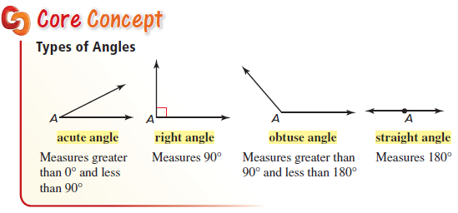
Core Concept
Note: some people view a straight angle as a line and not an angle

Slide 10
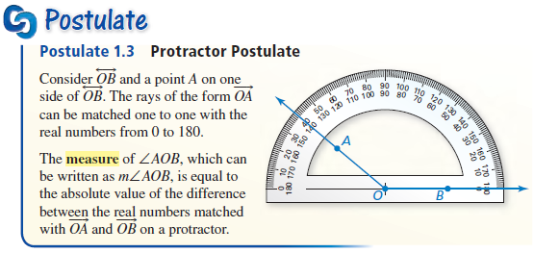
Protractor Postulate
Note: m∠AOB = 140° (an obtuse angle)

Slide 11
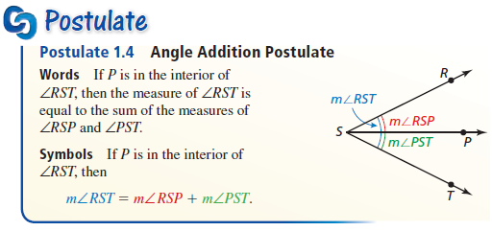
Angle Addition Postulate
Note: This is the sum of the parts is equal to the whole

Slide 12
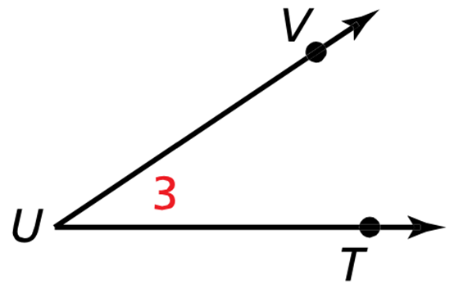
Example 1
Write three names for the angle
∠3
∠U
∠TUV
∠VUT

Slide 13
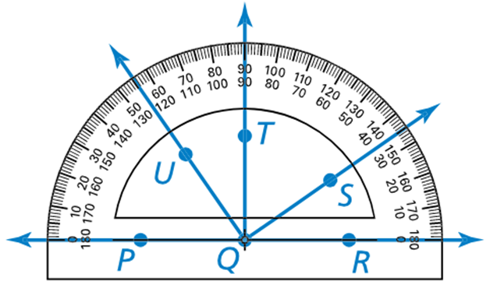

Example 2
Find the measure of each angle.
Then classify each angle.
a. $∠RQU$
b. $∠TQU$
c. $∠UQS$
m∠RQU = 125°
obtuse
m∠TQU = 35°
acute
m∠UQS = 90°
right

Slide 14
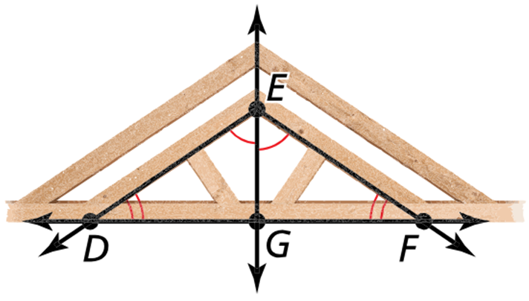

Example 3
Identify the congruent angles
in the roof frame.
If $m∠EDG=40°$. What is $m∠EFG$?
∠DEG ≅ ∠FEG
∠EDG ≅ ∠EFG
(and ∠DBE ≅ ∠FGE
By third angle theorem)
∠EDG ≅ ∠EFG so if m∠EDG = 40° the m∠EFG = 40°

Slide 15
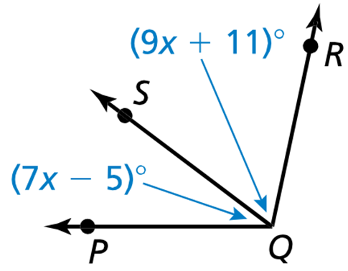
Example 4
Given that $m∠PQR=102°$, find $m∠SQR$ and $m∠PQS$.
Sum of the parts = whole
m∠PQS + m∠SQR = m∠PQR
(7x – 5)° + (9x + 11)° = 102°
(CLT !) 16x + 6 = 102
16x = 96
x = 6

Slide 16
Example 5
$\vec{VB}$ bisects $∠AVC$ and $m∠AVC=158°$. Find $m∠BVC$.
Bisects – cuts in half !!
m∠BVC is half of m∠AVC
m∠BVC = ½ (158°)
= 79°

Slide 17
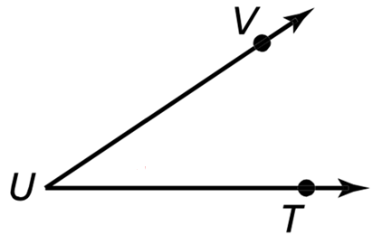
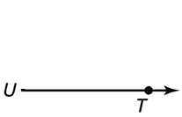
Construction 1
Copy the given angle
Copy -> Equal Angles
Don’t trust that UV = UT
Steps:
1) Draw an arc centered at the vertex crossing both sides of the angle. Repeat on new angle
2) Draw an arc measuring the distance from the lower ray to the upper ray. Repeat on new angle
3) Draw line connecting arc intersection and vertex

Slide 18
Construction 2
Bisects – cuts in half !!
Don’t trust that UV = UT
Bisect the given angle
Steps:
1) Draw an arc centered at the vertex crossing both sides of the angle.
2) Draw same arc centered at each intersection point on angle’s rays
3) Draw line from vertex to intersection of the step 2 arcs in the interior of the angle

Slide 19
Summary & Homework
Summary:
  Angles named with three letters and the vertex (hinge point) is always the middle letter
  Angles are classified by their measures as acute, right, obtuse or straight
  Congruent angles have equal measure
  Angle bisector cuts an angle into two equal halves
Homework:
  Angle WS 1 (naming and classifying)

