Slide 1
Opening
Solve
4x – 0 = 12
7 = -11c – 4
11 = -19x – 8
7 = 5n + 5 – 4n
3x + 2 + 8 = 2x – 5
x + 5 + 6x + 17 = x – 2
x = 3
c = -1
x = -1
n = 2
x = -15
x = -4

Slide 2
Lesson 1-6
Describing Pairs of Angles

Slide 3
Lesson Outline
Five-Minute Check
Objectives
Vocabulary
Core Concepts
Examples
Summary and Homework

Slide 4
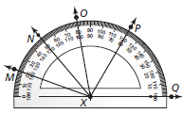
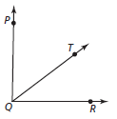
5-Minute Check on Lesson 1-5
Find the angle measure and classify the angle
m∠MXN
m∠NXP
m∠OXQ
Use the diagram and the given angle measures to find the indicated measure.
m∠PQT = 41.5° and m∠TQR = 48°. Find m∠PQR.
m∠PQR = 89° and m∠TQR = (2x + 4)°
and m∠PQT = (3x + 5). Find x
= 30° and acute
= 70° and acute
= 110° and obtuse
m∠PQR = 41.5 + 48 = 89.5
m∠PQR = 89 = (2x + 4) + (3x + 5) = 5x + 9 x = 16

Slide 5
Objectives
Identify complementary and supplementary angles
Identify linear pairs and vertical angles

Slide 6
Vocabulary
Adjacent angles – two coplanar angles that have a common vertex, a common side, but no common interior points
Complementary Angles – two angles whose measures sum to 90
Linear pair – a pair of adjacent angles whose noncommon sides are opposite rays
Perpendicular – two lines or rays are perpendicular if the angle (s) formed measure 90°
Supplementary Angles – two angles whose measures sum to 180
Vertical angles – two non-adjacent angles (opposite) formed by two intersecting lines; vertical angles are congruent (measures are equal)!!

Slide 7
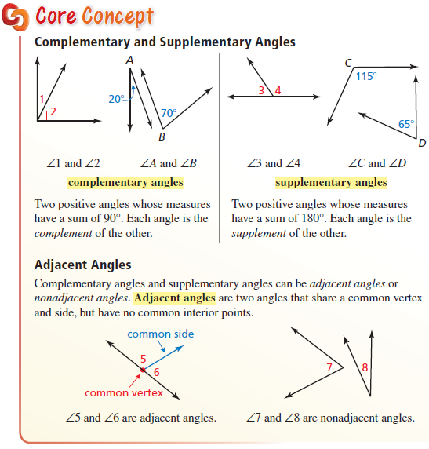
Core Concept

Slide 8
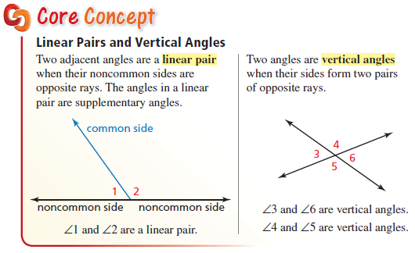
Core Concept
Rite Aid
KFC
Wendys
Food City

Slide 9
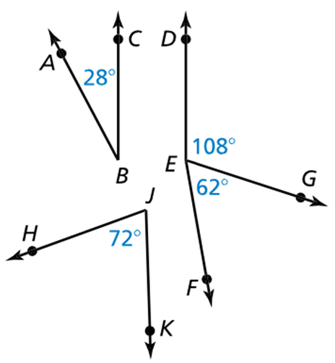
Example 1
In the figure, name a pair of complementary angles
a pair of supplementary angles
and a pair of adjacent angles.
∠ABC and ∠FEG add to 90°
∠HJK and ∠DEG add to 180°
∠DEG and ∠FEG note: always has two common letters

Slide 10

Example 2
$∠5$ is a complement of $∠3$, and $m∠3=53°$. Find $m∠5$.
$∠4$ is a supplement of $∠2$, and $m∠4=29°$. Find $m∠2$.
∠5 + ∠3 = 90°
∠5 + 53° = 90°
∠5 = 37°
∠4 + ∠2 = 180°
29° + ∠2 = 180°
∠2 = 151°

Slide 11


Example 3
The veins in a leaf form a pair of supplementary angles. Find the measures of the angles when
$m∠1=(7x+13)°$ and $m∠2=(25x+7)°$
m∠1 + m∠2 = 180° (supplementary)
(7x + 13) + (25x + 7) = 180°
32x + 20 = 180° (CLT !)
32x = 160
x = 5

Slide 12
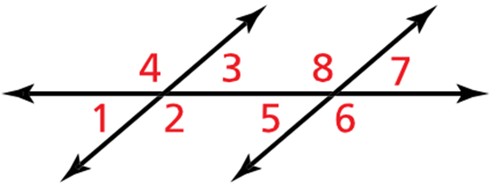
Example 4
Identify all of the linear pairs
and all of the vertical angles in the figure.
1 with 2 and 4
2 with 1 and 3
3 with 2 and 4
4 with 1 and 3
5 with 6 and 8
6 with 5 and 7
7 with 6 and 8
8 with 5 and 7
1 and 3
2 and 4
5 and 7
6 and 8

Slide 13
Example 5
Two angles form a linear pair. The measure of one angle is eight times the measure of the other angle. Find the measure of each angle.
m∠1 + m∠2 = 180° (linear pairs are supplementary)
m∠1 = 8 (m∠2) let m∠2 = x, so m∠1 = 8x
(8x ) + (x ) = 180°
9x = 160°
x = 20

Slide 14
Summary & Homework
Summary:
  There are many special pairs of angles such as
    complementary angles – angles that sum to 90 degrees
    supplementary angles – angles that sum to 180 degrees
    adjacent angles – angles that share a side
    linear pairs – adjacent angles that are supplementary (and form a straight line)
    vertical angles – angles that are across an “x” from each other
  Vertical angles are congruent
  Linear Pairs are supplementary
Homework:
  Finish Angle WS 1 (vertical angles and linear pairs)

