Slide 1
Lesson 10-1
Lines and Segments that Intersect Circles

Slide 2
Objectives
Identify special segments and lines
Draw and identify common tangents
Use properties of tangents

Slide 3
Vocabulary
Center – the central point of a circle
Chord – any segment that endpoints are on the circle
Circle – the set of all points in a plane equidistant for a given point called the center of the circle
Circumference – is the perimeter of the circle (once around the outside) C = 2πr = dπ
Common tangent – a line or segment that is tangent to two coplanar circles
Concentric circles – coplanar circle that have a common center
Diameter – a chord that contains the center of the circle

Slide 4
Vocabulary
Point of tangency – the point that the circle and tangent intersect
Radius – any segment that endpoints are the center and a point on the circle; ½ diameter
Secant – a line that intersects a circle in two points
Tangent – a line in the plane of a circle that intersects the circle in exactly one point
Tangent circles – coplanar circle that intersect in one point

Slide 5
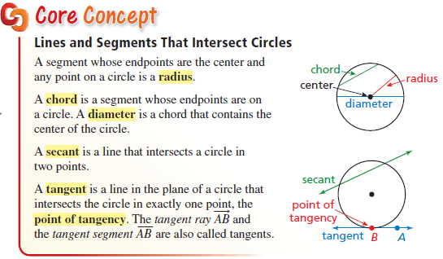
Things Intersecting Circles
Tangents are one point and secants are two points intersections.
Diameters are the longest chords

Slide 6
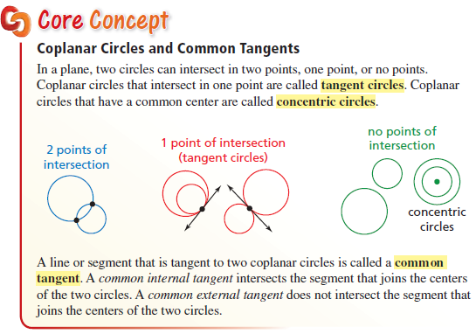
Common Tangents to Circles
Common tangents (0, 1, 2) depending on circle’s location.

Slide 7
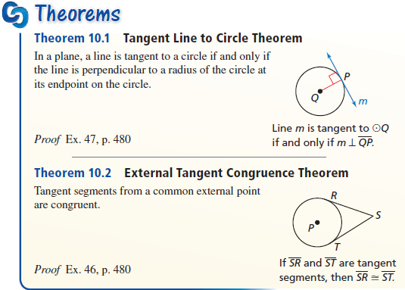
Tangents to Circles
Tangents ⊥ to radii or diameters.
Tangents congruent in length coming from the same point

Slide 8
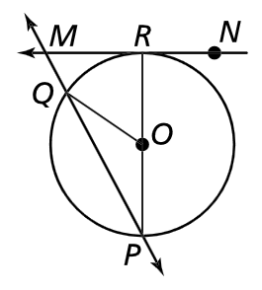

Example 1
Tell whether the line, ray, or segment is best described as a radius, chord, diameter, secant or tangent of circle O.
$\overline{PR}$
$\overset{⃡}{MN}$
$\overset{⃡}{PQ}$
$\overline{QO}$
Answer:
  Diameter (chord as well)
Tangent line (touches at R)
Chord
Radius
MP is a secant (touches at Q and P)

Slide 9
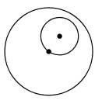


Example 2
Tell how many common tangents the circles have and draw them.
a. b. c.
None one two
Answer:

Slide 10
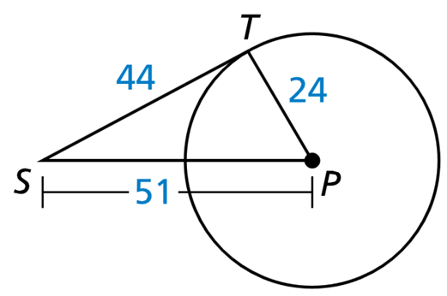
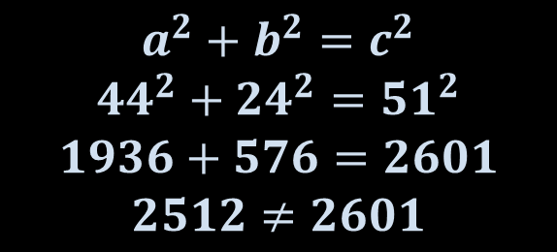

Example 3
Is $\overline{ST}$ tangent to $⊙P$?
$$a^{2}+b^{2}=c^{2}$$
$${44}^{2}+{24}^{2}={51}^{2}$$
$$1936+576=2601$$
$$2512≠2601$$
Answer: No.

Slide 11
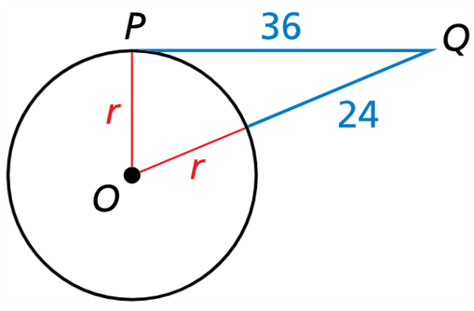
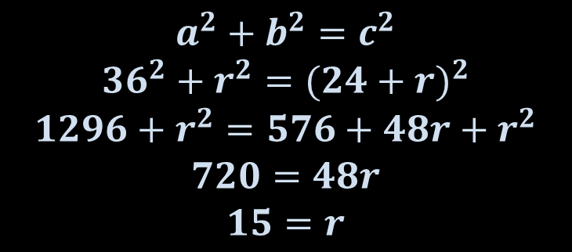

Example 4
In the diagram, point P is a point of tangency. Find the radius, r, of $⊙O$.
Answer: r = 15.
$$a^{2}+b^{2}=c^{2}$$
$${36}^{2}+r^{2}={(24+r)}^{2}$$
$$1296+r^{2}=576+48r+r^{2}$$
$$720=48r$$
$$15=r$$

Slide 12
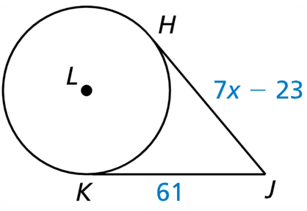
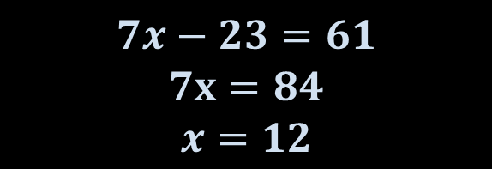

Example 5
$\overline{JH}$ is tangent to $⊙L$ at H, and $\overline{JK}$ is tangent to $⊙L$ at K. Find the value of x.
$$7x−23=61$$
$$7x=84$$
$$x=12$$
Answer: x = 12

Slide 13
Summary & Homework
Summary:
  A line that is tangent to a circle intersects the circle in exactly one point.
  A tangent is perpendicular to a radius (or diameter) of a circle
    Pythagorean Theorem applies
  Two segments tangent to a circle from the same exterior point are congruent
Homework:
  Circle Items Worksheet

