Slide 1
Lesson 10-2
Finding Arc Measures

Slide 2
Objectives
Find arc measures
Identify congruent arcs
Prove circles are similar

Slide 3
Vocabulary
Adjacent arcs – two arcs of the same circle that intersect at exactly one point
Arc – edge of the circle defined by a central angle
Central Angle – an angle whose vertex is the center of the circle with two radii as sides
Congruent arcs – arcs that have the same measure
Congruent circles – circles with equal radii
Minor Arc – an arc with the central angle less than 180° in measurement
Major Arc – an arc with the central angle greater than 180° in measurement
Semicircle – an arc with the central angle equal to 180° in measurement
Similar arcs – if and only if they have the same measure

Slide 4
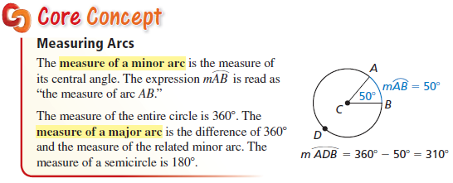
Arcs – measures
Arcs are the “perimeter” of the circle and measure in degrees
Arcs have same measure as their central angle
Minor Arcs < 180 Major Arcs > 180

Slide 5
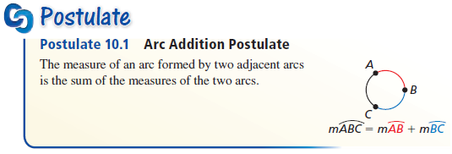
Arc Addition Postulate
All arcs in a circle sum to 360.
Sum of adjacent arc pieces is equal to the whole arc
“Sum of the parts is equal to the whole”

Slide 6
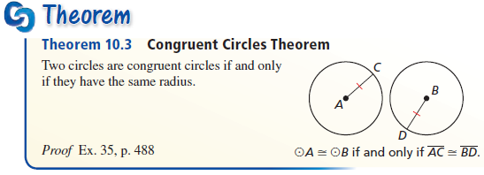
Congruent Circles
Equal radii give us congruent circles

Slide 7
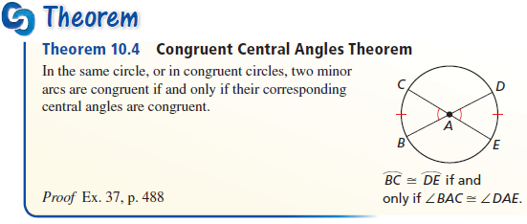
Congruent Central Angles
Equal Central angles have equal arc measures and vice-versa

Slide 8
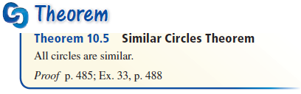
Similar Circles
Scaling factor is the ratio of the radii
Circumference ratios are the same as radii
Area, is a squared relationship, and has the ratio of the radii squared.

Slide 9
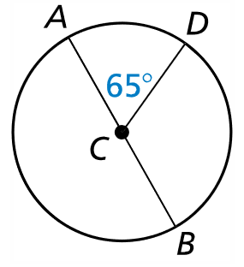

Example 1
Find the measure of each arc of $⊙C$, where $\overline{AB}$ is a diameter.
$\hat{AD}$
$\hat{DAB}$
$\hat{BDA}$
Answer:
65°
65° + 180° = 245°
180° (AB as diameter divides circle in half)

Slide 10
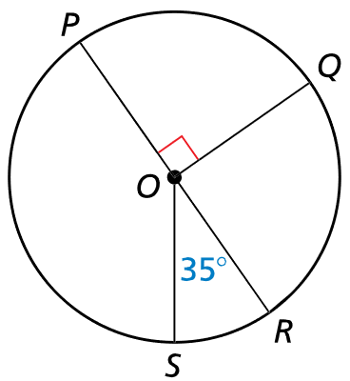

Example 2
Find the measure of each arc.
$\hat{SRQ}$
$\hat{RPQ}$
$\hat{PRS}$
Answer:
125° = 35 + 90
90°
215° = 180 + 35

Slide 11
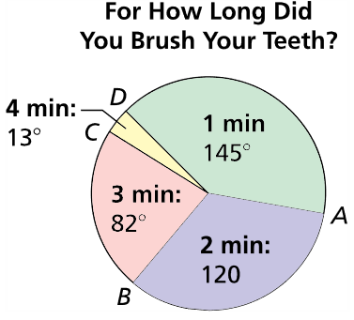

Example 3
A survey asked people how many minutes they spend brushing their teeth each morning. The circle graph shows the results. Find the indicated arc measures.
m$\hat{ABC}$
m$\hat{ACB}$
m$\hat{BD}$
m$\hat{CBD}$
Answer:
202° = 120 + 82
240° = 145 + 13 + 82
95° = 82 + 13
347° = 82 + 120 + 145

Slide 12
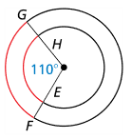
Example 4a
Tell whether the red arcs are congruent. Explain why or why not.
Answer: Yes.
The red arcs have the same central angle, so they have the same measure, but not the same length!

Slide 13
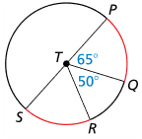
Example 4b
Tell whether the red arcs are congruent. Explain why or why not.
Answer: Yes.
If PS is a diameter, then m∠STR = 65° (180 – 65 – 50) and the measures of the arcs are equal

Slide 14

Example 4c
Tell whether the red arcs are congruent. Explain why or why not.
Answer: Yes
If LN is a diameter, then both arcs have the same central angle (90°)

Slide 15
Summary & Homework
Summary:
  Sum of measures of central angles of a circle with no interior points in common is 360°
  Measure of each arc is related to the measure of its central angle
  Length of an arc is proportional to the length of the circumference
Homework:
  none

