Slide 1
Lesson 10-3
Using Chords

Slide 2
Objectives
Use chords of circles to find lengths and arc measures

Slide 3
Vocabulary
Inscribed Polygon – all vertices lie on the circle
Circumscribed – circle contains all vertices of a polygon

Slide 4
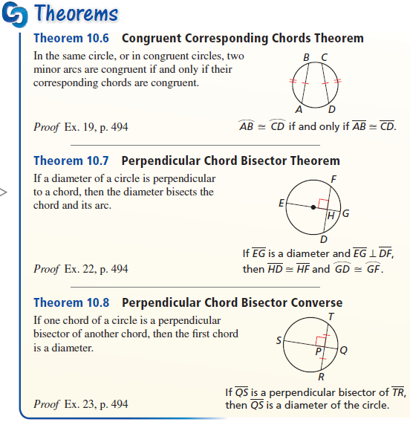
Chords and Arcs
Chords of equal distance cuts arcs into equal arcs

Slide 5
Diameters and Chords
If a diagonal (or radius) is perpendicular to a chord, then it cuts the chord in half

Slide 6
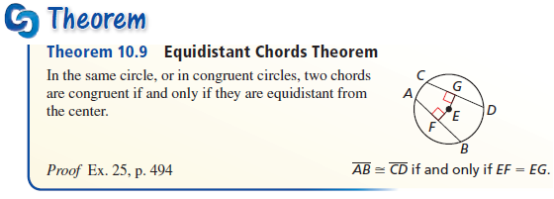
Chords and the Center
Equal length chords are equidistant from the center of the circle

Slide 7
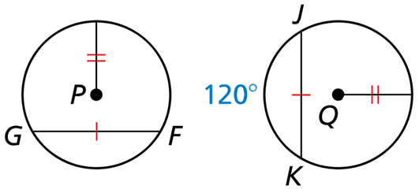

Example 1
In the diagram, $⊙P≅ ⊙Q$, $\overline{FG}≅\overline{JK}$, and $m\hat{JK}=120°$. Find $m\hat{FG}$.
Answer:
120°
GF and JK are equal chords
So they cut off equal arcs

Slide 8
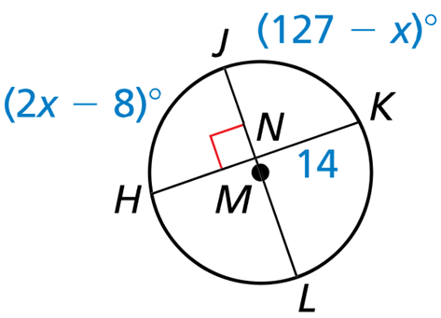

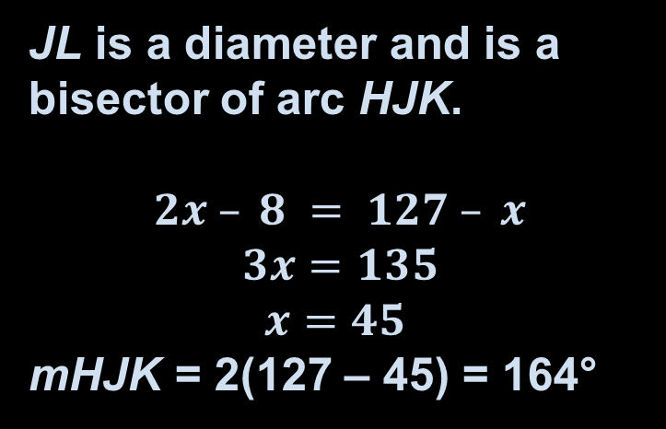
Example 2
Find KH
Find $m\hat{HLK}$
JL is a diameter and is a bisector of HK.
KH = 2 (14) = 28
JL is a diameter and is a bisector of arc HJK.
$$2x – 8 = 127 – x$$
$$3x=135$$
$$x=45$$
mHJK = 2(127 – 45) = 164°
Answer:

Slide 9
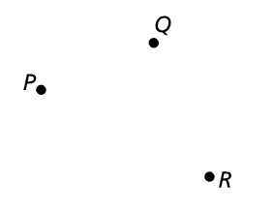
Example 3
A telephone company plans to install a cell tower that is the same distance from the centers of three towns, labeled P, Q, and R. Where should the cell tower be placed?
Answer:
Equidistant from the vertices is the circumcenter
Find the perpendicular bisectors

Slide 10
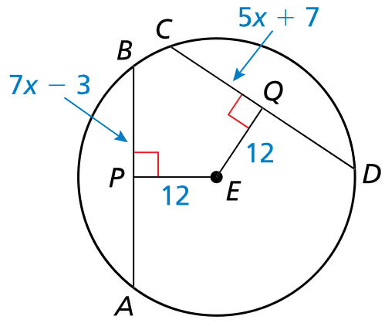
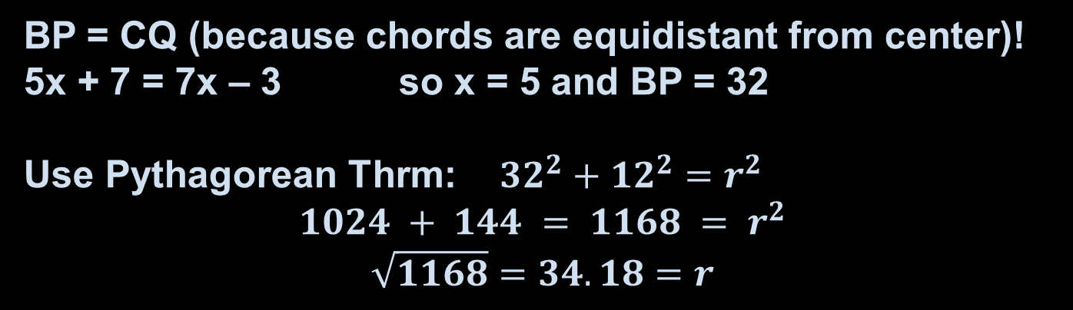

Example 4
In the diagram, $EP=EQ=12$, $CD=5x+7$, and $AB=7x−3$. Find the radius of $⊙E$.
Answer: r = 34.18
BP = CQ (because chords are equidistant from center)!
5x + 7 = 7x – 3 so x = 5 and BP = 32
Use Pythagorean Thrm: ${32}^{2}+{12}^{2}=r^{2}$
$$1024 + 144 = 1168 = r^{2}$$
$$\sqrt{1168}=34.18=r$$

Slide 11
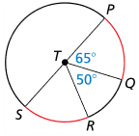
Example 4b
Tell whether the red arcs are congruent. Explain why or why not.
Answer: Yes.
If PS is a diameter, then m∠STR = 65° (180 – 65 – 50) and the measures of the arcs are equal

Slide 12

Example 4c
Tell whether the red arcs are congruent. Explain why or why not.
Answer: Yes
If LN is a diameter, then both arcs have the same central angle (90°)

Slide 13
Summary & Homework
Summary:
  The endpoints of a chord are also the endpoints of an arc
  Diameters and radii that are perpendicular to chords bisect chords and intercepted arcs
Homework:
  none

