Slide 1
Lesson 10-4
Inscribed Angles and Polygons

Slide 2
Objectives
Use inscribed angles
Use inscribed polygons

Slide 3
Vocabulary
Circumscribed circle – the circle that contains the vertices of an inscribed polygon
Inscribed Angle – an angle with its vertex on the circle and whose sides contain chords of the circle
Inscribed Polygon – a polygon whose vertices lie on a circle
Intercepted arc – an arc that lies between two lines, rays or segments
Subtend – the sides or arc of an inscribed angle

Slide 4
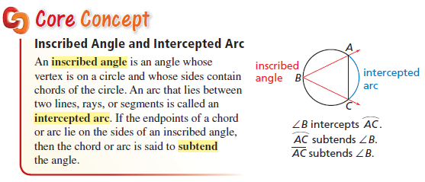
Chords and Arcs
Inscribed angle has chords for sides and its vertex is on the edge of the circle

Slide 5
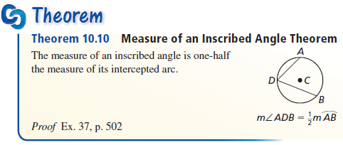
Diameters and Chords
Inscribed angle is equal to ½ of it’s arc

Slide 6
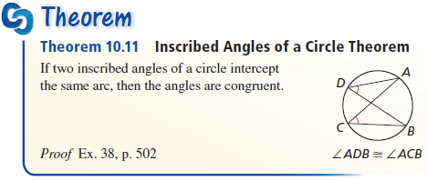
Chords and the Center
Equal length chords are equidistant from the center of the circle

Slide 7
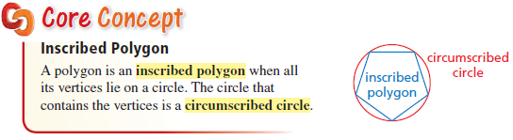
Chords and the Center
Equal length chords are equidistant from the center of the circle

Slide 8
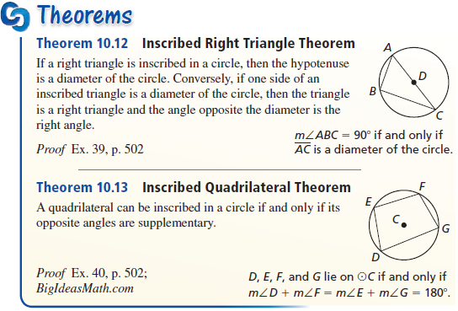
Chords and the Center
Equal length chords are equidistant from the center of the circle

Slide 9
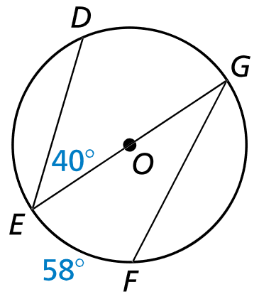

Example 1
Find the indicated measure.
$\hat{mDG}$
$m∡G$
Answer:
80° = 2(40)
29° = ½ (58)

Slide 10
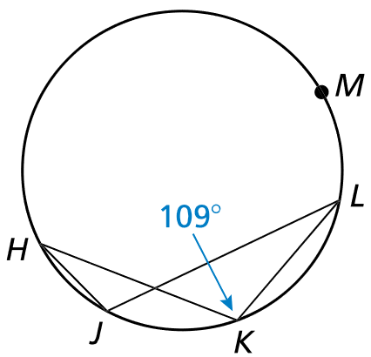


Example 2
Find $m\hat{HML}$ and $m\hat{HJL}$. What do you notice about $∡HKL$ and $∡LKH$?
Answer:
$m\hat{HML}$ = 2(109) = 218
$m\hat{HJL}=360 −m\hat{HML}=142$
Same angle, letters reversed
Angle HJL and HKL both share the same arc, so they must be equal

Slide 11
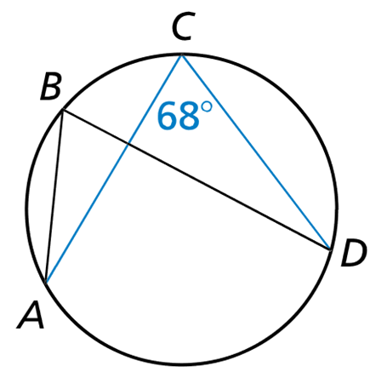


Example 3
Given $m∡C=68°$, find $m∡B$.
Answer:
$$m∡=68°$$
Both angles share the same arc, AD, so both angles are equal

Slide 12
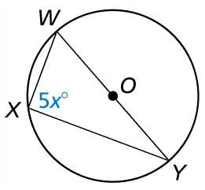
Example 4a
Find the value of each variable.
Answer: x = 18
Angle x has a semi-circle for an intercepted arc (WY is a diameter). 5x = ½(180 5x = 90 x = 18

Slide 13
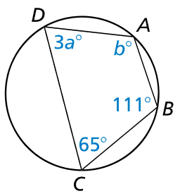
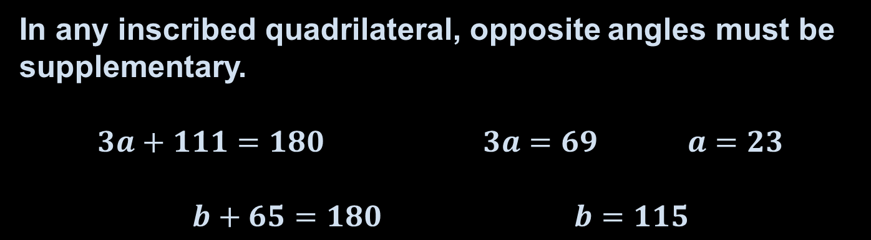
Example 4b
Find the value of each variable.
Answer: a = 23, b = 115
In any inscribed quadrilateral, opposite angles must be supplementary.
$$3a+111=180 3a=69 a=23$$
$$b+65=180 b=115$$

Slide 14
Summary & Homework
Summary:
  The measure of the inscribed angle is half the measure of its intercepted arc
  The angles of inscribed polygons can be found by using arc measures
  Opposite angles in inscribed quadrilaterals are supplementary
Homework:
  none

