Slide 1
Lesson 10-5
Angle Relationships in Circles

Slide 2
Objectives
Find angle and arc measures
Use circumscribed angles

Slide 3
Vocabulary
Tangent – a line that intersects a circle in exactly one point
Point of tangency – point where a tangent intersects a circle

Slide 4
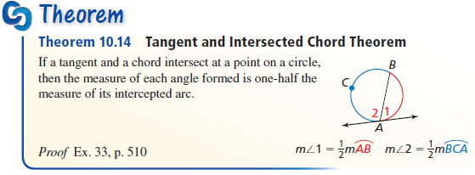
Tangents and Inscribed Angles
Angle 1 and 2 are a linear pair (adds to 180°)
The two arcs ACB and AB must add to 360°

Slide 5
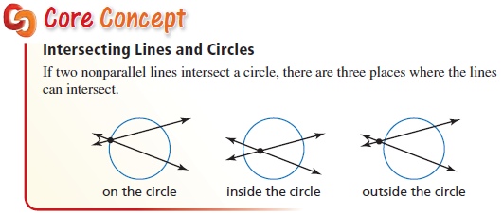
Intersecting Lines and Circles
Intersection point can be inside, on the edge or outside the circle

Slide 6
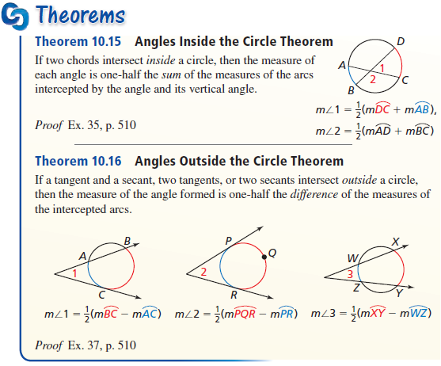


Interior and Exterior Angles
$$Int angle=\frac{(front arc+back arc)}{2}$$
$$Ext angle=\frac{(far arc −near arc)}{2}$$

Slide 7
Circles – External Angles
Two Secants
Secant & Tangent
Two Tangents
J
J
J
L
K
K
T
S
T
M
M
M
N
m∠J = ½(m Arc TM – m Arc TK)
m∠J = ½|m Arc TM – m Arc TK|
m∠J = ½(m Arc MN – m Arc LK)
m∠J = ½|m Arc MN – m Arc LK|
m∠J = ½(m Arc TMS – m Arc TS)
m∠J = ½|m Arc TMS – m Arc TS|

Slide 8
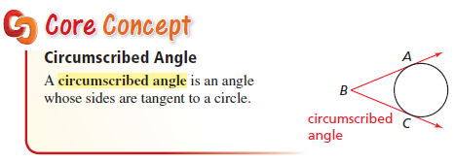
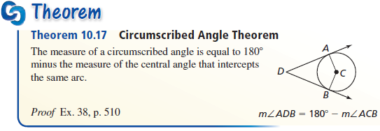
Circumscribed Angles
Derived from 360 around the circle and two tangents

Slide 9
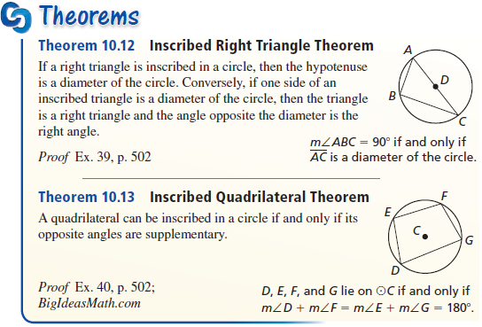
Chords and the Center
Equal length chords are equidistant from the center of the circle

Slide 10
Angles and Circles
Angle | Vertex | Sides | Formula (arcs) | Picture
Central | Center | Radii | = arc
Inscribed | Edge | Chords | = ½ arc
Interior | Inside (not at center) | Chords | = ½ (arc1+arc2)
Exterior | Outside | Secants Tangents | = ½ (Far arc – Near arc)
arc
arc
arc1
arc2
NA
FA

Slide 11
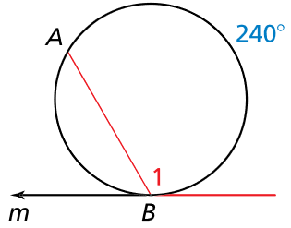
Example 1a
Line m is tangent to the circle. Find the measure of the red angle or arc.
Answer:
120° = ½ (240)

Slide 12
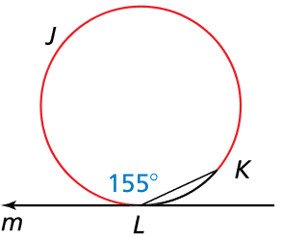
Example 1b
Line m is tangent to the circle. Find the measure of the red angle or arc.
Answer:
155° = ½ (x)
310° = x

Slide 13
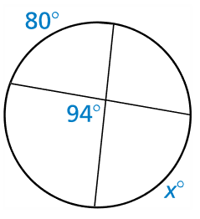
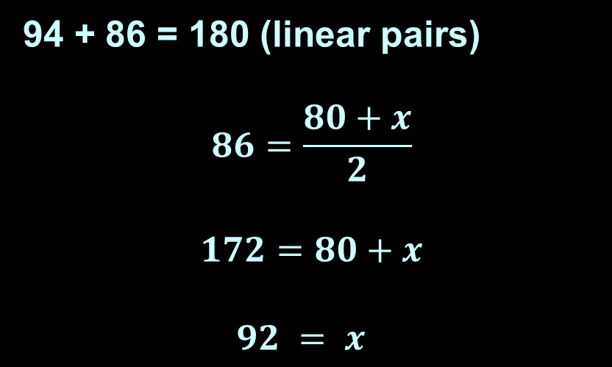
Example 2a
Find the value of x.
Answer:
94 + 86 = 180 (linear pairs)
$$86=\frac{80+x}{2}$$
$$172=80+x$$
$92 = x$

Slide 14
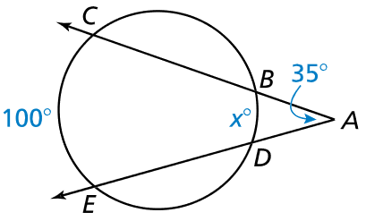

Example 2b
Find the value of x.
Answer:
$$35=\frac{100−x}{2}$$
$$70=100−x$$
$x =30$

Slide 15
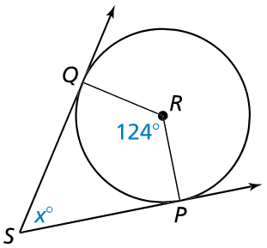

Example 3a
Find the value of x.
Answer:
$x + 124 = 180$
$x=56$
Or
$x=\frac{(\left(360−124\right)−124)}{2}$
$x=180−124=56$

Slide 16
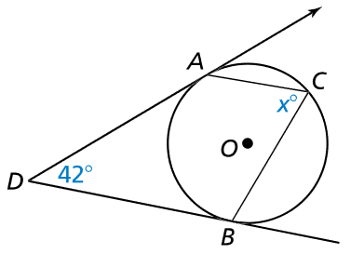
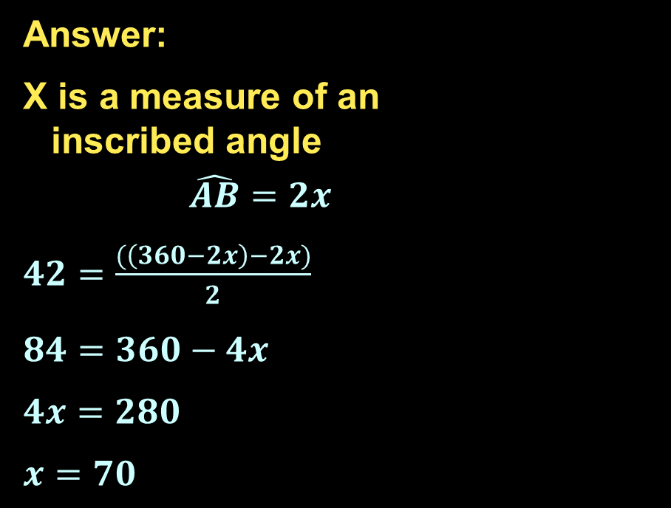
Example 3b
Find the value of x.
Answer:
X is a measure of an
inscribed angle
$$\hat{AB}=2x$$
$42=\frac{(\left(360−2x\right)−2x)}{2}$
$84=360−4x$
$4x=280$
$x=70$

Slide 17
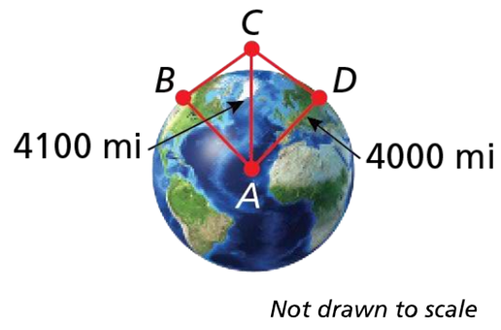


Example 4
Use the information (radius of Earth is about 4000 miles). A flash occurs 100 miles above Earth at point C. Find the measure of $\hat{BD}$, the potion of Earth from which the flash is visible.
Answer: x = 154.54°
$$∡CAD=\sin^{−1}\left(\frac{4000}{4100}\right)=77.32°$$
$$\hat{BD}=2\left(77.32\right)=154.64°$$

Slide 18
Summary & Homework
Summary:
  Central angle is equal to its arc
  Inscribed angle is equal to half of its arc
  Interior angle is equal to the average of the sum of its vertical angle pairs
  Exterior angle is equal to the average of the difference of far and near arcs
Homework:
  Circle Angles Worksheet

