Slide 1
Lesson 10-6
Segment Relationships in Circles

Slide 2
Objectives
Use segments of chords, tangents, and secants

Slide 3
Vocabulary
Secant – a line that intersects a circle in exactly two points

Slide 4
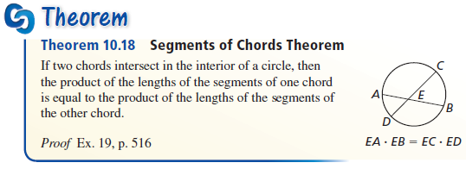
Tangents and Inscribed Angles
The two parts of one chord multiplied together is equal to the two parts of the other chord multiplied together

Slide 5
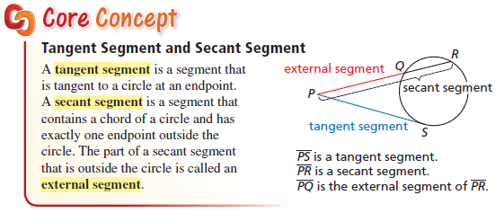
Intersecting Lines and Circles
Intersection point can be inside, on the edge or outside the circle

Slide 6
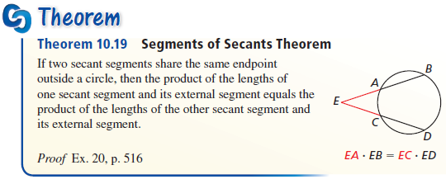
Secant Segments
Outside x Whole = Outside x Whole

Slide 7
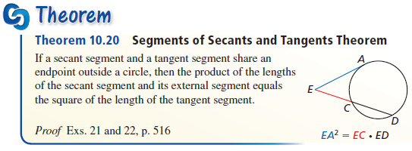
Secant and Tangent Segments
Outside x Whole = Outside x Whole
Outside x Whole = Outside x (Outside + 0)
Outside x Whole = Outside²

Slide 8
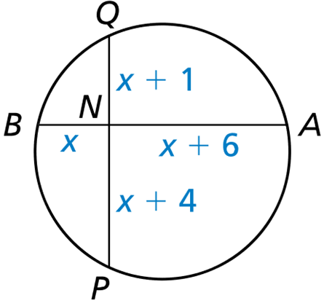
Example 1
Find AB and PQ.
Answer:
x(x + 6) = (x + 1)(x + 4)
x² + 6x = x² + 5x + 4
x = 4
AB = 2x + 6 = 14
PQ = 2x + 5 = 13

Slide 9
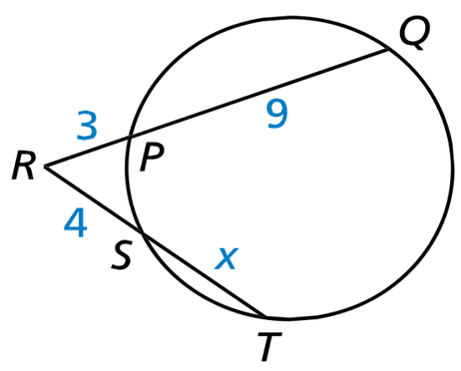
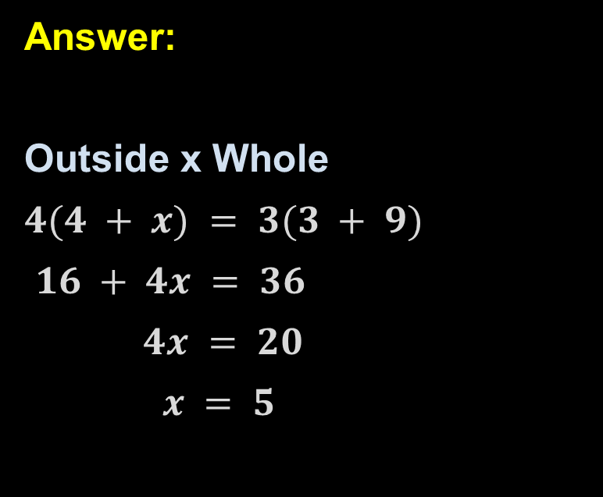
Example 2
Find the value of x.
Answer:
Outside x Whole
$4(4 + x) = 3(3 + 9)$
$16 + 4x = 36$
$4x = 20$
$x = 5$

Slide 10
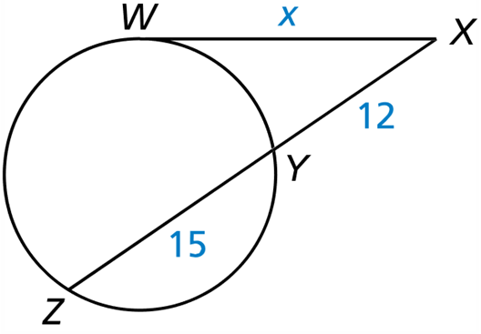
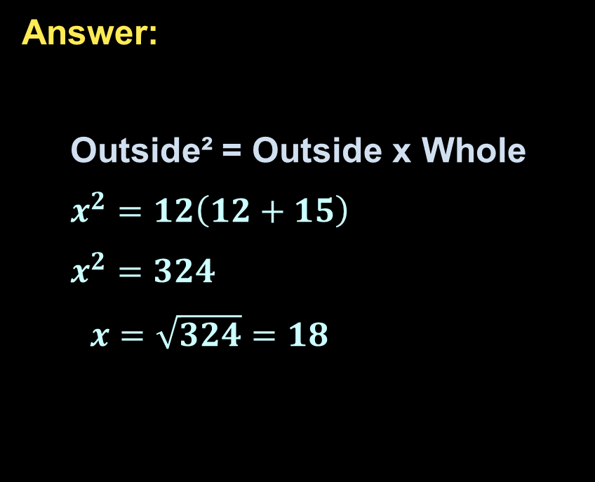
Example 3
Find the value of x.
Answer:
Outside² = Outside x Whole
$x^{2}=12\left(12+15\right)$
$x^{2}=324$
$x=\sqrt{324}=18$

Slide 11
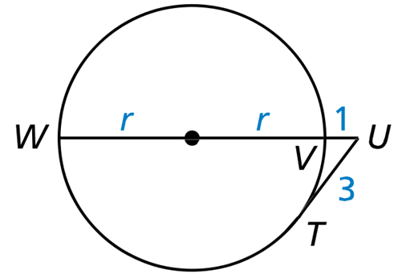
Example 4
Find the radius of the circle.
Answer: r = 4
Outside² = Outside x Whole
3² = 1(1 + r + r)
9 = 1 + 2r
8 = 2r
4 = r

Slide 12
Summary & Homework
Summary:
  The length of segments inside the circle are found using:
    Part of segment x other part of segment = Part of the second segment x other part of second segment
  The length of segments outside the circle are found using:
    Outside x Whole = Outside x Whole
Homework:
  Circle Angles Worksheet

