Slide 1
Lesson 10-7
Circles in the Coordinate Plane

Slide 2
Objectives
Write and graph equations of circles
Write and coordinate proofs involving circles
Solve real-life problems using graphs of circles

Slide 3
Vocabulary
None new

Slide 4
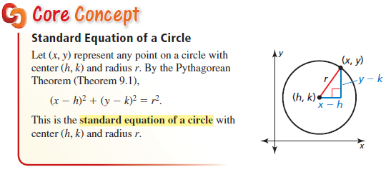
Standard Equation of a Circle
Formula is on our SOL formula sheet
It is derived from Pythagorean Theorem
It is the basis of Unit Circle Trigonometry

Slide 5
Important Parts to Finding the Equation of a Circle
Any point on the edge of the circle will satisfy the equation of a circle – make the equation a true statement
The midpoint of the diameter is the center of the circle
The distance from the center to the edge (or a point on the edge) is the radius

Slide 6
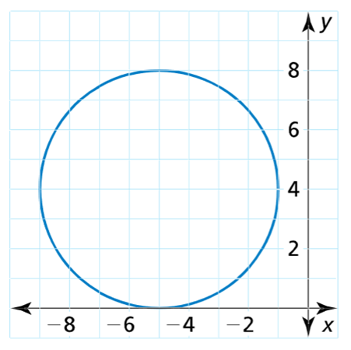
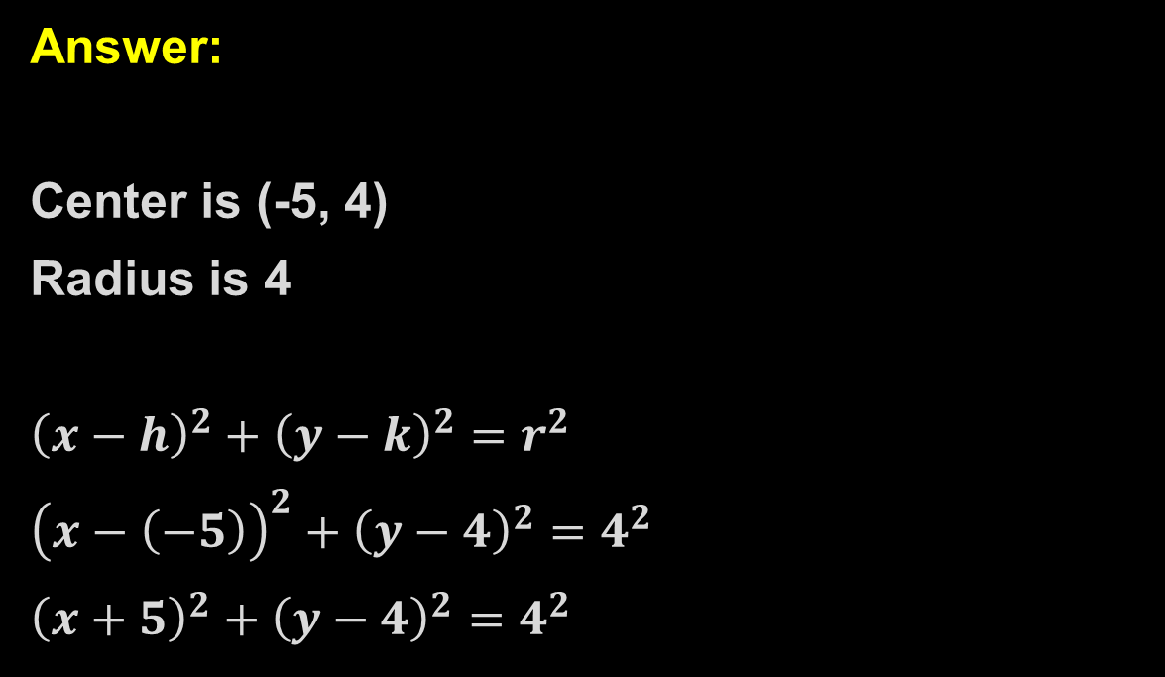
Example 1a
Write the standard equation of the circle:
Answer:
Center is (-5, 4)
Radius is 4
${\left(x−h\right)}^{2}+{\left(y−k\right)}^{2}=r^{2}$
${\left(x−\left(−5\right)\right)}^{2}+{\left(y−4\right)}^{2}=4^{2}$
${\left(x+5\right)}^{2}+{\left(y−4\right)}^{2}=4^{2}$

Slide 7
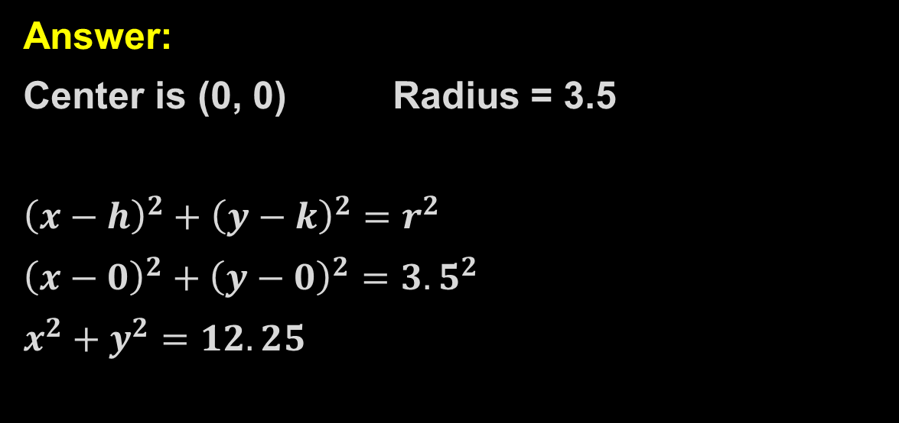
Example 1b
Write the standard equation of the circle:
b) A circle with center at the origin and radius 3.5
Answer:
Center is (0, 0) Radius = 3.5
${\left(x−h\right)}^{2}+{\left(y−k\right)}^{2}=r^{2}$
${\left(x−0\right)}^{2}+{\left(y−0\right)}^{2}={3.5}^{2}$
$x^{2}+y^{2}=12.25$

Slide 8
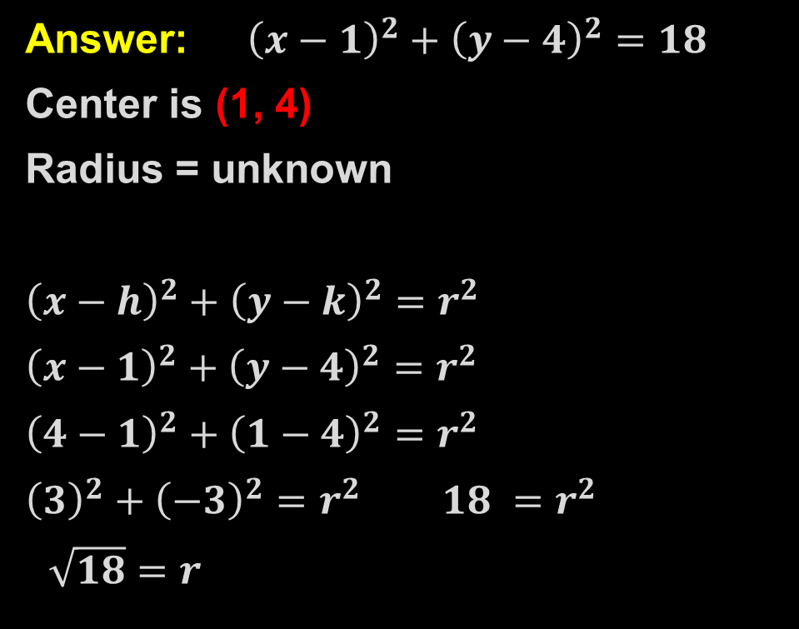
Example 2
The point (4, 1) is on a circle with center (1, 4). Write the standard equation of the circle.
y
Answer: ${\left(x−1\right)}^{2}+{\left(y−4\right)}^{2}=18$
Center is (1, 4)
Radius = unknown
${\left(x−h\right)}^{2}+{\left(y−k\right)}^{2}=r^{2}$
${\left(x−1\right)}^{2}+{\left(y−4\right)}^{2}=r^{2}$
${\left(4−1\right)}^{2}+{\left(1−4\right)}^{2}=r^{2}$
${\left(3\right)}^{2}+{\left(−3\right)}^{2}=r^{2}$ $18 =r^{2}$
$\sqrt{18}=r$
x

Slide 9
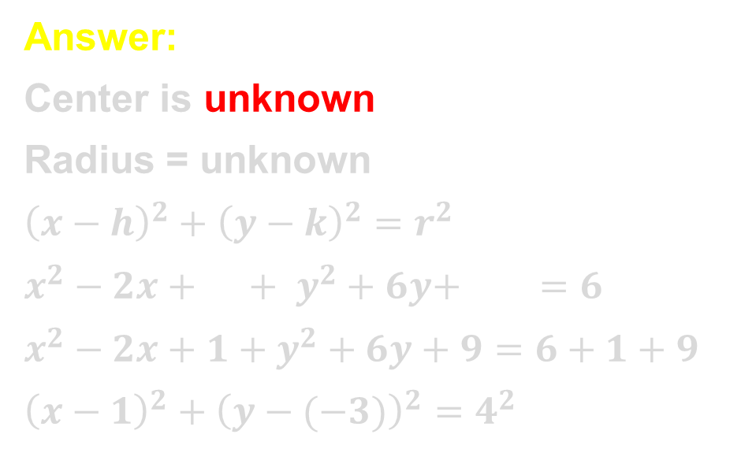

Example 3
The equation of a circle is $x^{2}+y^{2}−2x+6y−6=0$. Find the center and the radius of the circle. Then graph the circle.
y
Answer:
Center is unknown
Radius = unknown
${\left(x−h\right)}^{2}+{\left(y−k\right)}^{2}=r^{2}$
$x^{2}−2x+ + y^{2}+6y+ =6$
$x^{2}−2x+1+y^{2}+6y+9=6+1+9$
${\left(x−1\right)}^{2}+{\left(y−(−3)\right)}^{2}=4^{2}$
(1, -3)
r = 4
x

Slide 10
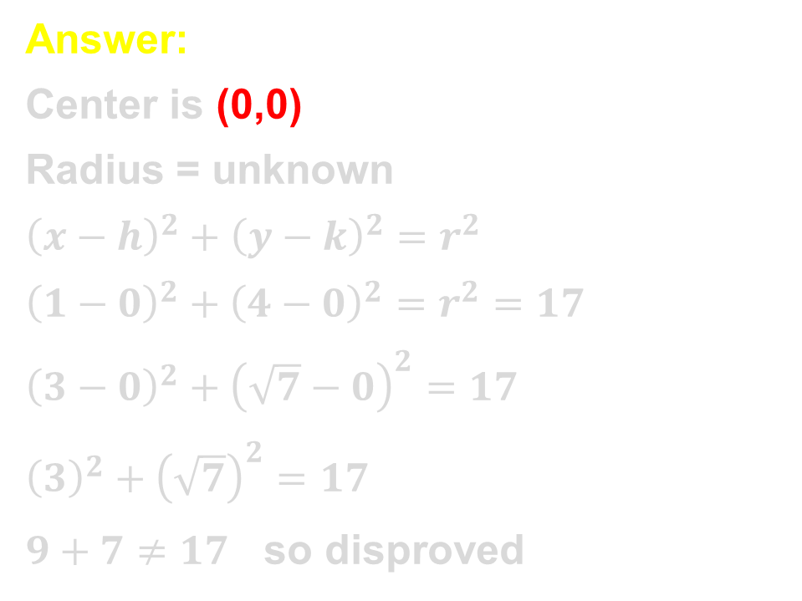

Example 4
Prove or disprove that the point $(3,\sqrt{7})$ lies on the circle centered at the origin and containing the point (1, 4).
Answer:
Center is (0,0)
Radius = unknown
${\left(x−h\right)}^{2}+{\left(y−k\right)}^{2}=r^{2}$
${\left(1−0\right)}^{2}+{\left(4−0\right)}^{2}=r^{2}=17$
${\left(3−0\right)}^{2}+{\left(\sqrt{7}−0\right)}^{2}=17$
${\left(3\right)}^{2}+{\left(\sqrt{7}\right)}^{2}=17$
$9+7≠17$ so disproved

Slide 11
Example 5
The epicenter of an earthquake is 10 miles away from (-1,-3), 2 miles away from (5,3) and 5 miles away from (2,9). Find the coordinates of the epicenter.
Answer:
Draw a circle centered at (-1,-3) r =10
Draw a circle centered at (5,3) r =2
Draw a circle centered at (2,9) r =5
Three circles intersect at (5,5)
That point should solve all 3 equations
y
x

Slide 12
Summary & Homework
Summary:
  The length of segments inside the circle are found using:
    Part of segment x other part of segment = Part of the second segment x other part of second segment
  The length of segments outside the circle are found using:
    Outside x Whole = Outside x Whole
Homework:
  Circle Angles Worksheet

