Slide 1
Lesson 11-1
Circumference and Arc Length

Slide 2
Objectives
Use the formula for circumference
Use arc length to find measures
Solve real-life problems
Measure angles in radian

Slide 3
Vocabulary
Arc length – a portion of the circumference of a circle
Circumference – the distance (perimeter) around the circle
Radian – a measure in π units of central angles (180° = 1 radian and 360° = 2 radians)

Slide 4
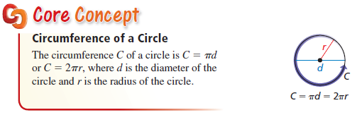

Circumference (Perimeter)
The “perimeter” of a circle is it’s circumference.
Formula $C=2πr=dπ$ is on the formula sheet

Slide 5
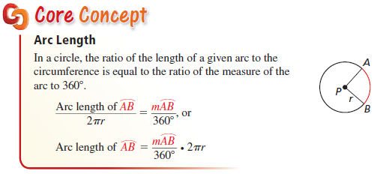
Arc Length (part of circumference)
The portion of the circumference that corresponds to the arc length is determined by the ratio of the central angle to 360°

Slide 6
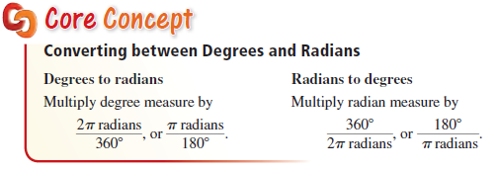
Degrees and Radians
Converting back and forth between degrees and radians involves 360° = 2π radians

Slide 7
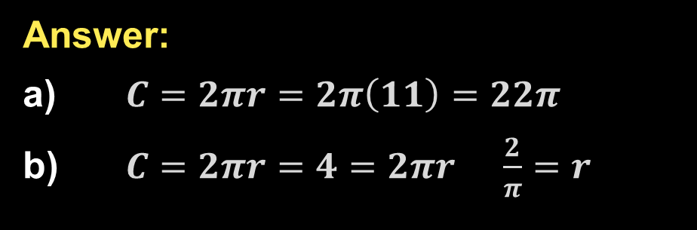
Example 1
Find each indicated measure.
a) Circumference of a circle with a radius of 11 inches.
b) Radius of a circle with a circumference of 4 millimeters.
Answer:
$C=2πr=2π\left(11\right)=22π$
$C=2πr=4=2πr \frac{2}{π}=r$

Slide 8
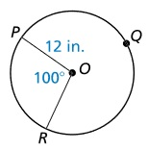
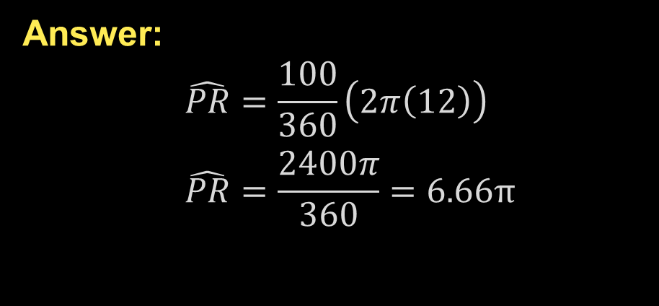

Example 2a
Find each indicated measure.
a) Arc length of $\hat{PR}$
Answer:
$$\hat{PR}=\frac{100}{360}\left(2π\left(12\right)\right)$$
$$\hat{PR}=\frac{2400π}{360}=6.66π$$

Slide 9
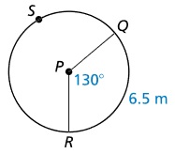

Example 2b
Find each indicated measure.
b) Circumference of P
Answer:
$$\hat{QR}=6.5=\frac{130}{360}\left(C\right)$$
$$\frac{2340}{130}=18=C$$

Slide 10
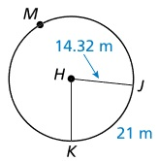


Example 2c
Find each indicated measure.
c) $m\hat{JK}$
Answer:
$$\frac{m\hat{JK}}{360}(2π\left(14.32\right))=21$$
$$m\hat{JK}=\frac{21(360)}{28.64π}≈84$$

Slide 11

Example 3
The radius of a wheel on a toy truck is 4 inches. To the nearest foot, how far does the wheel travel when it makes 7 revolutions?
$$C=2πr=8π$$
$$7C=7\left(8π\right)=56π≈176 ft$$
Answer: 176 ft.

Slide 12
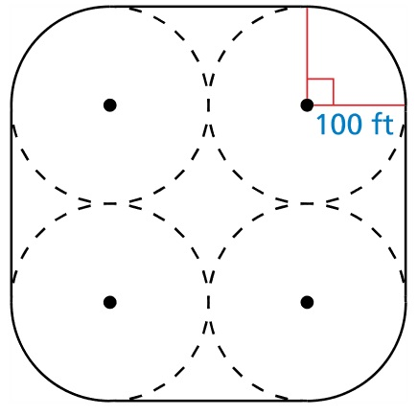
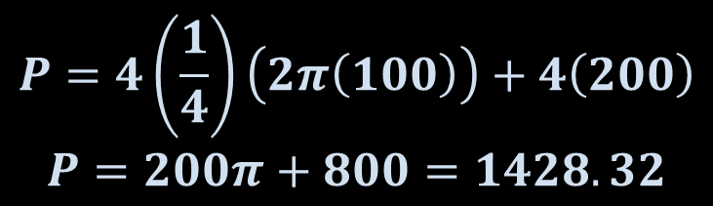
Example 4
A path is built around four congruent circular fields. The radius of each field is 100 feet. How long is the path? Round to the nearest hundred feet.
$$P=4\left(\frac{1}{4}\right)\left(2π\left(100\right)\right)+4\left(200\right)$$
$$P=200π+800=1428.32$$
Answer: P ≈ 1400.

Slide 13
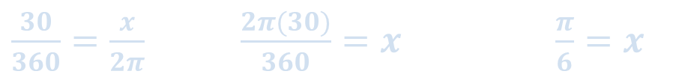

Example 5
Convert 30° to radians
Convert $\frac{3π}{8}$ radians to degrees.
Answer:
$\frac{30}{360}=\frac{x}{2π} \frac{2π(30)}{360}=x \frac{π}{6}=x$
$\frac{3π}{8}=\frac{2πx}{360} \frac{3π(360)}{16π}=x 67.5=x$

Slide 14
Summary & Homework
Summary:
  Circumference of a circle (perimeter), C = 2πr = dπ
  Arc length is a proportion of the circumference
  180 degrees is π radians
Homework:
  none

