Slide 1
Lesson 11-2
Areas of Circles and Sectors

Slide 2
Objectives
Use the formula for the area of a circle
Use the formula population density
Find areas of sectors
Use areas of sectors

Slide 3
Vocabulary
Population density – a measure of how many people live within a given area
Sector of a circle – region of area bounded by two radii and their intercepted arc

Slide 4
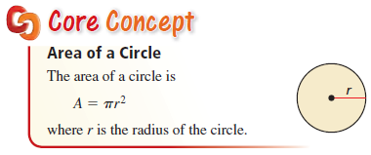

Area of a Circle
Formula $A=πr^{2}$ is on the formula sheet

Slide 5
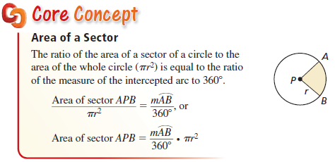
Sector area (part of total area)
A sector is like a piece of pie, a slice from the whole pie. It’s area is a proportion of the area of the whole circle, based on the sector’s central angle – or the measure of the sector’s arc.

Slide 6
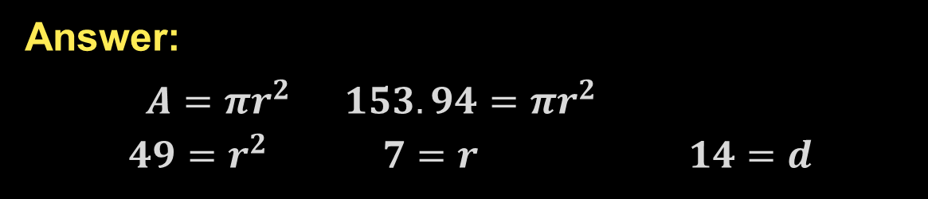
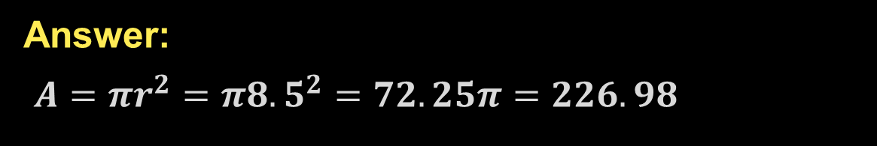
Example 1
Find each indicated measure.
a) Area of a circle with a radius of 8.5 inches
b) Diameter of a circle with an area of 153.94 square feet
Answer:
$A=πr^{2}=π{8.5}^{2}=72.25π=226.98$
Answer:
$A=πr^{2} 153.94=πr^{2}$
$$49=r^{2} 7=r 14=d$$

Slide 7


Example 2
a) About 124,000 people live in a 2-mile radius of a city’s post office. Find the population density in people per square mile.
b) A region with a 10-mile radius has a population density of about 869 people per square mile. Find the number of people who live in the region.
Answer: $density=\frac{people}{sq mile}=\frac{124000}{π2^{2}}=9867.6$
Answer: $density=\frac{people}{sq mile}=\frac{x}{π{10}^{2}}=869$
$$x=869\left(100π\right)=273,004$$

Slide 8
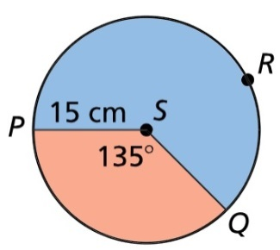
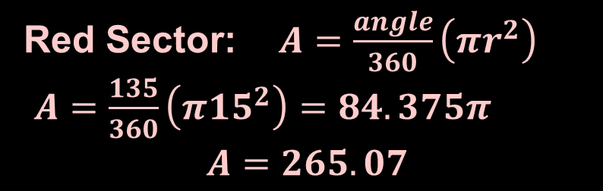
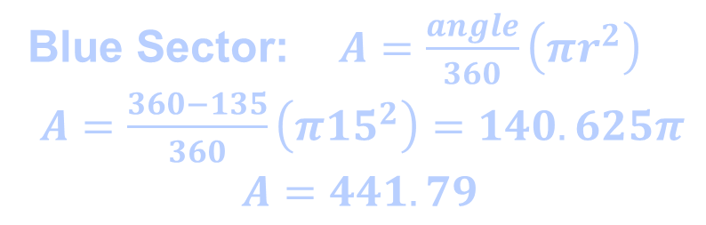
Example 3
Find the areas of the sectors formed by ∠PSQ
Answer:
Red Sector: $A=\frac{angle}{360}\left(πr^{2}\right)$
$A=\frac{135}{360}\left(π{15}^{2}\right)=84.375π$
$$A=265.07$$
Blue Sector: $A=\frac{angle}{360}\left(πr^{2}\right)$
$A=\frac{360−135}{360}\left(π{15}^{2}\right)=140.625π$
$$A=441.79$$

Slide 9
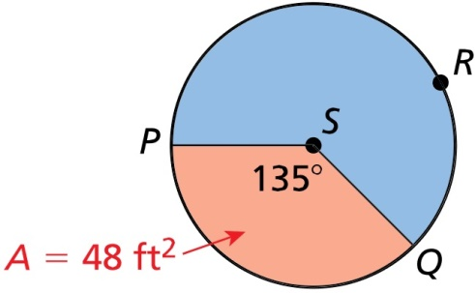
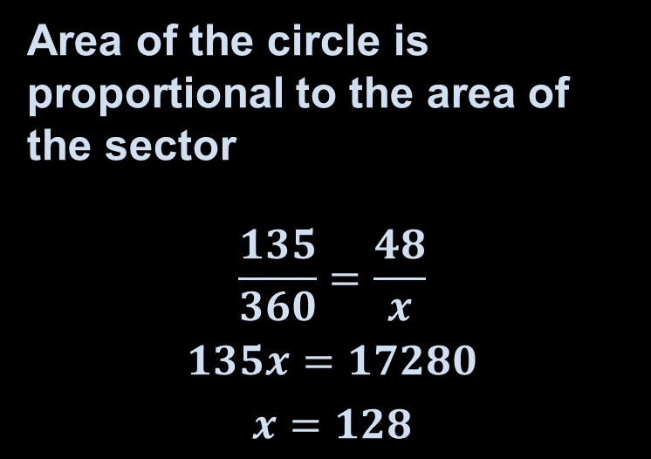
Example 4
Find the area of S
Answer: A =128 ft²
Area of the circle is proportional to the area of the sector
$$\frac{135}{360}=\frac{48}{x}$$
$$135x=17280$$
$$x=128$$

Slide 10
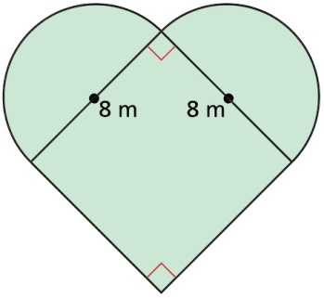
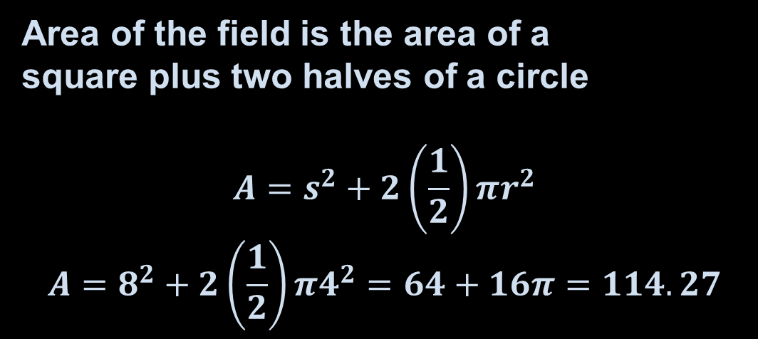
Example 5
A farmer has a field with the shape shown. Find the area of the shaded region to the nearest square meter.
Answer:
Area of the field is the area of a
square plus two halves of a circle
$$A=s^{2}+2\left(\frac{1}{2}\right)πr^{2}$$
$$A=8^{2}+2\left(\frac{1}{2}\right)π4^{2}=64+16π=114.27$$

Slide 11

Summary & Homework
Summary:
  Area of a circle is A = πr²
  A sector is a portion (like a piece of pie) of a circle
  The area of a sector is proportional to its central angle, $Sec Area =\left(\frac{central angle}{360}\right)circumference$
Homework:
  none

