Slide 1
Lesson 11-3
Areas of Polygons

Slide 2
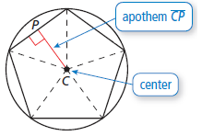
Objectives
Find areas of rhombuses and kites
Find angle measures in regular polygons
Find areas of regular polygons

Slide 3
Vocabulary
Apothem of a regular polygon – the distance from the center to any side of the polygon
Center of a regular polygon – the center of the circle circumscribed around the polygon
Central angle of a regular polygon – the angle formed by two radii drawn to consecutive vertices of the polygon; (also equal to the exterior angle of the polygon!!)
Radius of a regular polygon – the radius of the circle circumscribed around the polygon

Slide 4
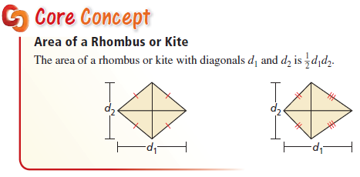
Area of a Rhombus or Kite
Formula is not on the formula sheet; but a rhombus is made up of 4 congruent triangles (and that formula is on the sheet)

Slide 5
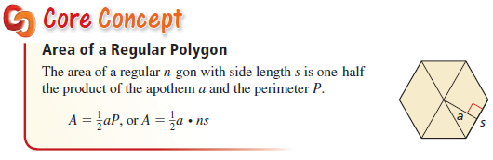
Regular Polygon Area
The apothem, a, looks like a radius. The perimeter, P, is found by taking the side length and multiplying by the number of sides.

Slide 6
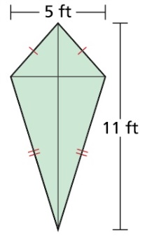
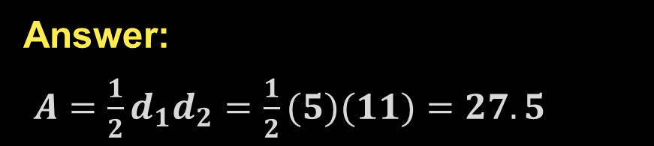
Example 1a
Find the area of each rhombus or kite.
Answer:
$A=\frac{1}{2}d_{1}d_{2}=\frac{1}{2}(5)(11)=27.5$

Slide 7
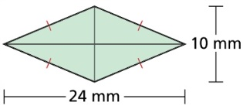
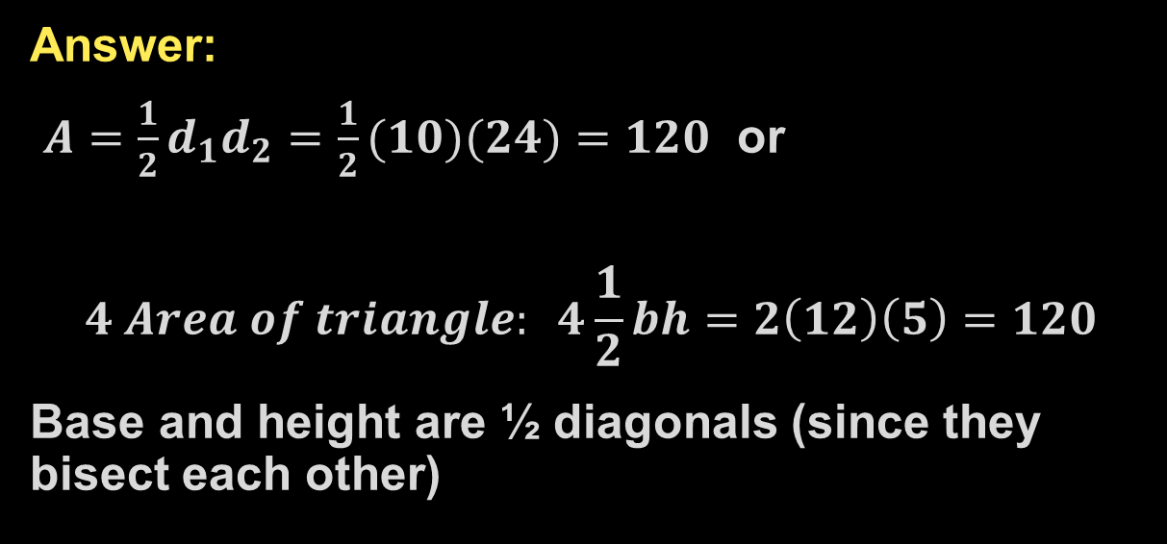
Example 1b
Find the area of each rhombus or kite.
Answer:
$A=\frac{1}{2}d_{1}d_{2}=\frac{1}{2}(10)(24)=120$ or
$$4 Area of triangle: 4\frac{1}{2}bh=2\left(12\right)\left(5\right)=120$$
Base and height are ½ diagonals (since they bisect each other)

Slide 8
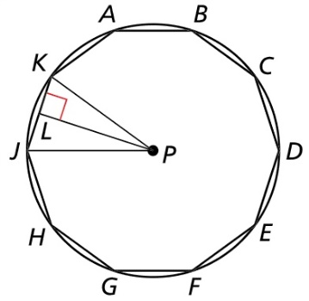




Example 2
In the diagram, polygon ABCDEFGHJK is a regular decagon inscribed in P.
Find each angle measure.
$m∠KPJ$
$m∠LPK$
$m∠LJP$
Answer:
$$m∡KPJ=\frac{360}{10}=36$$
$$m∡LPK=\frac{m∡KPJ}{2}=18$$
$$m∡LJP=90−18=72$$

Slide 9
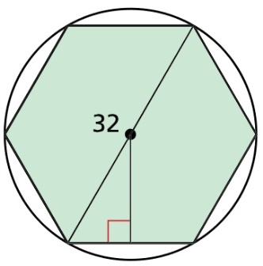
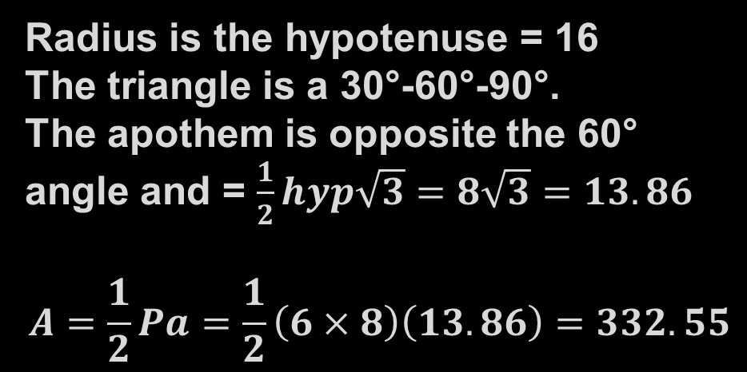
Example 3
A regular hexagon is inscribed in a circle with a diameter of 32 units. Find the area of the hexagon.
Answer:
Radius is the hypotenuse = 16
The triangle is a 30°-60°-90°.
The apothem is opposite the 60° angle and = $\frac{1}{2}hyp\sqrt{3}=8\sqrt{3}=13.86$
$$A=\frac{1}{2}Pa=\frac{1}{2}\left(6×8\right)\left(13.86\right)=332.55$$

Slide 10
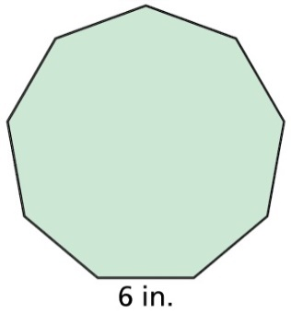
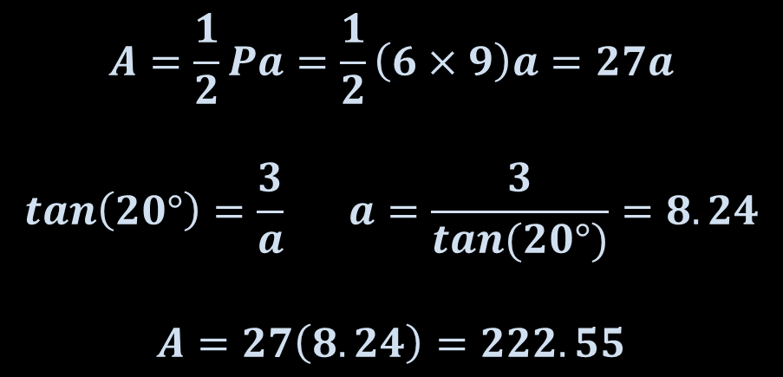
Example 4
A mirror is in the shape of a regular nonagon with 6-inch sides. What is the area of the mirror?
Answer:
$$A=\frac{1}{2}Pa=\frac{1}{2}\left(6×9\right)a=27a$$
$$tan\left(20°\right)=\frac{3}{a} a=\frac{3}{tan(20°)}=8.24$$
$$A=27\left(8.24\right)=222.55$$
a
20°
3

Slide 11

Summary & Homework
Summary:
  Area formulas of most figures on the formula sheet
  Area of a polygon, $A=1/{2Pa}$, a = apothem and P = perimeter is not on it
  Area of a rhombus, $A=1/{2d_{1}d_{1}}$, d is the whole length of diagonal is not on it
  Area of composite figures is the area of each of its parts added up
Homework:
  none

