Slide 1
Lesson 11-4
Three-Dimensional Figures

Slide 2
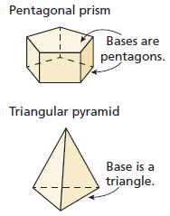
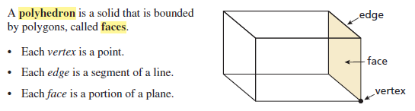
Objectives
Classify solids
Describe cross sections
Sketch and describe solids of revolutions

Slide 3
Vocabulary
Axis of revolution – the line around which a shape is rotated
Cross section – the intersection of a plane and a solid
Edge – line segment formed by the intersection of two faces
Face – the sides of a polyhedron
Polyhedron – a solid that is bounded by polygons
Solid of revolution – a three dimensional figure that is formed by rotating a two-dimensional shape around an axis
Vertex – a point where three or more edges meet

Slide 4
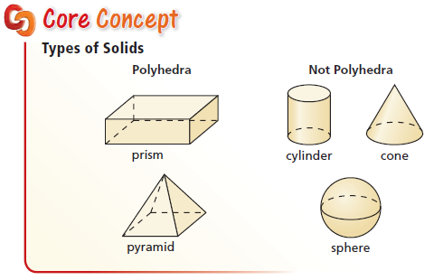
Common 3d Figures
All formulas on SOL Formula sheet

Slide 5
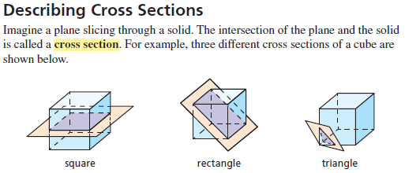
Cross Sections
All conic sections, studied in Math Analysis (course after Algebra II) are cross sections of a cone.

Slide 6
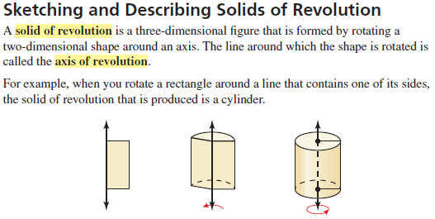
Figures of Revolutions
Concept used in calculus problems
(and in wood-working by routers)

Slide 7
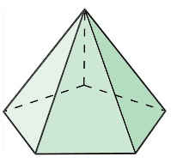
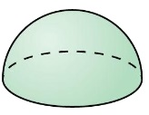
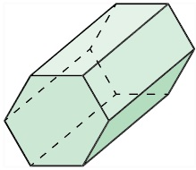
Example 1
Tell whether each solid is a polyhedron. If it is, name the polyhedron.
a) b) c)
Answer:
No
Hemisphere
Yes
Pentagonal pyramid
Yes
Hexagonal cylinder

Slide 8
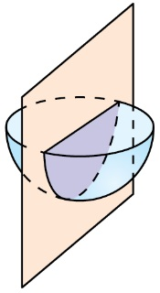
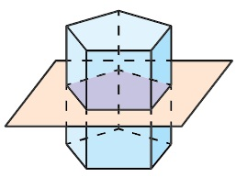
Example 2
Describe the shape formed by the intersection of the plane and the solid.
a) b)
Answer:
Pentagon
Half a circle

Slide 9


Example 3
Sketch the solid produced by rotating the figure around the given axis. Then identify and describe the solid (defining parameters needed for surface area or volume).
Answer:
Cone:
Ht = 6 r =4
Sphere:
r =5

Slide 10
Summary & Homework
Summary:
  A revolutionary solid is formed by rotating a 2-d figure around an axis or revolution
  Revolutionary solids are talked about in calculus courses a lot
  Conic sections in Algebra 2 are the cross-sections of the intersections of a plane and a cone
  Faces are sides, vertexes are corner points and edges are line segments connecting sides
Homework:
  none

