Slide 1
Lesson 11-5
Surface Areas of Prisms and Cylinders

Slide 2
Objectives
Find lateral area and surface areas of right prisms
Find lateral area and surface areas of right cylinders
Use surface areas of right prisms and right cylinders
Find surface area of similar solids

Slide 3
Vocabulary
Lateral area – the sum of the area of a figure’s lateral faces
Lateral edges – segments connecting the bases
Lateral faces – faces of a polyhedron other than the bases
Net – a two-dimensional representation of the faces
Oblique cylinder – segment joining the centers of the bases is not perpendicular to the bases
Oblique prism – each lateral edge is not perpendicular to both bases

Slide 4
Vocabulary
Right cylinder – segment joining the centers of the bases is perpendicular to the bases
Right prism – each lateral edge is perpendicular to both bases
Similar solids – two solids of the same type with equal ratios of corresponding linear measures (heights, radii, etc)
Surface area – the sum of the area of a figure’s faces (lateral and base)

Slide 5
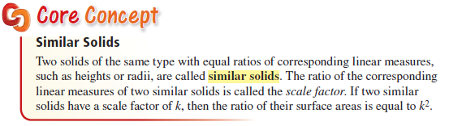
Similar Solids
Area is a squared (two parts multiplied) relationship. Ratio of areas is the scaling factor squared.

Slide 6
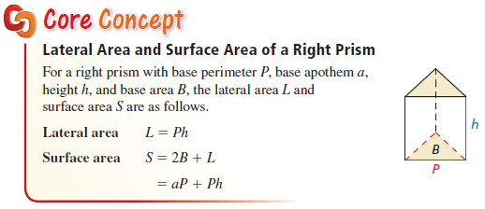
Surface Area of Right Prism
Prisms have two bases, which use the 2-d formula of the base figure, and then the lateral (or sides) area which is always the perimeter times the height of the prism.

Slide 7
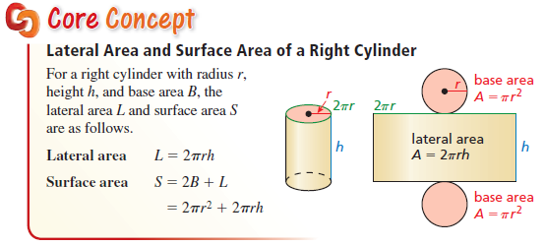
Surface Area of Right Cylinder
Cylinders have two bases, which use the circle formula, and then the lateral (or sides) area which is always the circumference times the height of the cylinder.

Slide 8
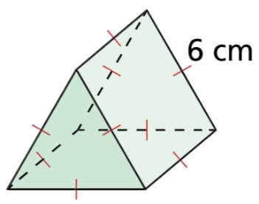
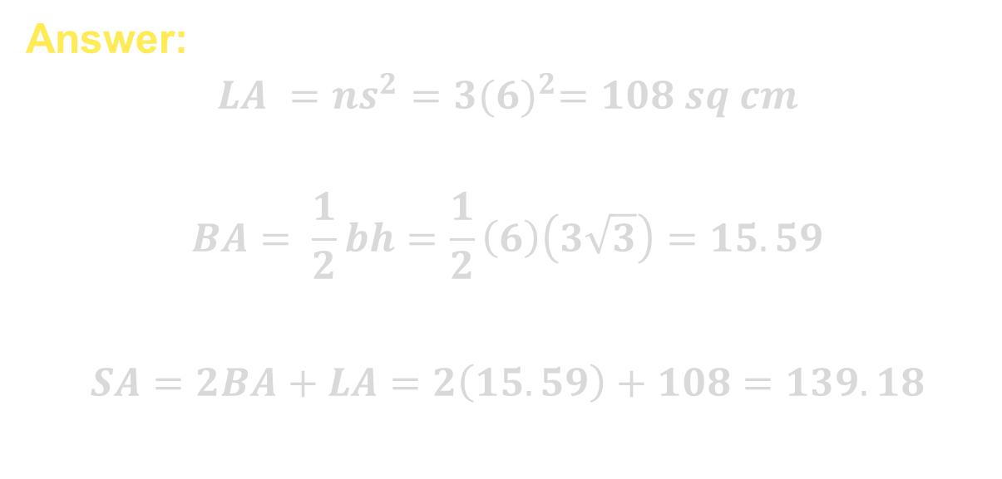
Example 1
Find the lateral area and the surface area of the triangular prism.
Answer:
$$LA =ns^{2}=3{(6)}^{2}=108 sq cm$$
$$BA= \frac{1}{2}bh=\frac{1}{2}\left(6\right)\left(3\sqrt{3}\right)=15.59$$
$$SA=2BA+LA=2\left(15.59\right)+108=139.18$$

Slide 9
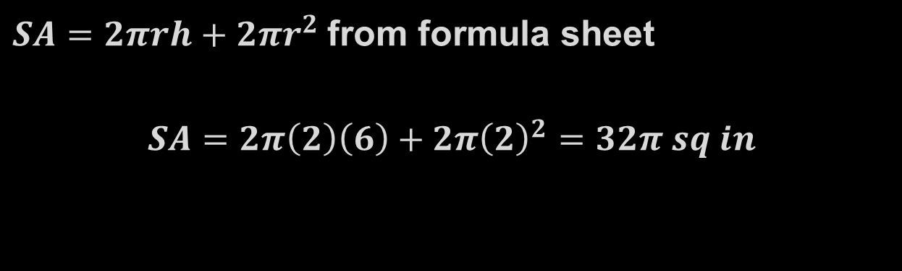
Example 2
Find the lateral area and the surface area of a right cylinder with a radius of 2 inches and a height of 6 inches.
Answer:
$SA=2πrh+2πr^{2}$from formula sheet
$$SA=2π\left(2\right)\left(6\right)+2π{\left(2\right)}^{2}=32π sq in$$

Slide 10
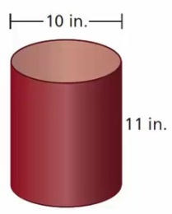

Example 3
You are covering the lateral area of a wastebasket with paper. Find the minimum amount of paper you need.
Answer:
$$Lateral area =2πrh=2π\left(5\right)\left(11\right)=110π=345.58 sq in$$

Slide 11
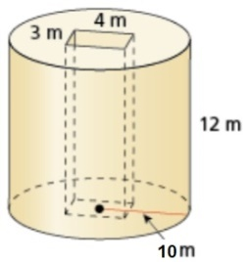
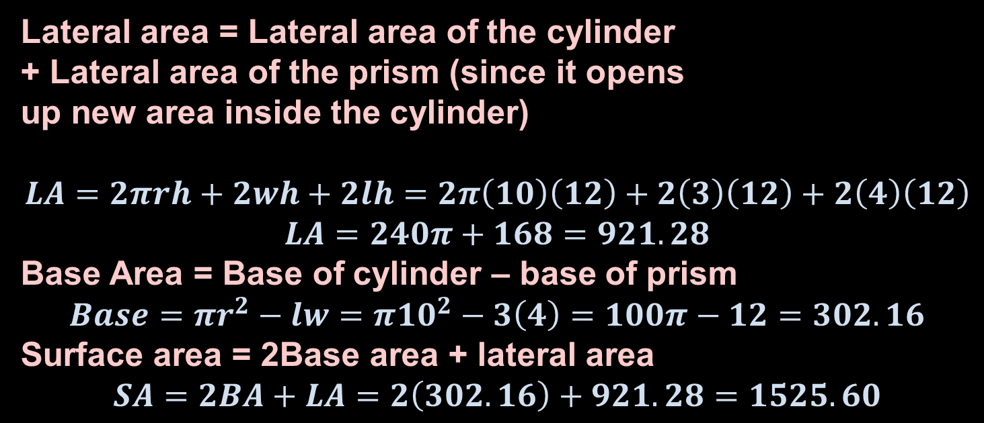
Example 4
Find the lateral area and the surface area of the composite figure.
Answer:
Lateral area = Lateral area of the cylinder
+ Lateral area of the prism (since it opens
up new area inside the cylinder)
$$LA=2πrh+2wh+2lh=2π\left(10\right)\left(12\right)+2\left(3\right)\left(12\right)+2\left(4\right)\left(12\right)$$
$$LA=240π+168=921.28$$
Base Area = Base of cylinder – base of prism
$$Base=πr^{2}−lw=π{10}^{2}−3\left(4\right)=100π−12=302.16$$
Surface area = 2Base area + lateral area
$$SA=2BA+LA=2\left(302.16\right)+921.28=1525.60$$

Slide 12
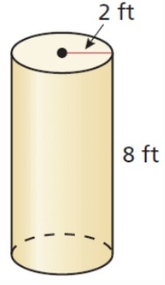
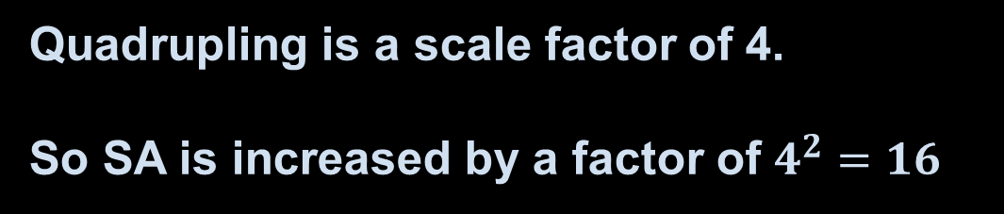
Example 5
Describe how quadrupling all the linear dimensions of the cylinder affects the surface area of the right cylinder.
Answer:
Quadrupling is a scale factor of 4.
So SA is increased by a factor of $4^{2}=16$

Slide 13
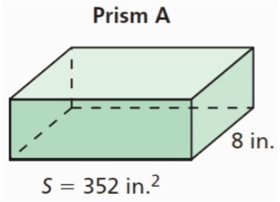
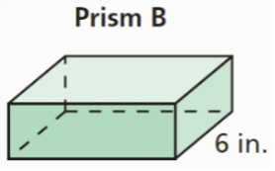
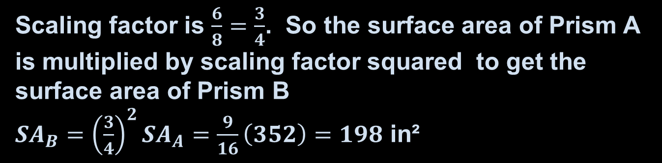
Example 6
Prism A and Prism B are similar. Find the surface area of the Prism B.
Answer:
Scaling factor is $\frac{6}{8}=\frac{3}{4}$. So the surface area of Prism A is multiplied by scaling factor squared to get the surface area of Prism B
${SA}_{B}={\left(\frac{3}{4}\right)}^{2}{SA}_{A}=\frac{9}{16}\left(352\right)=198$ in²

Slide 14
Summary & Homework
Summary:
  Lateral (means sides) area can be found, when it exists, on the formula sheet
  Surface areas of cylinders, rectangular and triangular prism are on the formula sheet
  Rectangular prisms have 6 surfaces (top/bottom, front/back, right/left sides)
  Formulas on SOL formula sheet
Homework:
  none

