Slide 1
Lesson 11-6
Surface Areas of Pyramids and Cones

Slide 2
Objectives
Find lateral areas and surface areas of regular pyramids and right cones
Find surface areas of similar pyramids and cones
Use surface areas of regular pyramids and right cones

Slide 3
Vocabulary
Lateral surface of a cone – consists of all segments that connect the vertex with points on the edge of the base
Oblique cone – segment joining the vertex and the center of the base is not perpendicular to the base
Regular pyramid – has a regular polygon for a base and the segment joining the vertex and the center of the base is perpendicular to the base
Right cone – segment joining the vertex and the center of the base is perpendicular to the base

Slide 4
Vocabulary
Slant height of a regular pyramid – is the height of a lateral face of the regular pyramid
Slant height of a right cone – the distance between the vertex and a point on the edge of the base
Vertex of a cone – is not in the same plane as the base
Vertex of a pyramid – the common vertex of the triangular faces of a pyramid

Slide 5
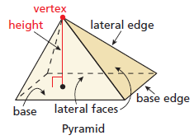
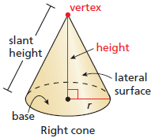
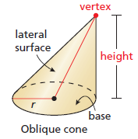
Visual Vocabulary
xxxxx

Slide 6
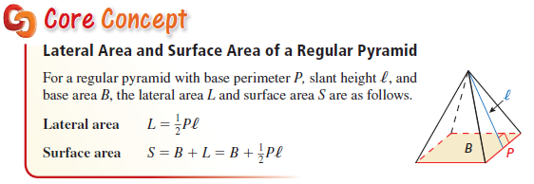
Surface Area of Right Prism
Lateral area is half of the perimeter times the slant height.
The slant height is in a Pythagorean relationship with the height and half the side

Slide 7
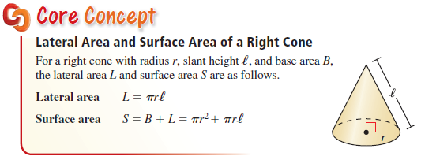
Surface Area of Right Cylinder
Lateral area is π radius times the slant height.
The slant height is in a Pythagorean relationship with the height and the radius

Slide 8
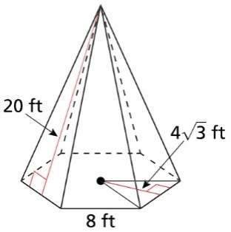
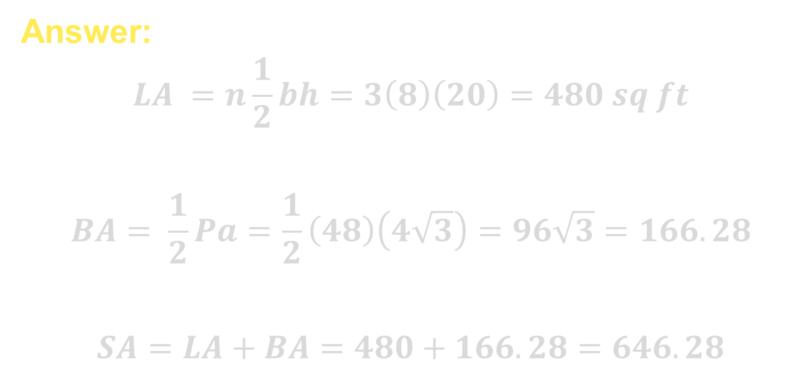
Example 1
Find the lateral area and the surface area of the regular hexagonal pyramid.
Answer:
$$LA =n\frac{1}{2}bh=3\left(8\right)\left(20\right)=480 sq ft$$
$$BA= \frac{1}{2}Pa=\frac{1}{2}\left(48\right)\left(4\sqrt{3}\right)=96\sqrt{3}=166.28$$
$$SA=LA+BA=480+166.28=646.28$$

Slide 9
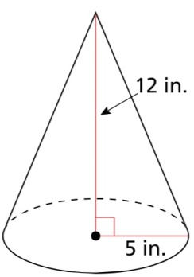
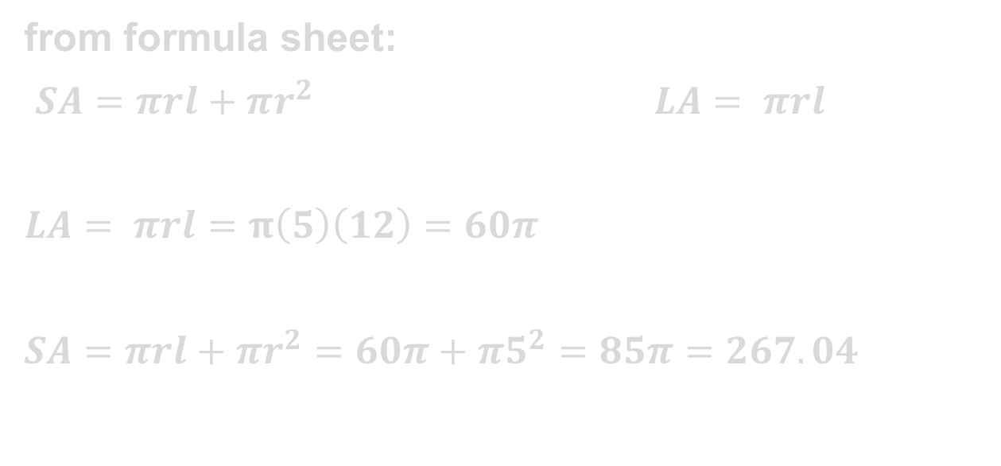
Example 2
Find the lateral area and the surface area of the right cone.
Answer:
from formula sheet:
$SA=πrl+πr^{2} LA= πrl$
$LA= πrl=π\left(5\right)\left(12\right)=60π$
$SA=πrl+πr^{2}=60π+π5^{2}=85π=267.04$

Slide 10
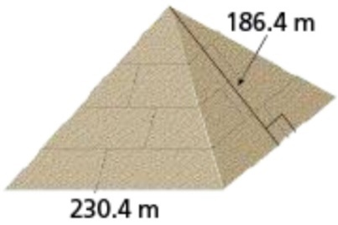

Example 3
The Great Pyramid of Giza is a regular square pyramid. It is estimated that when the pyramid was first built, each base edge was 230.4 meters long and the slant height was 186.4 meters long. Find the lateral area of a square pyramid with those dimensions.
Answer:
$$Lateral area =4\frac{1}{2}bh=2\left(186.4\right)\left(230.4\right)=86893.12 sq m$$

Slide 11
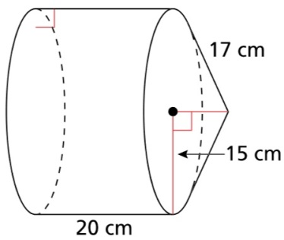
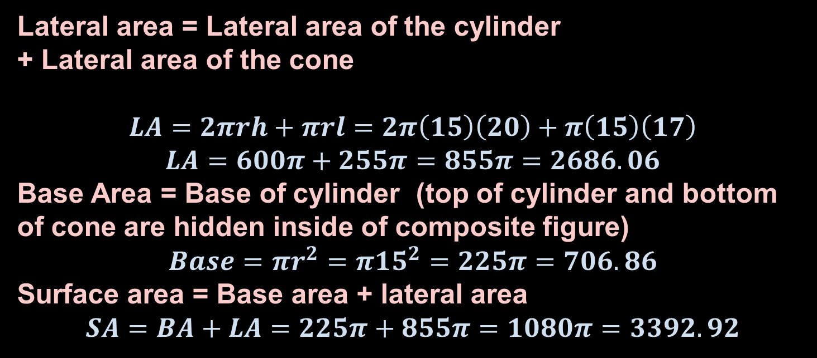
Example 4
Find the lateral area and the surface area of the composite figure.
Answer:
Lateral area = Lateral area of the cylinder
+ Lateral area of the cone
$$LA=2πrh+πrl=2π\left(15\right)\left(20\right)+π\left(15\right)\left(17\right)$$
$$LA=600π+255π=855π=2686.06$$
Base Area = Base of cylinder (top of cylinder and bottom of cone are hidden inside of composite figure)
$$Base=πr^{2}=π{15}^{2}=225π=706.86$$
Surface area = Base area + lateral area
$$SA=BA+LA=225π+855π=1080π=3392.92$$

Slide 12
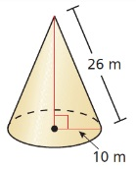
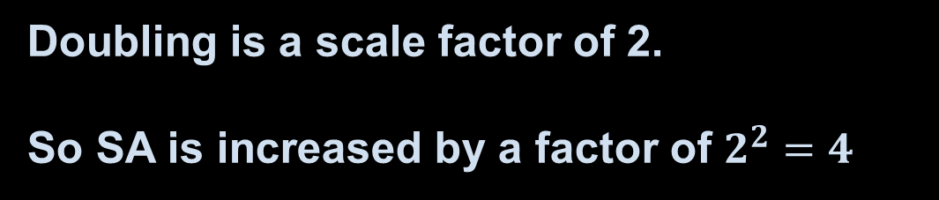
Example 5
Describe how doubling all the linear dimensions of the right cone affects the surface area of the solid.
Answer:
Doubling is a scale factor of 2.
So SA is increased by a factor of $2^{2}=4$

Slide 13
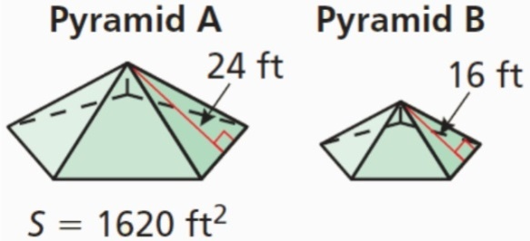
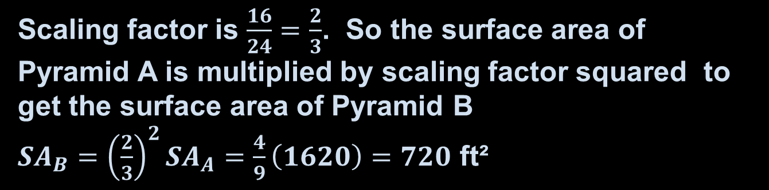
Example 6
Pyramids A and B are similar regular pyramids. Find the surface area of pyramid B.
Answer:
Scaling factor is $\frac{16}{24}=\frac{2}{3}$. So the surface area of Pyramid A is multiplied by scaling factor squared to get the surface area of Pyramid B
${SA}_{B}={\left(\frac{2}{3}\right)}^{2}{SA}_{A}=\frac{4}{9}\left(1620\right)=720$ ft²

Slide 14
Summary & Homework
Summary:
  Lateral (means sides) area can be found, when it exists, on the formula sheet
  Surface area formulas for pyramids and cones are found on the formula sheet
  Surface area is a squared relationship so with similar figures you need to check the variables carefully to determine changes
Homework:
  none

