Slide 1
Lesson 11-7
Surface Areas of Spheres

Slide 2
Objectives
Find surface areas of spheres and hemi-spheres
Find surface areas of similar spheres

Slide 3
Vocabulary
Chord of a sphere – a segment whose endpoints are on the sphere
Great circle – the intersection of a sphere and a plane that goes through its center
Note: in global navigation routes, the shortest distance between two points on the surface of the sphere (like the earth) is along the great circle containing those two points.

Slide 4
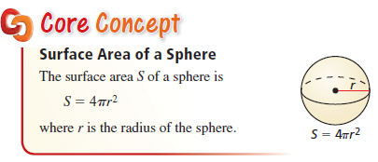
Surface Area of Sphere
Only depends on the radius!

Slide 5
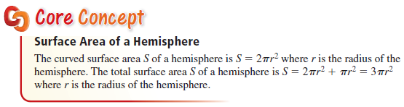
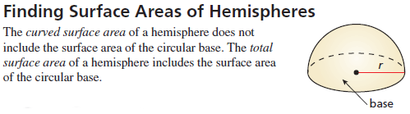
Surface Area of Hemi-sphere
Not on the SOL formula sheet

Slide 6
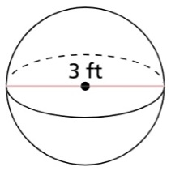
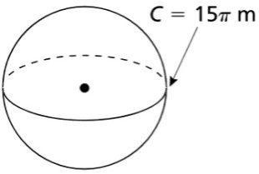
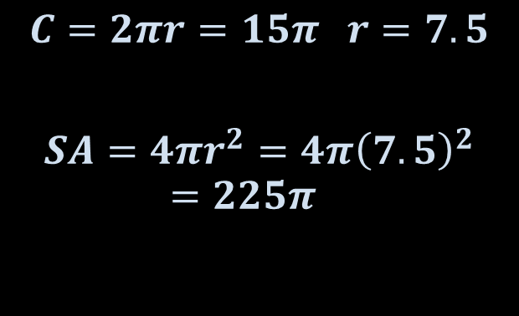
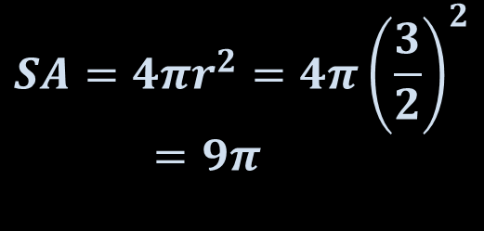
Example 1
Find the surface area of each sphere.
a) b)
Answer:
$$C=2πr=15π r=7.5$$
$$SA=4πr^{2}=4π{\left(7.5\right)}^{2}=225π$$
$$SA=4πr^{2}=4π{\left(\frac{3}{2}\right)}^{2}=9π$$

Slide 7
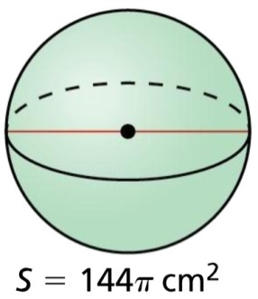

Example 2
Find the diameter of the sphere.
Answer:
from formula sheet:
$SA=4πr^{2}=144π$
$r^{2}=64$
$r=8 d=16$

Slide 8
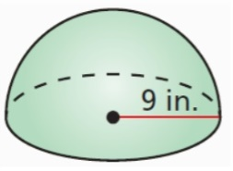
Example 3
Find the indicated surface area of the hemisphere
a) Curved surface area
b) Total surface area
Answer:
$$SA=2πr^{2}=2π9^{2}=162π$$
$$SA=3πr^{2}=3π9^{2}=243π$$

Slide 9
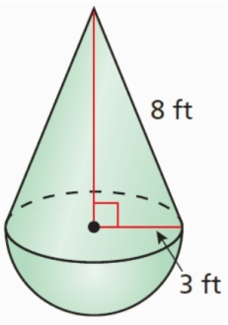
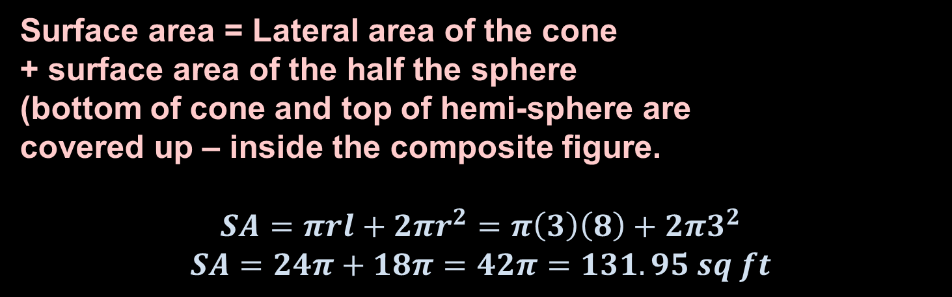
Example 4
Find the surface area of the composite solid.
Answer:
Surface area = Lateral area of the cone
+ surface area of the half the sphere
(bottom of cone and top of hemi-sphere are
covered up – inside the composite figure.
$$SA=πrl+2πr^{2}=π\left(3\right)\left(8\right)+2π3^{2}$$
$$SA=24π+18π=42π=131.95 sq ft$$

Slide 10
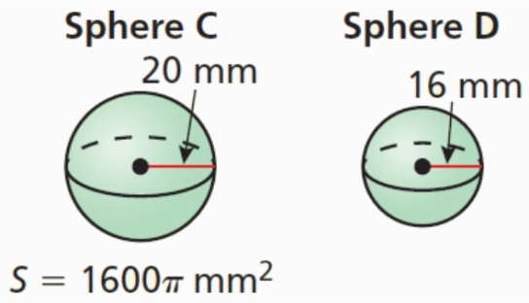
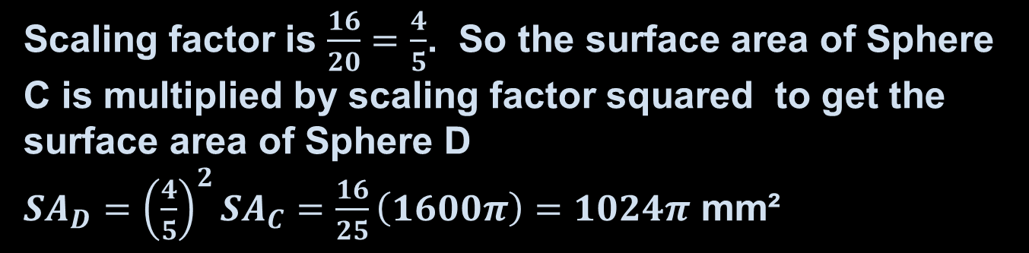
Example 5
Spheres C and D are similar. Find the surface area of Sphere D.
Answer:
Scaling factor is $\frac{16}{20}=\frac{4}{5}$. So the surface area of Sphere C is multiplied by scaling factor squared to get the surface area of Sphere D
${SA}_{D}={\left(\frac{4}{5}\right)}^{2}{SA}_{C}=\frac{16}{25}\left(1600π\right)=1024π$ mm²

Slide 11

Summary & Homework
Summary:
  Surface area of a sphere: $SA = 4πr^{2}$ and is on the formula sheet
  Area is a squared relationship, so similar sphere’s surface area is proportional to the squares of their radii
  Surface area of a hemi-sphere: $SA = 3πr^{2}$ is not on the SOL formula sheet. It is the sum of half the surface area of the sphere plus the area of the newly exposed circle
Homework:
  none

