Slide 1
Lesson 12-1
Volumes of
Prisms and Cylinders

Slide 2
Objectives
Find volumes of prisms and cylinders
Use the formula for density
Use volumes of prisms and cylinders

Slide 3
Vocabulary
Cavalieri’s Principle – states that if two solids have the same height and the same cross-sectional area at every level, then they have the same volume.
Density – the amount of matter that an object has in a given unit of volume. The density of an object is calculated by dividing its mass by its volume.
Volume – the number of cubic units contained in a solid’s interior

Slide 4
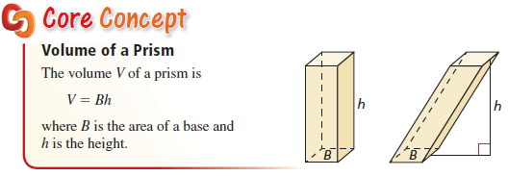
Volume of a Prism
Note: like in two-dimensional figures, the height, h, is always perpendicular to the area of the Base, B.
Big “B” is the area of the base.

Slide 5
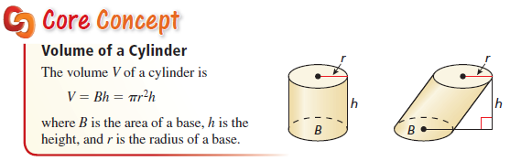
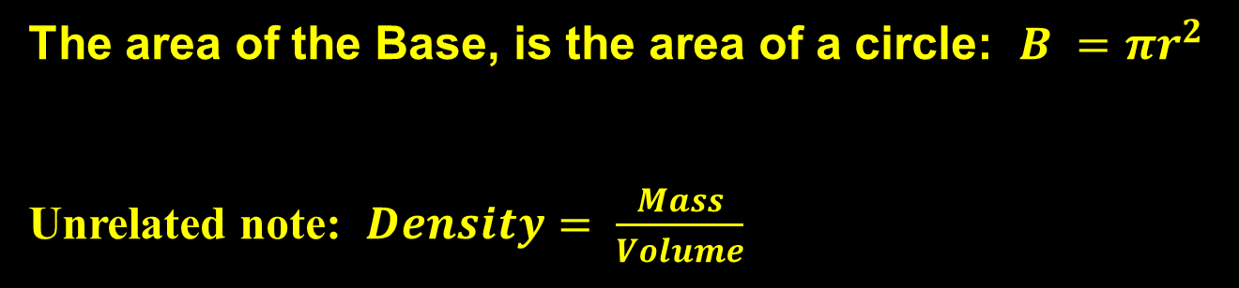
Volume of a Cylinder
The area of the Base, is the area of a circle: $B =πr^{2}$
Unrelated note: $Density= \frac{Mass}{Volume}$

Slide 6
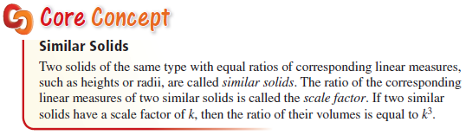
Volumes of Similar Solids
Volume is a cubic relationship and therefore the ratio of the volumes of similar figures is equal to the cube of the scaling factor

Slide 7
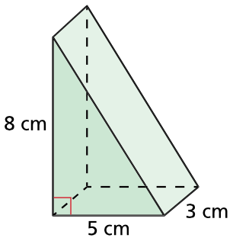

Example 1a
Find the volume of each prism.
a)
Answer:
The base is facing us and is a triangle.
$$B=\frac{1}{2}\left(b\right)h=\frac{1}{2}\left(5\right)8=20 sq cm$$
$$V=Bh=\left(20\right)\left(3\right)=60 {cm}^{3}$$

Slide 8
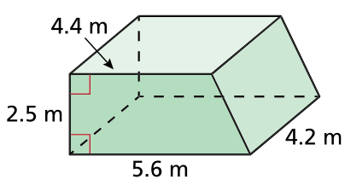
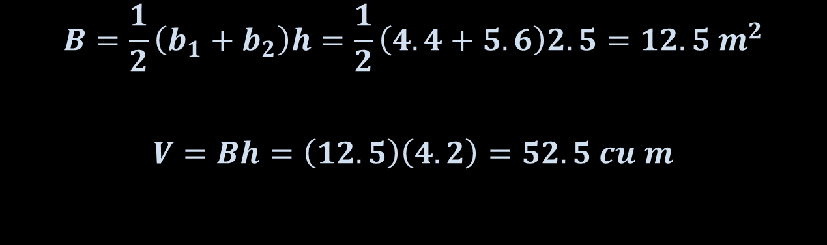
Example 1b
Find the volume of each prism.
b)
Answer:
The base is facing us and is a trapezoid.
$$B=\frac{1}{2}\left(b_{1}+b_{2}\right)h=\frac{1}{2}\left(4.4+5.6\right)2.5=12.5 m^{2}$$
$$V=Bh=\left(12.5\right)\left(4.2\right)=52.5 cu m$$

Slide 9
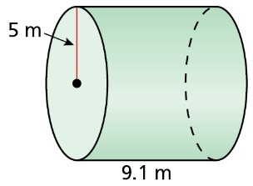
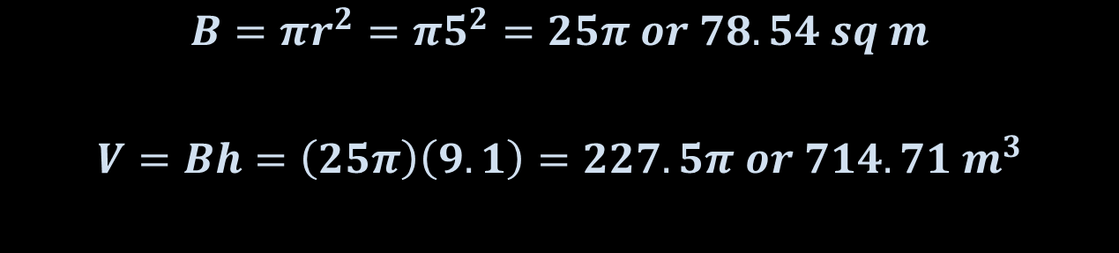
Example 2a
Find the volume of each cylinder.
a)
Answer:
The base is a circle facing to the left
$$B=πr^{2}=π5^{2}=25π or 78.54 sq m$$
$$V=Bh=\left(25π\right)\left(9.1\right)=227.5π or 714.71 m^{3}$$

Slide 10
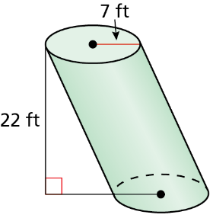
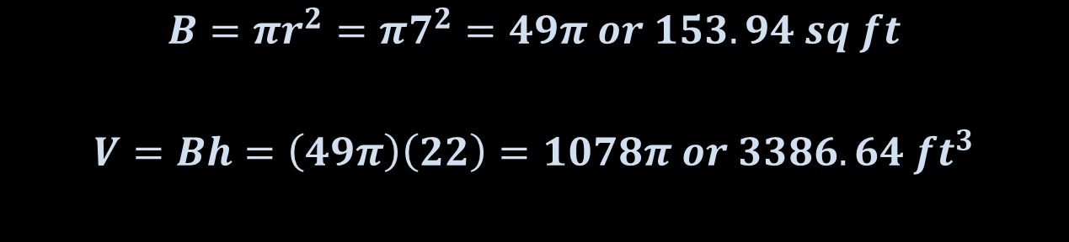
Example 2b
Find the volume of each cylinder.
b)
Answer:
The base is a circle facing up
$$B=πr^{2}=π7^{2}=49π or 153.94 sq ft$$
$$V=Bh=\left(49π\right)\left(22\right)=1078π or 3386.64 {ft}^{3}$$

Slide 11

Example 3
The density of water is 1000 kilograms per cubic meter. Find the mass of 1 cubic foot of water. Use the fact that 1 foot = 0.3048 meters.
Answer:
$$Density= \frac{1000 kg}{1 m^{3}}×{\left(\frac{.3048 m}{1 ft}\right)}^{3}=28.32 {kg}/{{ft}^{3}}$$

Slide 12
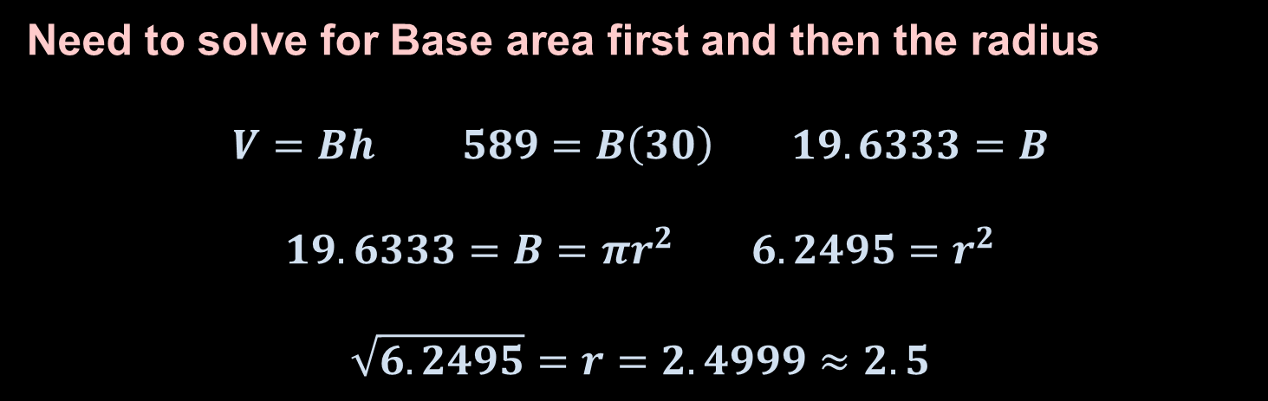
Example 4
You are building a cylindrical packing tube. You want the length of the tube to be 30 inches and the volume to be 589 cubic inches. What should the radius of the base be?
Answer:
Need to solve for Base area first and then the radius
$$V=Bh 589=B\left(30\right) 19.6333=B$$
$$19.6333=B=πr^{2} 6.2495=r^{2}$$
$$\sqrt{6.2495}=r=2.4999≈2.5$$

Slide 13
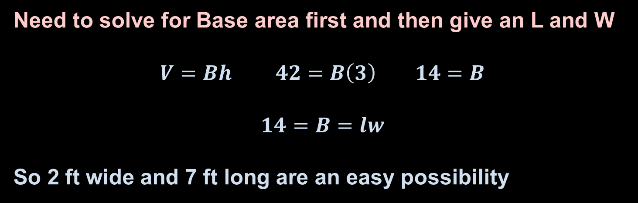
Example 5
You are building a 3-foot tall dresser. You want the volume to be 42 cubic feet. What should the area of the base be? Give a possible length and width.
Answer:
Need to solve for Base area first and then give an L and W
$$V=Bh 42=B\left(3\right) 14=B$$
$$14=B=lw$$
So 2 ft wide and 7 ft long are an easy possibility

Slide 14
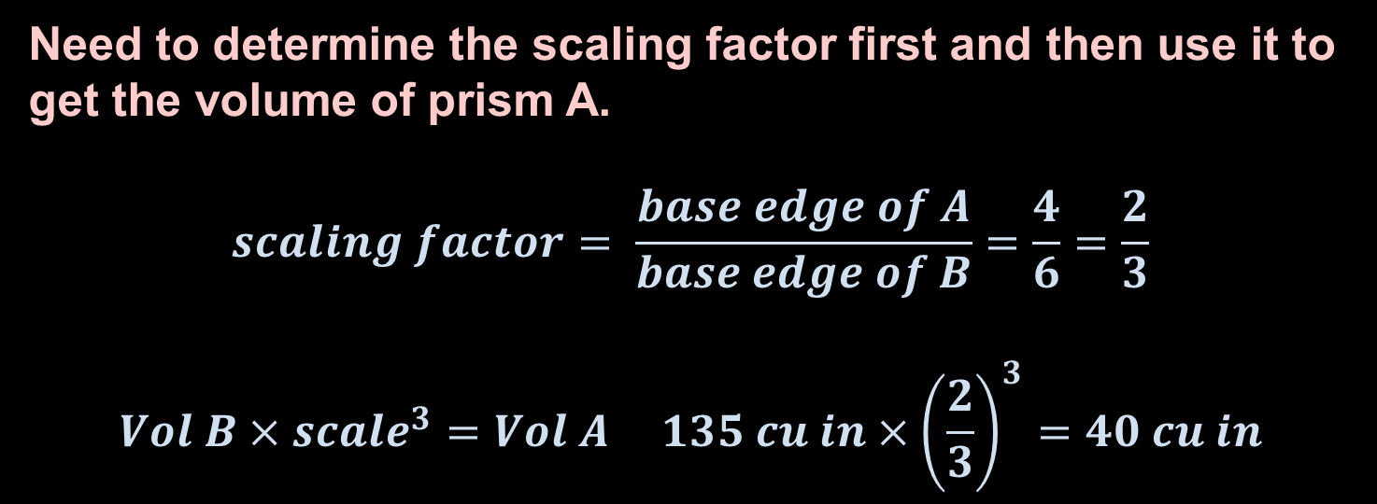
Example 6
Square prism A and square prism B are similar. Each base edge of prism A is 4 inches, and each base edge of prism B is 6 inches. The volume of prism B is 135 cubic inches. Find the volume of prism A.
Answer:
Need to determine the scaling factor first and then use it to get the volume of prism A.
$$scaling factor= \frac{base edge of A}{base edge of B}=\frac{4}{6}=\frac{2}{3}$$
$$Vol B×{scale}^{3}=Vol A 135 cu in×{\left(\frac{2}{3}\right)}^{3}=40 cu in$$

Slide 15
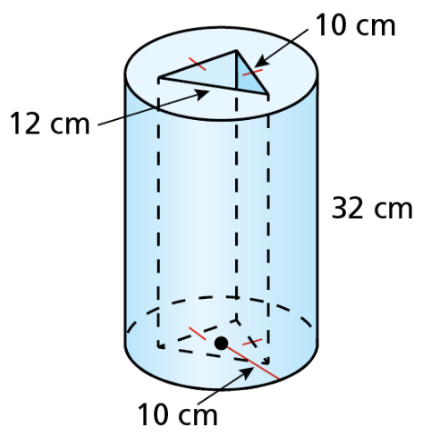
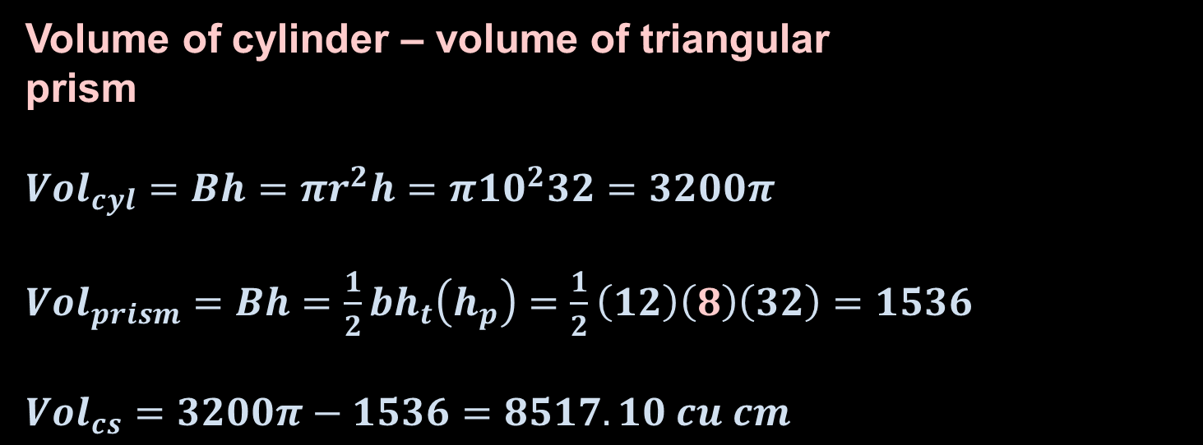
Example 7
Find the volume of the composite solid.
Answer:
Volume of cylinder – volume of triangular
prism
${Vol}_{cyl}=Bh=πr^{2}h=π{10}^{2}32=3200π$
${Vol}_{prism}=Bh=\frac{1}{2}bh_{t}\left(h_{p}\right)=\frac{1}{2}\left(12\right)\left(8\right)\left(32\right)=1536$
${Vol}_{cs}=3200π−1536=8517.10 cu cm$
10
10
ht
12
Solve for ht by using Pythagorean Thrm and Isosceles Triangle

Slide 16
Summary & Homework
Summary:
  Volume of Prism and Cylinders is Base Area x Height
  Volume is a cubic relationship so similar figures will have their volumes found by using the cube of the scaling factor
Homework:
  none

