Slide 1
Lesson 12-2
Volume of Pyramids

Slide 2
Objectives
Find volumes of pyramids
Use volumes of pyramids

Slide 3
Vocabulary
None new

Slide 4
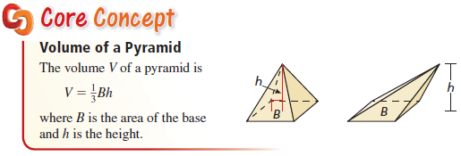
Volume of a Pyramid
Note: like in two-dimensional figures, the height, h, is always perpendicular to the area of the Base, B.
Slant height, ½ the base side and height have a Pythagorean relationship.
SOL usually has only square (based) pyramids

Slide 5
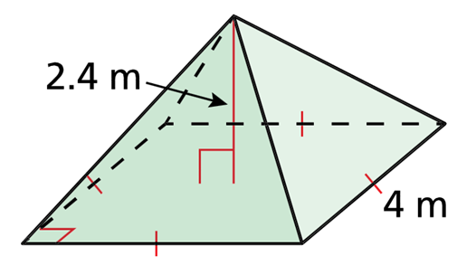

Example 1
Find the volume of the pyramid.
Answer:
The base is a square
$$B=s^{2}=4^{2}=16 sq m$$
$$V=\frac{1}{3}Bh=\frac{1}{3}\left(16\right)\left(2.4\right)=12.8 m^{3}$$

Slide 6
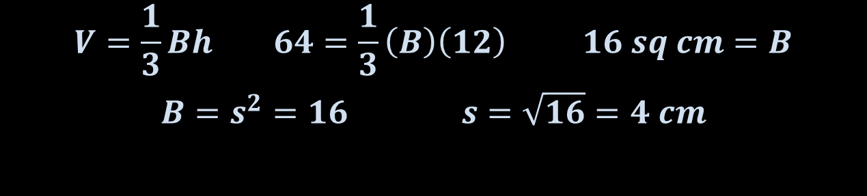
Example 2
A square pyramid has a height of 12 centimeters and a volume of 64 cubic centimeters. Find the side length of the square base.
Answer:
The base is how we name a pyramid, so it has a square base.
$$V=\frac{1}{3}Bh 64=\frac{1}{3}\left(B\right)\left(12\right) 16 sq cm=B$$
$$B=s^{2}=16 s=\sqrt{16}=4 cm$$

Slide 7
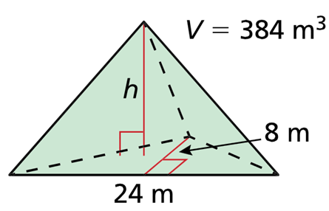
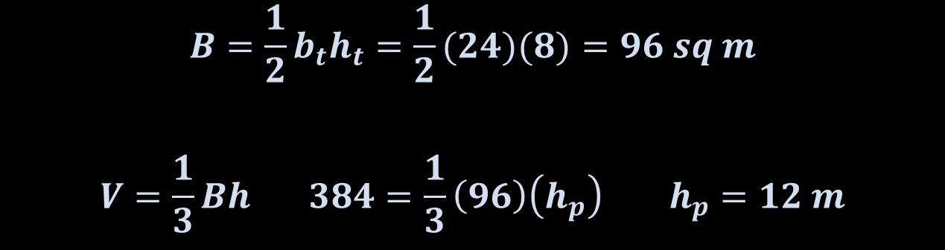
Example 3
Find the height of the triangular pyramid.
Answer:
$$B=\frac{1}{2}b_{t}h_{t}=\frac{1}{2}(24)(8)=96 sq m$$
$$V=\frac{1}{3}Bh 384=\frac{1}{3}\left(96\right)\left(h_{p}\right) h_{p}=12 m$$

Slide 8
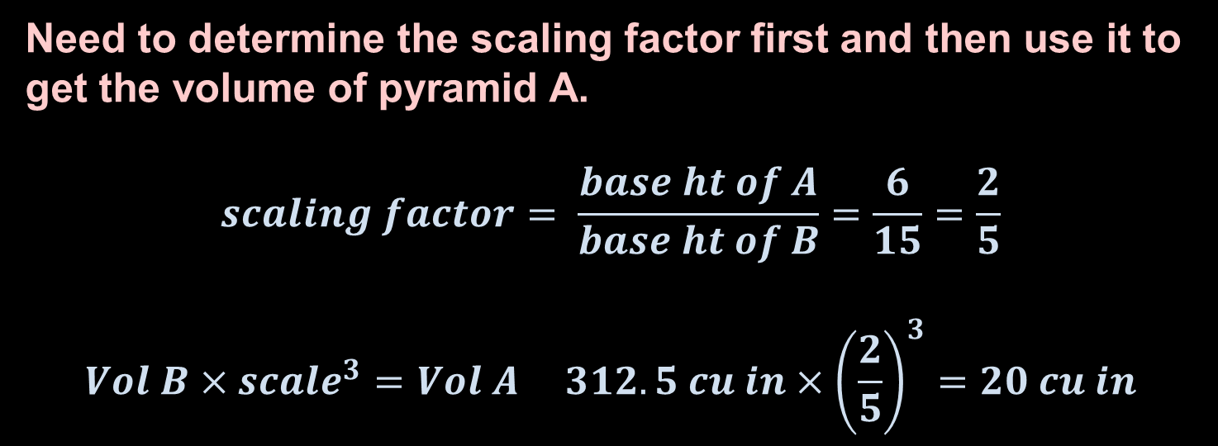
Example 4
Square pyramid A and square pyramid B are similar. The height of pyramid A is 6 inches and the height of pyramid B is 15 inches. The volume of pyramid B is 312.5 cubic inches. Find the volume of pyramid A.
Answer:
Need to determine the scaling factor first and then use it to get the volume of pyramid A.
$$scaling factor= \frac{base ht of A}{base ht of B}=\frac{6}{15}=\frac{2}{5}$$
$$Vol B×{scale}^{3}=Vol A 312.5 cu in×{\left(\frac{2}{5}\right)}^{3}=20 cu in$$

Slide 9
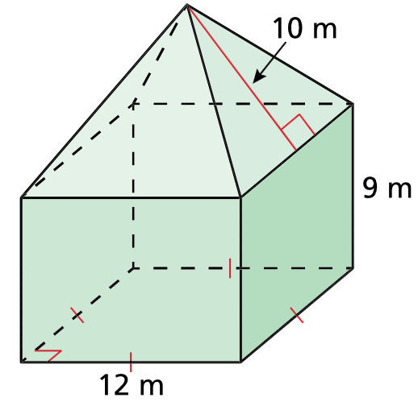
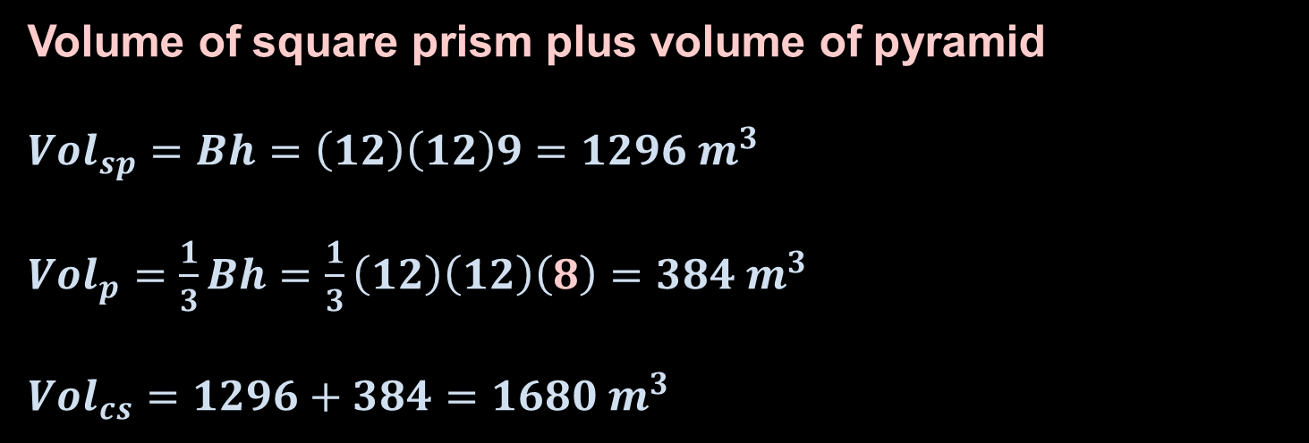
Example 5
Find the volume of the composite solid.
Answer:
Volume of square prism plus volume of pyramid
${Vol}_{sp}=Bh=\left(12\right)\left(12\right)9=1296 m^{3}$
${Vol}_{p}=\frac{1}{3}Bh=\frac{1}{3}\left(12\right)\left(12\right)\left(8\right)=384 m^{3}$
${Vol}_{cs}=1296+384=1680 m^{3}$
10
10
ht
12
Solve for ht by using Pythagorean Thrm and Isosceles Triangle

Slide 10
Summary & Homework
Summary:
  Volume of Pyramid is 1/3 the Base Area times the height
  SOL usually only has square-based pyramids
Homework:
  none

