Slide 1
Lesson 12-3
Volume of Cones

Slide 2
Objectives
Find volumes of cones
Use volumes of cones

Slide 3
Vocabulary
None new

Slide 4
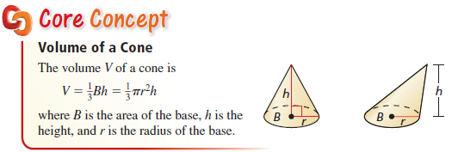
Volume of a Cone
Note: like in two-dimensional figures, the height, h, is always perpendicular to the area of the Base, B.
There is a Pythagorean relationship between slant height, the radius and the height

Slide 5
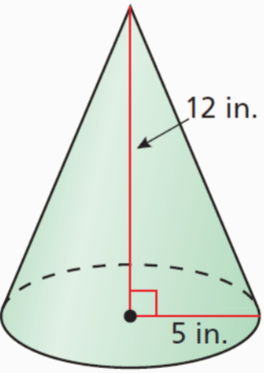
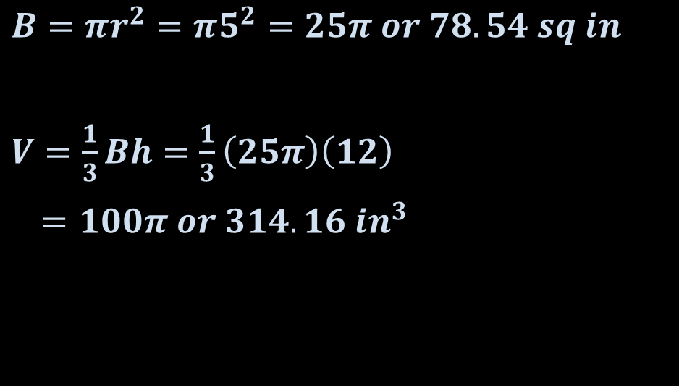
Example 1
Find the volume of the cone.
Answer:
The base is the circle on the bottom
$B=πr^{2}=π5^{2}=25π or 78.54 sq in$
$V=\frac{1}{3}Bh=\frac{1}{3}\left(25π\right)\left(12\right)$
$=100π or 314.16 {in}^{3}$

Slide 6
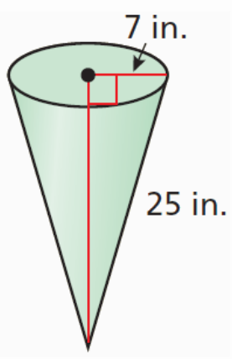
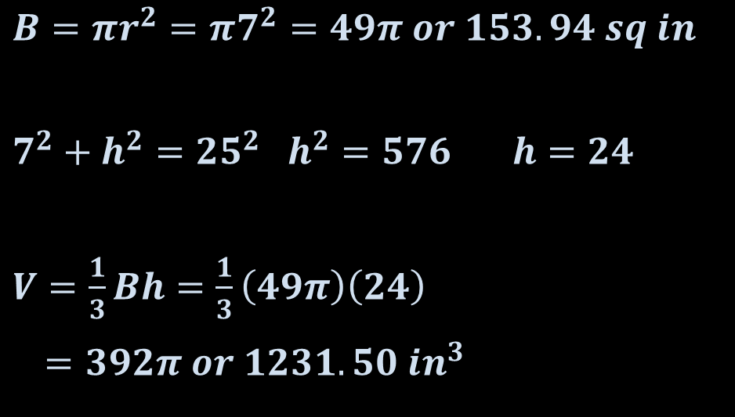
Example 2
Find the volume of the cone.
Answer:
The base is the circle on the bottom and 25 is the slant height
$B=πr^{2}=π7^{2}=49π or 153.94 sq in$
$7^{2}+h^{2}={25}^{2} h^{2}=576 h=24$
$V=\frac{1}{3}Bh=\frac{1}{3}\left(49π\right)\left(24\right)$
$=392π or 1231.50 {in}^{3}$

Slide 7

Example 3
A waffle ice cream cone has a height of 6 inches and a diameter of 3 inches. Find the amount of ice cream (in cubic inches) the cone can hold.
Answer:
$B=πr^{2}=π{1.5}^{2}=2.25π or 7.07 sq in$
$V=\frac{1}{3}Bh=\frac{1}{3}\left(2.25π\right)\left(6\right)$
$=4.5π or 14.14 {in}^{3}$

Slide 8
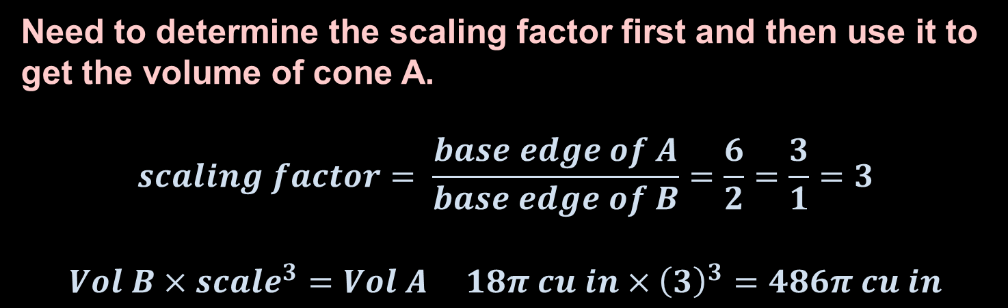
Example 4
Cone A and cone B are similar. The height of cone A is 6 inches and the height of cone B is 2 inches. The volume of cone B is 18π cubic inches. Find the volume of cone A.
Answer:
Need to determine the scaling factor first and then use it to get the volume of cone A.
$$scaling factor= \frac{base edge of A}{base edge of B}=\frac{6}{2}=\frac{3}{1}=3$$
$$Vol B×{scale}^{3}=Vol A 18π cu in×{\left(3\right)}^{3}=486π cu in$$

Slide 9
Summary & Homework
Summary:
  Volume of a Cone is 1/3 the Base Area times the height
  A Pythagorean relationship exists between the slant height, the radius and the height in a cone
  Volume is a cubic relationship so similar figures will have their volumes found by using the cube of the scaling factor
Homework:
  none

