Slide 1
Lesson 12-4
Volumes of
Spheres and Hemi-spheres

Slide 2
Objectives
Find volumes of spheres
Find volumes of hemi-spheres
Solve real-life problems

Slide 3
Vocabulary
None new

Slide 4
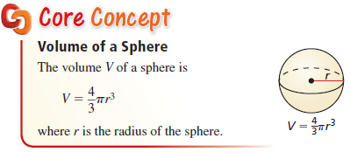
Volume of a Sphere
Note: Volume of a hemi-sphere is just half the volume of a sphere (unlike the surface area)

Slide 5
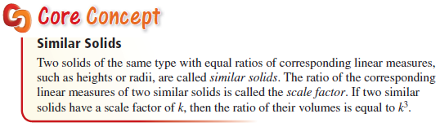
Volumes of Similar Solids
Volume is a cubic relationship and therefore the ratio of the volumes of similar figures is equal to the cube of the scaling factor
Spheres are the common SOL similar 3-d figure.

Slide 6
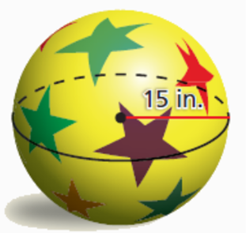
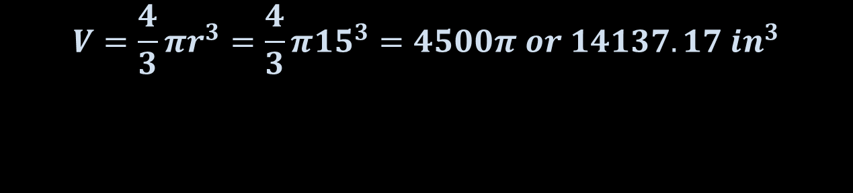
Example 1
Find the volume of the ball.
Answer:
$$V=\frac{4}{3}πr^{3}=\frac{4}{3}π{15}^{3}=4500π or 14137.17 {in}^{3}$$

Slide 7
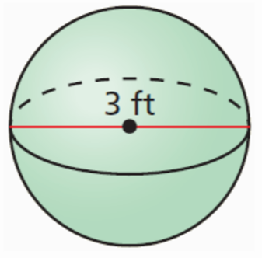
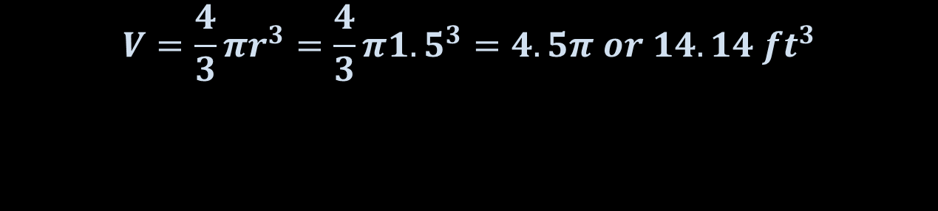
Example 2
Find the volume of the sphere.
Answer:
$$V=\frac{4}{3}πr^{3}=\frac{4}{3}π{1.5}^{3}=4.5π or 14.14 {ft}^{3}$$

Slide 8
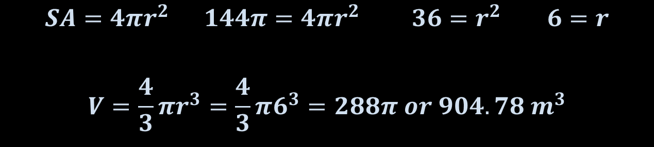
Example 3
The surface area of a sphere is 144π square meters. Find the volume of the sphere.
Answer: Need to find radius first
$$SA=4πr^{2} 144π=4πr^{2} 36=r^{2} 6=r$$
$$V=\frac{4}{3}πr^{3}=\frac{4}{3}π6^{3}=288π or 904.78 m^{3}$$

Slide 9
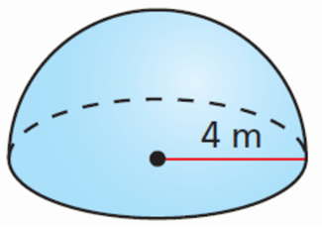
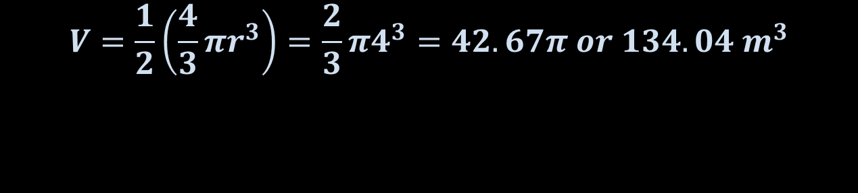
Example 4
Find the volume of the hemi-sphere.
Answer:
$$V=\frac{1}{2}\left(\frac{4}{3}πr^{3}\right)=\frac{2}{3}π4^{3}=42.67π or 134.04 m^{3}$$

Slide 10
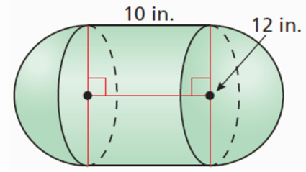
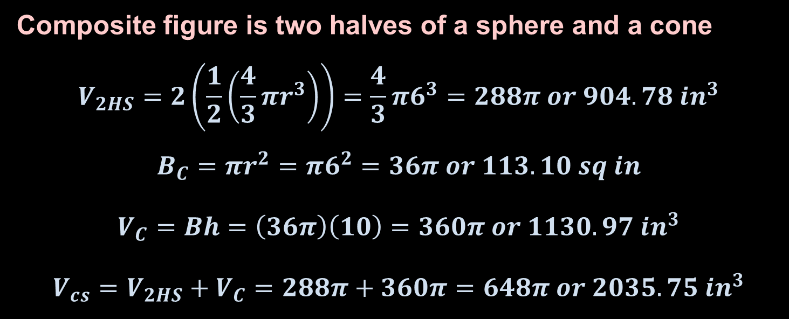
Example 5
Find the volume of the composite solid.
Answer:
Composite figure is two halves of a sphere and a cone
$$V_{2HS}=2\left(\frac{1}{2}\left(\frac{4}{3}πr^{3}\right)\right)=\frac{4}{3}π6^{3}=288π or 904.78 {in}^{3}$$
$$B_{C}=πr^{2}=π6^{2}=36π or 113.10 sq in$$
$$V_{C}=Bh=\left(36π\right)\left(10\right)=360π or 1130.97 {in}^{3}$$
$$V_{cs}=V_{2HS}+V_{C}=288π+360π=648π or 2035.75 {in}^{3}$$

Slide 11
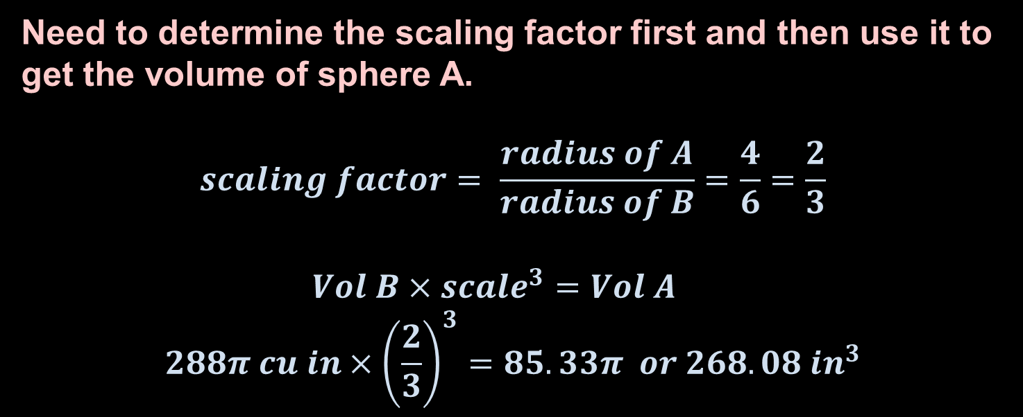
Example 6
Sphere A and sphere B are similar. The radius of sphere A is 4 inches, and the radius of prism B is 6 inches. The volume of prism B is 288π cubic inches. Find the volume of sphere A.
Answer:
Need to determine the scaling factor first and then use it to get the volume of sphere A.
$$scaling factor= \frac{radius of A}{radius of B}=\frac{4}{6}=\frac{2}{3}$$
$$Vol B×{scale}^{3}=Vol A$$
$$288π cu in×{\left(\frac{2}{3}\right)}^{3}=85.33π or 268.08 {in}^{3}$$

Slide 12
Summary & Homework
Summary:
  Volume of Sphere is 4/3 times pi times the radius cubed
  Volume is a cubic relationship so similar figures will have their volumes found by using the cube of the scaling factor
  Spheres are the most common SOL 3D figures used in similarities
Homework:
  SA/Vol WS 3

