Slide 1
Opening
hexagon
A _____________________ has six sides.
If two lines form a _________________ angle, they are perpendicular.
Two angles that form a right angle are ___________________________ angles.
A ___________________ angle has measure of 180°.
right
complementary
straight

Slide 2
Lesson 2-1
Conditional Statements

Slide 3
Lesson Outline
Opening
Five Minute Review
Objectives
Vocabulary
Key Concept
Examples
Summary and Homework

Slide 4



5-Minute Check on Chapter 1
Identify the line
Find the distance between A and C
Name three collinear points
Find the midpoint between C and D
If A is a midpoint and C is the endpoint,
find the other endpoint
Name an obtuse angle with a vertex of D
$\overset{⃡}{BC}$, k
$$d=\sqrt{6^{2}+3^{2}}=\sqrt{45}$$
A, B, C
$mdpt=\left(\frac{4+6}{2},\frac{4+−2}{2}\right)$ = (5, 1)
y
k
(6,4)
(0,1)
C
x
C to A is down 3, left 6. So down 3 and left 6 from A (0,1) is B(-6, -2)
(-6,-2)
A
(4,-2)
B
D
∠BDC
Click the mouse button or press the
Space Bar to display the answers.

Slide 5
Objectives
Analyze statements in if-then form
Write the converse, inverse and contrapositive of if-then statements

Slide 6
Vocabulary
Implies symbol (→)
Conditional statement – a statement written in if-then form
Hypothesis – phrase immediately following the word “if” in a conditional statement
Conclusion – phrase immediately following the word “then” in a conditional statement
Converse – exchanges the hypothesis and conclusion of the conditional statement
Inverse – negates both the hypothesis and conclusion of the conditional statement
Contrapositive – negates both the hypothesis and conclusion of the converse statement
Logically equivalent – multiple statements with the same truth values
Biconditional – conjunction of the conditional and its converse

Slide 7
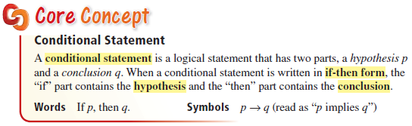
Key Concept
Hypothesis follows “if”
Conclusion follows “, then”

Slide 8
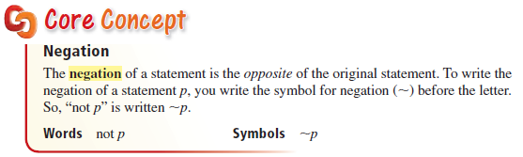
Key Concept
Note: Symbol, ~, uses hint word “opposite”
  Not true is false
  Not false is true

Slide 9
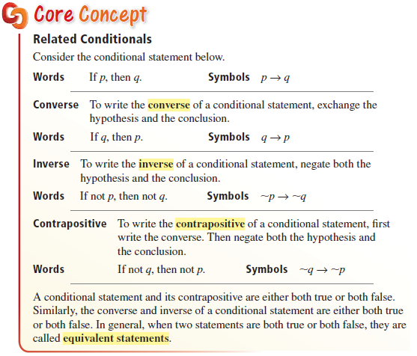
Key Concept

Slide 10
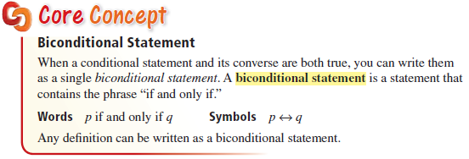
Key Concept
Note: all definitions are biconditional statements

Slide 11
Key Concept Illustrated
If we get a blizzard, then we miss school.
If we get a blizzard, then we miss school.
we get a blizzard
we miss school.
Hypothesis:
Conclusion:

Slide 12

Example 1A
Use $(H)$ to identify the hypothesis and $(C)$ to identify the conclusion. Then write each conditional in if-then form.
A$. x>5$ if $x>3$.
Answer: Hypothesis: x > 3.
Conclusion: x > 5.
If x > 3, then x > 5.
H
C

Slide 13

Example 1B
Use $(H)$ to identify the hypothesis and $(C)$ to identify the conclusion. Then write each conditional in if-then form.
B. All members of the soccer team have practice today.
Answer: Hypothesis: you are a member of the soccer team.
Conclusion: you have practice today
If you are a member of the soccer team, then you have practice today.

Slide 14
Example 2A
Write the negation of each statement
A. The car is white.
Answer: The car is not white.

Slide 15
Example 2B
Write the negation of each statement
B. It is not snowing.
Answer: It is snowing.

Slide 16
Key Concept
Example: If two segments have the same measure, then they are congruent
 | Hypothesis | p | two segments have the same measure
 | Conclusion | q | they are congruent
Statement | Formed by | Symbols | Examples
Conditional | Given hypothesis and conclusion | p → q | If two segments have the same measure, then they are congruent
Converse | Co – changing the order | q → p | If two segments are congruent, then they have the same measure
Inverse | In – insert nots into both parts | ~p → ~q | If two segments do not have the same measure, then they are not congruent
Contrapositive | Cont – change order and add nots | ~q → ~p | If two segments are not congruent, then they do not have the same measure

Slide 17
Key Concept - Converse
If we get a blizzard, then we miss school.
If we get a blizzard, then we miss school.
we get a blizzard
we miss school
P: hypothesis
Q: conclusion
FLIP
If , then .
Converse
If we miss school, then we got a blizzard.

Slide 18
Key Concept - Inverse
If we get a blizzard, then we miss school.
If we get a blizzard, then we miss school.
we get a blizzard
we miss school
P: hypothesis
Q: conclusion
Negate
If , then .
we don’t get a blizzard
we don’t miss school
Inverse
If we don’t get a blizzard, then we don’t miss school.

Slide 19
Key Concept - Contrapositive
If we get a blizzard, then we miss school.
If we get a blizzard, then we miss school.
we get a blizzard
we miss school
P: hypothesis
Q: conclusion
Flip and Negate
If , then .
we don’t miss school
we don’t get a blizzard
Contrapositive
If we don’t miss school, then we don’t get a blizzard.

Slide 20
Conditionals in Symbols
Statements | Symbology
Conditional | P →Q
Converse | Q→P
Inverse | ~P →~Q
Contrapositive | ~Q→~P

Slide 21

Example 3A
Let $p$ be “you are in New York City”
and let $q$ be “you are in the United States.”
Write each statement using symbols and decide whether it is true or false.
A. If you are in New York City, then you are in the United States.
Answer: p → q and it is true conditional

Slide 22

Example 3B
Let $p$ be “you are in New York City”
and let $q$ be “you are in the United States.”
Write each statement using symbols and decide whether it is true or false.
B. If you are in the United States, then you are in New York City.
Answer: q → p and it is false converse

Slide 23

Example 3C
Let $p$ be “you are in New York City”
and let $q$ be “you are in the United States.”
Write each statement using symbols and decide whether it is true or false.
C. If you are not in New York City, then you are not in the United States
Answer: ~p → ~q and it is false inverse

Slide 24

Example 3D
Let $p$ be “you are in New York City”
and let $q$ be “you are in the United States.”
Write each statement using symbols and decide whether it is true or false.
D. If you are not in the United States, then you are not in New York City.
Answer: ~q → ~p and it is true contrapositive

Slide 25
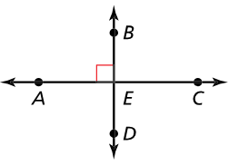

Example 4
Decide whether each statement about the diagram is true.
Explain your answer using the definitions you have learned.
a. $m∠AEB=90°$
b. Points $A$, $C$, and $D$ are collinear.
c. $\vec{AC}$ and $\vec{CA}$ are opposite rays.
True; right angle symbol
False; they form a triangle; not on the same line
False; they overlap between A and C

Slide 26

Example 5
Rewrite the definition of complementary angles as a biconditional statement.
Dfn: If two angles are complementary, then the sum of the measures of the angles is $90°$.
Biconditional: Two angles are complementary if and only if the sum of their measures is 90°

Slide 27
Example 6
Make a truth table for the conditional statement
~(~p → q)
Truth table:
A conditional statement is only false if a true hypothesis gives a false conclusion.
p | q | ~p | ~p → q | ~(~p → q )
T | T | F | T | F
T | F | F | T | F
F | T | T | T | F
F | F | T | F | T

Slide 28
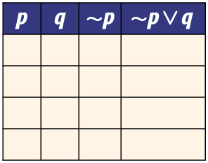
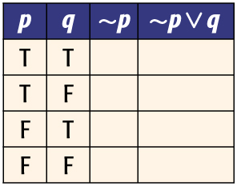
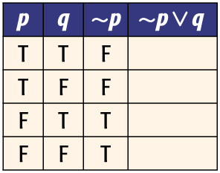
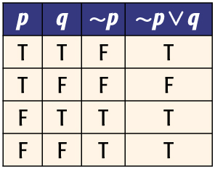
Example 7A
A. Construct a truth table for ~p ∨ q.
Step 1 Make columns with the heading p, q, ~p, and ~p ∨ q.
Step 2 List the possible combinations of truth values for p and q.
Step 3 Use the truth values of p to determine the truth values of ~p.
Answer:
Step 4 Use the truth values of ~p and q to write the truth values for ~p ∨ q.

Slide 29
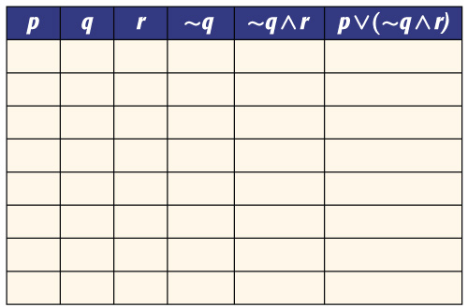
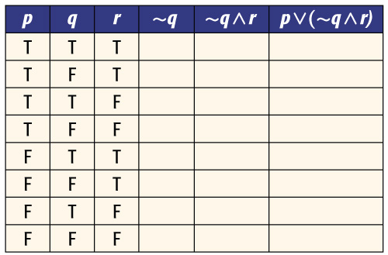
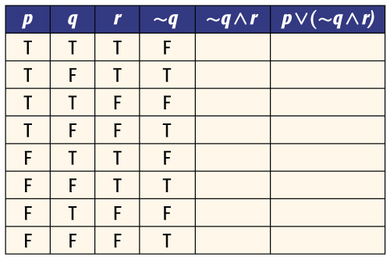
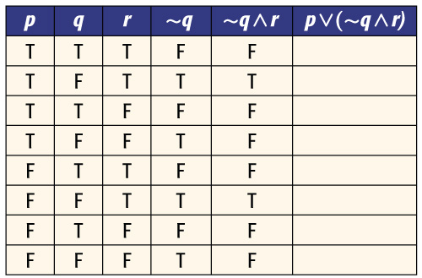
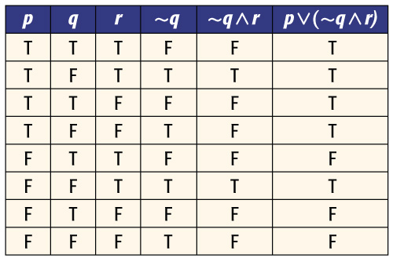
Example 7B
B. Construct a truth table for p ∨ (~q ∧ r).
Step 1 Make columns with the headings p, q, r, ~q, ~q ∧ r, and p ∨ (~q ∧ r).
Step 2 List the possible combinations of truth values for p, q, and r.
Step 3 Use the truth values of q to determine the truth values of ~q.
Answer:
Step 4 Use the truth values for ~q and r to write the truth values for ~q ∧ r.
Step 5 Use the truth values for ~q ∧ r and p to write the truth values for p ∨ (~q ∧ r).

Slide 30
Conditional | If two lines are perpendicular, then their angle is right.
Converse
Inverse
Contrapositive
Conditional
Converse | If two angles are supplementary, then they sum to 180º
Inverse
Contrapositive
Conditional
Converse
Inverse | If today is not Friday, then we do not have a quiz.
Contrapositive
Conditional
Converse
Inverse
Contrapositive | If two angles aren’t a linear pair, then they aren’t supplementary.

Slide 31
Summary & Homework
Summary:
  A conditional statement is usually in the form of an If …, then …; in symbols P → Q
    Hypothesis follows If
    Conclusion follows then
  Converse: change order (or flip); in symbols Q → P
  Inverse: insert nots (negate); in symbols ~P → ~Q
  Contrapositive: change order, nots (both); in symbols ~Q → ~P
Homework:
  Conditional WS and Truth Table WS

