Slide 1
Opening
Find the common difference of the arithmetic sequence. Find the next two terms.
0.009, 0.15, 0.21, 4. 2.4, 2.9, 3.4,
3.36, 1.14, -1.08, 5. 2, 4, 6,
8, 3, -2, 6. 16, 9, 2,
0.06 0.27, 0.33
0.5 3.9, 4.4
-2.22 -3.40, -5.62
2 8, 10
-5 -7, -12
-7 -5, -12

Slide 2
Lesson 2-2
Inductive and Deductive Reasoning

Slide 3
Lesson Outline
Opening
Five Minute Review
Objectives
Vocabulary
Key Concept
Examples
Summary and Homework

Slide 4
5-Minute Check on Section 1
Given the conditional statement:
“If It's Tuesday, This Must Be Belgium”
Find the hypothesis and conclusion
Find the converse in words and symbols
Find the inverse in words and symbols
Find the contrapositive in words and symbols
If p is true and q is false, find the truth value of ~p ∨ q
If p is true and q is false, find the truth value of p ∧ ~q
P: it is Tuesday Q: this must be Belgium
If this is Belgium, then it must be Tuesday Q → P
If it is not Tuesday, then this must not be Belgium ~P → ~Q
If this is not Belgium, then it must not be Tuesday ~Q → ~P
Not true or false is false
True and not false is true
Click the mouse button or press the
Space Bar to display the answers.

Slide 5
Objectives
Use inductive reasoning
  Examples or patterns
Use deductive reasoning
  Steps with reasons

Slide 6
Vocabulary
Conjecture – an unproven statement based on observations
Counterexample – a specific case for which the conjecture is false
Deductive reasoning – uses facts, definitions, accepted properties, and the laws of logic to form a logical argument
Inductive reasoning – uses specific examples and patterns to make a conjecture for the general case

Slide 7
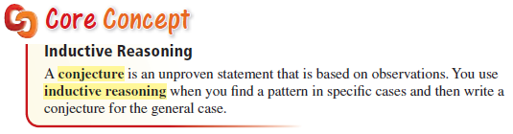
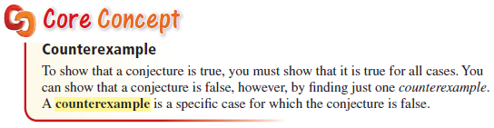
Key Concept
Based on patterns, examples or observations
The exception to the conjecture

Slide 8
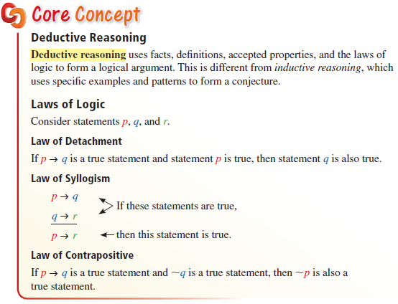
Key Concept
Based on facts, definitions, properties and theorems

Slide 9
Example 0
See the pattern in the following series:
a. 1, 4, 7, 10, 13, ______ b. 1, -2, 4, -8, 16, ____
Find the pattern in the following series:
a. 2, 4, 8, 16, 32, ____ b. 1, 4, 9, 16, 25, _____
c. 3, 1, 5, 3, 7, 5, ____ d. 1, 2, 3, 5, 7, 11, _____
e. 10, 12, 6, 8, 2, 4, ____ f. 5, 3, 10, 6, 15, 9, ____
16
-32
+3
+3
+3
+3
•(-2)
•(-2)
64
36
9
13
-2
20

Slide 10

Example 1
Describe how to sketch the fifth figure in the pattern. Then sketch the fifth figure.
Figure 1 Figure 2 Figure 3 Figure 4
Answer:
Each figure adds a block on the left and on top

Slide 11
Example 2
Make and test a conjecture about the product of a negative integer and a positive integer.
Answer: Conjecture: product of a negative integer and a positive integer is a negative integer.
Tests: -2 x 3 = -6 1 x -5 = -5 4 x -3 = -12

Slide 12
Example 3
A student makes a conjecture about absolute values.
Find a counterexample to disprove the student’s conjecture.
Conjecture: The absolute value of the sum of two numbers is equal to the sum of the two numbers.
Answer:
Counterexample: |-5 + 1| = 4 ≠ -4 = -5 + 1

Slide 13

Example 4A
Write each logical argument symbolically.
Then use deductive reasoning to determine whether each argument is valid.
A. If two rectangles both have side lengths of $3$ inches and $4$ inches, then the two rectangles are congruent. If two rectangles are congruent, then they have the same area. Therefore, if two rectangles both have side lengths of $3$ inches and $4$ inches, then they have the same area.
Answer: let p = two rectangles have side lengths …
q = the two rectangles are congruent.
r = they have the same area
p → q q → r ∴ p → r Example of Law of Syllogism

Slide 14
Example 4B
Write each logical argument symbolically.
Then use deductive reasoning to determine whether each argument is valid.
B. If two rectangles are congruent, then the two rectangles have the same area. Two rectangles do not have the same area. Therefore, the two rectangles are congruent.
Answer: let p = two rectangles are congruent.
q = the two rectangles have the same area
p → q is true. ~q ∴ p invalid example of Law of Contrapositive

Slide 15

Example 4C
Write each logical argument symbolically.
Then use deductive reasoning to determine whether each argument is valid.
C. If two rectangles both have side lengths of $3$ inches and $4$ inches, then the two rectangles are congruent. Two rectangles both have side lengths of $3$ inches and $4$ inches. Therefore, the two rectangles are congruent.
Answer: let p = two rectangles have side lengths …
q = the two rectangles are congruent.
r = they have the same area
p → q is true p is true ∴ q is true Example of Law of Detachment

Slide 16
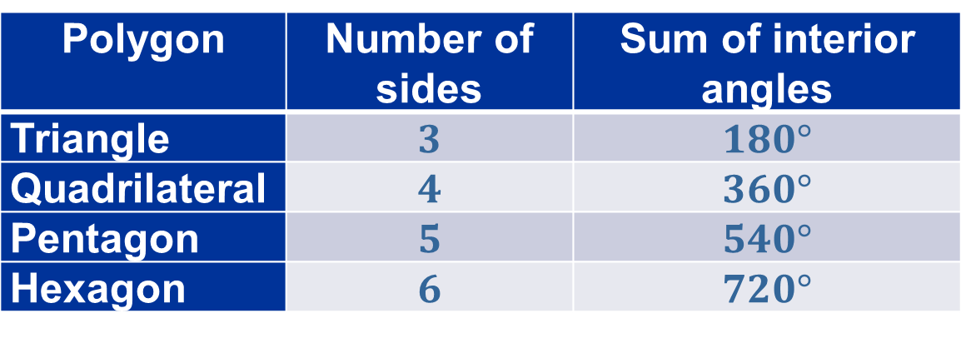

Example 5
The table shows the sum of the measures of the interior angles in various polygons.
What conclusion can you make about the sum of the interior angles in an $n$-sided polygon?
Polygon | Number of sides | Sum of interior angles
Triangle | $$3$$ | $$180°$$
Quadrilateral | $$4$$ | $$360°$$
Pentagon | $$5$$ | $$540°$$
Hexagon | $$6$$ | $$720°$$
Answer: S (sum of interior angles) = (n-2) x 180

Slide 17

Example 6A
Decide whether inductive reasoning or deductive reasoning is used to reach the conclusion. Explain.
A. If the sum of the digits of a number is divisible by $3$, then the number is divisible by $3$. The sum of the digits of the number $147$ is $12$. So the number $147$ is divisible by $3$.
Answer: Deductive; Law of Detachment example; p →q is true and p is true; therefore q must be true

Slide 18
Example 6B
Decide whether inductive reasoning or deductive reasoning is used to reach the conclusion. Explain.
B. Each time you forget to do your math homework, your parents take away your phone privileges for a day. So, the next time you forget to do your math homework, you will lose your phone privileges.
Answer: Inductive; based on a pattern; unless your parents have a set of rules and this is one; then it is a Deductive Law of Detachment example.

Slide 19
Venn Diagrams
(on the Fall test)

Slide 20
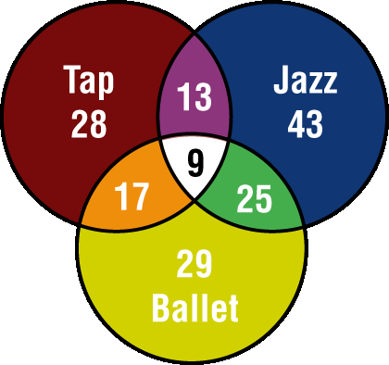
Example 7A
DANCING The Venn diagram shows the number of students enrolled in Monique’s Dance School for tap, jazz, and ballet classes.
A. How many students are enrolled in all three classes?
The students that are enrolled in all three classes are represented by the intersection of all three sets.
Answer: There are 9 students enrolled in all three classes.

Slide 21
Example 7B
DANCING The Venn diagram shows the number of students enrolled in Monique’s Dance School for tap, jazz, and ballet classes.
B. How many students are enrolled in tap or ballet?
The students that are enrolled in tap or ballet are represented by the union of these two sets.
Answer: There are 28 + 13 + 9 + 17 + 25 + 29 or 121 students enrolled in tap or ballet.

Slide 22
Example 7C
DANCING The Venn diagram shows the number of students enrolled in Monique’s Dance School for tap, jazz, and ballet classes.
C. How many students are enrolled in jazz and ballet, but not tap?
The students that are enrolled in jazz and ballet, but (and) not tap, are represented by the intersection of jazz and ballet minus any students enrolled in tap.
Answer: There are 25 + 9 – 9 or 25 students enrolled in jazz and ballet, but not tap.

Slide 23
Summary & Homework
Summary:
  Venn Diagrams:
    Overlaps of the circles have the key word “some”
    Circle that have no overlaps have the key word “none”
  Conjectures are guesses
  Counter examples are examples that go against the conjectures
  Inductive reasoning uses examples and looks for patterns
  Deductive reasoning uses facts, theorems and postulates to prove things
Homework:
  Venn Diagram WS

