Slide 1
Opening
∠1 is a supplement of ∠2 and m∠1 = 32°. Find m∠2.
∠3 is a supplement of ∠4 and m∠3 = 155°. Find m∠4.
∠5 is a complement of ∠6 and m∠5 = 59°. Find m∠6.
∠7 is a supplement of ∠8 and m∠7 = 18°. Find m∠8.
Supplement: 180 – 32 = 148° = m∠2
Supplement: 180 – 155 = 25° = m∠4
Complement: 90 – 59 = 31° = m∠6
Supplement: 180 – 18 = 162° = m∠8

Slide 2
Lesson 2-3
Postulates and Diagrams

Slide 3
Lesson Outline
Opening
Objectives
Vocabulary
Key Concept
Examples
Summary and Homework

Slide 4
5-Minute Check on Section 2
What is the type of reasoning that uses examples?
What is the type of reasoning that uses facts and theorems?
What are the three laws of logic from last section?
Use the Venn Diagram to answer the following:
How many students were at the JV match?
How many students were at the varsity match?
How many were at both?
How many were at neither?
Inductive reasoning
Deductive reasoning
Laws of Syllogism, Detachment and Contrapositive
6 + 4 = 10
Wrestling Attendance
JV
Var
4 + 12 = 16
6
4
12
4
5
5
Click the mouse button or press the
Space Bar to display the answers.

Slide 5
Objectives
Identify postulates using diagrams
Sketch and interpret diagrams

Slide 6
Vocabulary
Line perpendicular to a plane – if and only if it is perpendicular to every line in the plane that intersects it

Slide 7
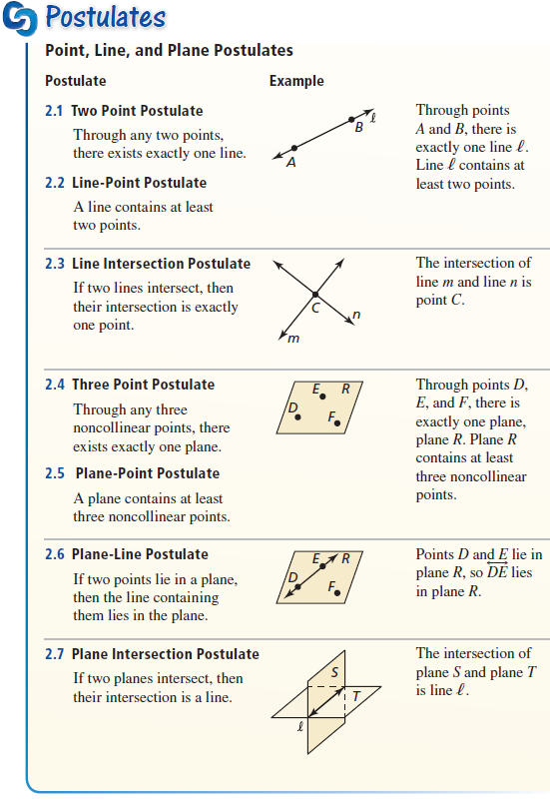
Key Concept
Each line contains (at least) two points and lines intersect in a single point.

Slide 8
Key Concept
Each plane contains (at least) 3 noncollinear points and two planes intersect in a line

Slide 9
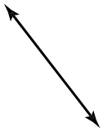
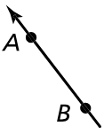
Example 1A
State the postulate illustrated by the diagram:
If then .
Answer: a line contains at least two points

Slide 10


Example 1B
State the postulate illustrated by the diagram:
If then .
Answer: three noncollinear points form exactly one plane

Slide 11
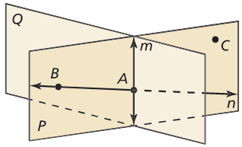
Example 2
Use the diagram to write an example of the Three Point Postulate.
Answer: A, B, and C are three noncollinear points lying on only one plane P

Slide 12

Example 3
Sketch a diagram showing $\vec{VX}$ intersecting $\overset{⃡}{UW}$ at $V$ so that $\vec{VX}$ is perpendicular to $\overset{⃡}{UW}$ and $U$, $V$, and $W$ are collinear.
W
Answer:
V
X
U

Slide 13
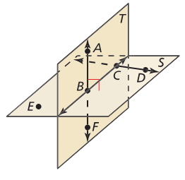

Example 4
Use the diagram. Which statements cannot be assumed from the diagram?
There exists a plane that contains points $A$, $D$, and $E$.
$AB=BF$.
Answer: First statement is true; any three noncollinear points make a plane. Second statement cannot be assumed from the diagram.

Slide 14
Summary & Homework
Summary:
  Postulates are things that we accept to be true
  Theorems are things that we can prove to be true
Homework:
  none

