Slide 1

Opening
State the mistake made in solving the equation. Rewrite the solution so it is correct.
$f – 23 = −17$ 3. $\left(\frac{4}{7}\right)m=22$
$f – 23 – 23 = −17 – 23 \left(\frac{7}{4}\right)\left(\frac{4}{7}\right)m=\left(\frac{4}{7}\right)22$ $f = −40$ $m=\frac{88}{7}$
$8r = 4$ 4. $−\frac{n}{6}=3$
$\frac{8r}{−8}=\frac{4}{−8}$ $\frac{6}{1}\left(\frac{n}{6}\right)=\frac{6}{1}\left(3\right)$
$r=\frac{−1}{2}$ $n=18$
+23
f = 6
×(7/4)
m = 77/2
÷8
r = ½
×(-6/1)
n = -18

Slide 2
Lesson 2-4
Algebraic Reasoning

Slide 3
Lesson Outline
Opening
Objectives
Vocabulary
Key Concept
Examples
Summary and Homework

Slide 4
5-Minute Check on Section 3
What do two lines intersect in?
How many points does it take to define a line?
How many points does it take to define a plane?
What has to be special about the points that define a plane?
What do two planes intersect in?
What is accepted as fact in Geometry?
point
2
3
Must be non-collinear (not on the same line; form a triangle)
line
Postulates
Click the mouse button or press the
Space Bar to display the answers.

Slide 5
Objectives
Use Algebraic Properties of Equality to justify the steps in solving an equation
Use the Distributive Property to justify the steps in solving an equation
Use properties of equality involving segments lengths and angle measures

Slide 6
Vocabulary
Equation – two mathematical expressions connected by the “=” sign
Formula – an equation for a specific quantity
Solve an equation – to solve for the unknown variable

Slide 7
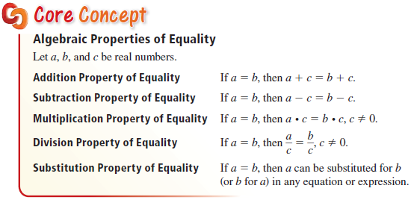
Key Concept
Do the same thing to both sides of an equation

Slide 8
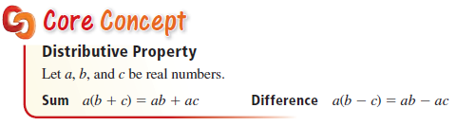

Key Concept
Applies (distributes) the number to both parts of the expression; “Bear Trap”
Parentheses are the teeth; the + or – sign is the pressure plate; distribute the weight or set it off

Slide 9
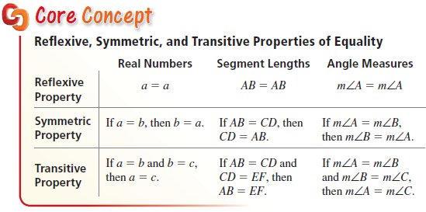
Key Concept
RST → 1, then 2, then 3 “items” involved

Slide 10
Example 1
Solve $2x−5=13$. Justify each step.
Answer:
Statements | Reasons
2x – 5 = 13 Given
+ 5 = + 5 Addition POE
2x = 18 Substitution POE (Simplify)
÷ 2 = ÷ 2 Division POE
x = 9 Substitution POE (Simplify)
Note: An addition, subtraction, multiplication, or division step is always followed by a simplify or substitution POE step

Slide 11
Example 2
Solve $2\left(x+1\right)=−4$. Justify each step.
Answer:
Statements | Reasons
2(x + 1) = -4 Given
2x + 2 = -4 Distribution POE
- 2 = - 2 Subtraction POE
2x = -6 Substitution POE (Simplify)
÷ 2 = ÷ 2 Division POE
x = -3 Substitution POE (Simplify)
Note: Distribution does not need substitution POE step to follow it

Slide 12


Example 3
Use the formula $p\left(1+rt\right)=a$ to find the value $a$ of an investment, where $p$ is the original principal invested, $r$ is the rate of simple interest (as a decimal), and $t$ is the time in years the money is invested. Solve the formula for $t$. How many years will it take until a principal of $\$250$ grows to a value of $\$285$ when the simple interest rate is $2\%$?
Answer: Solve for t gives: $t =\frac{\frac{a}{p}−1}{r}$
Plug the numbers in $t =\frac{\frac{285}{250}−1}{.02}=\frac{1.14−1}{.02}=7$years

Slide 13
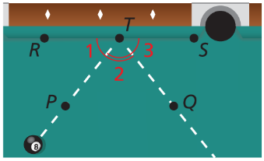

Example 4
You bounce a pool ball off the wall of a pool table, as shown. Determine whether $m∠RTP=m∠STQ$.
Answer: Since ∠1 + ∠2 is marked congruent to ∠2 + ∠3 we can get m∠1 + m∠2 = m∠2 + m∠3
- m∠2 = - m∠2
m∠1 = m∠3
m∠RTP = m∠STQ

Slide 14

Example 5
There are two exits from Theater $10$ at the local cinema. The cinema manager wants to put a trash can along the wall, the same distance from each of the two exits. Create a diagram to model this problem. Show that the distance from the trash can to the left exit is half the distance between the two exits.
Answer:
Trash can
exit
exit

Slide 15
Summary & Homework
Summary:
  Algebraic Statements must be justified by properties of equality
  Start with the givens; end with what you are trying to prove
  Reflexive, Symmetric and Transitive (alpha order) matches number of equal signs (1, 2, 3)
Homework:
  Algebraic Proof Worksheet

