Slide 1
Opening
Find the complement and supplement of the angle measurement.
59° 4. 22.6°
20° 5. 28°
53° 6. 74°

Slide 2
Lesson 2-5
Proving Statements about Segments and Angles

Slide 3
Lesson Outline
Opening
Objectives
Vocabulary
Key Concept
Examples
Summary and Homework

Slide 4
5-Minute Check on Section 4
What algebraic steps are followed by a “simplify” step?
Match the following properties (to the equal signs involved):
Reflexive A = B, B = C, A = C
Symmetric A = B, B = A
Transitive A = A
First step in a two-column proof:
Last step in a proof:
Addition, Subtraction, Multiplication or Division
List the givens
What you are trying to prove!!
Click the mouse button or press the
Space Bar to display the answers.

Slide 5
Objectives
Write two-column proofs
Name and prove properties of congruence

Slide 6
Vocabulary
Axiom – or a postulate, is a statement that describes a fundamental relationship between the basic terms of geometry
Postulate – accepted as true
Proof – a logical argument in which each statement you make is supported by a statement that is accepted as true
Theorem – is a statement or conjecture that can be shown to be true
Two-column proof – has numbered statements and corresponding reasons that show an argument in a logical order

Slide 7
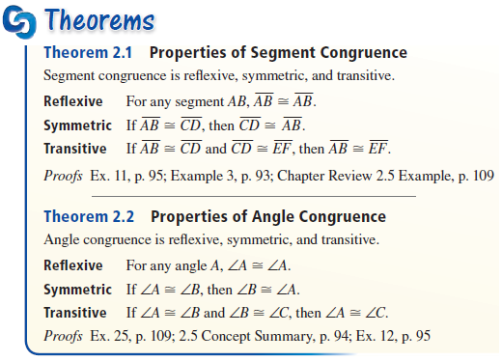
Key Concept
RST → 1, then 2, then 3 “items” involved

Slide 8
Key Concept
Important “things” to remember with segments
  Segment Addition Postulate (sum of parts = whole)
  Midpoints (divide segments into congruent halves)
Important “things” to remember with angles
  Supplementary – adds to 180
  Complementary – adds to 90
  Angle bisectors (cuts angles into congruent halves)
  Linear pairs are supplementary
  Vertical angles are congruent
Use congruence definition to go back and froth from ≅ to = or = to ≅

Slide 9
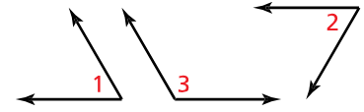

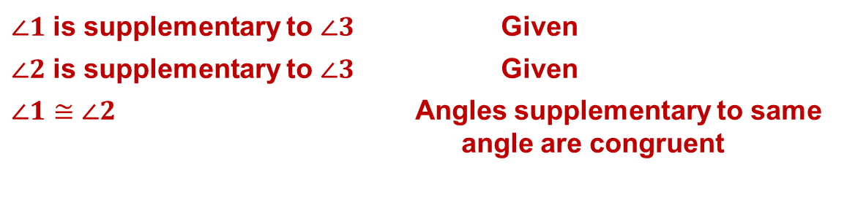
Example 1
Write a two-column proof.
Given: $∠1$ is supplementary to $∠3$
$∠2$ is supplementary to $∠3$
Prove: $∠1≅∠2$
Answer:
Statements | Reasons
$∠1$ is supplementary to $∠3$Given
$∠2$ is supplementary to $∠3$Given
$∠1≅∠2$Angles supplementary to same
angle are congruent

Slide 10

Example 1 extended
Write a two-column proof.
Given: $∠1$ is supplementary to $∠3$
$∠2$ is supplementary to $∠3$
Prove: $∠1≅∠2$
Answer:
Statements | Reasons
$∠1$ is supplementary to $∠3$Given
m∠1 + m∠3 = 180 Supplementary Dfn
$∠2$ is supplementary to $∠3$Given
m∠2 + m∠3 = 180 Supplementary Dfn
m∠1 - m∠2 = 0 Subtract line 4 from line 2
m∠2 = + m∠2 Subtraction POE
m∠1 = m∠2 Substitution POE (Simplify)
$∠1≅∠2$Congruence Dfn

Slide 11

Example 2
Name the property that the statement illustrates.
a. $∠A≅∠A$
b. If $\overline{PQ}≅\overline{JG}$ and $\overline{JG}≅\overline{XY}$, then $\overline{PQ}≅\overline{XY}$
Answer: Reflexive property of congruence (1 item)
Answer: Transitive property of congruence (3 items)

Slide 12
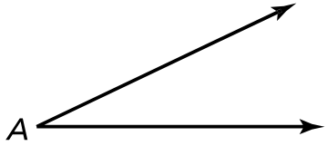

Example 3
Write a two-column proof for the Reflexive Property of Angle Congruence.
Given: $∠A$
Prove: $∠A≅∠A$
Answer:
Statements | Reasons
∠A Given
m∠A = m∠A Reflexive Property of Equality
∠A ≅ ∠A Congruence Dfn

Slide 13
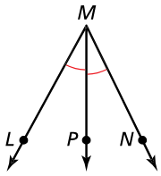

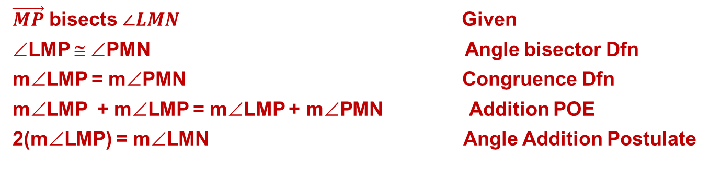
Example 4
Write a two-column proof.
Given: $\vec{MP}$ bisects $∠LMN$.
Prove: $2\left(m∠LMP\right)=m∠LMN$
Answer:
Statements | Reasons
$\vec{MP}$ bisects $∠LMN$ Given
∠LMP ≅ ∠PMN Angle bisector Dfn
m∠LMP = m∠PMN Congruence Dfn
m∠LMP + m∠LMP = m∠LMP + m∠PMN Addition POE
2(m∠LMP) = m∠LMN Angle Addition Postulate

Slide 14
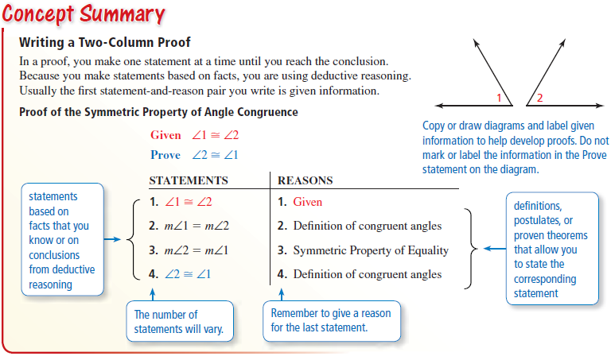
Summary & Homework
Homework:
  Start Geometric Proof Worksheet

