Slide 1
Opening
9x + 6 = 10x – 3
6y = 5y + 35
9x + 5 = 5(x – 3)
17 y + 18 = 15y
14x – 44 = 20x – 2
7x – 1 = 13x + 41

Slide 2
Lesson 2-6
Proving Geometric Relationships

Slide 3
Lesson Outline
Opening
Objectives
Vocabulary
Key Concept
Examples
Summary and Homework

Slide 4
5-Minute Check on Section 5
Why can we go from a ≅ to an = (or vice-versa)?
What are the first things usually listed in a proof?
What are used as reasons in proofs?
Match the following:
Complement Equal
Congruent Adds to 90
Supplement Adds to 180
Congruence definition
Any givens
Givens, postulates, theorems, definitions and properties
Click the mouse button or press the
Space Bar to display the answers.

Slide 5
Objectives
Write flow-chart proofs to prove geometric relationships
Write paragraph proofs to prove geometric relationships

Slide 6
Vocabulary
Flow or flowchart proof – uses boxes and arrows to show the flow of a logical argument
Paragraph Proof – statements and reasons of a proof are presented as sentences in a paragraph

Slide 7
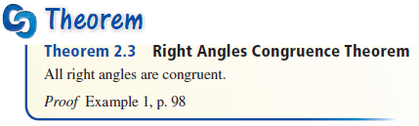
Key Concept
A right angle measures 90°;
so all right angles are congruent

Slide 8
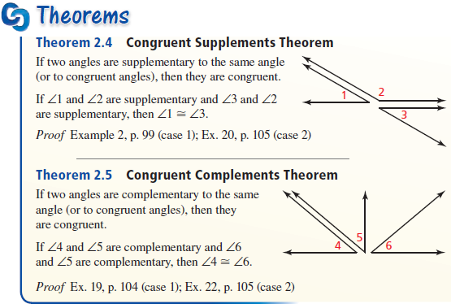
Key Concept
Angles either complement or supplement to the same angle are congruent

Slide 9
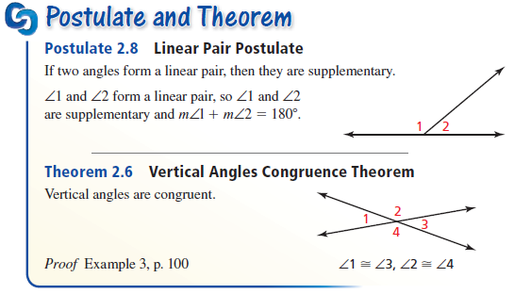
Key Concept
Linear pairs are supplementary
Vertical angles are congruent

Slide 10
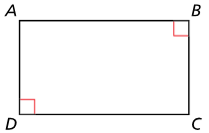

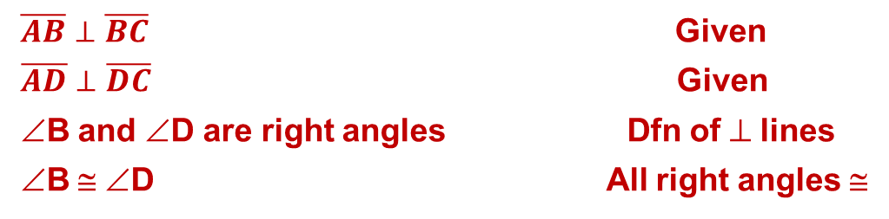

Example 1
Use the given flowchart proof to write a two-column proof.
Given: $\overline{AB}⊥\overline{BC}$, $\overline{AD}⊥\overline{DC}$
Prove: $∠B≅∠D$
$$\boxed{\overline{AB}⊥\overline{BC}, \overline{AD}⊥\overline{DC}}$$
Given
$$↓$$
$$\boxed{∠B and ∠D are right angles}$$
Definition of $⊥$ lines
$$↓$$
$$\boxed{∠B≅∠D}$$
All right angles are congruent.
Answer:
Statement | Reason
$\overline{AB}⊥\overline{BC}$ Given
$\overline{AD}⊥\overline{DC}$ Given
∠B and ∠D are right angles Dfn of ⊥ lines
∠B ≅ ∠D All right angles ≅

Slide 11
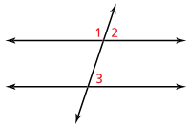


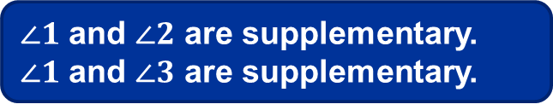
Example 2
Write a flowchart proof.
Given: $∠1$ and $∠2$ are supplementary.
$∠1$ and $∠3$ are supplementary.
Prove: $∠2≅∠3$
Answer:
$∠1$ and $∠2$ are supplementary.
$∠1$ and $∠3$ are supplementary.
Given
$$∠2≅∠3$$
Angles supplementary to same angle are congruent

Slide 12
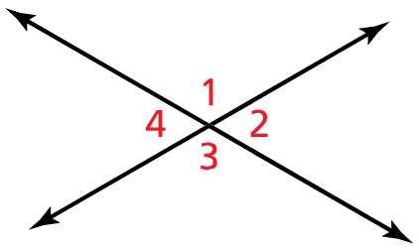


Example 3
Use the diagram and the given angle measure to find the other three angle measures.
$m∠3=128°$
Answer:
$m∠1=128°$ vertical angles
$m∠2=180−128=52°$ linear pairs
$m∠4=180−128=52°$ vertical angles

Slide 13
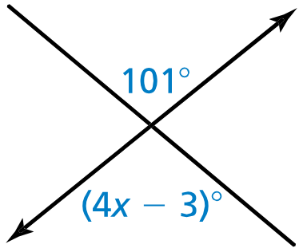

Example 4
Find the value of $x$.
Answer:
101 = 4x – 3 (vertical ∠)
104 = 4x
26 = x

Slide 14
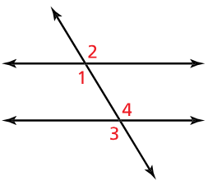

Example 5
Write a paragraph proof.
Given: $∠1≅∠4$
Proof: $∠2≅∠3$
Answer:
Angle 1 is congruent to angle 4 because its given. Angle 4 is congruent to angle 3 because they are vertical angles.
Angle 1 is congruent to angle 2 because they are vertical angles.
Angle 2 must be congruent to angle 3 because of the transitive property of congruence.

Slide 15
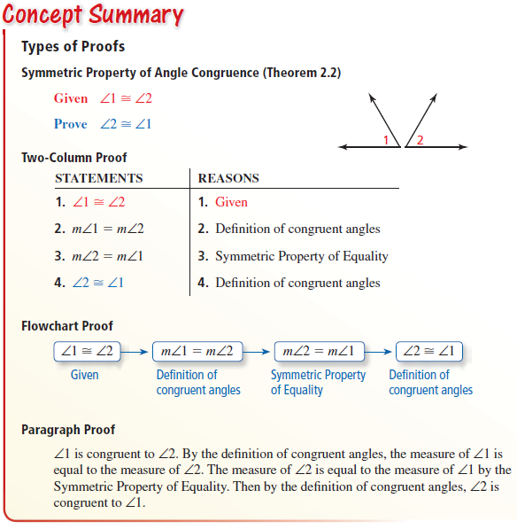
Summary
Normally we do not see these types of proofs on the SOL

Slide 16
Summary & Homework
Homework:
  Finish Geometry Proof worksheet

