Slide 1
Lesson 2-R
Chapter 2 Review

Slide 2
5-Minute Check on Section 6
Which type of proof is used on SOLs?
What is the reason for m∠ABC + m∠DBC = m∠ABD?
What could be the reason for m∠ABC = m∠DBC ?
Match the following:
Linear Pairs Equal
Right Angles Is 90
Vertical Angles Adds to 180
Congruence definition
Angle Addition Postulate
Angle bisector definition (BC)
Click the mouse button or press the
Space Bar to display the answers.

Slide 3
Objectives
Know chapter objectives

Slide 4
Vocabulary
No new vocabulary

Slide 5
Venn Diagrams Review
P: All students at MSHS
Q: All students born in VA
P ٨ Q: All students at MSHS and were born in VA
P ٧ Q: All students at MSHS or were born in VA
P
P ٨ Q
Q
The intersection of the two circles is the “and” – the students in that group are both students at MSHS and were born in VA
The union of the two circles is the “or” – the students in that group are either students at MSHS or were born in VA
The area in circle Q, outside of circle P, represents students not at MSHS that were born in VA
The area in circle P, outside of circle Q, represents students at MSHS that were not born in VA

Slide 6
Symbols and Vocabulary
Boolean Word | Symbol | Hint Idea | Vocabulary
Not | ~ | Opposite | Negation
And | ∧ | Both True | Conjunction
Or | ∨ | Either True | Disjunction
Not – makes the value opposite
not true is false
not false is true
And – is true only if both sides are true
Or – is true if either side is true
Truth Tables!!

Slide 7
Related Conditionals:
Example: If two segments have the same measure, then they are congruent
 | Hypothesis | p | two segments have the same measure
 | Conclusion | q | they are congruent
Statement | Formed by | Symbols | Examples
Conditional | Given hypothesis and conclusion | p → q | If two segments have the same measure, then they are congruent
Converse | Exchanging the hypothesis and conclusion of the conditional | q → p | If two segments are congruent, then they have the same measure
Inverse | Negating both the hypothesis and conclusion of the conditional | ~p → ~q | If two segments do not have the same measure, then they are not congruent
Contra-positive | Negating both the hypothesis and conclusion of the converse | ~q → ~p | If two segments are not congruent, then they do not have the same measure

Slide 8
Law of Detachment
Example: If you have more than 9 absences, then you must take the final.
P: you have more than 9 absences
Q: you must take the final
P → Q: If you have more than 9 absences, you must take the final
The conditional (if then) statement is true (from your student handbook). So when John Q. Public misses 12 days of school this year, he knows he will have to take the final.
[ P → Q is true; and P is true (for John), therefore Q must be true]
Only 1 conditional statement

Slide 9
Law of Syllogism
Example: If you have more than 9 absences, then you must take the final. If you have to take the final, then you don’t get out early.
P: you have more than 9 absences
Q: you must take the final
R: you don’t get out early
At least two conditional statements
P → Q and Q → R, so P → R
(similar to the transitive property of equality:
a = b and b = c so a = c)
The first conditional (if then) statement is true and the second conditional statement is true. So if you have more than 9 absences, then you have to take the final and you don’t get out early!
[P→Q is true; and Q→R is true; therefore, P→R must be true.]

Slide 10
Proofs
Algebraic
  Properties of Equality:
  Addition / Subtraction Multiplication / Division
  Distributive Transitive (a=b, b=c, a=c)
  Symmetric (y=x, x=y) Reflexive (x=x)
Segment
  Congruence Definition (= → ≅ = → ≅ )
  Segment Addition Postulate:
  sum of parts is equal to the whole
Angle
  Vertical Angle Theorem (“X”) – vertical angles are =
  Definition of Linear Pair (“Y”) – add to 180

Slide 11
Summary & Homework
Summary:
  Properties of equality and congruence can be applied to angle relationships
Homework:
  study for the chapter test

Slide 12
Sequences
Use the difference between adjacent numbers to help determine the pattern.
Use the pattern to predict the next number in the sequence.
If no apparent pattern, look at the numbers themselves to see if they are special (primes)
1, -3, 5, -7, 9, ____ 2. 100, 90, 70, 40, _____
3. 3, 6, 9, 12, _____ 4. 100, 50, 25, 12.5, _____
-11
0
15
6.25

Slide 13
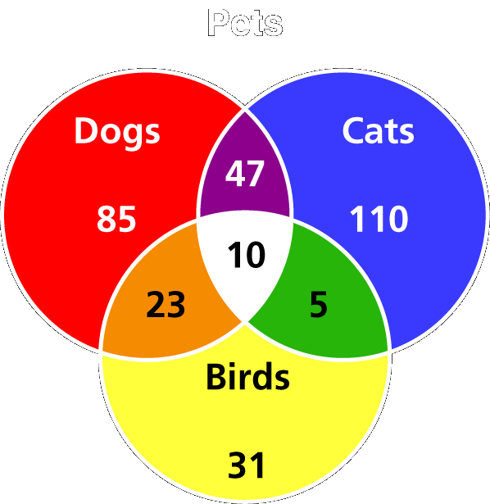
Venn Diagrams
Where two circles overlap is an intersection (A ∧ B)
Combining two circles is a union (A ∨ B)
To exclude part of a circle is to not the intersection
(A ∧ ~B)
How many people own Dogs and Cats?
How many people own dogs and birds, but no cats
How many people own just cats?
47 + 10 = 57
D ∧ C
23 + 10 - 10 = 23
D ∧ B ∧ ~C
110
C ∧ ~B ∧ ~D

Slide 14
Symbols and Vocabulary
Boolean Word | Symbol | Hint Idea | Vocabulary
Not | ~ | Opposite | Negation
And | ∧ | Both True | Conjunction
Or | ∨ | Either True | Disjunction
Not – makes the value opposite
not true is false
not false is true
And – is true only if both sides are true
Or – is true if either side is true

Slide 15



Truth Tables
Use the hint words to figure out whether the compound statement is true or false
Use anything given to you to check your work
p
q
r
T
T
T
T
T
T
T
T
F
T
F
T
T
F
T
T
F
T
T
F
F
T
F
T
F
T
T
T
T
T
F
T
F
T
F
T
F
F
T
F
F
F
F
F
F
F
F
F

Slide 16
Conditional Statements
Hypothesis, known as P – follows “if”
Conclusion, known as Q – follows “, then”
Read P implies Q P → Q

Slide 17
Conditional Statements
Conditional P → Q
Converse Q → P
Inverse ~P → ~Q
Contrapositive ~Q→ ~P
If the conditional and the converse are both true, then we call it bi-conditional (goes both ways)
  In symbols P Q or P → Q and Q → P
  All definitions are biconditional
  A double arrow is read “if and only if”
Flips
Negates
Both

Slide 18
Logic Laws
Law of Detachment
  Given a true conditional and told that the hypothesis is true, then the conditional means that the conclusion must be true
  If P → Q is true, and P is true, then Q must also be true
  Almost always involves only one “if – then” or conditional statement
  Example: If you miss more than 9 days, then you have to take the final. Jon missed 15 days of school. Jon has to take the final.
Law of Syllogism
  Given a true conditional statement and another that uses the conclusion of the first as its hypothesis, then the first hypothesis will imply the second conclusion
  If P → Q is true, and Q → R is true, then P → R
  Almost always involves at least two “if – then” or conditional statements
  Example: If you miss more than 9 days, then you have to take the final. If you have to take the final, then you do not get out early. Jon missed 15 days of school. Jon will not get out early.

Slide 19
Misc
Reasoning
  Inductive – patterns in numbers
  Deductive – proving something step-by-step
Postulates vs Theorems
  Know those 7 postulates!
  Postulates accept as true; Theorems prove true
Matrix Logic

Slide 20
Algebraic Properties
Properties of Equality for Real Numbers
Reflexive | For every a, a = a
Symmetric | For all numbers a and b, if a = b, then b = a
Transitive | For all numbers a, b, and c, if a = b and b = c, then a = c
Addition & Subtraction | For all numbers a, b, and c, if a = b, then a + c = b + c and a – c = b - c
Multiplication & Division | For all numbers a, b, and c, if a = b, then ac = bc and if c ≠ 0, a/c = b/c
Substitution | For all numbers a and b, if a = b, then a may be replaced by b in any equation or expression
Distributive | For all numbers a, b, and c, a(b + c) = ab + ac

Slide 21
Congruence and Equality
Congruence, like equality, is reflexive, symmetric and transitive
Reflexive Property AB ≅ AB
Symmetric Property If AB ≅ CD, then CD ≅ AB
Transitive Property If AB ≅ CD and CD ≅ EF, then AB ≅ EF
Congruence and Equal: If we go from an ≅ to an = or
from an = to an ≅, then the reason is the definition of congruence
Postulate 2.9, Segment Addition Postulate: If B is between A and C, then AB + BC = AC and if AB + BC = AC, then B is between A and C.
sum of the parts = the whole

Slide 22
Important Angle Theorems
Theorem 2.5, Angles supplementary to the same angle or to congruent angles are congruent.
Theorem 2.6, Angles complementary to the same angle or to congruent angles are congruent.
Theorem 2.7, Vertical Angles Theorem: If two angles are vertical angles, then they are congruent.

Slide 23
Misc
Difference between Postulates and Theorems
  Postulates accept as true; Theorems prove true
Biconditional Statements
  All definitions are biconditional
Always, Sometime and Never True Problems
  Look through the book for them
  Good way to test theorems and postulates

