Slide 1
Lesson 3-1
Pairs of Lines and Angles

Slide 2
Lesson Outline
Opening
Objectives
Vocabulary
Key Concept
Examples
Summary and Homework

Slide 3
Opening
hexagon
A _____________________ has six sides.
If two lines form a _________________ angle, they are perpendicular.
Two angles that form a right angle are ___________________________ angles.
A ___________________ angle has measure of 180°.
right
complementary
straight

Slide 4
Objectives
Identify lines and planes
Identify parallel and perpendicular lines
Identify pairs of angles formed by transversals

Slide 5
Vocabulary
Alternate Exterior angles – lie outside the lines but on opposite sides of the transversal
Alternate Interior angles – lie between the lines but on opposite sides of the transversal
Consecutive Exterior angles – lie outside the lines but on the same side of the transversal
Consecutive Interior angles – lie inside the lines but on the same side of the transversal
Corresponding angles – angles that have corresponding positions (both lower right or upper left)
Parallel Symbol (║ in text or ─►─ on a line or segment in picture )
Parallel Lines – coplanar lines that do not intersect
Parallel Planes – planes that do not intersect
Skew lines – lines that do not intersect and are not coplanar
Transversal – a line that intersects two or more coplanar lines at different points

Slide 6
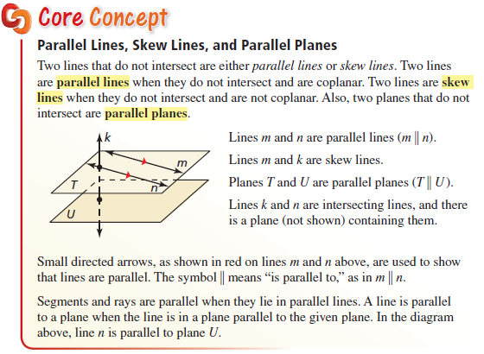
Key Concept
Parallel – coplanar lines that do not intersect
Skew – not coplanar lines that do not intersect

Slide 7
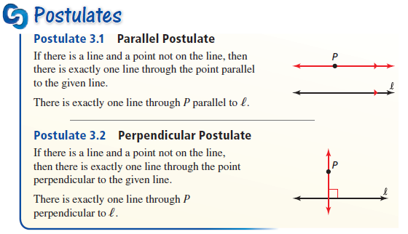
Key Concept
Uniqueness of a parallel or perpendicular line

Slide 8
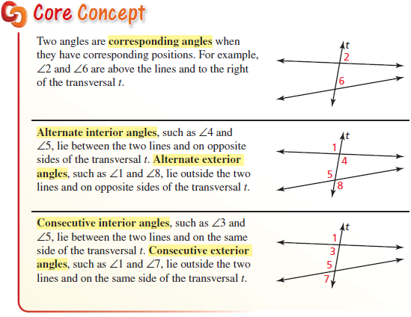
Key Concept
“C” angles on same side of the transversal
“A” angles on opposite sides of transversal

Slide 9
Angles formed by Transversals
t
k
1
2
3
4
5
6
l
7
8
Name | Definition | Examples
Exterior angles | Angles outside the two lines | ∠1, ∠2, ∠7, and ∠8
Interior angles | Angles in-between the two lines | ∠3 , ∠4, ∠5, and ∠6
Consecutive Interior angles | In-between lines on the same side of the transversal | ∠3 and ∠5, ∠4 and ∠6
Alternate exterior angles | Outside the two lines on opposite sides of the transversal | ∠1 and ∠8, ∠2 and ∠7
Alternate interior angles | In-between the two lines on opposite sides of the transversal | ∠3 and ∠6, ∠4 and ∠5
Corresponding angles | Occupy similar positions in relation to transversal and lines | ∠1 and ∠5, ∠2 and ∠6, ∠3 and ∠7, ∠4 and ∠8

Slide 10
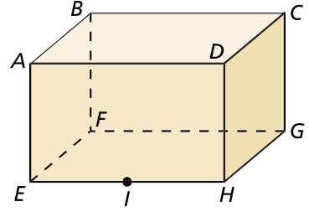



Example 1 A/B
Think of each segment in the figure as part of a line. Which line(s) or plane(s) appear to fit the description?
A. Line(s) parallel to $\overset{⃡}{GH}$ and containing point F.
B. Line(s) skew to $\overset{⃡}{GH}$ and containing point F.
Answer: $\overset{⃡}{EF}$ in the “bottom” plane
Answer: $\overset{⃡}{BF}$ (not coplanar)

Slide 11


Example 1 C/D
Think of each segment in the figure as part of a line. Which line(s) or plane(s) appear to fit the description?
C. Line(s) perpendicular to $\overset{⃡}{GH}$ and containing point F.
D. Plane(s) parallel to plane GHD and containing point F.
Answer: $\overset{⃡}{FG}$ in the “bottom” plane
Answer: plane ABF (left side to GHD’s right side)

Slide 12
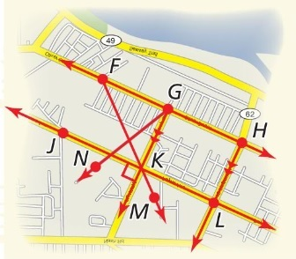


Example 2
The given line markings show how the roads in a town are related to each other.
A. Name a pair of parallel lines.
B. Name a pair of perpendicular lines.
C. Is $\vec{GN}⊥\overset{⃡}{JL}$? Explain.
Answer: none really ($\vec{GM}∥\vec{HL}$)
Answer: none really ($\vec{GK}⊥\overset{⃡}{JL}$)
Answer: no; intersection is not at right angle

Slide 13
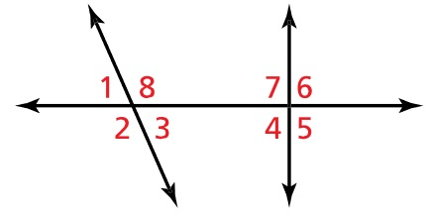
Example 3
Identify all pairs of angles of the given type.
Consecutive interior
Alternate exterior
Corresponding
Alternate interior
Consecutive exterior
Answer: ∠8, ∠7 and ∠3, ∠4
Answer: ∠1, ∠5 and ∠2, ∠6
Answer: ∠1, ∠7 ; ∠2, ∠4 ; ∠8, ∠6 and ∠3, ∠5
Answer: ∠8, ∠4 and ∠3, ∠7
Answer: ∠1, ∠6 and ∠2, ∠5

Slide 14
Summary & Homework
Summary:
  xxxx
Homework:
  Angle Worksheet 2

