Slide 1
Lesson 3-2
Pairs of Lines and Angles

Slide 2
Lesson Outline
Opening
Objectives
Vocabulary
Key Concept
Examples
Summary and Homework

Slide 3
Opening
hexagon
A _____________________ has six sides.
If two lines form a _________________ angle, they are perpendicular.
Two angles that form a right angle are ___________________________ angles.
A ___________________ angle has measure of 180°.
right
complementary
straight

Slide 4
Objectives
Use properties of parallel lines
Prove theorems about parallel lines
Solve real-life problems

Slide 5
Vocabulary
No new vocabulary words or symbols

Slide 6
Key Concept

Slide 7
Key Concept

Slide 8
Solving Angle Problems
95% of all angle problems are solved by one of two equations:
  Angle = Angle (angles are congruent)
  Angle + Angle = 180 (angles are supplementary)
t
k
1
2
3
4
Angle = Angle
m∠1 = m∠4
3x + 10 = 4x – 30
+30 = +30
3x + 40 = 4x
-3x = -3x
40 = x
Angle + Angle = 180
m∠1 + m∠2 = 180
4x – 30 + x + 10 = 180
5x – 20 = 180
+20 = +20
5x = 200
x = 40
5
6
l
7
8

Slide 9
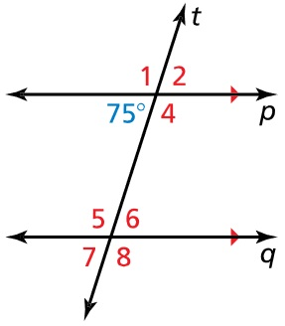
Example 1
The measures of three of the numbered angles are 75°. Identify the angles. Explain your reasoning for each.
Answer: Angles 2 (vertical with 75°),
angle 6 (alternate interior) and
angle 8 (vertical with 6).

Slide 10
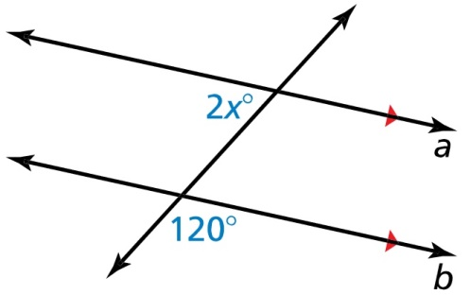
Example 2
Find the value of x.
Answer:
2x + 120 = 180 (after moving 120 inside thru vertical angles, you have consecutive interior angles)
2x = 60
x = 30

Slide 11
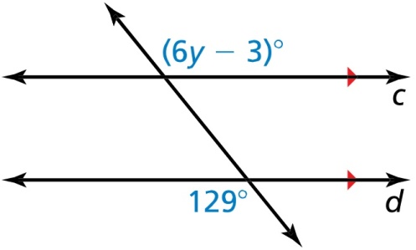
Example 3
Find value of y.
Answer:
6y – 3 = 129 (alternate exterior angles)
6y = 132
y = 22

Slide 12
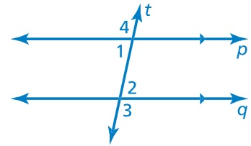

Example 4
Prove the Alternate Interior Angles Theorem without using the Corresponding Angles Theorem
Given p // q
Prove $∠1≅∠2$.
Answer:
Statement | Reason
p // q Given
∠4 ≅ ∠3 Alt Ext Angle Thrm
m∠4 = m∠3 Congruence Dfn
m∠4 + m∠1 = 180 Linear Pair Dfn
m∠3 + m∠2 = 180 Linear Pair Dfn
m∠1 – m∠2 = 0 Subtract lines 3 - 4
m∠1 = m∠2 Add POE
∠1 ≅ ∠2 Congruence Dfn

Slide 13
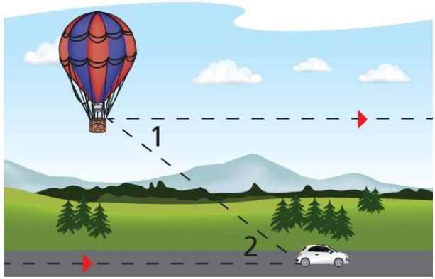
Example 5
A balloonist sees a car at a 37° angle of depression from horizontal. In the diagram, m∠1 = 37°. What is m∠2?
How do you know?
Answer: Angle 2 is alternate interior so it has the same measure as angle 1; m∠1 = 37° = m∠2 .

Slide 14
Summary & Homework
Summary:
  Congruent Special Angle pairs:
    Vertical angles from chapter 1
    Corresponding angles
    Alternate Interior angles
    Alternate Exterior angles
  Supplementary Special Angle pairs:
    Linear pairs from chapter 1
    Consecutive Interior angles
    Consecutive Exterior angles
Homework:
  Angle worksheet 3

