Slide 1
Lesson 3-3
Proofs with Parallel Lines

Slide 2
Lesson Outline
Opening
Objectives
Vocabulary
Key Concept
Examples
Summary and Homework

Slide 3
Opening
hexagon
A _____________________ has six sides.
If two lines form a _________________ angle, they are perpendicular.
Two angles that form a right angle are ___________________________ angles.
A ___________________ angle has measure of 180°.
right
complementary
straight

Slide 4
Objectives
Use the Corresponding Angles Converse
Construct parallel lines
Prove theorems about parallel lines
Use the Transitive Property of Parallel Lines

Slide 5
Vocabulary
No new vocabulary words or symbols

Slide 6
Key Concept
Converse of Corresponding Angle Thrm
  Start with congruent angles and get parallel lines

Slide 7
Key Concept
Same thing with these converses
    Start with congruent angles and get parallel lines

Slide 8
Key Concept
Transitive property of equality and congruence applied to parallel lines

Slide 9
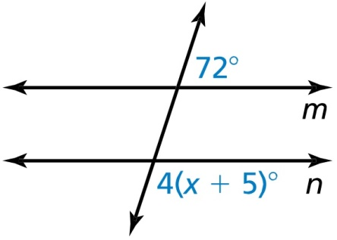

Example 1
Find the value of x that makes $m∥n$.
Answer: consecutive exterior (so supplementary)
72° = 4(x + 5)°
72° = 4x + 20°
52° = 4x
13° = x

Slide 10
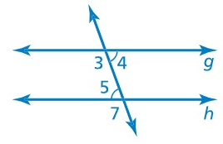

Example 2
Prove the Alternate Interior Angles Converse without using the Vertical Angles Congruence Theorem.
Given $∠4≅∠5$
Prove $g∥h$
Answer:
Statement | Reason

Slide 11
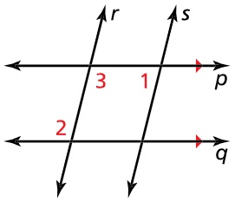
Example 3
In the diagram, p // q and angle 1 is supplementary to angle 2. Prove r //s.
Answer:
Statement | Reason

Slide 12

Example 4
Each parking space in a lot is defined by two parallel lines and shares a common line with the next adjacent space. Explain why the left line in space 02 is parallel to the right line in space 08.
Answer: Each right and left lines of the parking spaces are parallel to each other. Transitive property of parallel lines allows us to conclude that the left line in space 02 is parallel to the right line in space 08

Slide 13
Summary & Homework
Summary:
  xxxx
Homework:
  Conditional Worksheet

