Slide 1
Lesson 3-4
Proofs with Parallel Lines

Slide 2
Lesson Outline
Opening
Objectives
Vocabulary
Key Concept
Examples
Summary and Homework

Slide 3
Opening
hexagon
A _____________________ has six sides.
If two lines form a _________________ angle, they are perpendicular.
Two angles that form a right angle are ___________________________ angles.
A ___________________ angle has measure of 180°.
right
complementary
straight

Slide 4
Objectives
Find the distance from a point to a line
Construct perpendicular lines
Prove theorems about perpendicular lines
Solve real-life problems involving perpendicular lines

Slide 5
Vocabulary
Distance from a point to a line – the length of the perpendicular segment between the point and the line
Perpendicular bisector – is something that is perpendicular to the segment and passes through the midpoint of the segment

Slide 6
Key Concept

Slide 7
Key Concept

Slide 8
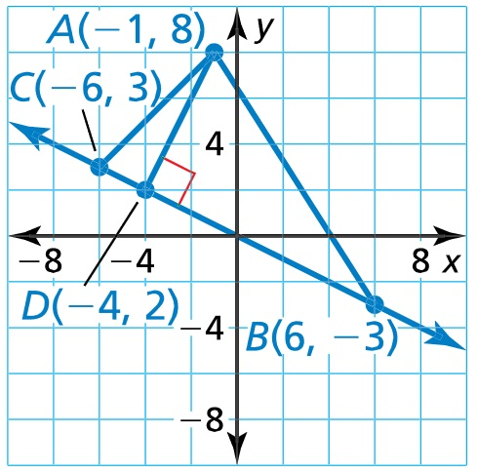

Example 1
Find the distance from point A to $\overset{⃡}{BC}$.
Answer: Angles 2 (vertical), angle 6 (alternate interior) and angle 8 (vertical with 6).

Slide 9
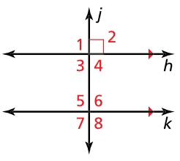
Example 2
Prove the Perpendicular Transversal Theorem using the diagram and the Alternate Interior Angles Theorem (Theorem 3.2).
Answer:
Statement | Reason

Slide 10
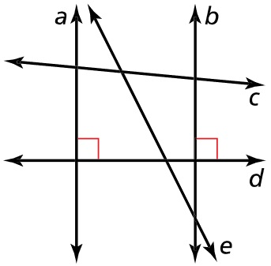
Example 3
The diagram shows the layout of walking paths in a town park. Determine which lines, if any, must be parallel in the diagram. Explain your reasoning.
Answer: lines a and b must be parallel because they are perpendicular to the same line. The other lines you can’t say for sure, but then don’t “look” parallel

Slide 11
Summary & Homework
Summary:
  A conditional statement is usually in the form of an If …, then …; in symbols P → Q
    Hypothesis follows If
    Conclusion follows then
  Converse: change order (or flip); in symbols Q → P
  Inverse: insert nots (negate); in symbols ~P → ~Q
  Contrapositive: change order, nots (both); in symbols ~Q → ~P
Homework:
  Conditional Worksheet

