Slide 1
Lesson 4-1
Translations

Slide 2
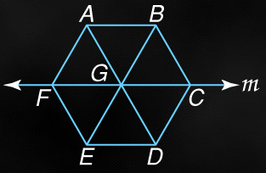
5-Minute Check on Lesson 9-1
Transparency 9-2
Name the reflected image of each figure in line m
BC
AB
∆AGB
B
ABCF
6. How many lines of symmetry are in an equilateral triangle?
DC
ED
∆EGD
D
EDCF
Standardized Test Practice:
A
1
B
2
C
3
D
4
C
Click the mouse button or press the
Space Bar to display the answers.

Slide 3
Objectives
Perform translations
Perform compositions
Solve real-life problems involving compositions

Slide 4
Vocabulary
Component form – combines horizontal and vertical components; <x, y>
Composition of transformations – when two or more transformations are combined to form a single transformation
Horizontal component – vector travel in the “x” direction
Image – figure after the transformation
Initial point – starting point of a vector; initial position in motion problems
Magnitude – the length of a vector; found by using Pythagorean Theorem on its components

Slide 5
Vocabulary
Preimage – figure before the transformation
Rigid motion – a transformation that preserves length and angle measure; congruent transformation
Terminal point – the ending point of the vector
Transformation – a function that moves or changes a figure in some way to produce a new figure (called the image)
Translation – moves every point of a figure the same distance in the same direction
Vector – a quantity that has both direction and magnitude
Vertical component – vector travel in the “y” direction

Slide 6
Translation
Translation – a transformation that moves all points of a figure, the same distance and direction
A(6,8) moved down 11 and left 9 to A’(-3, -3)
B(8,5) moved down 11 and left 9 to B’(-1, -6)
C(3,4) moved down 11 and left 9 to C’(-6, -7)
Translation Vector: <-9, -11>
y
A
y
A(t=4)
C
B
A(t=3)
x
x
A’
A(t=2)
A(t=1)
C’
B’
A(t=0)
Composition – transformation made up of successive transformations (animation); also could be successive reflections across parallel lines

Slide 7
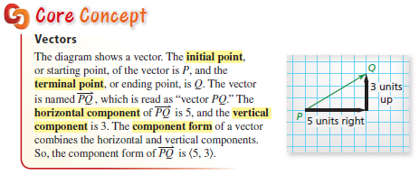
Core Concept

Slide 8
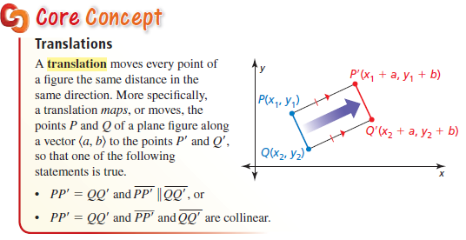
Core Concept

Slide 9

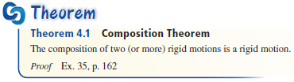
Core Concept

Slide 10
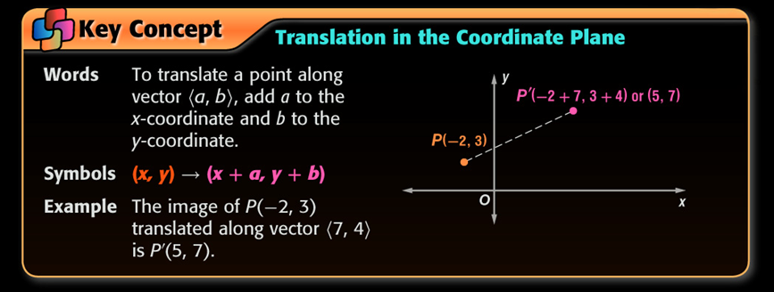
Translation Vectors
In order to get the signs right in a translation vector we need to remember the coordinate plane
  Up is positive y and Down is negative y
  Right is positive x and Left is negative x
A translation vector of <7,4> moves each point of the figure right 7 and up 4

Slide 11
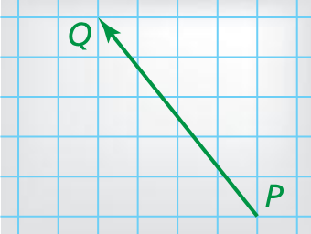

Example 1
Name the vector and write its component form.
Answer:
$\overset{⃑}{PQ}$ <-4, 5>

Slide 12
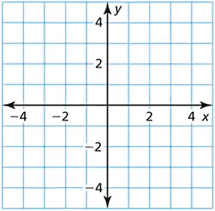

Example 2
The vertices of $∆ABC$ are $A(0, 3)$, $B(2, 4)$, and $C(1, 0)$. Translate $∆ABC$ using the vector $〈−1, −2〉$.
B
Answer:
A
B’
- 1 means left 1
- 2 means down 2
Translation function:
(x, y) → (x – 1, y – 2)
A’
C
C’

Slide 13
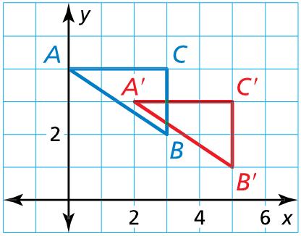
Example 3
Write a rule for the translation of $∆ABC$ to $∆A′B′C′$.
Answer: function notation: (x, y) → (x + 2, y – 1)

Slide 14
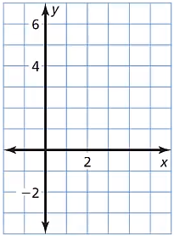

Example 4
Graph quadrilateral $ABCD$ with vertices $A(1, −2)$, $B(2, 1)$, $C(4, 1)$, and $D(4, −2)$ and its image after the translation $(x,y)→(x−1, y+4)$.
x – 1 means left 1
y + 4 means up 4
B’
C’
A’
B
D’
C
A
D

Slide 15
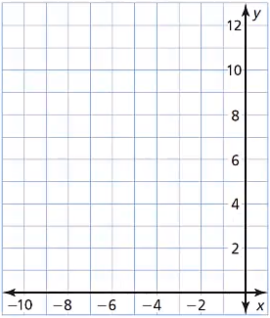
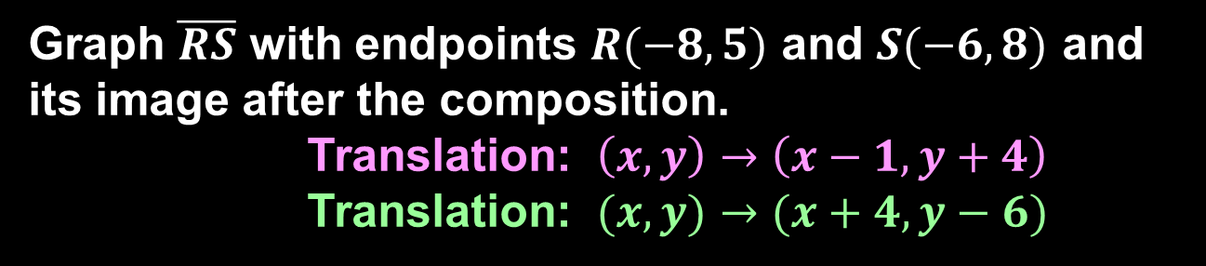
Example 5
Graph $\overline{RS}$ with endpoints $R(−8, 5)$ and $S(−6, 8)$ and its image after the composition.
Translation: $\left(x, y\right)→\left(x−1, y+4\right)$
Translation: $(x,y)→(x+4, y−6)$
Answer:
S’
x – 1 means left 1
y + 4 means up 4
R’
S
S’’
x + 4 means right 4
y – 6 means down 6
R
R’’
x – 1 + 4 = x + 3 means right 3
y + 4 – 6 = y – 2 means down 2

Slide 16
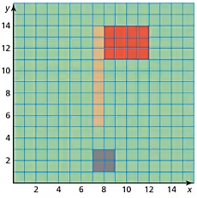

Example 6
A graphic artist is designing a favicon for a golf website. In an image-editing program, she moves the red rectangle 3 units right and $1$ unit down. Then she moves the red rectangle $1$ unit left and $4$ units up. Rewrite the composition as a single transformation.
Answer:
Right 3, left 1 → x + 3 – 1 = x + 2
Down 1, up 4 → y – 1 + 3 = y + 2
(x, y) → (x + 2, y + 2)

Slide 17
Summary & Homework
Summary:
  A translation moves all points of a figure the same distance in the same direction
  Up is added to y and down is subtracted
  Right is added to x and left is subtracted
  A translation maintains length and angles (rigid motion)
  A translation moves all parts of the figure the same distance and direction
Homework:
  Translation worksheet

