Slide 1
Lesson 4-2
Reflections
or
Flips

Slide 2
Objectives
Perform reflections
  Across x-axis
  Across y-axis
  Across origin
  Across line y = x
  Across line y = -x
Perform glide reflections
Identify lines of symmetry
  How many lines of symmetry in a figure?
  How many points of symmetry in a figure?
Solve real-life problems involving reflections

Slide 3
Vocabulary
Glide reflection – a transformation involving a translation followed by a reflection
Line of reflection – the mirror line in the reflection
Line of symmetry – the line of reflection that generates line symmetry
Line symmetry – when a figure can be mapped onto itself by a reflection in that line
Reflection – a transformation that use a line like a mirror to reflect a figure
Point of symmetry – midpoint of all segments between the pre-image and the image; figure must have more than one line of symmetry

Slide 4
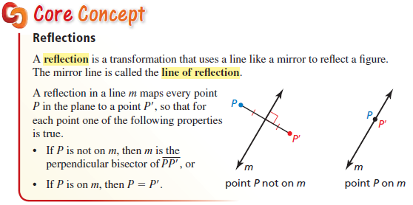
Reflections in a Line
Key Concept:
Equal distance (at a 90° angle) from the line of reflection

Slide 5
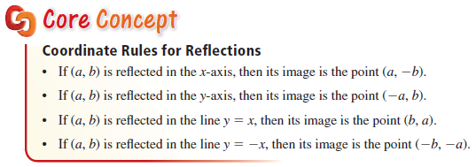
Rules for Reflections
Key Concept:
Equal distance (at a 90° angle) from the line of reflection
Reflection over the origin is a reflection of both axes: (a, b) → (-a, -b)

Slide 6
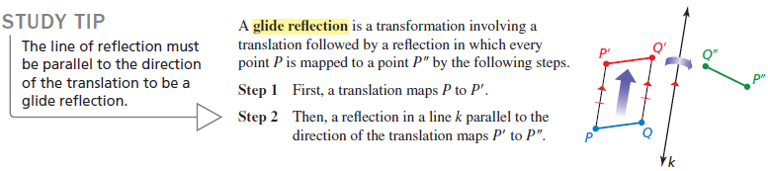
Glide Reflection
Postulate:
Reflections are rigid motions.
Glide reflection is a translation first and then a reflection

Slide 7
Reflections
Across the x-axis
Across the y-axis
y
y
A
A’
A
C
B
B’
B
x
C’
C
x
C’
B’
KEY:
Equal
Distance
from
Reflection
Line
A’
Multiply y coordinate by -1
Multiply x coordinate by -1
Across the origin
Across the line y = x
y
y
A
A
B
B
B’
C
C
x
x
C’
A’
B’
C’
A’
Multiply both coordinates by -1
Interchange x and y coordinates

Slide 8
Common reflections in the coordinate plane
Reflection | x-axis | y-axis | origin | y = x | y= - x
Pre-image to image | (a, b) ➔ (a, -b) | (a, b) ➔ (-a, b) | (a, b) ➔ (-a, -b) | (a, b) ➔ (b, a) | (a, b) ➔ (-b, -a)
Find coordinates | Multiply y coordinate by -1 | Multiply x coordinate by -1 | Multiply both coordinates by -1 | Interchange x and y coordinates | Interchange x and y coordinates and negate
A line of symmetry is like a line of reflection.
The line of symmetry in a figure is a line where the figure could be folded in half so that the two halves match exactly

Slide 9
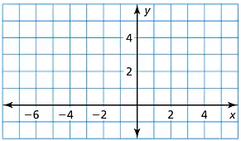

Example 1a
Graph $∆ABC$ with vertices $A(1, 3)$, $B(5, 2)$, and $C(2, 1)$ and its image after the reflection described.
a. In the line $n$: $x=−1$
Answer:
A’
A
B’
B
C’
C

Slide 10

Example 1b
Graph $∆ABC$ with vertices $A(1, 3)$, $B(5, 2)$, and $C(2, 1)$ and its image after the reflection described.
b. In the line $m$: $y=3$
Answer:
A’
B’
C’
A
B
C

Slide 11
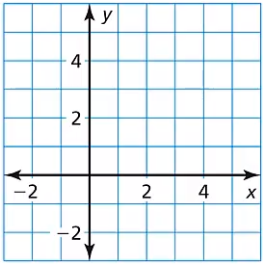

Example 2
Graph $\overline{AB}$ with endpoints $A(3, −1)$ and $B(3, 2)$ and its image after the reflection in the line $y=x$.
Answer:
B’
A’
B
A

Slide 12
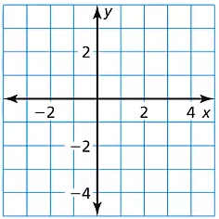

Example 3
Graph $\overline{AB}$ with endpoints $A(3, −1)$ and $B(3, 2)$ and its image after the reflection in the line $y=−x$.
Answer:
B
A
B’
A’

Slide 13
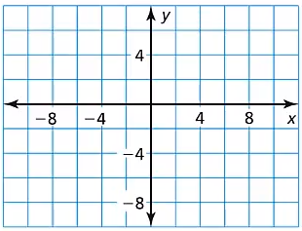

Example 4
Graph $∆ABC$ with vertices $A(3, 2)$, $B(6, 3)$, and $C(7, 1)$ and its image after the glide reflection.
Translation: $\left(x, y\right)→\left(x, y−6\right)$
Reflection: in the $y−$axis
Answer:
B
A
C
B’’
B’
A’’
A’
C’’
C’

Slide 14
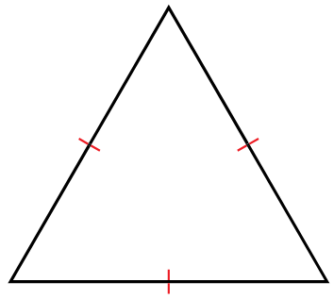
Example 5
How many lines of symmetry does the triangle have?
Answer: 3

Slide 15


Example 6
You are going to the music store. Your friend is going to buy craft supplies. Where should you park to minimize the distance you will both walk?
Answer:

Slide 16
Summary & Homework
Summary: EQUAL DISTANCE!!
  Line of Symmetry – a line across which the figure could be folded in half
  Point of Symmetry – even numbered regular figures only for us
Homework:
  Reflections worksheet
Reflection | x-axis | y-axis | origin | y = x
Pre-image to image | (a, b) ➔ (a, -b) | (a, b) ➔ (-a, b) | (a, b) ➔ (-a, -b) | (a, b) ➔ (b, a)
Find coordinates | Multiply y coordinate by -1 | Multiply x coordinate by -1 | Multiply both coordinates by -1 | Interchange x and y coordinates

