Slide 1
Lesson 4-3
Rotations
or
Turns

Slide 2
5-Minute Check on Lesson 4-2
Transparency 9-3
Find the coordinates of each figure under the given translation.
RS with endpoints R(1,-3) and S(-3,2) under the
translation right 2 units and down 1 unit.
Quadrilateral GHIJ with G(2,2), H(1,-1), I(-2,-2), and J(-2,5) under the translation left 2 units and down 3 units.
∆ABC with vertices A(-4,3), B(-2,1), and C(0,5) under
the translation (x, y) → (x + 3, y – 4)
Trapezoid LMNO with vertices L(2,1), M(5,1), N(1,-5), and O(0-2) under the translation (x, y) → (x – 1, y + 4)
Find the translation that moves AB with endpoints
A(2,4) and B(-1,-3) to A’B’ with endpoints A’(5,2) and B’(2,-5)
Which describes
the translation left 3 units and up 4 units?
R’(3,-4), S’(-1,1)
G’(-1,0), H’(-2,-3),
I’(-5,-4), J’(-5,3)
A’(-1,-1), B’(1,-3), C’(3,1)
L’(1,5), M’(4,5), N’(0,-1),
O’(-1,2)
Standardized Test Practice:
(x, y) → (x + 3, y – 2)
A
(x, y) → (x + 3, y – 4)
B
(x, y) → (x – 3, y – 4)
C
(x, y) → (x + 3, y + 4)
D
(x, y) → (x – 3, y + 4)
D
Click the mouse button or press the
Space Bar to display the answers.

Slide 3
Objectives
Perform rotations
Perform compositions with rotations
Identify rotational symmetry and point symmetry

Slide 4
Vocabulary
Angle of rotation – determined by the rays drawn from the center of rotation to a point in the preimage and its point in the image
Center of rotation – the point about which a figure is turned
Center of symmetry – the center of the figure
Point symmetry – a figure can be mapped onto itself by a rotation of 180°
Rotation – a transformation in which a figure is turned about a fixed point (center of rotation)

Slide 5
Vocabulary
Rotational symmetry – when a figure can be mapped onto itself by a rotation of 180° or less
Rotational symmetry magnitude – the angle turn of rotation; 360/order
Rotational symmetry order – how many times a figure maps back onto itself; for regular polygons it is the number of sides

Slide 6
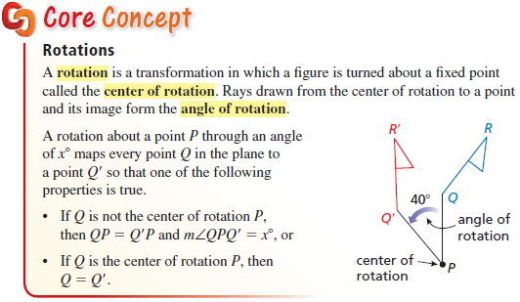
Rotations
Rotations of 90° is all that we will be responsible for

Slide 7
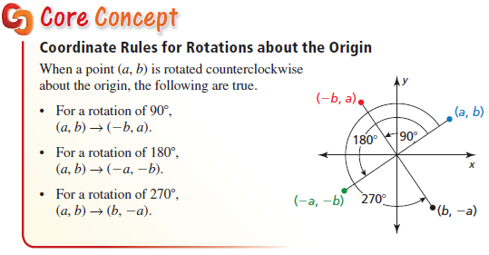
90° Rotations
Clockwise and counterclockwise 90° increment rotations overlap!!

Slide 8
Rotation
Rotation – a transformation that turns all points of a figure, through a specified angle and direction about a fixed point
y
B’
A
A (2,7)
B (8,4)
C (3,3)
In Powerpoint:
the free rotate
(green dot) allows
rotation, but only
around the figure’s
center point – not
an outside point
C’
B
A’
C
x
Each point rotated
90° to the left
(counter clockwise)
around the origin
point of rotation
(origin)
angle of rotation
(90°)
180° Rotation – reflection across the origin!

Slide 9
90° Rotational Turns
Rotation | Counterclockwise | Clockwise | Equivalent
90 | (x, y) → (-y, x) | (x, y) → (y, -x) | 90 CCW same as 270 CW
180 | (x, y) → (-x, -y) | (x, y) → (-x, -y) | Same either way
270 | (x, y) → (y, -x) | (x, y) → (-y, x) | 270 CCW same as 90 CW
SSM: Rotate the entire graph by the degrees and direction of rotation. Label axis's in the normal way (y up and x to the right) and read off the transformed points.

Slide 10
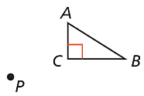
Example 1
Draw a $60°$ rotation of $∆ABC$ about point $P$.
First draw ΔACB and plot point P.

Slide 11
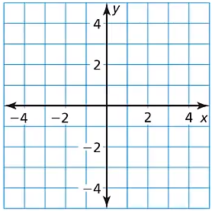

Example 2
Graph $∆ABC$ with vertices $A(3, 1)$, $B(3, 4)$, and $C(1, 1)$ and its image after a $180°$ rotation about the origin.
Answer:
180° rotation is the same as a reflection across the origin !!
B
C
A
B
C
A

Slide 12
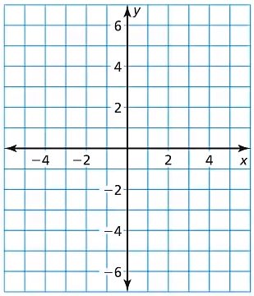

Example 3
Graph $\overline{RS}$ with endpoints $R(1, −3)$ and $S(2, −6)$ and its image after the composition.
Rotation: $180°$ about the origin
Reflection: in the $y−$axis
R’
R’’
Answer:
S’
S’’
R
S

Slide 13
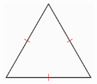

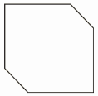
Example 4
Does the figure have rotational symmetry? If so, describe any rotations that map the figure onto itself.
Yes
Order = 3
Magnitude = 120°
No
Scalene triangle
Yes
Order = 1
Magnitude = 180°

Slide 14
Super Second Grade Method
To do 90 degree increment rotations about the origin, simply rotate the entire paper the degrees required (clockwise or counterclockwise
Record the points in the new positions
Turn the paper back and plot the points

Slide 15
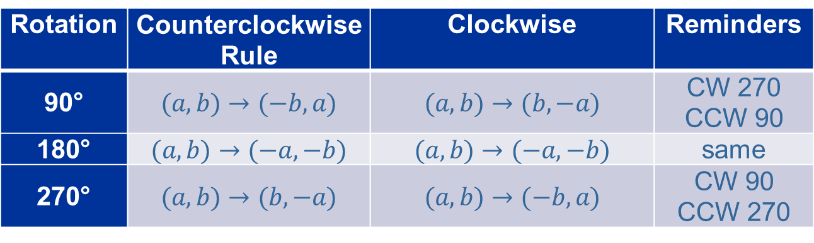
Summary & Homework
Summary:
  A rotation turns each point in a figure through the same angle about a fixed point
  An object has rotational symmetry when you can rotate it less than 360° and the pre-image and the image are indistinguishable (can’t tell them apart)
Homework:
  Rotation Worksheet
Rotation | Counterclockwise Rule | Clockwise | Reminders
90° | $$(a,b)→(−b, a)$$ | $$(a,b)→(b, −a)$$ | CW 270 CCW 90
180° | $$(a,b)→(−a, −b)$$ | $$(a,b)→(−a, −b)$$ | same
270° | $$(a,b)→(b, −a)$$ | $$(a,b)→(−b, a)$$ | CW 90 CCW 270

