Slide 1
Lesson 4-4
Congruence and Transformations

Slide 2
Objectives
Identify congruent figures
Describe congruence transformations
Use theorems about congruence transformations

Slide 3
Vocabulary
Congruent figures – figures are congruent, if and only if, there is a rigid motion or composition of rigid motions that maps on of the figures onto the other; congruent figures have the same size and shape
Congruence transformation – preimage and the image are congruent; terms “rigid motion” and “congruence transformation” are interchangeable

Slide 4
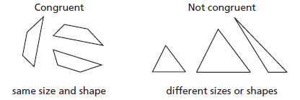
Congruent, or not
Key Concept:
Congruent – equal (same size and shape)

Slide 5
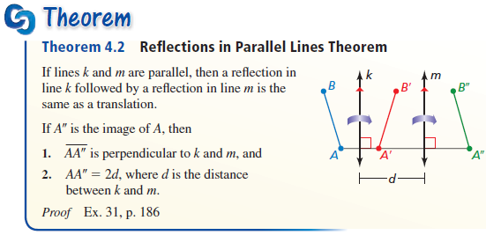
Reflections across Parallel Lines
Reflections across (even number) of parallel lines is the same as a translation

Slide 6
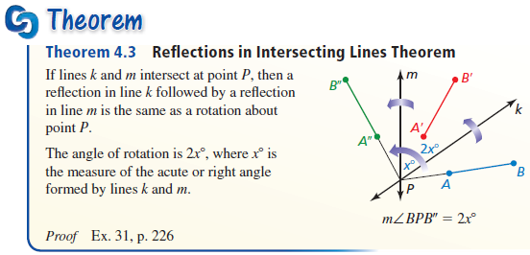
Reflections across Intersecting Lines
Reflections across intersecting lines is the same as a rotation

Slide 7
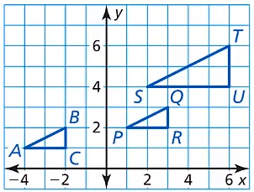
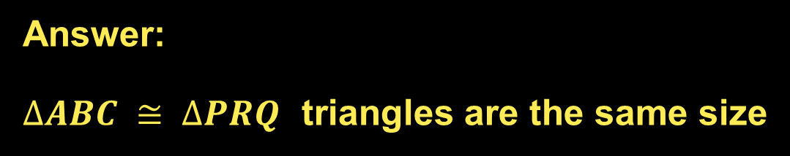
Example 1
Identify the congruent figures in the coordinate plane. Explain.
Answer:
$∆ABC ≅ ∆PRQ$ triangles are the same size

Slide 8
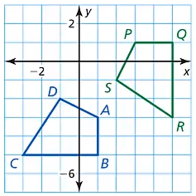

Example 2
Describe a congruence transformation that maps quadrilateral $ABCD$ to quadrilateral $PQRS$.
Answer:
Rotated 90° counterclockwise around point C.
Translated (x, y) → (x + 8, y + 2)

Slide 9
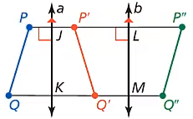

Example 3A
In the diagram, a reflection in line $a$ maps $\overline{PQ}$ to $\overline{P′Q′}$. A reflection in line $b$ maps $\overline{P′Q′}$ to $\overline{P′′Q′′}$.
Also, $PJ=3$ and $LP^{′′}=8$.
a. Name any segments congruent to each segment: $\overline{PQ}$, $\overline{PJ}$, and $\overline{QK}$.
Answer:
PQ: P’Q’ , P’’Q”
PJ: JP’
QK: KQ’

Slide 10

Example 3B
In the diagram, a reflection in line $a$ maps $\overline{PQ}$ to $\overline{P′Q′}$. A reflection in line $b$ maps $\overline{P′Q′}$ to $\overline{P′′Q′′}$.
Also, $PJ=3$ and $LP^{′′}=8$.
b. Does $JK=LM$? Explain.
Answer:
JK = LM if QQ’’ ⊥ JK and LM
Not equal otherwise

Slide 11

Example 3C
In the diagram, a reflection in line $a$ maps $\overline{PQ}$ to $\overline{P′Q′}$. A reflection in line $b$ maps $\overline{P′Q′}$ to $\overline{P′′Q′′}$.
Also, $PJ=3$ and $LP^{′′}=8$.
c. What is the length of $\overline{PP′′}$?
Answer:
2PJ = PP” = 6
2 P’L = P’P” = 16
PP” = 6 + 16 = 22

Slide 12
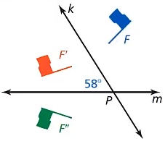

Example 4
In the diagram, the preimage is reflected in line $k$. The image is then reflected in line $m$. Describe a single transformation that maps $F$ to $F′′$.
Answer:
Counterclockwise
Rotation of 2(58) = 116°

Slide 13
Tessellations
A tessellation is when a figure (or combinations of figures) covers a plane with no gaps or overlaps.
  This only happens if the sum of the interior angles of the figures at the point of intersection sum to 360°.
  If the sum of the angles is less than 360°, then we have a gap in the pattern.
  If the sum of the angles is more than 360°, then we have an overlap.
Regular polygons that tessellate:
Triangles, Squares and Hexagons

Slide 14
Symmetry – Lines
A line of symmetry cuts a figure into two equal halves. You can fold a figure over a line of symmetry, like a napkin, to match up the two halves.
Regular polygons have the same number of lines of symmetry as they have sides. A triangle has 3, a square has 4 and so on.

Slide 15
Symmetry – Point
Point symmetry has many definitions. The easiest for us is that if we turn the figure 180°, does the figure look like what we started with.
  In regular polygons, only even numbered sided figures (squares, hexagons, octagons, etc) have point symmetry;
  odd numbered sided figures (triangles, pentagons, heptagons, etc) do not have point symmetry

Slide 16
Summary & Homework
Summary:
  A composition of several reflections can act like a single translation
  A composition of several reflections can act like a single rotation.
Homework:
  Alphabet Symmetry Worksheet

