Slide 1
Lesson 4-5
Dilations

Slide 2
5-Minute Check on Lesson 9-5
Transparency 9-6
Determine whether each regular polygon tessellates the plane. Explain
quadrilateral
octagon
3. 15 -gon
Determine whether a semi-regular tessellation can be created from each figure. Assume each figure has a side length of 1 unit.
4. triangle and square 5. pentagon and square
6. Which regular polygon will not tessellate the plane?
Yes, Square’s interior angle = 90 360 ÷ 90 = 4
No, Octagon’s interior angle = 135 360 ÷ 135 ≠ integer
No, 15-gon’s interior angle = 156 360 ÷ 156 ≠ integer
Yes, 3×60 + 2×90 = 360
No, 108n + 90m ≠ 360
Standardized Test Practice:
A
triangle
B
quadrilateral
C
pentagon
D
hexagon
C
Click the mouse button or press the
Space Bar to display the answers.

Slide 3
Objectives
Identify and perform dilations
Solve real-life problems involving scale factors and dilations
enlargement – gotten larger |k| > 1
reduction – gotten smaller |k| < 1
congruence transformation – stayed the same |k| = 1
where k is the scaling factor (similar triangles)

Slide 4
Vocabulary
Center of dilation – fixed point around which the dilation occurs
Congruence transformation – when the absolute value of the scaling factor is equal to one
Dilation – a transformation in which a figure is enlarged or reduced with respect to a fixed point C (center of dilation) and a scale factor k
Enlargement – the absolute value of the scaling factor is greater than one
Reduction – the absolute value of the scaling factor is less than one
Scale factor – the ratio of the lengths of corresponding sides of the image and the preimage

Slide 5
Dilations
y
x
Five hexagons that are each 50% reduction (1/2) of the size of the one before it
Scale factor is ½, and the center point is the origin (center of the figures)

Slide 6
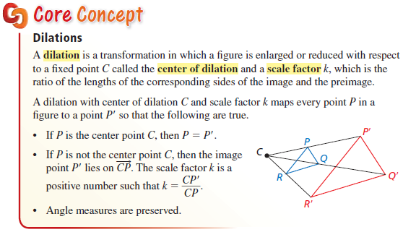
Dilations

Slide 7
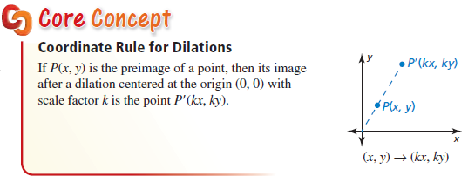
Dilations
This coordinate rule only works for dilations centered at the origin.

Slide 8
Steps to a Successful Dilation
Step 1: Draw a rays from the figure’s endpoints through the dilation’s center point
Step 2: Measure the vertical/horizontal distance from an end point to the center point
Step 3: Multiply the scaling factor k by the distance from step 2.
Step 4: Measure that distance away from the center point (negatives on side away from the figure)
Step 5: Draw the endpoint on the ray at that distance
Step 6: Repeat, if necessary, with other endpoints

Slide 9


Dilations
Center
Point
Reductions
Enlargements
Enlargements
Scaling Factor
k = -1
k = 0
k = 1

Slide 10
Dilations
y
A
B
A’
B’
Distance = 10
Distance = ½ (10)
= 5
x
CP
Distance = 5
opposite
B*
A*
Small dashed lines are the rays along which the dilations occur and the center point is CP . AB = 16, A’B’ = 8 so k = ½ (a reduction |k|<1)
A*B* = 8 but since its on the opposite side of CP, k = - ½ (negative = opposite, but still a reduction)

Slide 11
Dilations
y
|k| > 1
Enlargement
|k| < 1
Reduction
|k| = 1
Congruence
Transformation
1 < r
A
B
0 < r < 1
C
x
CP –
Center
Point
CP
These are the lines that the figure’s vertices “travel” on as
the figure is
dilated
C’
-1 < r < 0
A’B’C’
is with
r = -1.
B’
A’
-1 > r

Slide 12
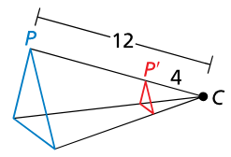
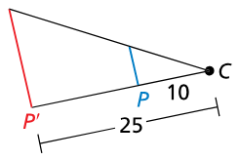

Example 1
Find the scale factor of the dilation. Then tell whether the dilation is a reduction or an enlargement.
Answer:
a. Reduction $k=\frac{4}{12}=\frac{1}{3}$ b. Enlargement $k=\frac{25}{10}=\frac{5}{2}$

Slide 13
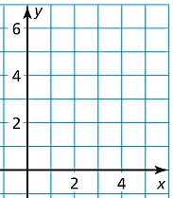

Example 2
Graph $∆PQR$ with vertices $P(0, 2)$, $Q(1, 0)$, and $R(2, 2)$ and its image after a dilation with scale factor $3$.
Answer:
Enlargement
P’
R’
P
R
Q
Q’

Slide 14
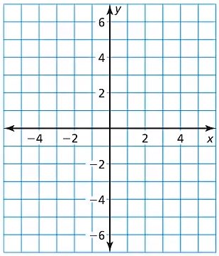

Example 3
Graph $∆PQR$ with vertices $P(4, 6)$, $Q(−4, 2)$, and $R(2, −6)$ and its image after a dilation with scale factor $0.5$.
P
P’
Answer:
Reduction
Q
Q’
R’
R

Slide 15
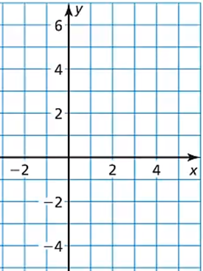

Example 4
Graph $∆FGH$ with vertices $F(3, 6)$, $G(3, −3)$, and $H(6, 6)$ and its image after a dilation with a scale factor of $−\frac{1}{3}$.
F
H
Answer:
Reduction
Negative flips the figure to the other side of the center point
G’
H’
F’
G

Slide 16


Example 5
You are using word processing software to type the online school newsletter. You change the size of the text in one headline from $0.5$ inch tall to $1.25$ inches tall. What is the scale factor of this dilation?
Answer:
Enlargement: $k=\frac{1.25}{0.5}=2.5$ (two and half times larger)

Slide 17


Example 6
You are using a magnifying glass that shows the image of an object that is six times the object’s actual size. The image of a spider seen through the magnifying glass is $13.5$ centimeters. Find the actual size of the spider.
Answer:
Spider $=\frac{1}{6}\left(13.5\right)=2.25$ cm

Slide 18
Summary & Homework
Summary:
  Dilations can be
    enlargements, (|scaling factor| > 1)
    reductions, or (|scaling factor| < 1
    congruence transformations (|scaling factor|=1)
    Negative flip to other side of center point
  May not be a congruence transformation
  Graphing using the 6 steps
Homework:
  Back of Rotations Worksheet

