Slide 1
Lesson 4-6
Similarity and Transformations

Slide 2
Objectives
Perform similarity transformations
Describe similarity transformations
Prove that figures are similar

Slide 3
Vocabulary
Similar figures – a similarity transformation maps one of the figures onto the other
Similar figures have all corresponding sides with the same ratio, called the scaling factor, k, and have all corresponding angles congruent.
Similarity transformation – dilation or a composition of rigid motions and dilations

Slide 4
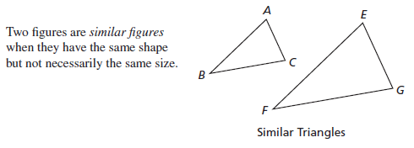

Core Concept
In the picture above, corresponding angles A and E are congruent; corresponding angles C and G are congruent; corresponding angles B and F are congruent. The sides have the same ratio:
$\frac{AB}{EF}=\frac{BC}{FG}=\frac{AC}{EG}=k, the scaling factor$

Slide 5
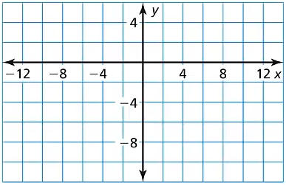

Example 1
Graph $\overline{AB}$ with endpoints $A(12, −6)$ and $B(0, −3)$ and its image after the similarity transformation.
Reflection: in the $y−$axis
Dilation: $(x, y)→\left(\frac{1}{3}x,\frac{1}{3}y\right)$
Answer:
Reflection is a congruence transformation
Dilation is a similar transformation
B’’
A’’
B’
B
A’
A

Slide 6
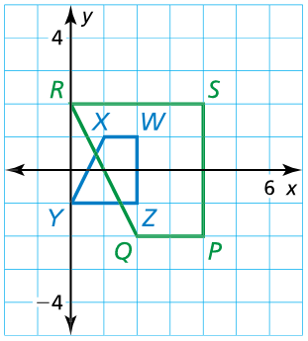

Example 2
Describe the similarity transformation that maps trapezoid $WXYZ$ to trapezoid $PQRS$.
Answer:
Flip over the x-axis
Dilation from the origin with a scaling factor of 2
Order of these steps is not important

Slide 7
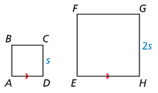


Example 3
Prove that square $ABCD$ is similar to square $EFGH$.
Given Square $ABCD$ with side length $s$, square $EFGH$ with side length $2s$, $\overline{AD}∥\overline{EH}$
Prove Square $ABCD$ is similar to square $EFGH$.
Answer:
All squares have 90° angles (so angles congruent)
All squares have their sides equal to each other
$\frac{2s}{s}=2$ is scaling factor

Slide 8
Summary & Homework
Summary:
  In a congruence transformation, the position of the image may differ from the preimage, but the two figures remain congruent.
  In a similar transformation, the position and size of the image may differ from the preimage, but the two figures keep the shape (angles congruent and sides scaled).
  Flips, turns, and slides are congruence transformations
  Dilations are similar transformations
Homework:
  None

