Slide 1
Lesson 5-1
Angles of Triangles

Slide 2
Objectives
Classify triangles by sides and angles
Find interior and exterior angles of triangles

Slide 3
Vocabulary
Corollary to a Theorem – a statement that can be proved easily using the theorem
Equilateral – all sides of a triangle are equal; equilateral ↔ equiangular
Equiangular – all angles of a triangle are equal; equiangular ↔ equilateral
Exterior angles – angles formed outside the triangle (or polygon) by extending one side
Interior angles – angles inside the triangle (or polygon)
Isosceles – two sides of a triangle are equal
Scalene – no sides of a triangle are equal; all sides have different lengths

Slide 4
Classifying Triangles
… By angles
Acute triangle Obtuse triangle Right triangle
All angles < 90 One angle > 90 One angle = 90
… By sides
Scalene triangle Isosceles triangle Equilateral triangle
No sides are ≅ Two sides are ≅ All sides are ≅

Slide 5
Classifying Triangles
Classify by
angle measure
Classify by number
of congruent sides
Angles
Sides
Measure of
one angle
is 90°
Right
Scalene
No sides
congruent
Measure of
one angle
> 90°
Obtuse
Isosceles
2 sides
congruent
Measure of
all angles
< 90°
Acute
3 congruent angles
Equiangular
Equilateral
3 sides
congruent

Slide 6
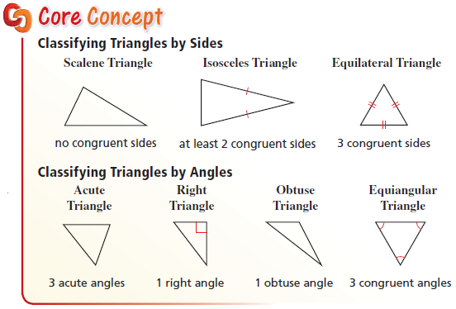
Classifying Triangles

Slide 7
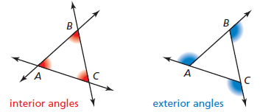
Triangle’s Angles
All triangles have at least 2 acute angles!!
The 3 interior angles of a triangle add to 180°
The 3 exterior angles of a triangle add to 360°
(any convex polygons’ exterior angles add to 360°)
Interior and Exterior angles form a linear pair

Slide 8
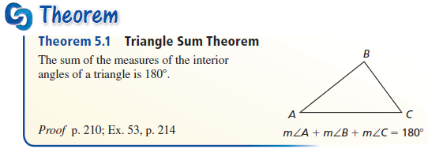
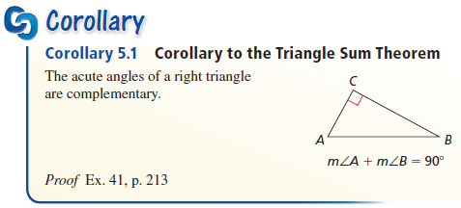
Triangle Theorems

Slide 9
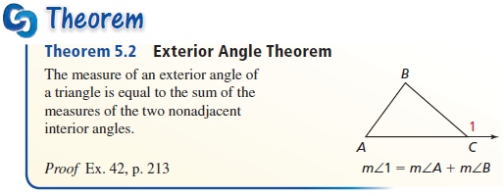
Triangle Theorems
Sum of exterior angle = sum of two “remote” interior angles

Slide 10
A Triangle’s Angles
m∠A + m∠B + m∠C = 180°
B
Remote Interior Angles to ∠A
Exterior Angle to ∠A
A
C
mExt∠A = m∠B + m∠C – Exterior ∠ Theorem
mExt∠A + m∠A = 180° – Linear Pair

Slide 11
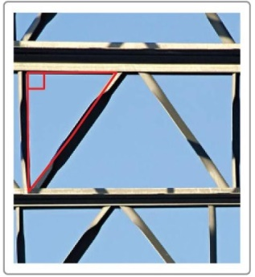
Example 1
Classify the triangular shape of the support beams in the diagram by its sides and by measuring its angles.
Answer: Support beam’s Δ is right.
Sides are scalene (height bigger than width)

Slide 12
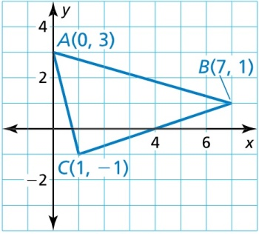

Example 2
Classify $∆ABC$ by its sides. Then determine whether it is a right triangle.
Answer: Sides are scalene (base bigger than height)
AB² = AC² + BC²
7² + 2² = 4² + 1² + 6² +2²
53 = 17 + 40
53 ≠ 57 not right angle

Slide 13
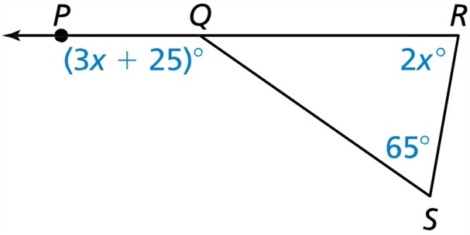

Example 3
Find $m∠PQS$
Answer:
Exterior = sum of remote interior
3x + 25 = 2x + 65
x + 25 = 65
x = 40

Slide 14
Example 4
The measure of one acute angle of a right triangle is 1.5 times the measure of the other acute angle. Find the measure of each acute angle.
Answer:
180 = sum of interior angles
180 = 90 + 1.5x + x
90 = 2.5x
36 = x

Slide 15
Summary & Homework
Summary:
  Triangles can be classified by their angles as acute, obtuse or right
  Triangles can be classified by their sides as scalene, isosceles or equilateral
  Exterior angle = sum of remote interiors
  Interior angles sum to 180
  Exterior angles sum to 360
Homework:
  Triangle Classification WS

